Slide 1
Dining Etiquette
UCR Career Center

Slide 2
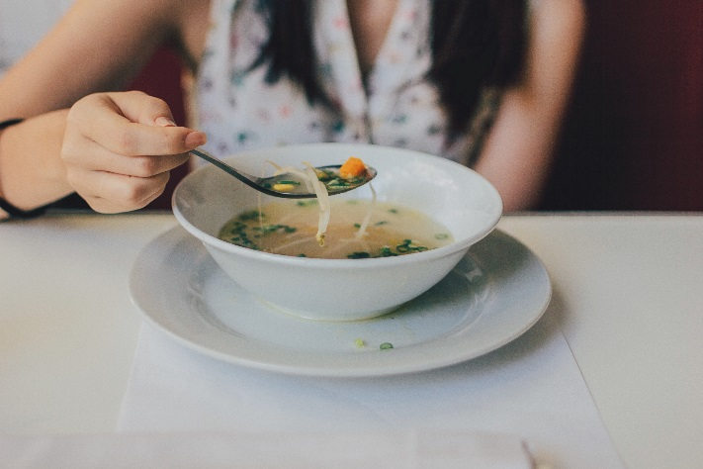
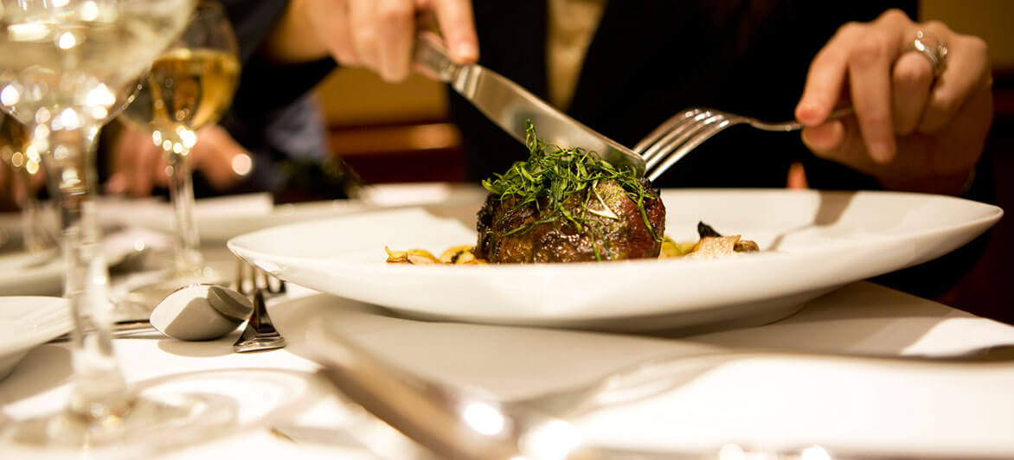
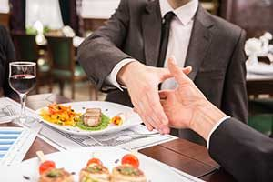

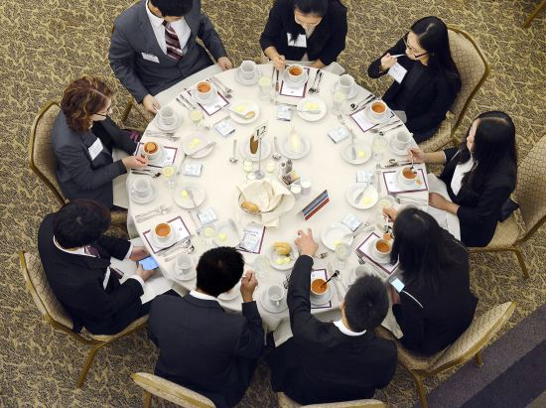
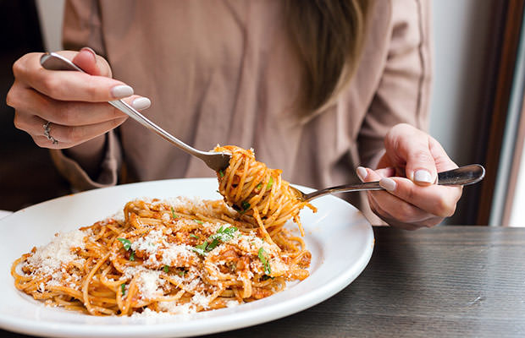
What does Dining Etiquette Mean to you?

Slide 3
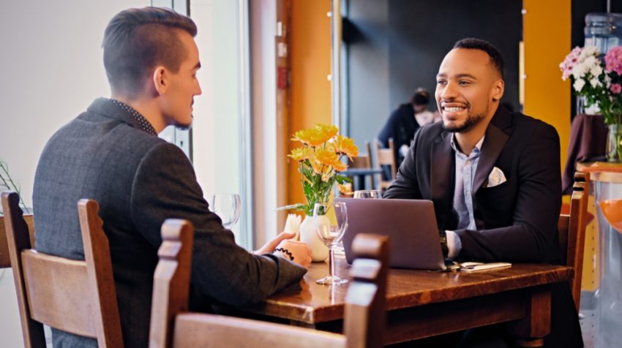
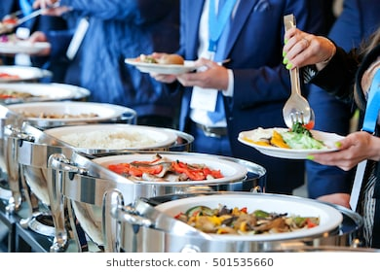
Why learn proper dining etiquette
A set of rules that govern the expectations of social and dining behavior in a workplace, group or society.
Table manners are visible signs that you are a polished, sophisticated, knowledgeable and professional.
Best place to make a good or bad impression.

Slide 4
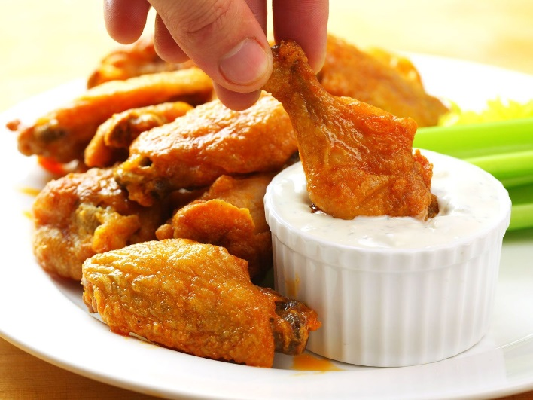
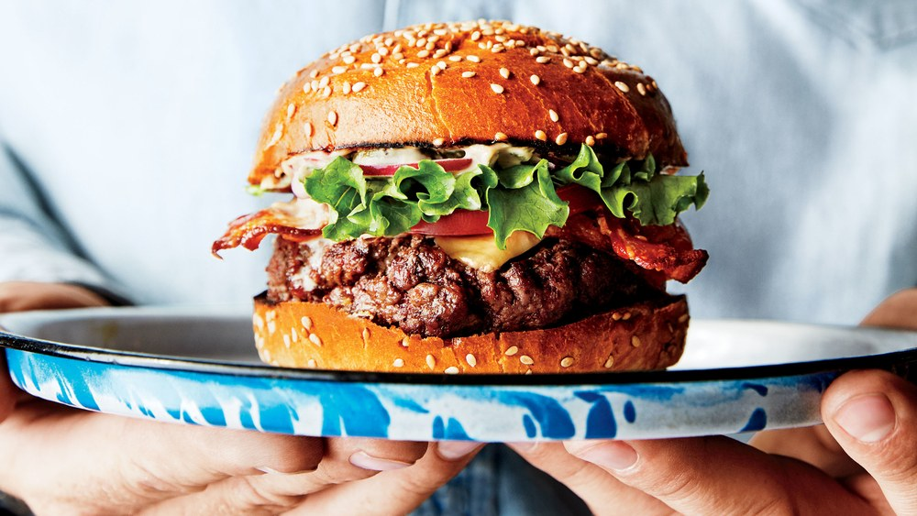
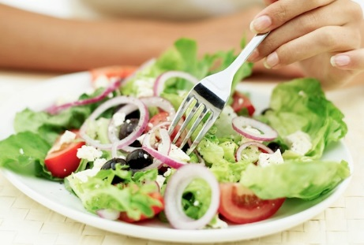
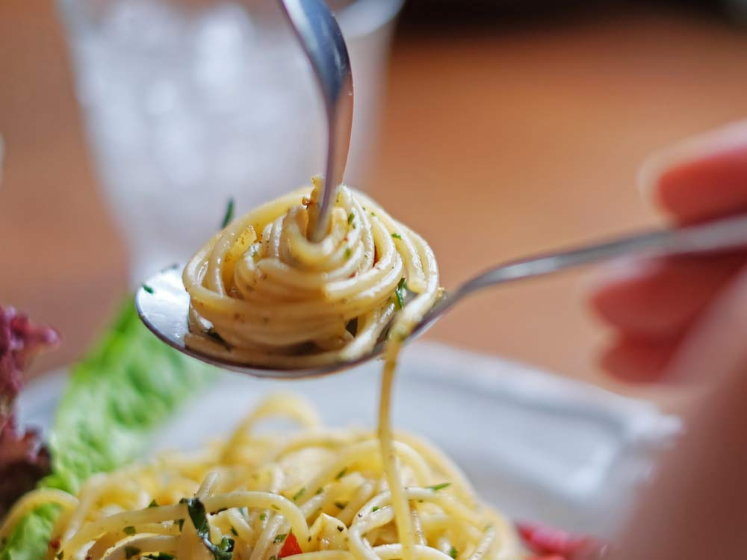
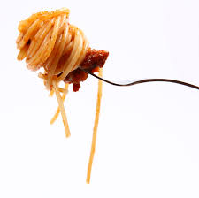
Ordering your meal
Never order an expensive entrée unless you are encouraged to do so by your host.
Likewise, ordering the cheapest item on the menu is not recommended either.
Consider any dining difficulties a particular food might present.
Always consider dietary restrictions.
Always follow the event host

Slide 5
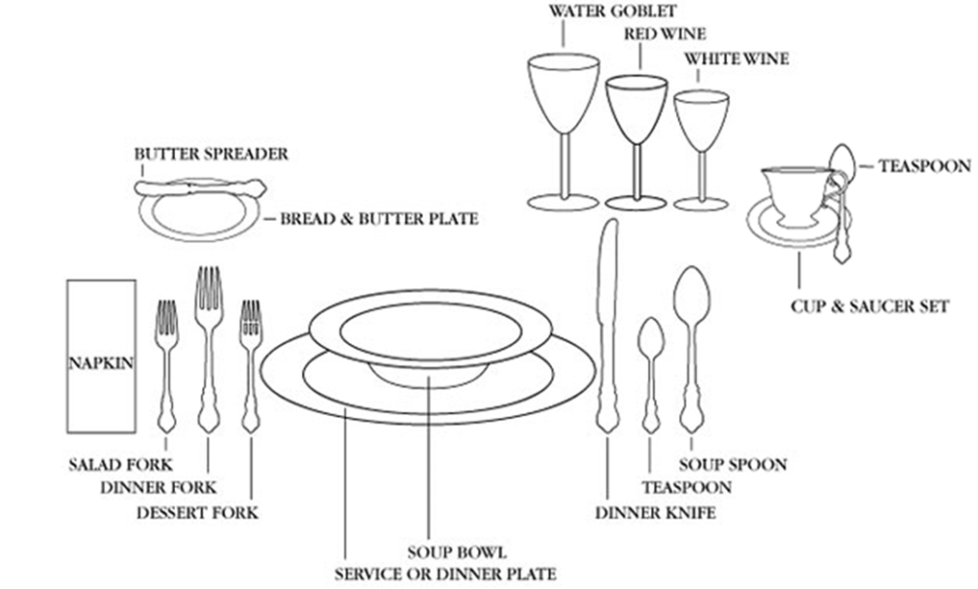
The formal dining table setting

Slide 6
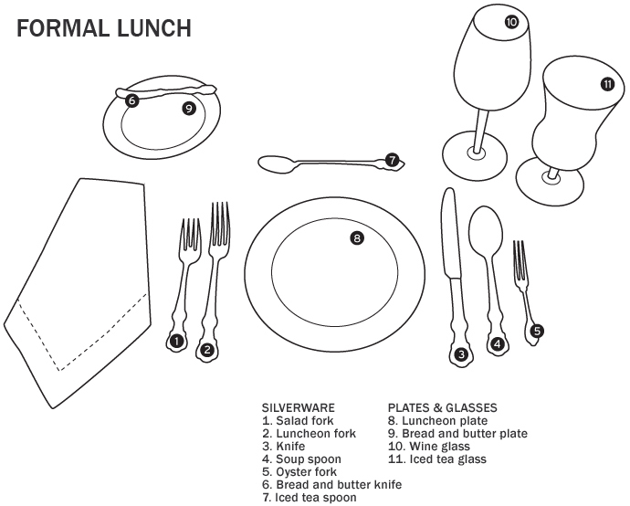
THE FORMAL LUNCH TABLE SETTING

Slide 7
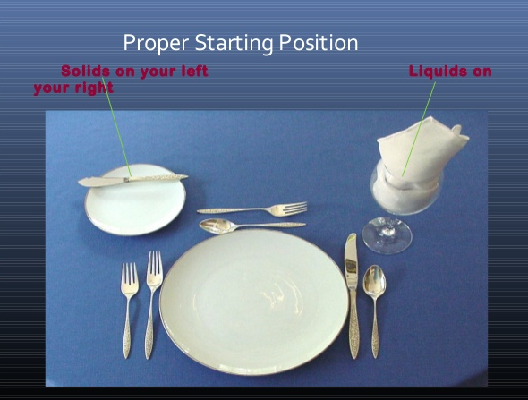
Table setting
Solids to the left – Liquids to the right.
Hand Trick - “b”read and “d”rink.
Pick up silverware from the outside in – toward your plate.
Put napkin on lap as soon as host does, or if in a large group, place napkin on lap when seated.
Napkins remain on your lap until completion of meal.

Slide 8
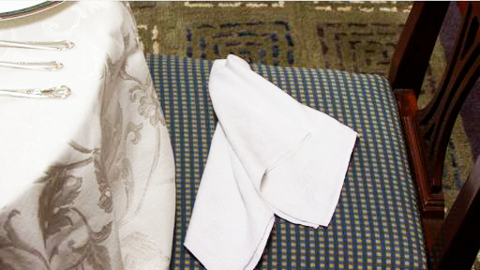
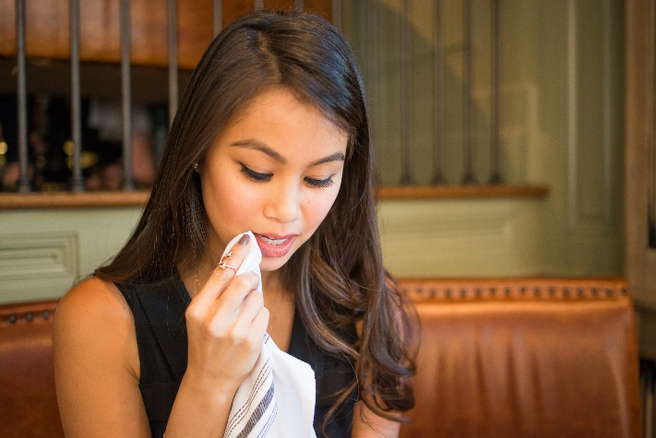
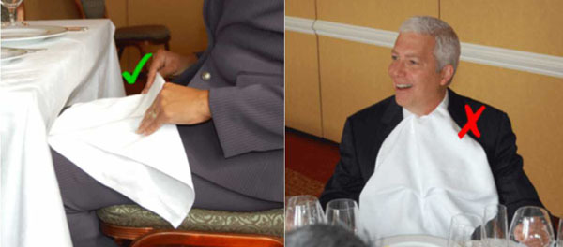
The napkin
Place the napkin on your chair if you need to get up.
Blot only.
Place napkin on the left side of the plate setting when finished eating.

Slide 9
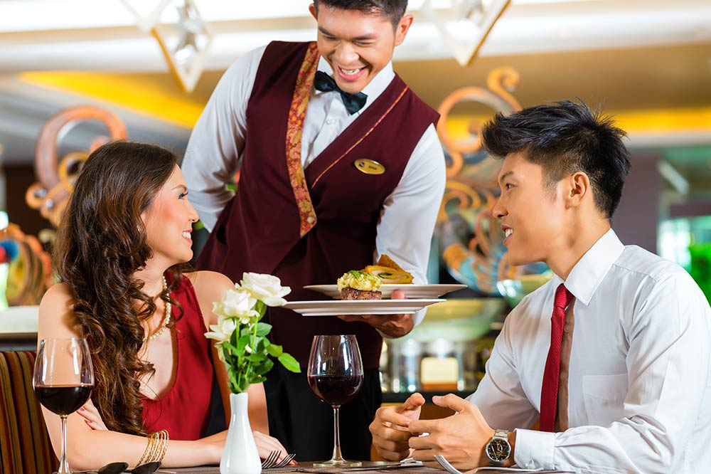
The meal: serving food
Pass food to your right.
Transfer dip to your plate.
Offer bread to others before taking some for yourself.
Break a small piece of bread and spread butter on each piece.
If water is placed in the middle of the table offer to others first.
Plates are served on the left and removed on your right.

Slide 10
Meal time basics
Diners should wait to be seated until directed to do so by their host or by their waiter if in a restaurant.
Shake hands and say, “hello” to diners at the table and introduce yourself.
Be polite and thank your server.
Keep all items off of the table including keys, eyeglasses, pens, basically anything that is not part of the meal.
Put your hands on your lap when not using your utensils to cut or eat food.
Even if you feel you must add your words at the perfect moment, wait until you have swallowed.
Do not put your purse, keys or cellphone on the table.

Slide 11
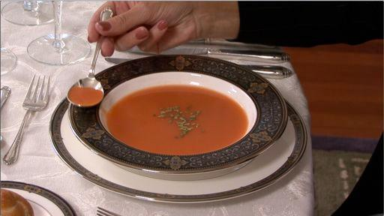
Eating Soup

Slide 12
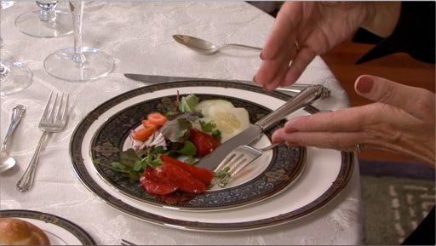
Eating Salad

Slide 13
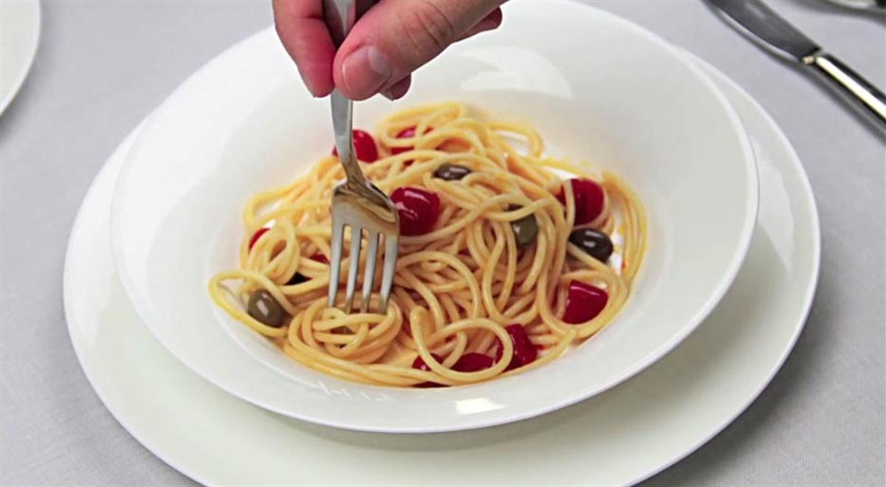
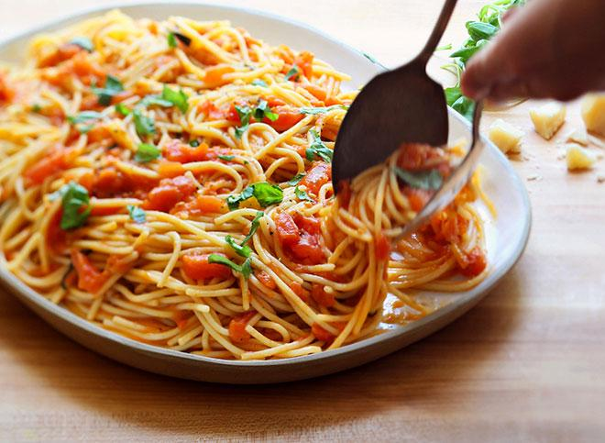
Eating Pasta
Get strands of pasta and twirl it on plate.
Don’t cut the pasta in small pieces.
There is no need for a spoon. However, if it’s provided use it to help you twirl the pasta.
Don’t plunge the fork into the pasta.

Slide 14
DRINKING BEVERAGES
Tuck empty sugar packs under the rim of your plate or under the edge of the saucer or butter dish.
Never turn a wine glass upside down to decline wine.
Don’t stir drinks (iced tea) loudly , making a noise with the spoon against the glass.
Do not take more than two sugar packets. Tear them only ¾ of the way (to minimize trash) and leave the empty packet on your coffee saucer or under your plate.
Stay away from alcoholic drinks. If your host insists simply say no thank you or if you must, HAVE ONLY ONE! (This message if for 21 and older)

Slide 15
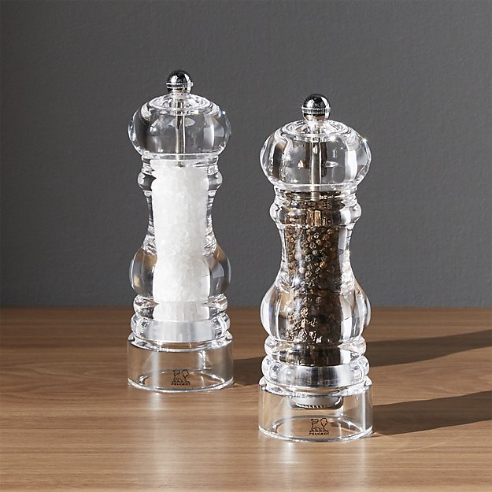
Salt and Pepper
Taste your food before adding salt & pepper.
If someone asks for the salt, pass the salt and pepper together.
Place the salt & pepper down on the table next to the person next to you.
Do not pass hand to hand.

Slide 16
The basics: attire
It is very important to ask yourself three questions before dressing for the event....
Who is the host of the dinner?
What is the purpose of the dinner?
Where is the location of the dinner?
If the dinner is a business function at a nice restaurant, business attire is appropriate. If the dinner is a picnic or BBQ, conservative casual wear would be correct.

Slide 17


Appropriate attire
Business Casual
Business Professional
V.S.

Slide 18
First impressions Matter!!!
Most people, find that first impressions are the most lasting. No matter what the occasion, it is always important to present yourself in the best possible manner.
Dining with professionals can occur in a variety of ways....
Interviewing for a position, academic program/opportunity
Networking events
Conferences
Assisting in entertaining a professional visitor
Meeting with a co-worker

Slide 19
Interview/table conversation
Research the opportunity you are interviewing for.
Review the academic scholarship programs, mission & values.
Know the mission statement and how it fits your goals.
Know current affairs.
Know your experience, know how it applies, give examples.
Stay away from controversial topics such as religion or politics.

Slide 20

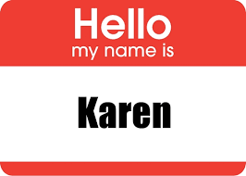
The name tag and introductions
Name Tag should be placed on the right hand side of your front shoulder area.
The logic: When shaking hands it allows for a natural progression for the eyes to the name tag.
Activity
Turn to the person on your right and introduce yourself and ask each other the following two questions:
1. What activities are you involved in?
2. What is your major and what do you like or dislike about it?

Slide 21
Frequently Asked questions
Q: What Should I do if I need to leave the table during dinner?
A: Wait until there is a break between courses. Say "excuse me", lay your napkin on the chair (arm or seat), and leave.
Q: What should I do if some food falls from my plate?
A: Just leave it there. The waiter or waitress will take care of it.
Q: What should I do if I bite into something awful?
A: Simply bring the food to the front of your mouth and put it back on the utensil used to take that bite. Place it on your plate discreetly, preferably under garnish.
Q: Can I take my leftover food home with me?
A: It is usually not appropriate to ask for a doggy bag. However, if the host does and in turn asks you, you may follow their lead.
Q: What should I do with my knife when I am not using it?
A: Place your knife across the top of your plate with the blade facing you when you are not using it.

Slide 22
Last REMINDERS
•Turn off phone before any meal or interview.
•Do not look at your phone/watch every few minutes.
•Do not text people.
•Men should never wear a hat at the table.
•Do not smoke before or at an interview meal.
•Excuse yourself to go to the restroom by saying, “Excuse me for a minute.” Do not say, “I need to go to the bathroom.”
•If you drop a utensil do not pick it up, ask for a new one

Slide 23


Slide 24


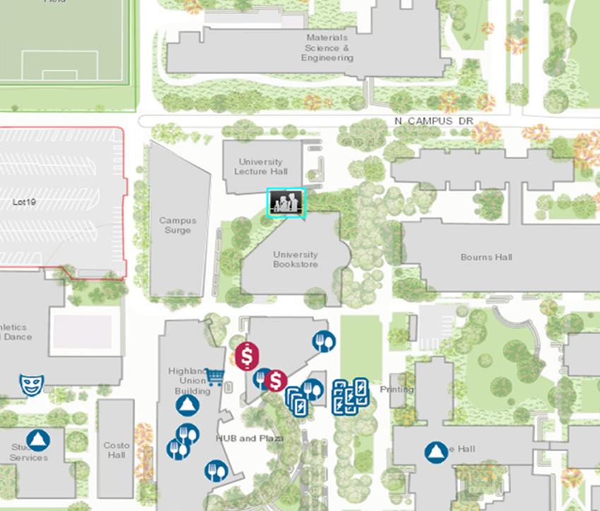
Come See Us
Hours:
Mon. - Fri. 8 am to 5 pm
except Wed. 9 am to 5 pm
Drop-In Hours:
Mon. - Thurs. 10 am-3pm
Fri. 10 am-12 pm

