Slide 1

You can see a Career Counselor or Peer Advisor for a 10-minute Drop-in meeting. No appointments needed!
M – Th: 10am to 3pm
F: 10am to 12pm

Slide 2


Slide 3


Slide 4





First Year Career Plan

Slide 5




FIRST Year Career Plan
Your step-by-step guide to career planning success
Notes:
You can use this slide as your opening or closing slide. Should you choose to use it as a closing, make sure you review the main points of your presentation. One creative way to do that is by adding animations to the various graphics on a slide. This slide has 4 different graphics, and, when you view the slideshow, you will see that you can click to reveal the next graphic. Similarly, as you review the main topics in your presentation, you may want each point to show up when you are addressing that topic.
Add animation to images and graphics:
Select your image or graphic.
Click on the Animations tab.
Choose from the options. The animation for this slide is “Split”. The drop-down menu in the Animation section gives even more animations you can use.
If you have multiple graphics or images, you will see a number appear next to it that notes the order of the animations.
Note: You will want to choose the animations carefully. You do not want to make your audience dizzy from your presentation.

Slide 6
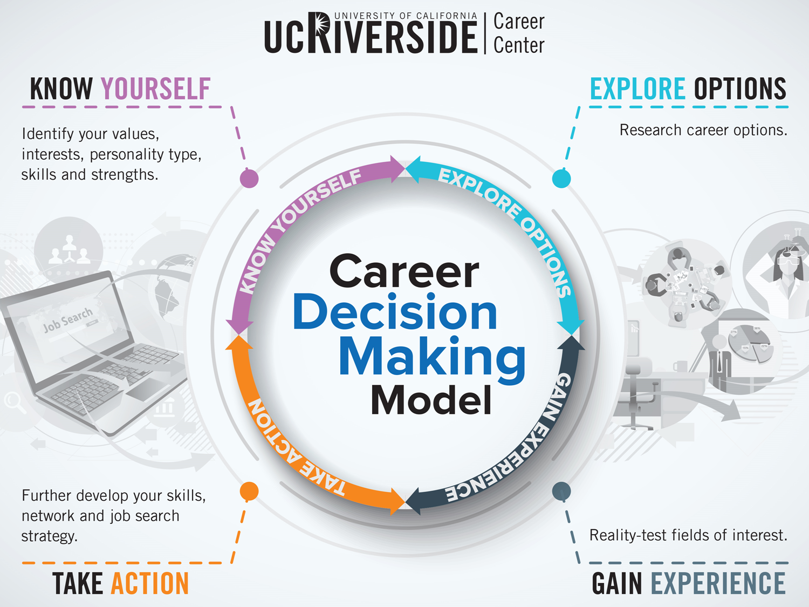

Slide 7

We Recommend
Meet with a career counselor
Learn about our career assessments
Speak with family, friends, mentors and colleagues about your strengths and interests, and how they align with potential majors and careers.
Notes:
When conducting research, it is easy to go to one source: Wikipedia. However, you need to include a variety of sources in your research. Consider the following sources:
Who can I interview to get more information on the topic?
Is the topic current and will it be relevant to my audience?
What articles, blogs, and magazines may have something related to my topic?
Is there a YouTube video on the topic? If so, what is it about?
What images can I find related to the topic?

Slide 8




Famous people & their college majors

Slide 9

Former President Obama graduated from Columbia University with a Bachelor of Arts Degree in_________
Psychology
Pre-med
Law
Political Science
Notes:
With an emphasis in International Relations. He later went on to Law School at Harvard University. President Obama’s degrees are directly related to his career choice in politics.

Slide 10

J.K. Rowling (Author; Harry Potter series)– Bachelor of Arts in _______ from University of Exeter in the UK.
A. Drama
B. French
C. English
D. Creative Writing
Notes:
French is not directly related to J.K. Rowling’s career as a successful author.

Slide 11
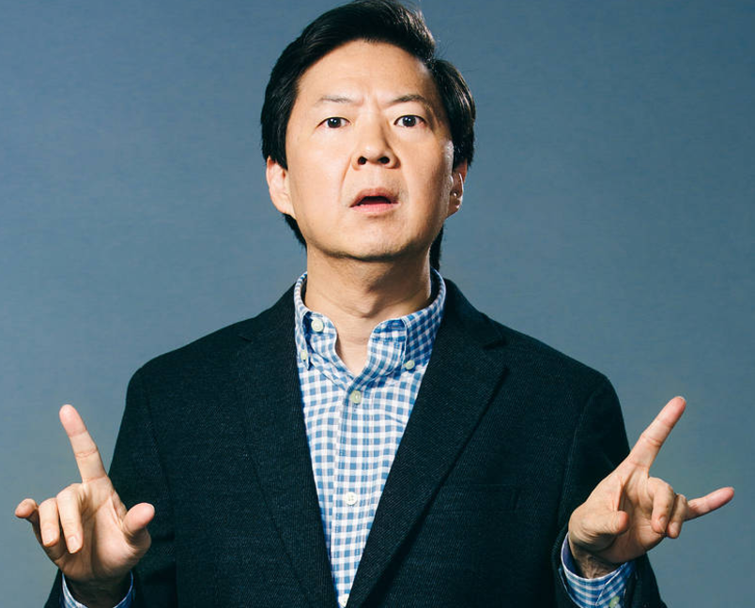
Ken Jeong graduated from the Duke University and majored in _______
A. Zoology
B. Drama
C. Literature
D. Chemistry

Slide 12




We Recommend
Attend a Choosing a Major workshop
Explore the UCR General Catalog: catalog.ucr.edu
Talk to your academic advisor
Take the Focus 2 career assessment by logging into your UCR Handshake account
Notes:
When conducting research, it is easy to go to one source: Wikipedia. However, you need to include a variety of sources in your research. Consider the following sources:
Who can I interview to get more information on the topic?
Is the topic current and will it be relevant to my audience?
What articles, blogs, and magazines may have something related to my topic?
Is there a YouTube video on the topic? If so, what is it about?
What images can I find related to the topic?

Slide 13



We Recommend
Attend a Resume Writing Workshop
(Bring your laptop or tablet)
Find resume samples at careers.ucr.edu
Upload your resume into UCR Handshake
Continue to add to your resume as you gain more experience
Notes:
When conducting research, it is easy to go to one source: Wikipedia. However, you need to include a variety of sources in your research. Consider the following sources:
Who can I interview to get more information on the topic?
Is the topic current and will it be relevant to my audience?
What articles, blogs, and magazines may have something related to my topic?
Is there a YouTube video on the topic? If so, what is it about?
What images can I find related to the topic?

Slide 14
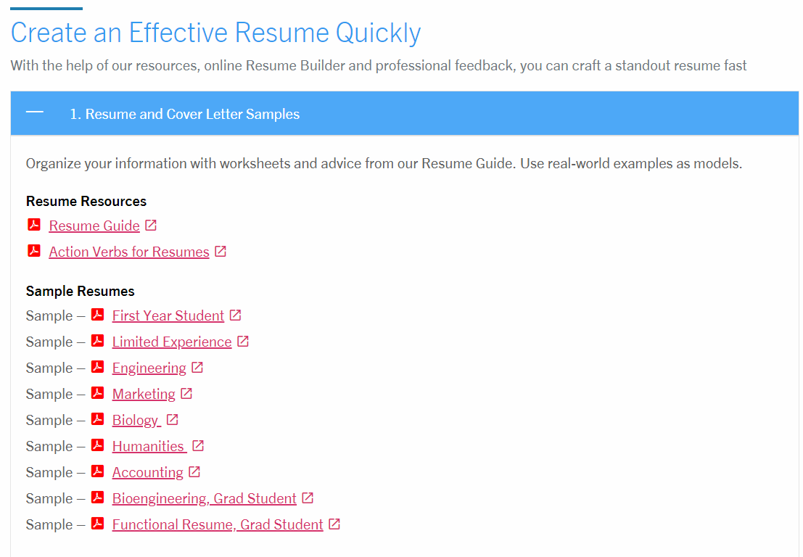

Slide 15
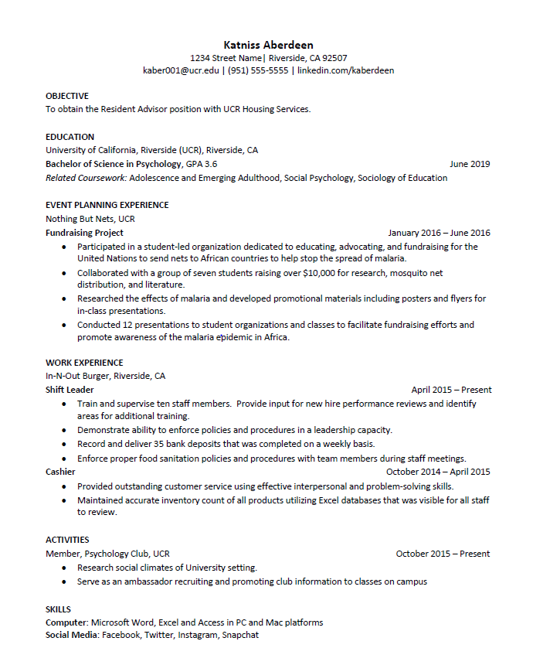

Slide 16






We Recommend
Explore and join UCR Student Organizations
Learn about volunteer & research opportunities
Attend Career Center events
Check out our Event Calendar at careers.ucr.edu
Learn about the Career Center’s Career Development Programs
Learn about Early Identification Programs

Slide 17
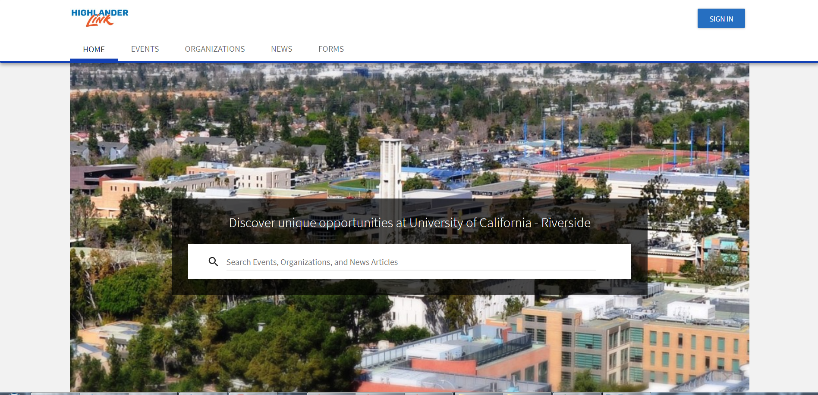

Slide 18
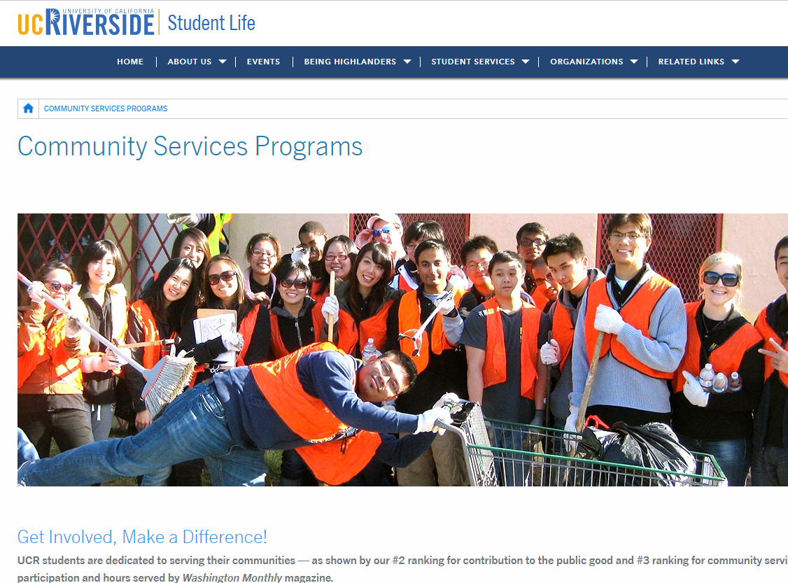

Slide 19
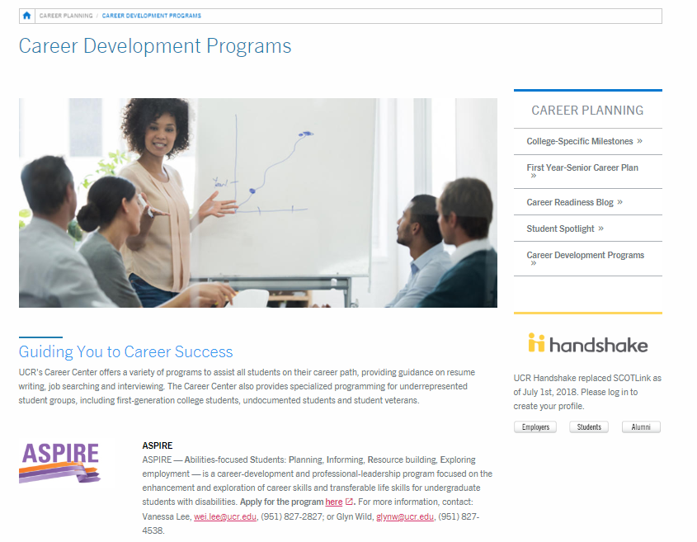
Career Development Programs

Slide 20






ASPIRE (Abilities-focused Students: Planning, Informing, Resource building, Exploring employment)
The Butterfly Project (A partnership between the Career Center and Undocumented Student Programs)
Get HIRED (Help International students Reach Employment Destinations)
Internship Success Program
Operation VETS (Veteran, Employment, Transition, Success)
ORBITS (Obtain Resources, Become Informed, Target Success)

Slide 21

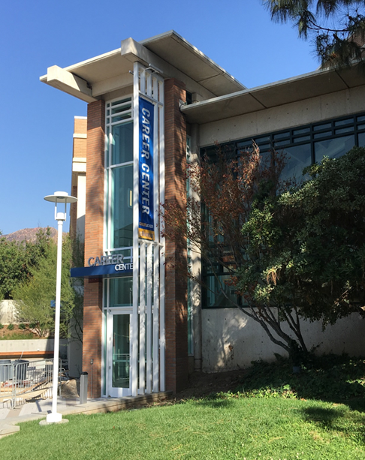
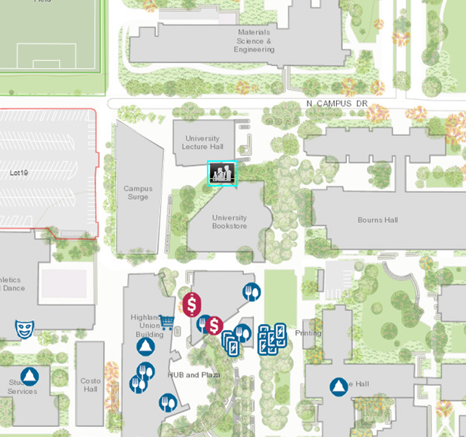
Come See Us!
Hours:
Mon. - Fri. 8 am to 5 pm
except Wed. 9 am to 5 pm
Drop-In Hours:
Mon. - Thurs. 10 am-3pm
Fri. 10 am-12 pm

