Slide 1

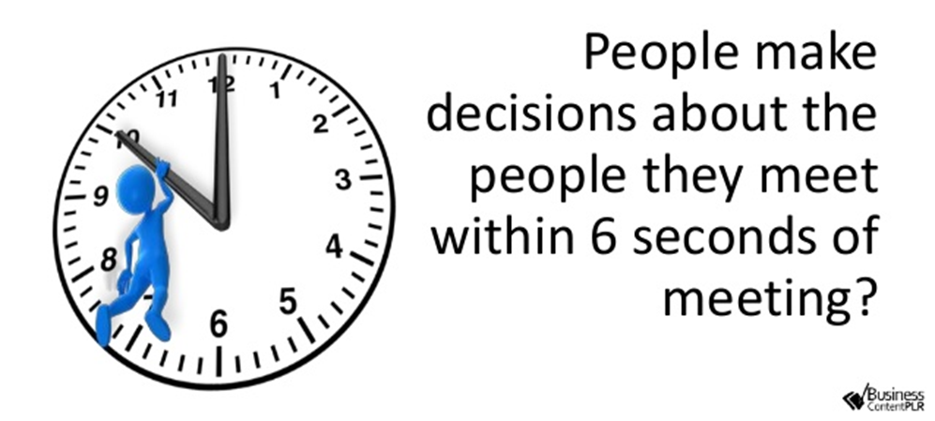

Slide 2
7% of any message is conveyed through words,
38% through certain vocal elements, and
55% through nonverbal elements (facial expressions, gestures, posture, etc).

Slide 3
93% of recruiters search for job candidates on
social media.

Slide 4


Slide 5
Create a Handshake Account
1.
Log into go.ucr.edu/ucrhandshake with your UCR username and password.
2.
Complete your UCR Handshake profile by adding your resume, photos, skills and more. Make your profile public to employers.
3.
Click “Jobs” in the menu bar and start applying. Save searches and sign up for notifications about future opportunities that match your interests!

Slide 6
Students enjoy:
A personalized feed of jobs, internships, events and resources — like Netflix but for careers!
A “Favorite” option to know when top employers are posting jobs and coming to campus.
A seamless experience across all devices: phones, tablets and computers.

Slide 7


Slide 8


#HireHighlanders #UCRCareerReady
How Not to Get Fired: Professional Etiquette

Slide 9
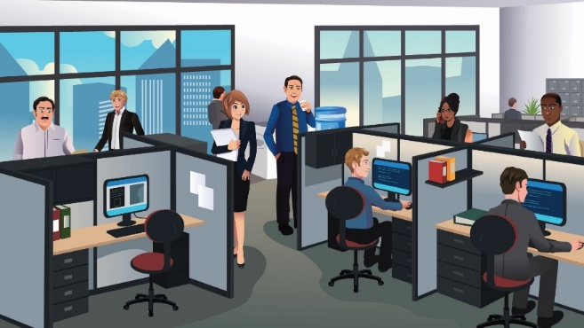
AGENDA
WHAT IS PROFESSIONALISM?
BOUNDARIES
DRESS CODE
COMMUNICATION MINDFULNESS
IN PERSON MEETINGS
SICK/VACATION DAYS

Slide 10

ICE BREAKER
When you think of professional etiquette, what comes to mind?
Why is it important?
It provides a standard framework within which people can operate as they communicate and collaborate.
Notes:
Icebreaker:
When you think of professionalism, what comes to mind?
Survey the audience to get an idea of what their views are on this topic.
Why is it important?
It provides a standard framework within which people can operate as they communicate and collaborate.
It is a sign of respect for others.
It brings all parties together under a common understanding.
It is a way of making positive first impressions while building trust among colleagues.
Professionalism is…
Situational- is knowing your work culture! This is dependent on your work setting and how you adapt to the culture
familiarize yourself with the system, structure, staff values, style and skills
Credibility- it is what you represent and how you brand yourself to others in order to develop trust and long lasting professional relationships
Responsibility- is about knowing that only you are responsible for your success
Being punctual
Keeping your word
Being mindful and accountable for your actions
Do practice active listening and be attentive at all times
Behavior- demonstrating a friendly personality and good manners, having a can do attitude and maintaining open communication
Do greet people when they enter and leave the office
Do state your first and last name and your goals
Competence- being open to learn new things and being knowledgeable in your role, asking questions to clarify in order to showcase a mature level of knowledge

Slide 11
BOUNDARIES
Notes:
ACTVITY: Tell us how you maximize your Newness in small groups and share out

Slide 12

Do’s
Establish work relationships
  BE A SPONGE
  Find a mentor
  Makes connections (Professionals & Other Interns)
Be mindful of your role at work events and parties
  BECOME AN EXPERT
  Go the extra mile
Check in with your supervisor when work is slow
Clean up after yourself
Be ethical
Notes:
Go the extra mile: Acknowledge that you can only do so much in your role so “going the extra mile” does not mean, going completely out of your way or doing things out of your position description (i.e. picking up your boss’s dog’s poop)

Slide 13
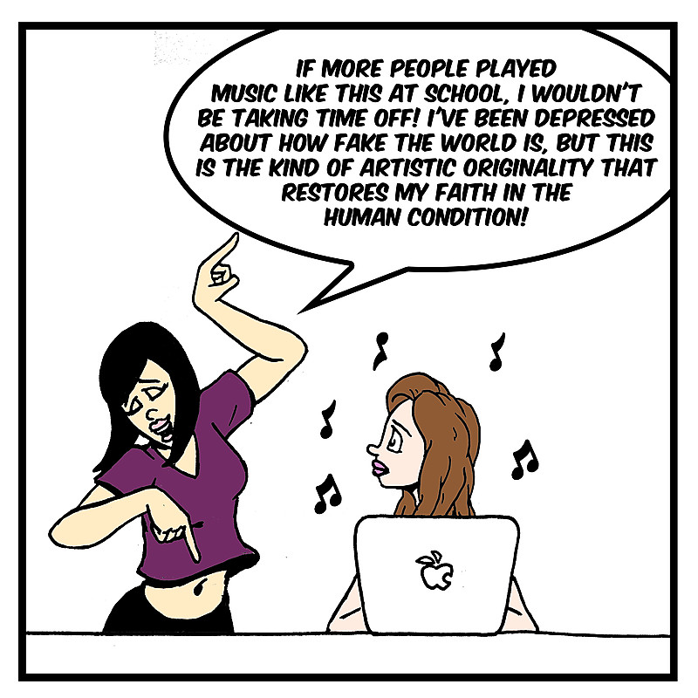
Don’t
Bring personal matters
Use social media for personal use
Misuse work resources
Expect an office maid
Take food items that don’t belong to you
Assume doing homework on the job is ok
Make decisions without your supervisor knowing

Slide 14
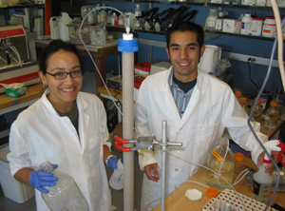

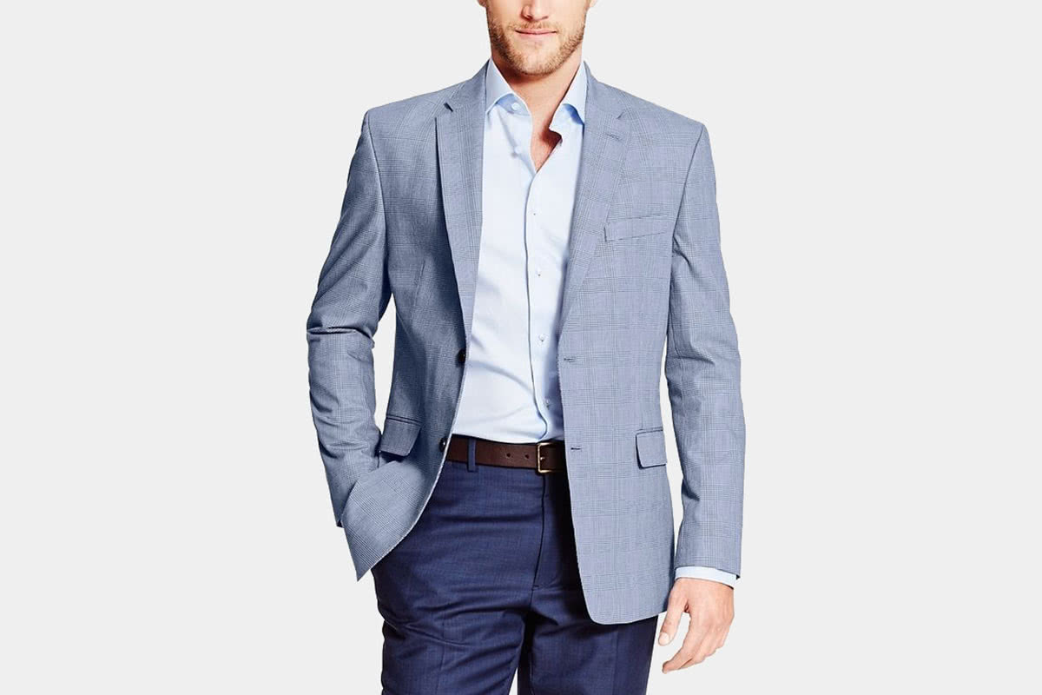

DRESS CODE
Check with your supervisor to learn the dress code policy!
Notes:
Important: Dress code can mean different things in various work environments
This is an example of what to wear in an office setting.
Emphasize the importance of dressing professionally and how this impacts people’s perception of you. Dressing professionally will differ from one place to another, but encourage students to dress not necessarily like other interns or student staff but dress like the other professional staff.
These images are examples of various dress codes for each work environment.
If there are items needed to complete your work, be sure to always have them with you each day
Aprons, safety wear, lab coats, stethoscope, portfolio, note pad and pen etc.
Always follow dress code and if unsure, check with your supervisor

Slide 15
COMMUNICATION MINDFULNESS
Notes:
ACTVITY: Tell us how you maximize your Newness in small groups and share out

Slide 16
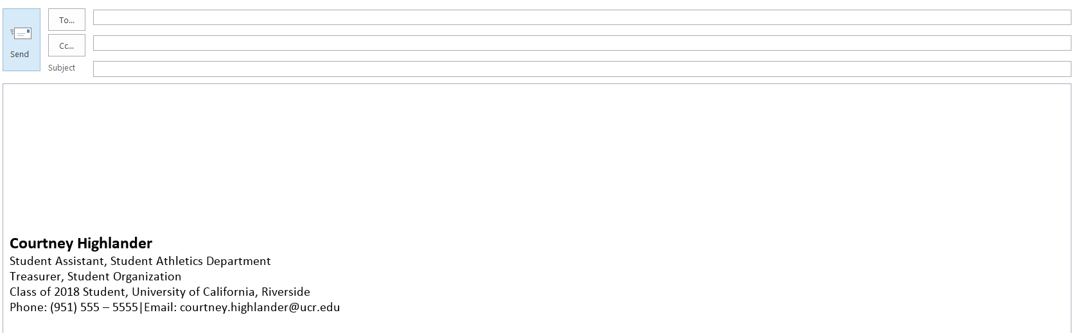
COMMUNICATION: EMAIL EXAMPLE
Taylor.smith@gmail.com
Add email address last
Meeting
Transportation to Marketing Meeting
Clear subject line
Dear Taylor,
Thank you for meeting with me yesterday. I wanted to see if you were available sometime this week to discuss plans on how we plan to get to the marketing meeting. My car is getting serviced and I wanted to discuss other transportation options in case my car isn’t ready. I am available tomorrow at 12pm but let me know what time works for you this week. Feel free to email or call me at (555) 553 – 2345. Thank you.
Hey there,
I would like to talk with you to discuss what we talked about yesterday regarding transportation to the meeting. I don’t think I will make it. I am available tomorrow at 12pm to talk. Thank you.
Professional salutation
Clear purpose
Sincerely,
Courtney
Sincerely,
Courtney Highlander
Student Assistant, Athletics Department
Class of 2018, UC Riverside
Phone: (951) 555 – 553 – 2345
Email: courtney01@ucr.edu
Signature
Notes:
DO
Professional email address
Clear subject line
Include signature w/ contact information
Leave the To: blank until you finish typing your message
Spellcheck, grammar check, proofread
Answer within 24-48hrs
DON’T
Use TXT language
Use emoticons/ emojis
Be careful with cc, bcc and reply all
Don’t write in all CAPS
Vent your frustrations or emotions
Don’t send personal emails

Slide 17
COMMUNICATION: TEXTING
Double check with your supervisor that it is OK to text them on their personal phone
Keep it professional at all times
Check grammar
Make sure to include your signature at the end
Try to avoid using emojis since they can send mixed signals or messages
Do not text after hours unless the policies state that it is OK to communicate at all hours of the day or if your supervisor permits it.

Slide 18
PHONE SKIT #1: ANWERING A CALL
Ring Ring Ring! C= Caller R= Receiver
R: Hello?
C: Is this XYZ Corporation?
R: Yep.
C: May I please speak with Taylor Smith?
R: Who is calling?
C: This is Courtney Collins with ABC Company.
R: Sorry, Taylor is not in, try calling back later.
C: Do you know when Taylor will be in? Can I leave a message?
R: Ok, I will put you on hold so I can get a pen. (5 minutes pass)
R: What is your name again? Phone number?
C: Courtney Collins with ABC Company, Taylor can reach me at 555-2121.
R: Got it I’ll let Taylor know, bye.
Notes:
Ask the audience for two volunteers, (caller and receiver)
Survey the audience: What is wrong with this call? What important information is missing from the receiver’s end?

Slide 19
PHONE SKIT#2: ANSWERING A CALL
Ring Ring Ring!
C= Caller R= Receiver
R: Hello this is the XYZ Corporation, my name is Jaimie how can I help you?
C: Hello Jaimie, may I speak with Taylor Smith? This is Courtney Collins.
R: Hi Courtney, let me see if Taylor is in, may I put you on hold for a moment?
C: Sure.
R: Thank you, one moment please, (quick hold), Hi Courtney, thank you for holding, Taylor is unfortunately not available at the moment. Would you like to leave a message or be transferred to Taylor’s voicemail?
C: Sure, I can leave a voicemail.
R: Ok great, before I transfer you, is there anything else I can help you with?
C: No that would be all.
R: Ok Courtney, please hold while I transfer your call and have a wonderful day.
Notes:
Ask the audience for two volunteers or use the same to volunteers, (caller and receiver)
Survey the audience: How did the “Receiver” handle this call?

Slide 20
PHONE SKIT: VOICEMAIL
C= Caller R= Receiver
R: Hello, you have reached Chris Bell at XYZ Corporation, I am unavailable to take your call, please leave me your name and number and a brief message and I will be sure to get back to you. Thank you.
C: Hey what’s up Chris this is Toni. I want to talk to you about tomorrow so get back at me, thanks, bye.
C: Hi Chris this is Toni Madison from ABC Company. My number is (909) 555-1234 and I was calling to confirm our meeting time and location tomorrow. When you have a moment can you please return my call so we can finalize our plans for tomorrow. Again this is Toni Madison with ABC Company and my number is (909) 555-1234. Thank you for your time and I look forward to your call.

Slide 21



IN-PERSON MEETINGS
Notes:
DO…
Show up on time
Prepare (what you’ve been working on, known issues)
Listen actively
Contribute (ask questions, offer ideas, etc.)
Have a learning attitude
Follow up with any agenda items quickly
DON’T…
Play with your cell phone/computer (emails, text, answer calls, etc.)
Doodle
Act like a know-it-all
Keep yawning or fall asleep
Have side conversations
Be disruptive

Slide 22

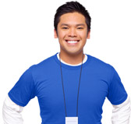




BODY LANGUAGE
DO
DON’T
Notes:
Dr. Albert Mehrabian found that 7% of any message is conveyed through words, 38% through certain vocal elements, and 55% through nonverbal elements (facial expressions, gestures, posture, etc). Subtracting the 7% for actual vocal content leaves one with the 93% statistic.
http://www.nonverbalgroup.com/2011/08/how-much-of-communication-is-really-nonverbal/
Verbal versus non-verbal:
90% of communication is non verbal
Eye contact
Posture
Tone/Speech Rate
Gestures
Appearance
Confidence
DO
Maintain open body language, smile, introduce yourself, eye contact
DON’T
Have poor posture, display negative emotions, closed body language, lack of eye contact

Slide 23
SICK & VACATION DAYS
SICK
VACATION
Good idea to ask your supervisor what s/he prefers (e.g. emails, voice messages, direct calls)
Who else needs to know? Who takes care of your appointments?
The notorious pattern of Monday/Friday sick days
Know your work cycle and plan ahead!
Follow your workplace procedures; put it on your work calendar
Remind your supervisor a week in advance
Notes:
Sick: Try to find a replacement to take on your job tasks that day.

Slide 24

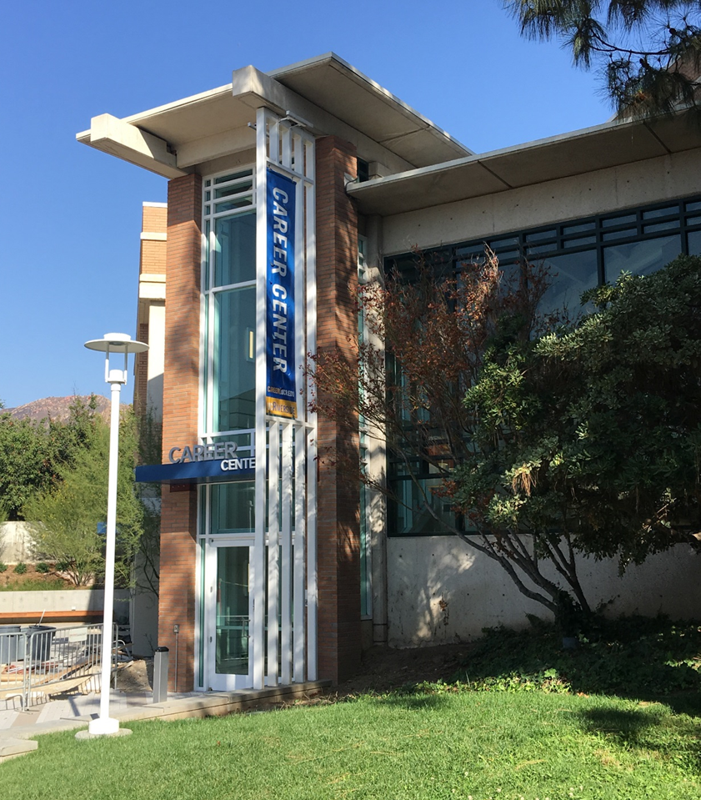
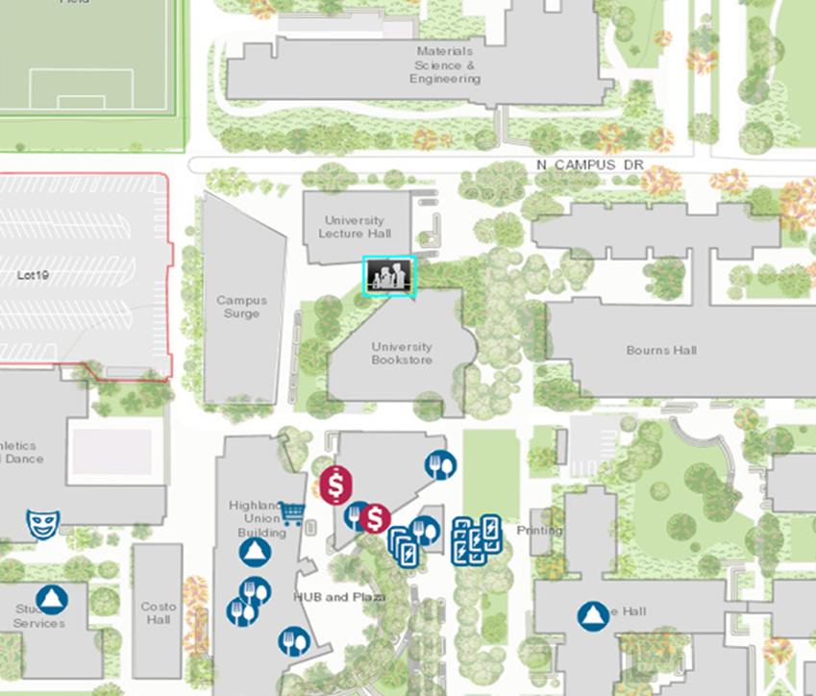
Come See Us
Hours:
Mon. - Fri. 8 am to 5 pm
except Wed. 9 am to 5 pm
Drop-In Hours:
Mon. - Thurs. 10 am-3pm
Fri. 10 am-12 pm

