Slide 1
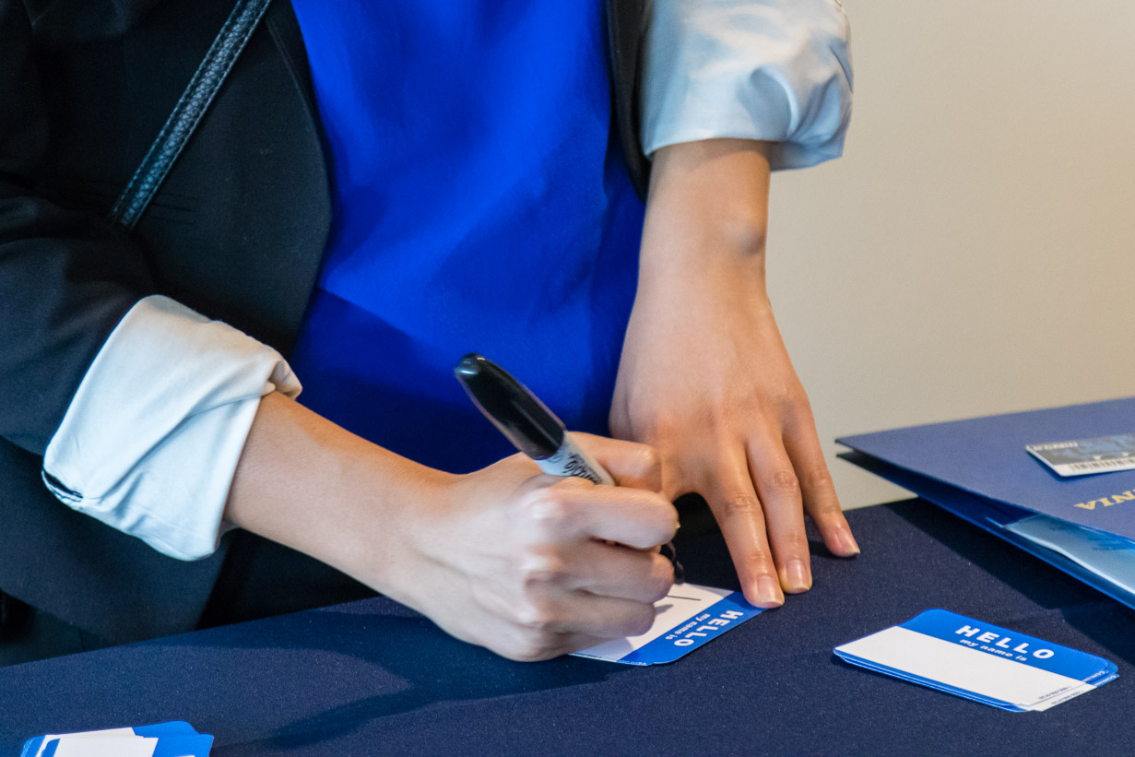
How To Work A
Career Fair Room
UCR Career Center

Slide 2

Ice Breaker
Think about what your biggest job fair concern is and consider:
How you might alleviate your concern?
Feel more in control of the situation?
Let’s Share!

Slide 3





What are your goals?
Network to build contacts/ practice
Identify employers with jobs/ internships in your field
Ask Questions. We’re here to help!
Gather Information
Not sure?

Slide 4
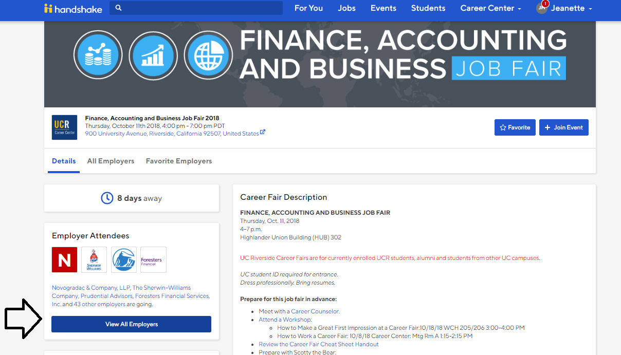
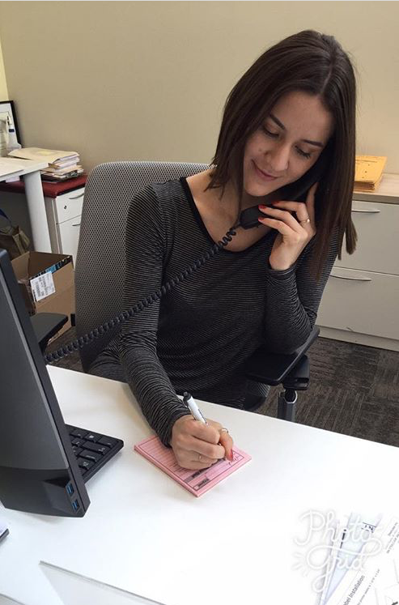

Preparation Before the Fair
Look on careers.ucr.edu to review the list of employers attending the fair.
Research employers by visiting company websites.
Prepare a list of questions to ask employers.
Gain confidence by practicing your questions out loud.
Develop a strong resume with the help of the Career Center.

Slide 5
Resume Tips
Print your resume on neutral-colored paper that is professional in appearance. Use BLACK ink.
Use a font that is easy to read at a glance.
Tailored objectives/general objectives. Do not include any graphics or pictures on your resume.
Keep resume in an easy accessible location.
Make sure that your resumes are not wrinkled, rained on, or otherwise blemished.

Slide 6

Career Fair Game Plan
Identify items that you want to carry to the event
  Resumes
  Portfolio or folder
  Bag for company literature/materials
  Pen
Identify your targets
  Use your research to rank the organizations in order of your interest to determine which organizations to visit in what order at the fair. This will help you make the best use of your time.

Slide 7




Dress to Impress

Slide 8




Non-Verbal Communication
Making good eye contact
Giving a firm handshake
Good posture
Smiling and being enthusiastic

Slide 9

The Perfect Handshake
Use Your
Right Hand
Eye Contact And Appropriate Smile Throughout
Dry Palm
Strong Grip With
Fingers Under
Receiving Palm
Three To Four Vigorous Shakes For Two To Three Seconds

Slide 10
Initiate a conversation with an employer by making eye contact, introducing yourself and shaking hands.
Give your 30 second pitch about your strengths and interest in the company. Be articulate and confident.
Verbal Communication
Offer the employer your resume when it feels most appropriate:
  At the start of the conversation
  When asked for it
  When you are discussing a particular experience listed on your resume
  At the close of the conversation

Slide 11
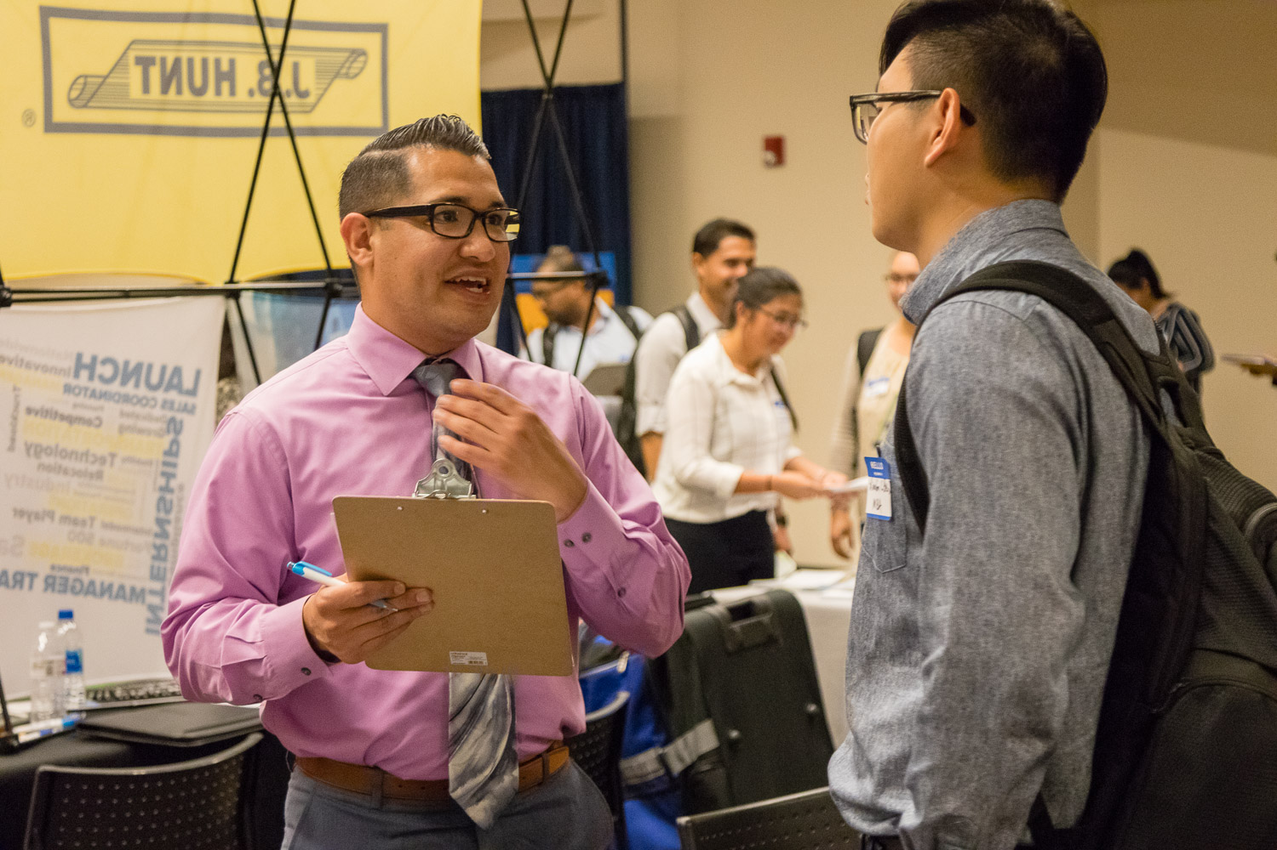
Initiating the Conversation with Employers
Create a smooth start to your conversation by including the following information:
Name
Class Level
Major
Opportunities you are seeking
Relevant experience
Highlights of skills and strengths
Knowledge of the company
Preparing a 30-second pitch consists of summarizing your professional background, skills, and interest.

Slide 12

Hello! My name is Heidi and I’m working on my Bachelor's in Business Administration. I have a great passion for marketing. Last summer I had an internship with a small start-up company where I had the opportunity to develop their social media branding. I gained a lot of great skills from this internship and I am looking forward to applying what I have learned in a career position.
I noticed on your company’s website that you do a lot of work in _________ and I was interested in learning more about that aspect of your business.
30 Second Pitch
Example:

Slide 13
Let’s Rehearse!
Prepare your 30 Second Pitch
Introduce yourself to your neighbor and give your 30 Second Pitch…
Give feedback to your partner
Now switch

Slide 14
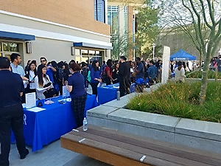
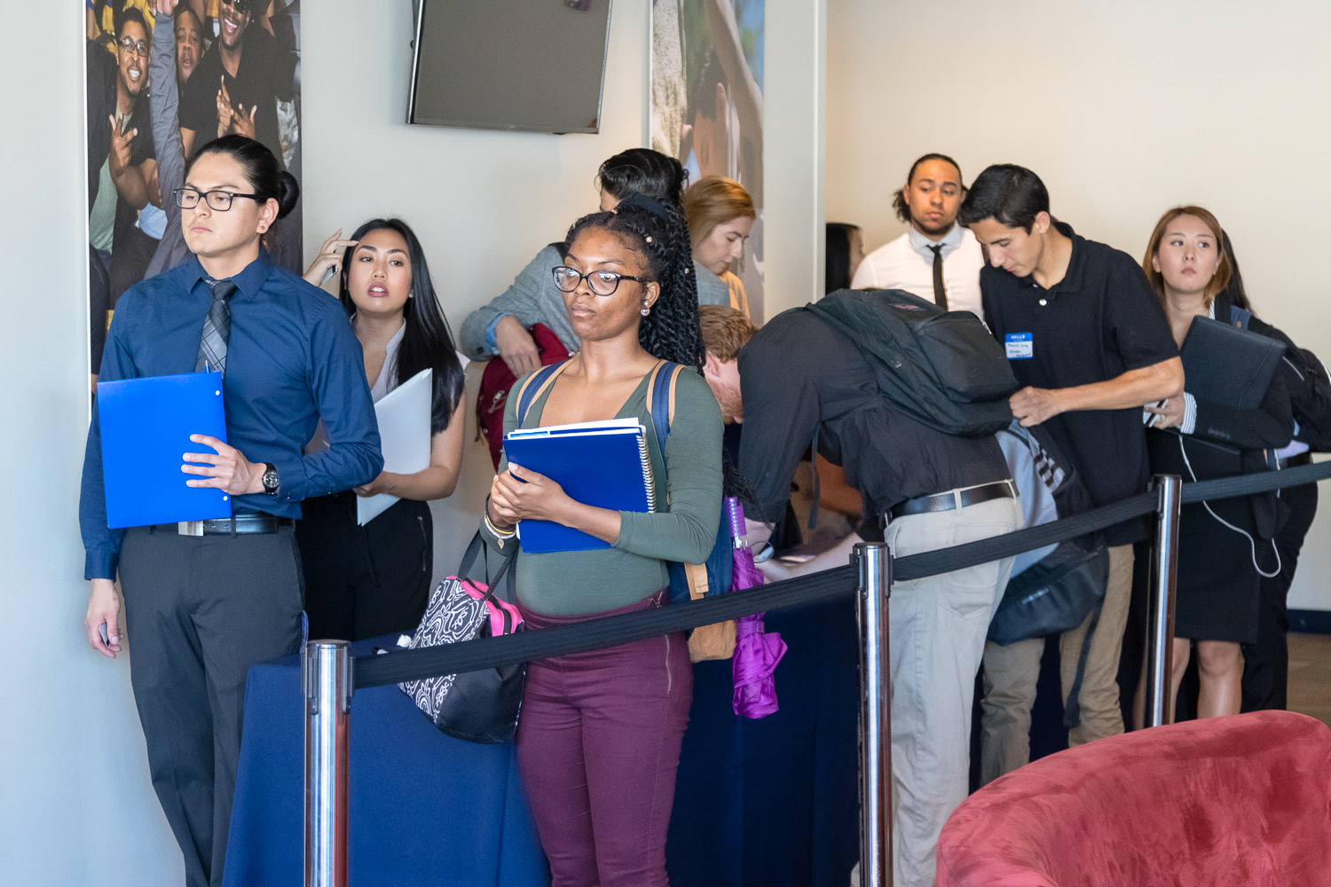
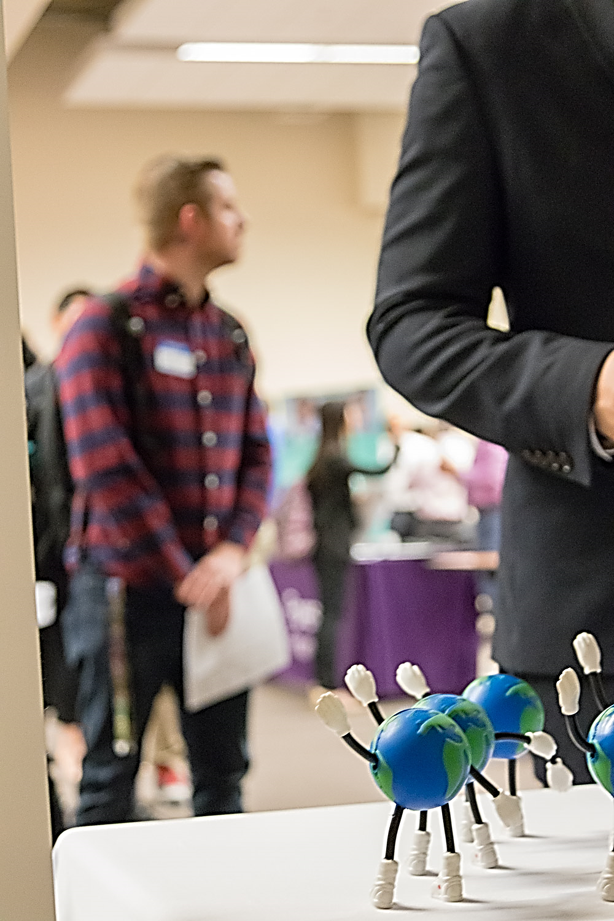

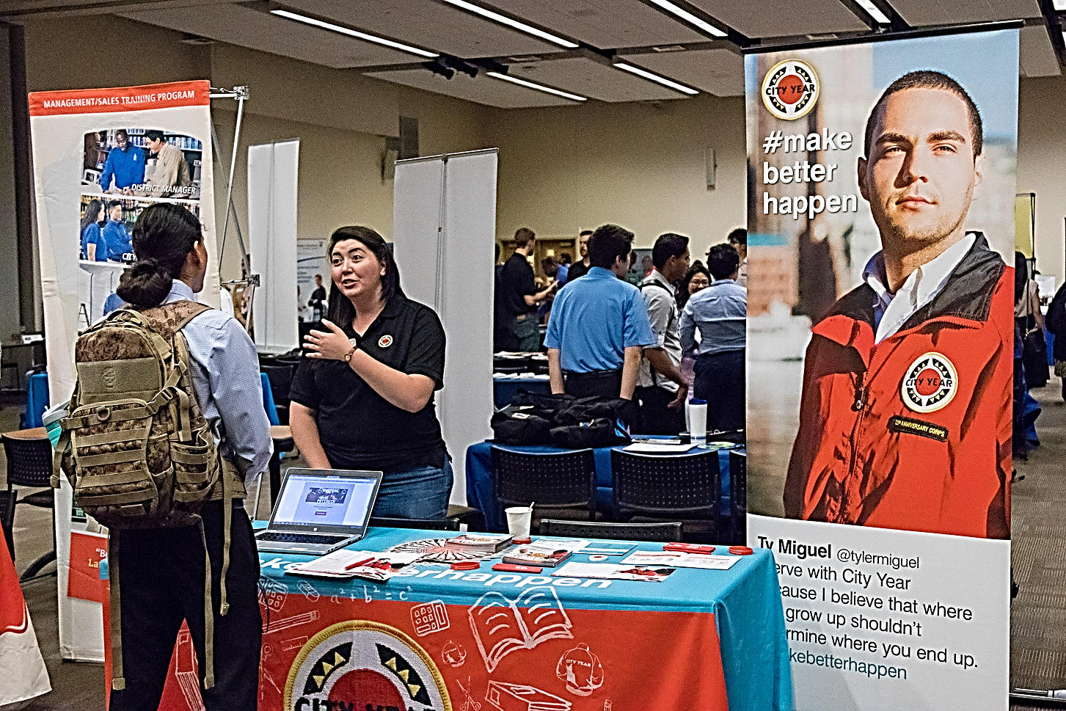
Navigating the Fair
Scot at the Career Fair
Notes:
People behind the tables
Recruiters who attend these events are NOT hiring managers, they usually work in Personnel/Human Resources.
Your appearance and attitude will also help the recruiter determine if you will fit in with the team/company.
How we Recruit Employers to Participate in Job Fairs
Cold calling, e-mails, LinkedIn, Relationships etc,.
Some employers may decide not to invest because: students have declined offers, they already have a set of schools they would like to recruit at, students don’t apply via Handshake and etc,.
Walk-Around Technique
When you first arrive, walk around the job fair to get a good feel for the layout and where each employer is located. Decide who you want to speak with and in what order.
If you are not familiar with a particular company, pick up some literature, job openings, etc. Stand back and listen to the recruiter. Ask yourself two questions:
“Is this something I’m interested in?” and “Am I able to show that I am qualified for the position(s) they are offering? If your answer is “yes”, then stand in line and read over the company materials

Slide 15

Navigating Tips
Walk around technique:
Personality Matching Technique:
Be aware of the voice (tempo and pitch).
Physical characteristics (facial expressions and posture).
The recruiters are the faces and personalities of the company and are looking for candidates like themselves to represent the company mission, values, etc.
Inquire:
If you see a company that you really want to work for, but they are not hiring for your field or area of interest….what can you do?
  Approach the recruiter and ask: “Who should I contact in your company for a position in my field (ie. Computer programming)?
  You MUST get their name and phone number to follow up if they forward your resume to another department in the company.

Slide 16
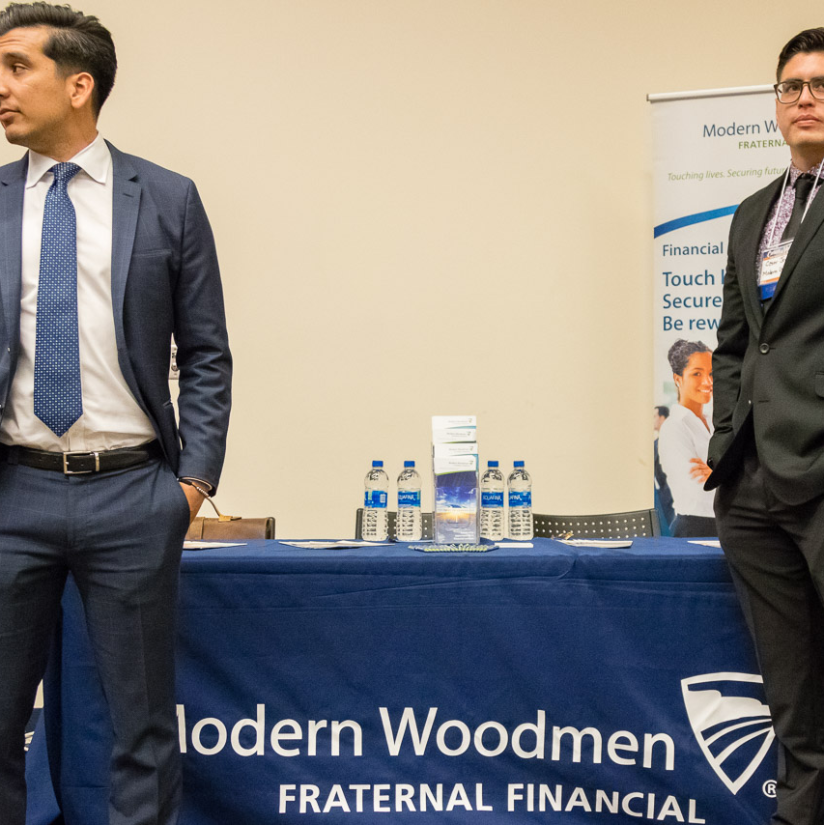


Before Leaving The Fair
Go back to the companies you really want to work for and wait until the recruiter is free, then thank him/her/them for their time.
They may be reviewing 50-100 resumes, and it is best if they can remember your name and face over the other candidates!
The lasting impression is very important for future contact!!

Slide 17



After the Fair
Follow up soon after the fair
  Send a thank you e-mail to each recruiter with whom you met.
  Express your appreciation for the time and advice offered. Let the recruiter know that you have completed anything he or she has asked you to do and reiterate your interest in the company.
Undertake next steps
  Apply online
  Sign up for the organizations on-campus interviews (check with the Career Center for this information)
Benefits of creating a LinkedIn profile
  75-80% of jobs are found through the hidden marketplace
  HR recruiters are using LinkedIn to reduce recruitment costs
Notes:
According to a recent study, 56% of employers use social networking sites to recruit
Career Explorer—For students: explore career paths, navigate LinkedIn, connect with professionals and currently free to post entry level positions for employers
LinkedIn just launched a "Apply With LinkedIn" button, which employers can embed on their websites, just like a Facebook "Like" button. When a candidate hits that button, their LinkedIn profile will be automatically be submitted for the position (rather than a resume). It will also show them if they have any contacts at the company they are applying to, and allow them to send those contacts a message.

Slide 18

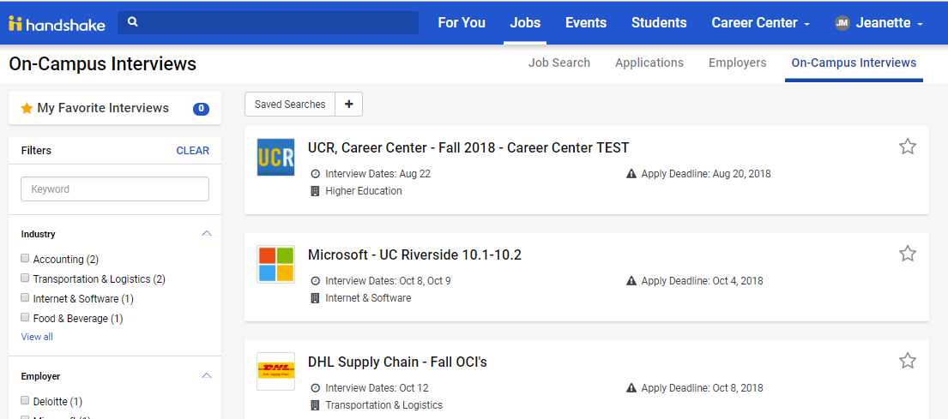
How The Career Center Can Help
Use UCR Handshake to research companies and more! Look at organizations visiting the Career Center for On Campus Interviews
Come to Drop-In Hours for a quick resume review or schedule a 30 min appointment with a Career Counselor

Slide 19
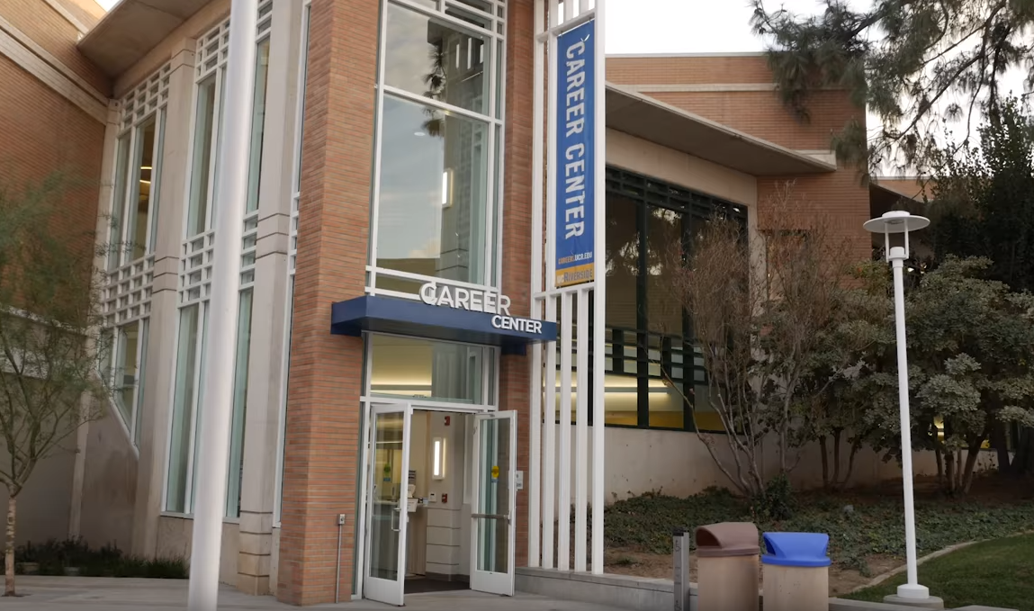
Thank you!
Phone:
Website:
951-827-3631
Careers.ucr.edu

Slide 20


