Slide 1
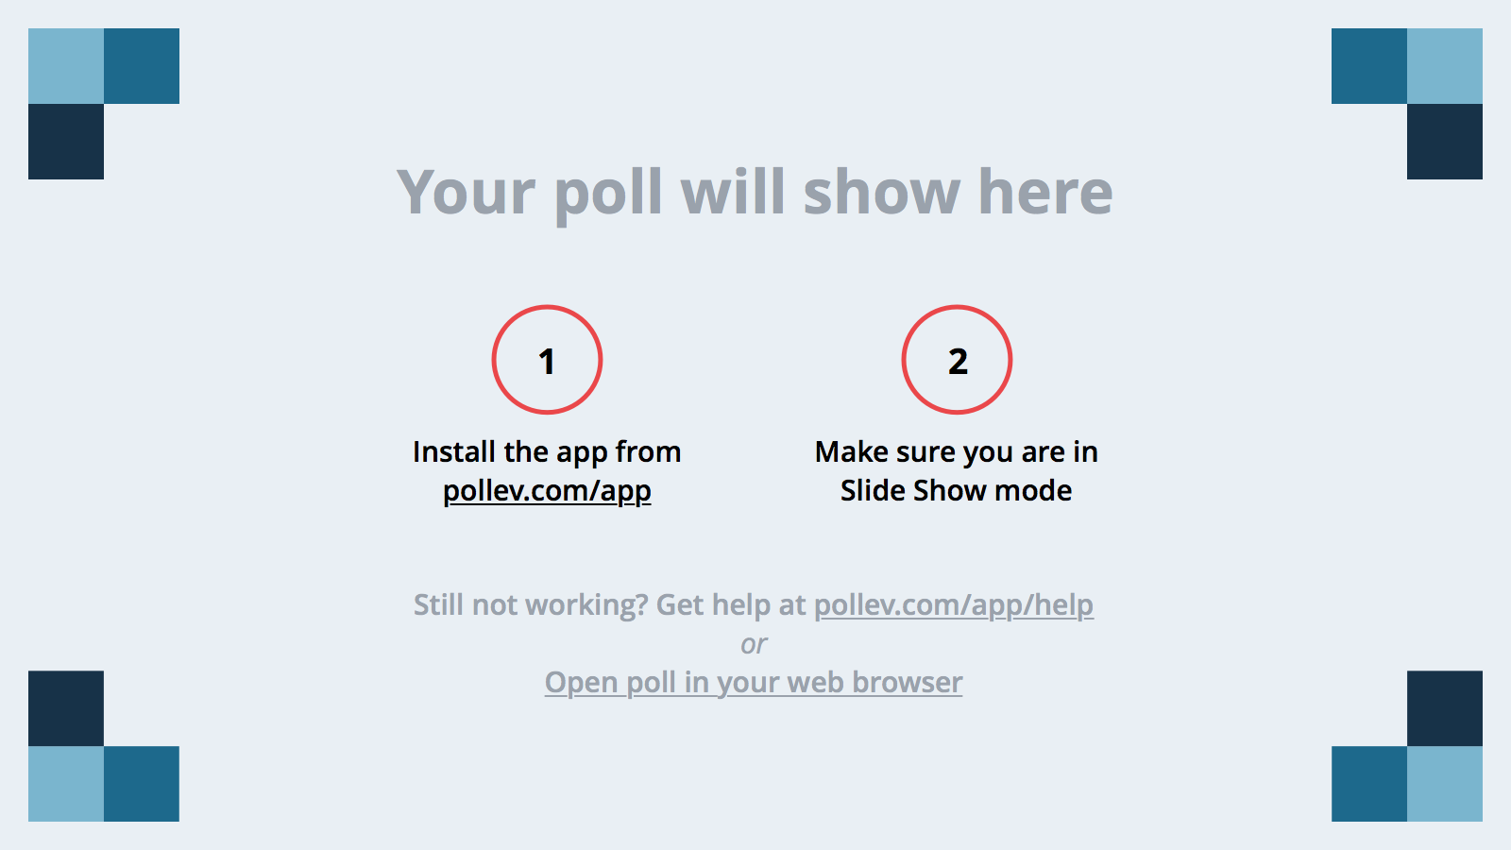
Notes:
Poll Title: In one word, what is a strength of being an introvert? https://www.polleverywhere.com/free_text_polls/TbPubkm2cgh5Me0

Slide 2

Interviewing
for Introverts

Slide 3
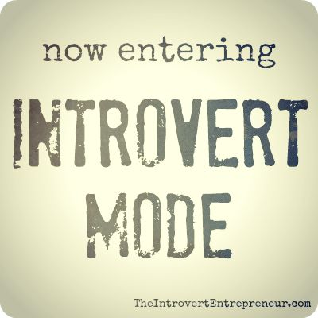
Agenda
Definition
Are You an Introvert?
Types of Interviews
Common Interview Challenges
Preparing for the Interview
After the Interview Introverts & Leadership

Slide 4
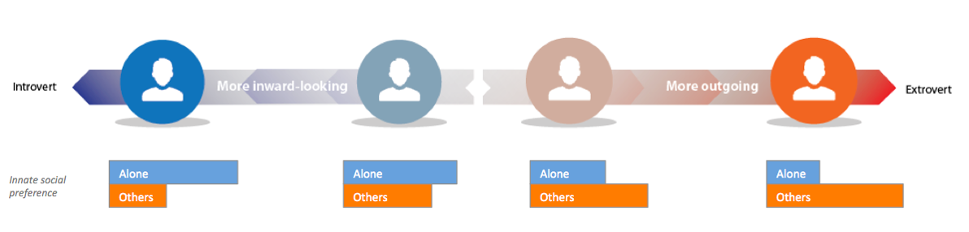
What is an introvert?
Introversion = Shyness
Introversion: preference for environments that are not overly stimulating
Shyness: fear of social disapproval or humiliation
Notes:
Introversion-Extroversion is a spectrum

Slide 5

Are you an introvert?
I prefer to relax alone or with a few close friends
I don’t like feeling rushed
I consider only deep relationships as friends
My mind goes blank in groups or under pressure
I need rest after outside activities, even ones I enjoy
I tend to think before I speak or act
I appear calm, self-contained, and like to observe
I often listen but talk a lot about topics of importance to me

Slide 6
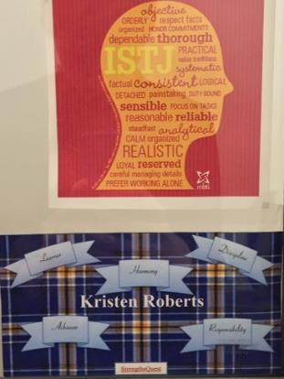
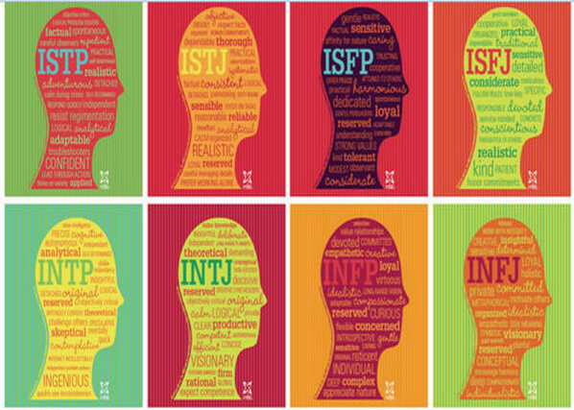
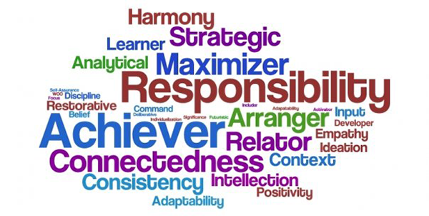
Assessments
MBTI
Strengthsfinder
Notes:
Some strengths can be highly correlated with introversion – learner, discipline, analytical, focus, intellection; could be using during the interview!

Slide 7
The Strengths of Introversion
What year are you in school?
Introduce yourself to your nearest neighbor…
What is your major? How did you choose it?
Based on what you know so far, what are some strengths of being an introvert?

Slide 8
Types of Interviews

Slide 9


1
Phone/Virtual
Clarify the Details
Find a Quiet Space
Do Your Research
Focus on Verbal Communication
Notes:
First impression: professional username and photo if appropriate, DRESS PROFESSIONALLY
Details: know the date, time, who is calling who
Research: keep your notes on the screen so that you don’t have to click around so much
Location: practice skyping with a friend in the location at the time that you will be interviewing – is the lighting/background correct, how is the internet connection,

Slide 10

2
Prepare for Standard Interview Questions
Connect With All Interviewers
Prepare Follow Up Questions
Traditional
Notes:
Know STAR Stories!
Research the interviewers ahead of time

Slide 11

3
Meal
Follow the Interviewer’s Lead
Maintain Conversation
Follow Etiquette Rules
Less Formal Environment
Notes:
Conversation may trend to the personal – it’s okay to open up
Know your focus points

Slide 12
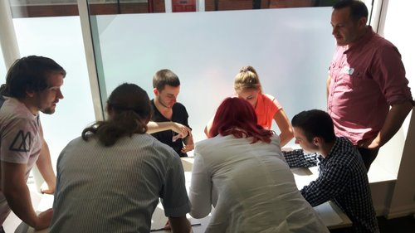
4
Focus on Interactivity & Inclusivity
Speak with Purpose
Listening is Key
Group
Notes:
Opportunity to see how the candidates compare directly to one another
Be prepared for the unexpected
Ensure your voice is heard – based on the role, what traits do you think are most important

Slide 13
Common Interview Challenges

Slide 14

Challenge: Getting Anxious
Prepare for the most common interview questions
There is no “right” answer
Think of the interview as a conversation
Relax – you’ve made it this far!
Notes:
Interviews are largely about determining fit, so give the answer that accurately reflects you, not what you think the interviewers want to hear – be genuine
The interviewers want to you to be comfortable so they get a feel for the real you

Slide 15

Challenge: Feeling Like You’re Bragging
Be as objective as possible
Talk about the most exciting aspects of your experience
Bring samples to show your work
Notes:
-Attitude adjustment – you are your own advocate. If not you, then who?
-Try to be as objective as possible if that’s what works for you.
-When introverts are passionate about something, they tend to show it, so think about your favorite project that you worked on

Slide 16

Challenge: Thinking on Your Feet
Do your research – preparation is key
Pause, reflect, then answer the question
Bring a notepad with key phrases and questions
Internal processors work out the details before they speak
External processors talk through their thinking
Notes:
-Introverts are internal processors, meaning that they tend to reflect quietly and think through a response, rather than external processors, who think out loud.
-That’s an interesting question! Let me think about that for a moment.
-Study the job description – what major strengths are required to do the position? What challenges do you see for this position? Think thematically – then prepare for questions along those lines.
-It is better to take a moment and provide a focused answer than to start talking ASAP and appear to ramble on.

Slide 17

Challenge: Making a Good First Impression
Give yourself as many advantages as possible
Know where you are going
Prepare a few topics of small-talk
Practice positive self-talk
Be aware of your body language
Notes:
-Have a few topics to discuss prepared so that you can keep the conversation flowing.
-Know the traffic patterns for the location and time of day of your interview, or even drive there if possible so you know which route to take.
-We all know that nonverbal communication says a lot about you without saying anything at all. But did you know that it can also affect the way you perform?
- High power poses (like the woman on the far right) are considered open and relaxed. Standing in such a pose is associated with increased levels of hormones (testosterone) in the body that increase your feelings of confidence and decreased levels of hormones (cortisol) that are associated with anxiety and stress.
- Low power poses (like the other three images) are considered guarded and closed.
- Think “fight or flight:” High power poses – give you the confidence to fight; low power poses increase your likelihood for flight.

Slide 18
Preparing for the Interview

Slide 19
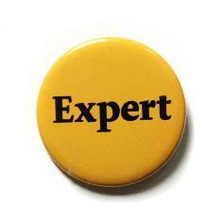

Play to your strengths
Research
Become an expert on the organization, your interviewer, and yourself
Prepare
Know the most common interview questions, and have answers ready
Practice
Make an appointment with a counselor or practice with a friend or family member
Tell me about yourself.

Slide 20
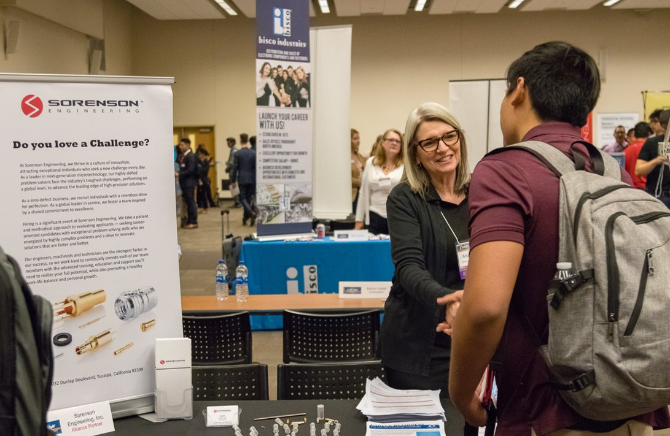

Have you...
Met with a career counselor?
Logged into UCR Handshake?
Attended Career Events?
Set up a job search agent?
Networked with employers via social media?
Practiced your interview skills?
Participated in the On-Campus Interview Program?

Slide 21
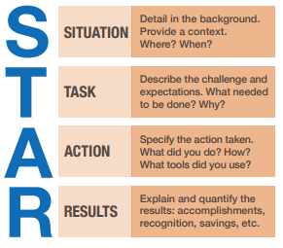
Behavior Based Interview Questions
Tell me about a time when you took the lead on a difficult team project.
Describe a situation in which you found a creative way to overcome an obstacle.
Share a rewarding team experience.
Tell me about a time when you had a conflict at work.
Tell me about a time when you failed.
Notes:
http://biginterview.com/blog/behavioral-interview-questions
Team: Hiring managers want to know if you are easy to work with, can you communicate effectively, how you handle disagreements.
Leadership: Can you motivate others who do/do not report to you, do you have leadership potential? Even in entry-level positions, employers want to know if you could potentially grow with the company.
Conflict: Can you get along with people who are different from you? Can you handle conflict professionally? Are you really a team player?
Problem-solving: Do you take initiative when you see inefficiencies/problems? Questions depend on the nature of the work – read the job description!
Failure: Are you self-aware of your failures/weaknesses? Do you learn from failure?

Slide 22
What skills are employers looking for?
1. Problem solving skills | 6. Analytical/quantitative skills
2. Ability to work in a team | 7. Communication Skills (Verbal)
3. Communication skills (Written) | 8. Initiative
4. Leadership | 9. Detail-oriented
5. Strong work ethic | 10. Flexibility/adaptability
- National Association of Colleges and Employers, 2018 Employer Survey

Slide 23
Putting it into Practice

Slide 24
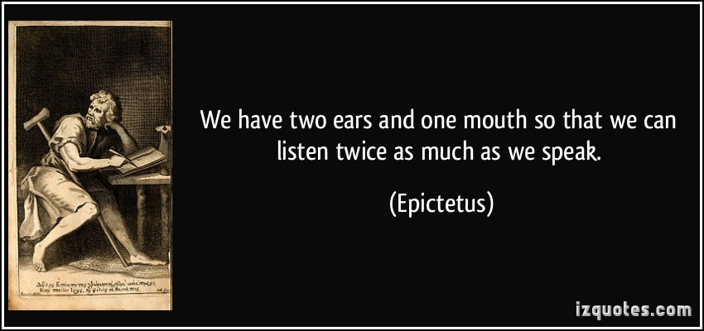
Notes:
Activity:
Hand out job descriptions – ask them to come up with two questions (behavior or otherwise) based on the role

Slide 25
After the Inteview

Slide 26

Send a thank you note
Reference what you learned in the interview
Connect your skills to the needs they shared

Slide 27


Slide 28
Introverts & Leadership

Slide 29
What makes a great leader?
Decisive people are typically considered leaders
Research suggests that the best management style depends on the team being managed
The faster a person speaks, the more capable and appealing they appear
The more a person says, the more competent they appear to be
Notes:
Remember that it is possible to become a leader as an introvert, and introverted leaders have several strengths to bring to the table.

Slide 30
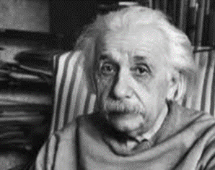
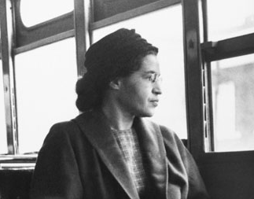
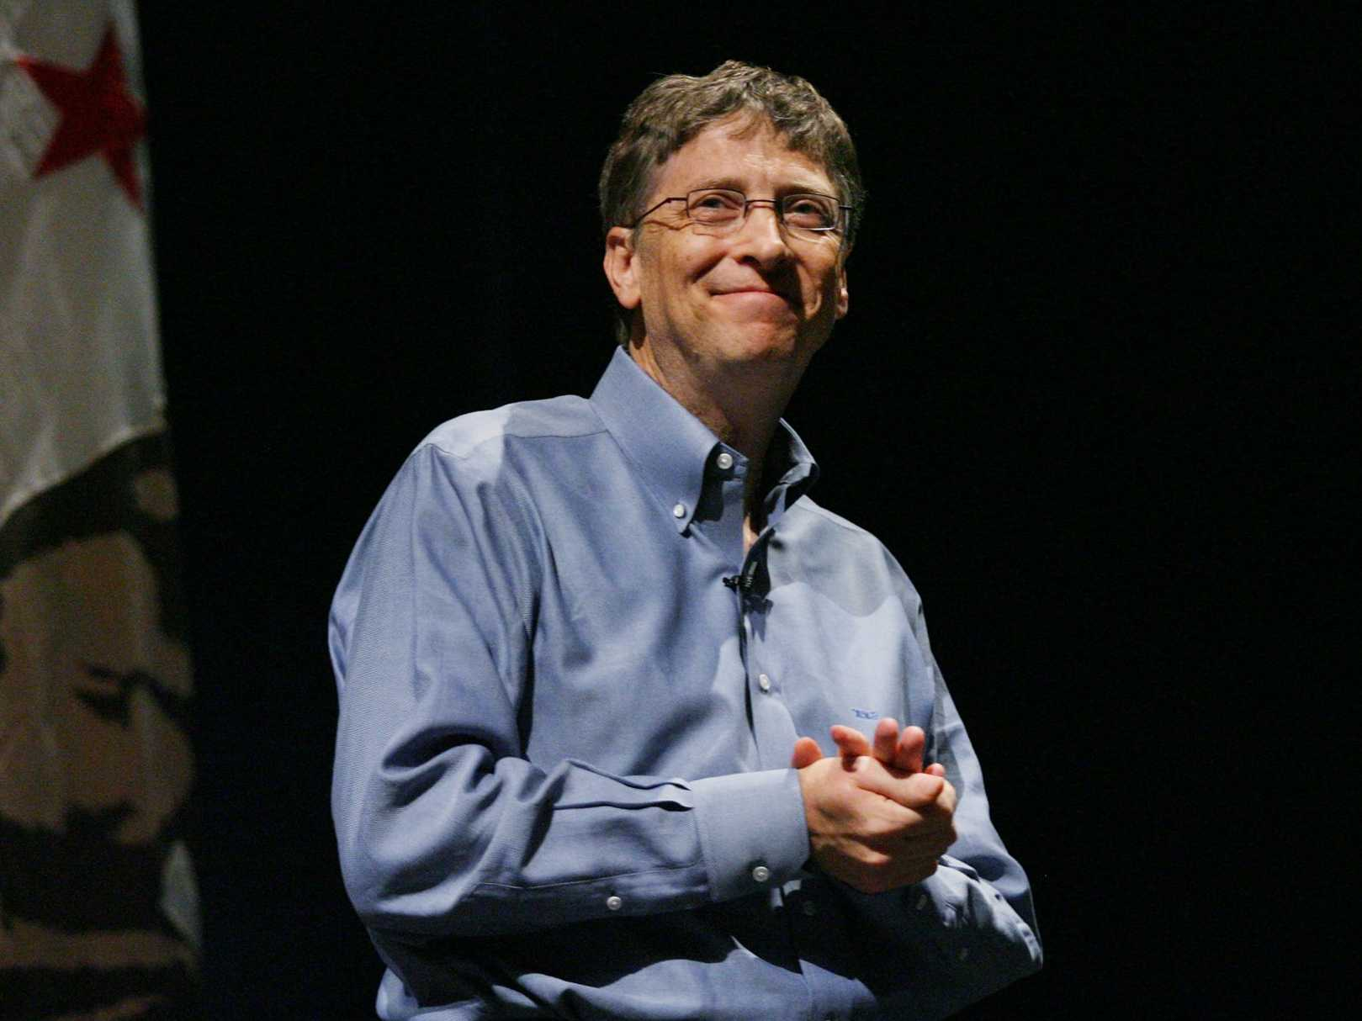
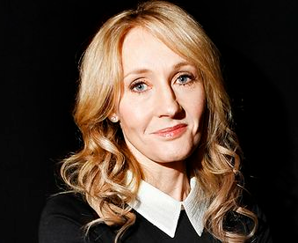

Introverts & Leadership
Do you know of any great introverted leaders?

Slide 31
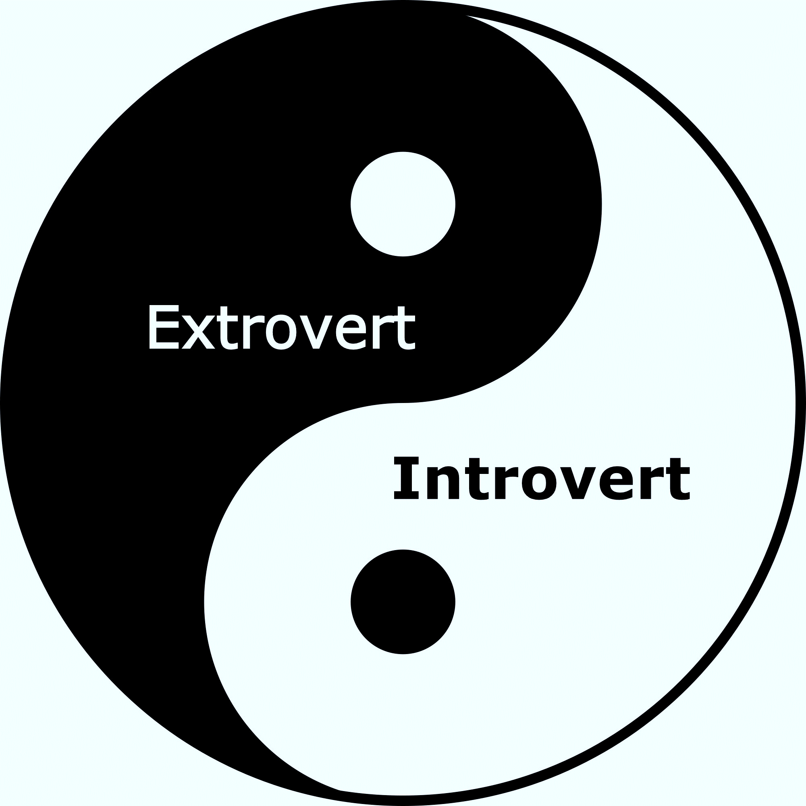
A note about extroverts...
Introversion is not inherently better or worse than extroversion
Both temperaments are needed for an organization to be successful
Extroverts tend to be more comfortable meeting new people, expressing their ideas verbally, and multi-tasking
Extroverts tend to work with what is
Introverts tend to ask what if

Slide 32


Slide 33
Questions?

Slide 34
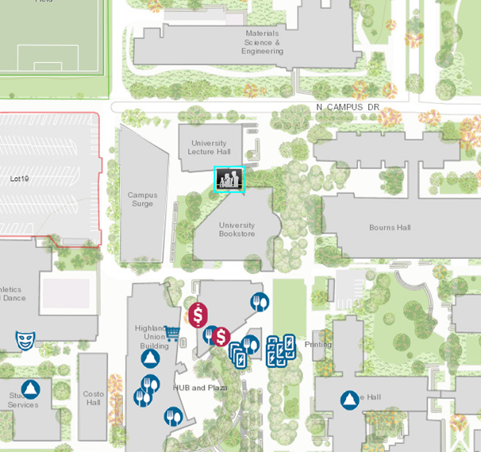
Where Can You Find Us?
Location: We are located in the Career Center Plaza. Our entrance is the University Lecture Hall and the Surge Building, behind the UCR Campus Store.
Hours:
Mon. - Fri. 8 am to 5 pm
except Wed. 9 am to 5 pm
Web Site: careers.ucr.edu
Individual counseling appointments available by calling:
(951) 827-3631
Drop-In Hours:
Mon. - Thurs. 10 am-3pm
Fri. 10 am-12 pm

