Slide 1

Within 3 Years of Enrollments, highest numbers of major switch:
52% of Math Majors
40% Life Science Majors
37% Education Majors
36% Humanities Majors
U.S. Department of Education’s Data Point newsletter in December, 2017

Slide 2
3 Largest UCR Majors in 2018:
Biology
Psychology
Business

Slide 3
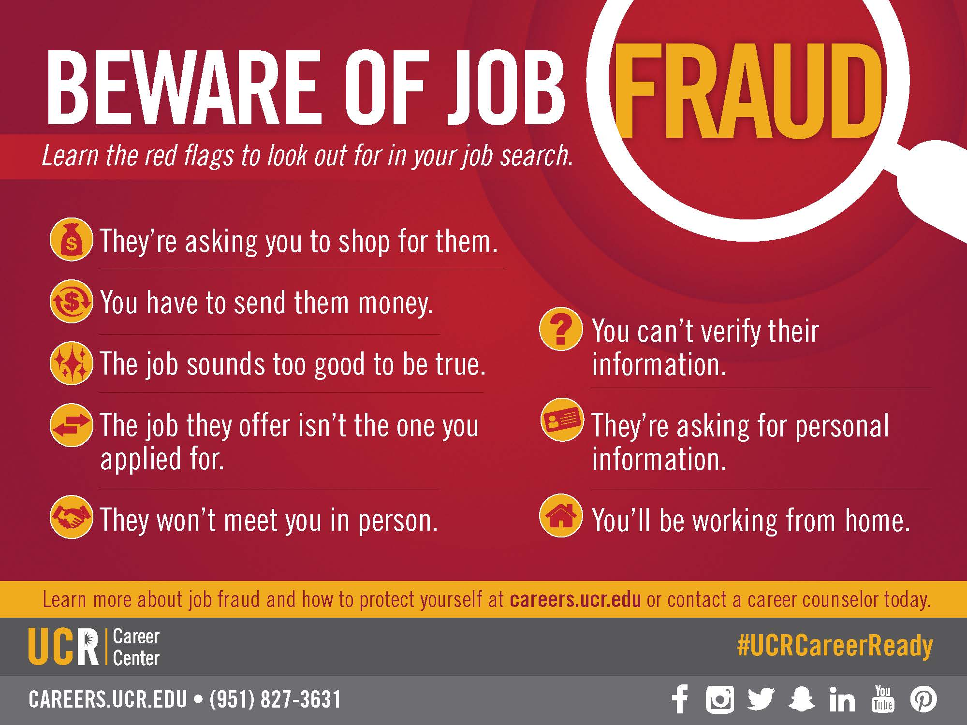

Slide 4


Slide 5

MAKING A MAJOR DECISION
Resources, tips

Slide 6
AGENDA
Major Choice:
Fact or Myth
The Major Planning Process
Career Center & Exploration Resources

Slide 7
Fact or Myth # 1
Making a decision on your major as soon as possible helps you focus on your studies and makes your college experience more satisfying.
Myth

Slide 8
Fact
Early major choice is associated with:
More frequent major change
80% of students change their major at least once
Major exploration can lead to:
Knowledge of all the options
Identifying a major that fits interests and skills
National Center for Education Statistics, 2013, EAB student success collaborative, 2016

Slide 9
Fact or Myth # 2
  Students with non-technical majors have trouble finding jobs because they don't have any marketable skills.
Myth

Slide 10
Fact
    According to the 2014 study on Liberal Arts and Employment:
    “93% of employers agree that candidates’ demonstrated capacity to think critically, communicate clearly, and solve complex problems is more important than their undergraduate major.”
    -Association of American Colleges and Universities
    Employers value non-technical majors and their broad knowledge

Slide 11
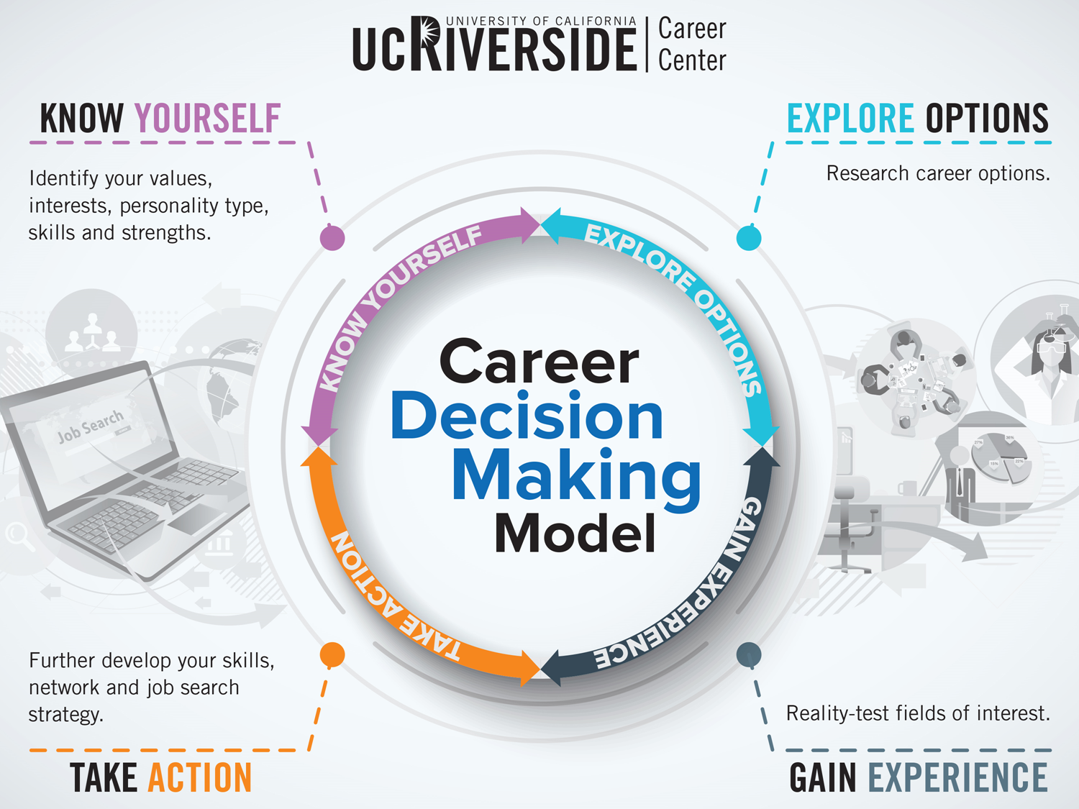

Slide 12
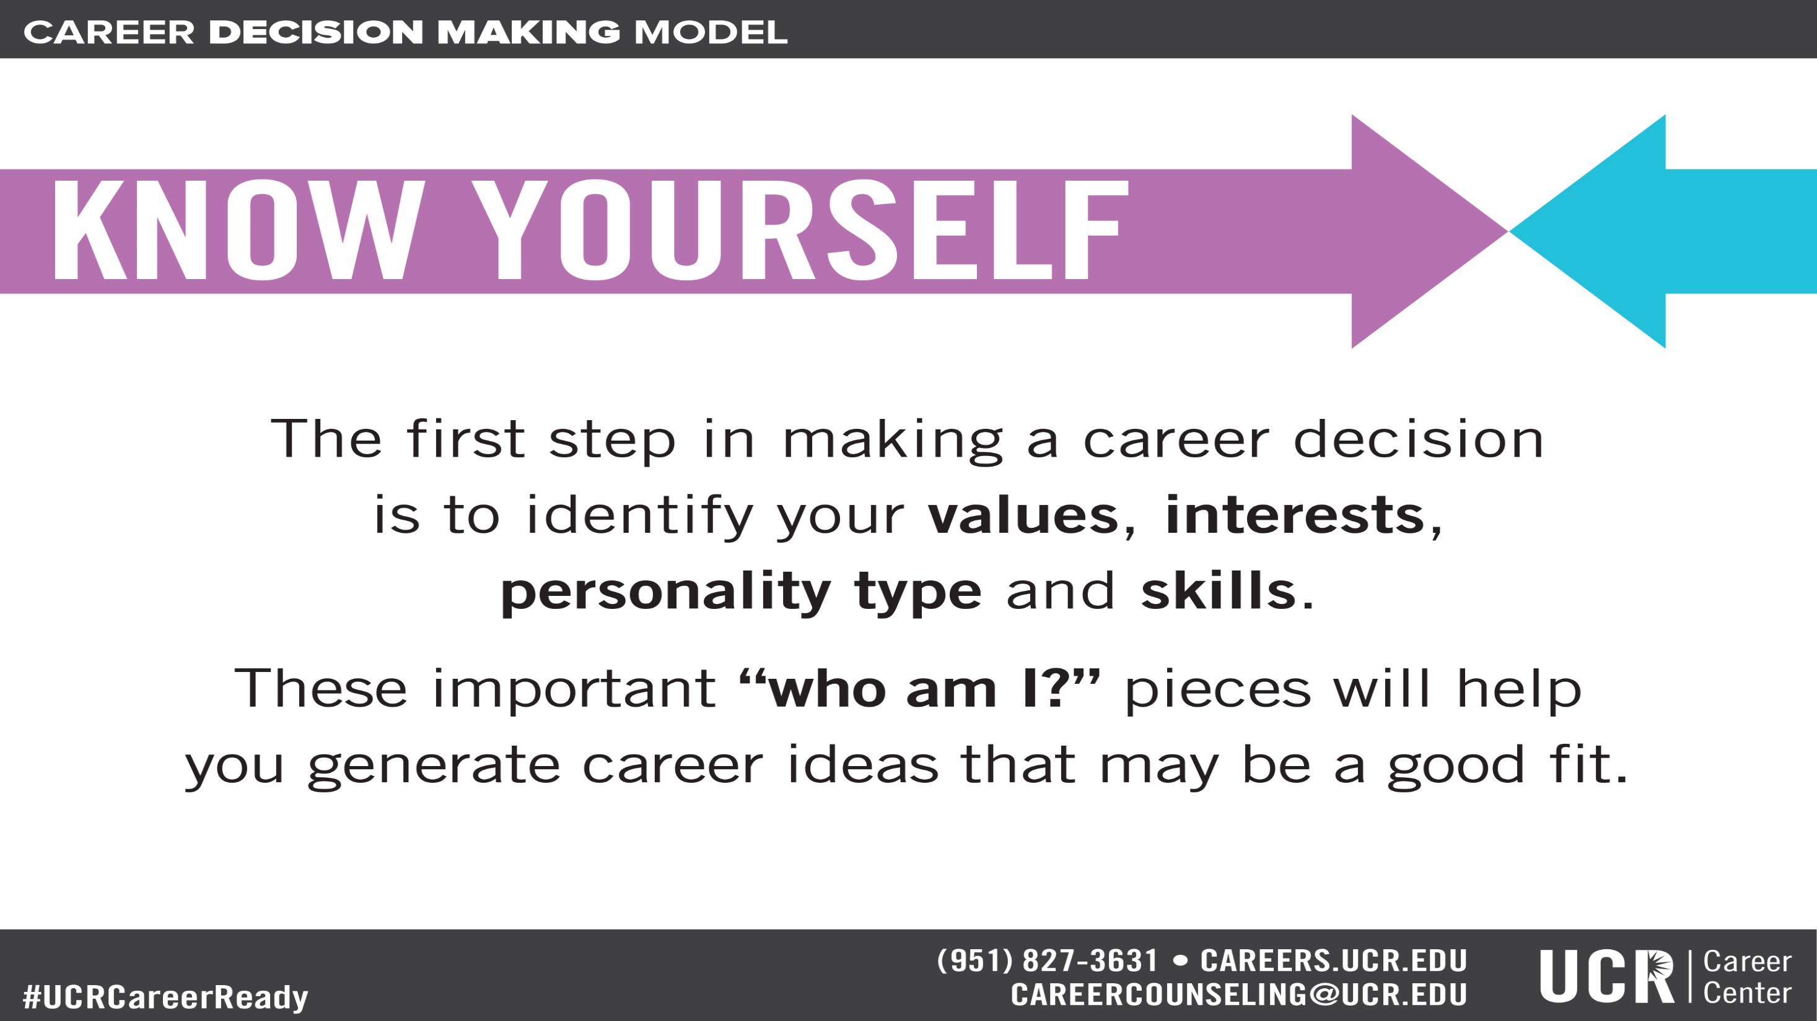

Slide 13
Assessment Tools Available Through Career Center
Strong Interest Inventory
Myers Briggs Type Indicator
Focus 2 (on Handshake)
Career Leader ($20 Fee)
Notes:
Self Assessment is an evaluative process that can help students to learn and understand important elements of their personal style, life values and interests. With the assistance of career counselors, teachers and friends, self assessment gives us an awareness of our strengths and abilities, as well as areas for personal growth and development. Matching these unique characteristics to a potentially satisfying major or career is the first step to more effective career planning.
The Career Center offers several online assessment options to assist students including the Strong Interest Inventory, the Myers-Briggs Type Indicator, Career Leader and Focus 2.

Slide 14

Assess: Who Am I?
Personality
Interests
Skills
Values
Continual Learning
Leadership
Creative
Persuasive
Travel
Public Speaking
Collaboration
Helping Others
Health
Jonathon
Notes:
Let’s practice together!
Share Jonathon as an example with the group. Talk through his personality traits, interests, skills and values. Ask the students to share major ideas that could fit with some or many of these pieces of information about him and write them up on the board.
**The goal is to teach students to assess what they already know about themselves, and learn how to connect it with majors and careers. Students should see that there may be multiple majors that could fit with who they are as a person.
*Activity – If there is time, pass out handout and give students 5-10 minutes to fill it in. Ask them to share their VIPS with family and friends who know them best and brainstorm major/career ideas together! And, meet with a career counselor for help with brainstorming, or to discuss ways to further explore majors of interest!

Slide 15
Activity: Quick Self-Assessment
Personality
Interests
Skills
Values
Notes:
Explain the importance of assessing who you are in terms of personality, interests, values, skills. Provide examples of personality types, interests, values, and skills.

Slide 16

Assess: Focus 2
careers.ucr.edu → UCR Handshake →Resource →Focus 2
Access Code can be found on Handshake
Notes:
Explain the importance of assessing who you are in terms of personality, interests, values, skills. Provide examples of personality types, interests, values, and skills.

Slide 17
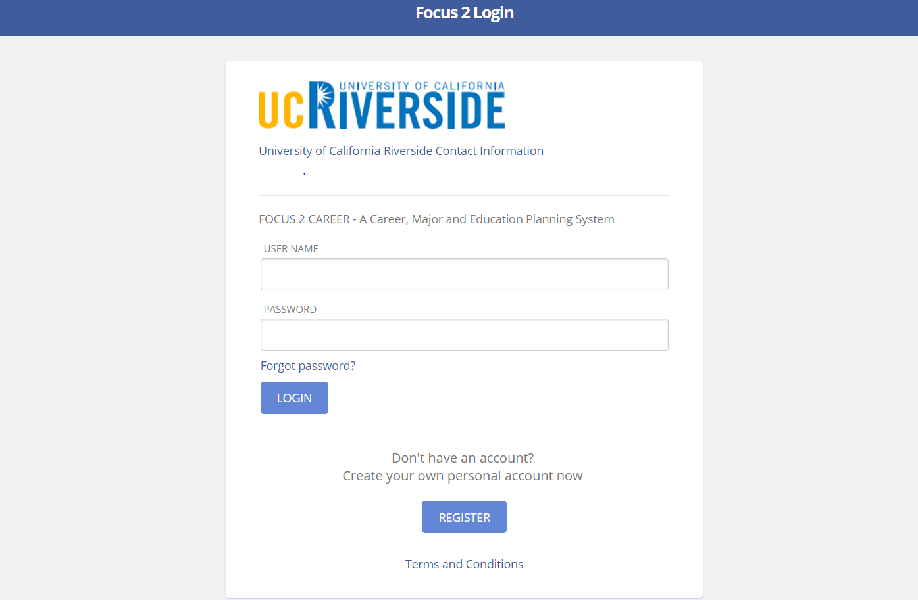

First time user, please create your account here!

Slide 18
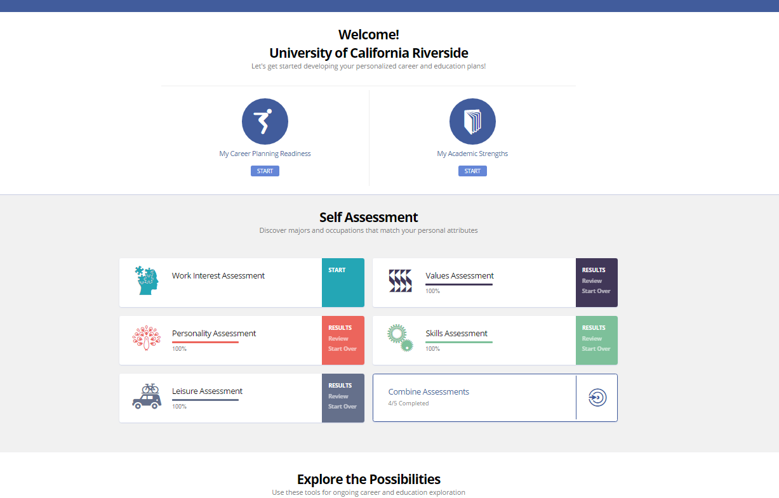

Slide 19
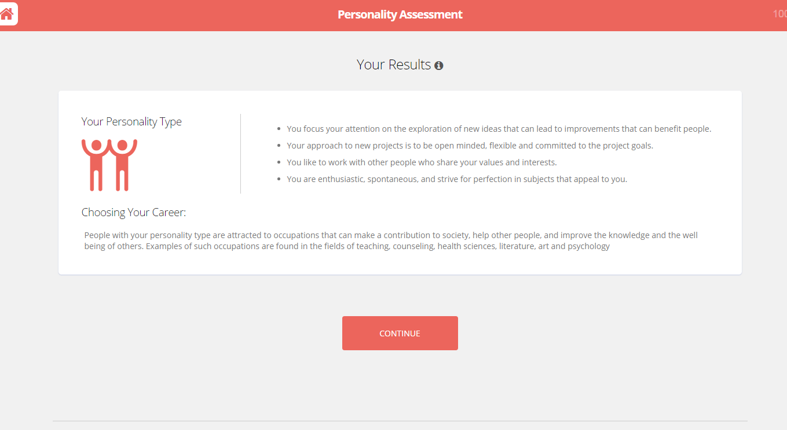

Slide 20
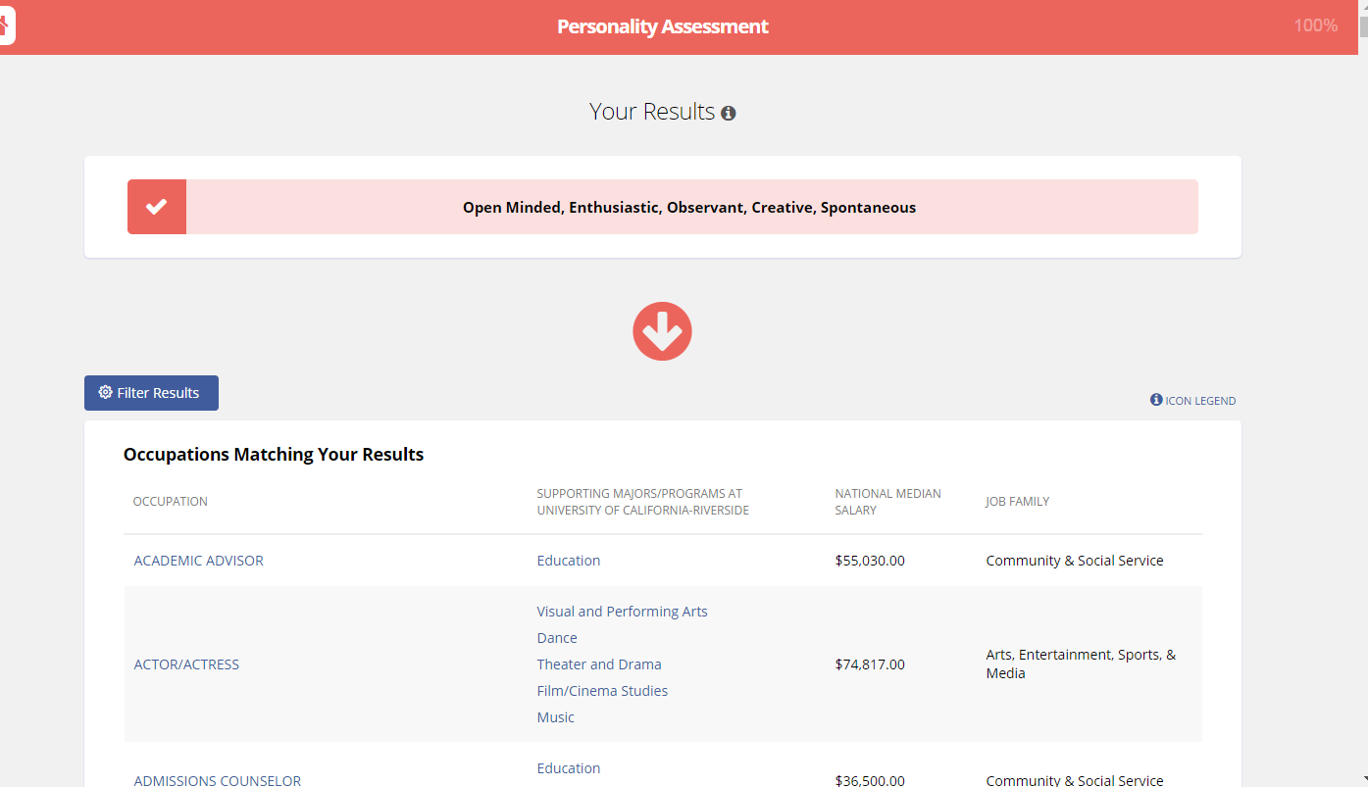

Slide 21
Explore: Major = Career?
Career Specific
Accounting, Engineering, Nursing
Industry Related
-Business Administration, Arts, Theater, Music
Non Career Specific
(Major and Career related by Interest and Skills)
- Sociology, Psychology, Mathematics, Art History

Slide 22
Explore: Ask Questions
Talk to…
  Academic Advisors Grad Students
Faculty Alumni
3rd/4th Year Students Career Counselors
Student Orgs
Look for ways to combine interests through your choice of major(s), minor(s) and areas of concentration
Think about the skills/experiences you would like to gain to complement your major

Slide 23
Add to Your Tool Box
NACE Job Outlook 2018: Top 10 Qualities/Skills
1. Problem Solving | 6. Analytical/Quantitative Skills
2. Ability to work in a team | 7. Communication Skills (Verbal)
3. Communication Skills (Written) | 8. Initiative
4. Leadership | 9. Detail Oriented
5. Strong Work Ethic | 10. Flexibility/Adaptability
NACE: National Association of Colleges & Employers

Slide 24
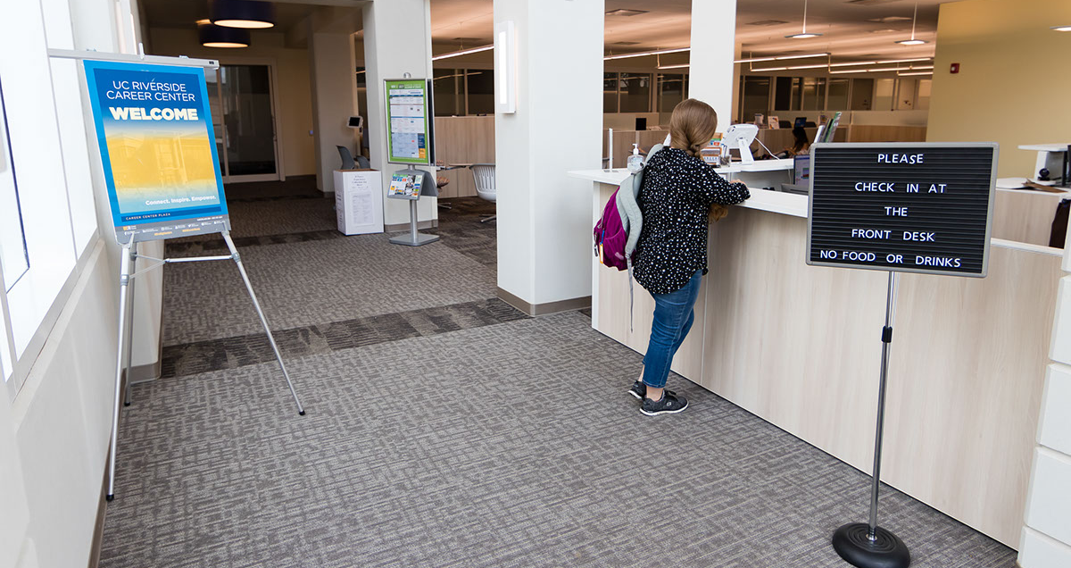
What resources are available??

Slide 25
Career Center Resources
Drop-in hours
Individual counseling
Assessments – Focus 2, MBTI, SII, Career Leader
Occupational Information – Workshops, Panels and Information Sessions, Career Center Library, Career Insider
Internship information
Career Center – Careers in Your Major

Slide 26
Exploration Resources
Course Catalog
  Upper Division Courses
ONET (Occupational Information Network)
http://online.onetcenter.org
OOH (Occupational Outlook Handbook)
http://www.bls.gov/ooh

Slide 27
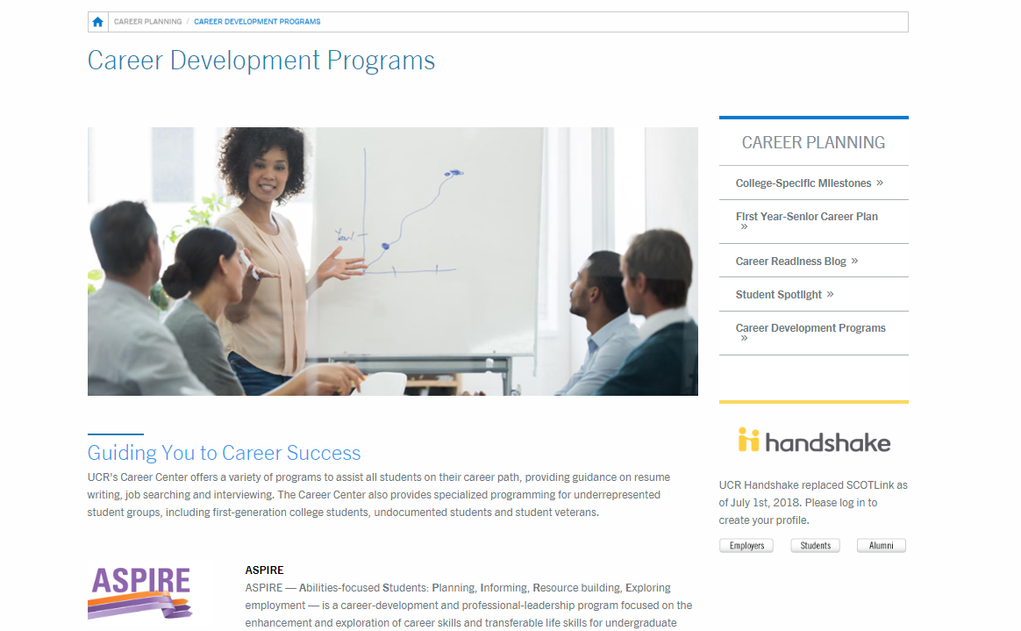
Career Development Programs
Careers.ucr.edu

Slide 28






ASPIRE (Abilities-focused Students: Planning, Informing, Resource building, Exploring employment)
The Butterfly Project (A partnership between the Career Center and Undocumented Student Programs)
Get HIRED (Help International students Reach Employment Destinations)
Internship Success Program
Operation VETS (Veteran, Employment, Transition, Success)
ORBITS (Obtain Resources, Become Informed, Target Success)

Slide 29

More Questions??

Slide 30

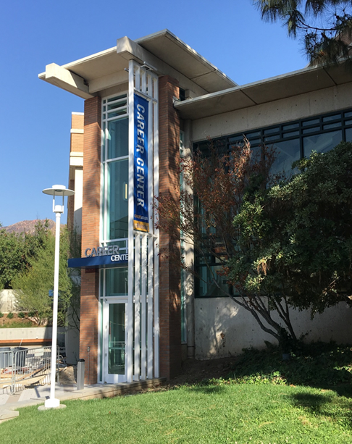
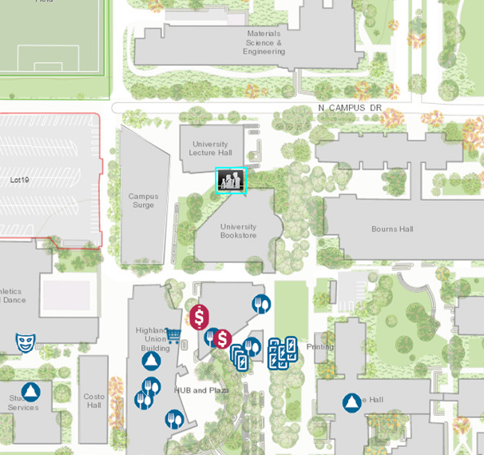
Come See Us!
Hours:
Mon. - Fri. 8 am to 5 pm
except Wed. 9 am to 5 pm
Drop-In Hours:
Mon. - Thurs. 10 am-3pm
Fri. 10 am-12 pm

