Slide 1

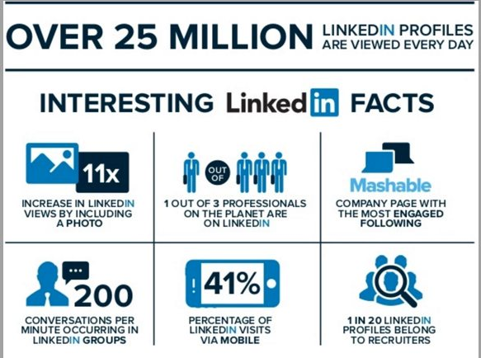
YOUR CONTENT CAN GO
IN THIS AREA

Slide 2
There are currently 89,058+ UCR Alumni on LinkedIn.

Slide 3
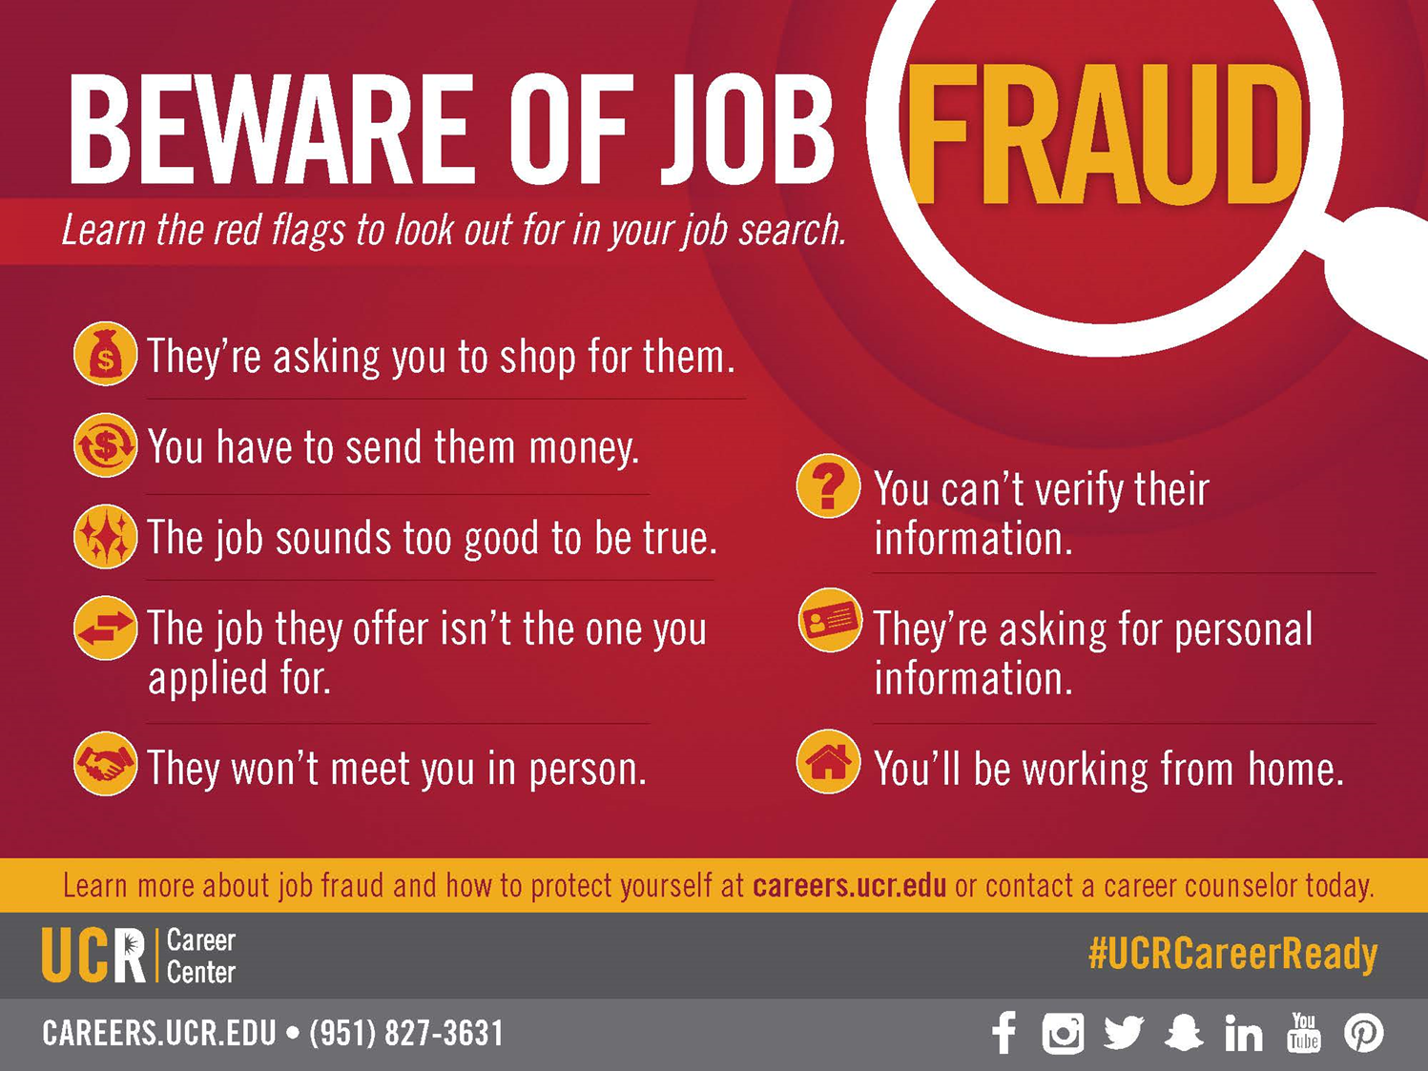

Slide 4
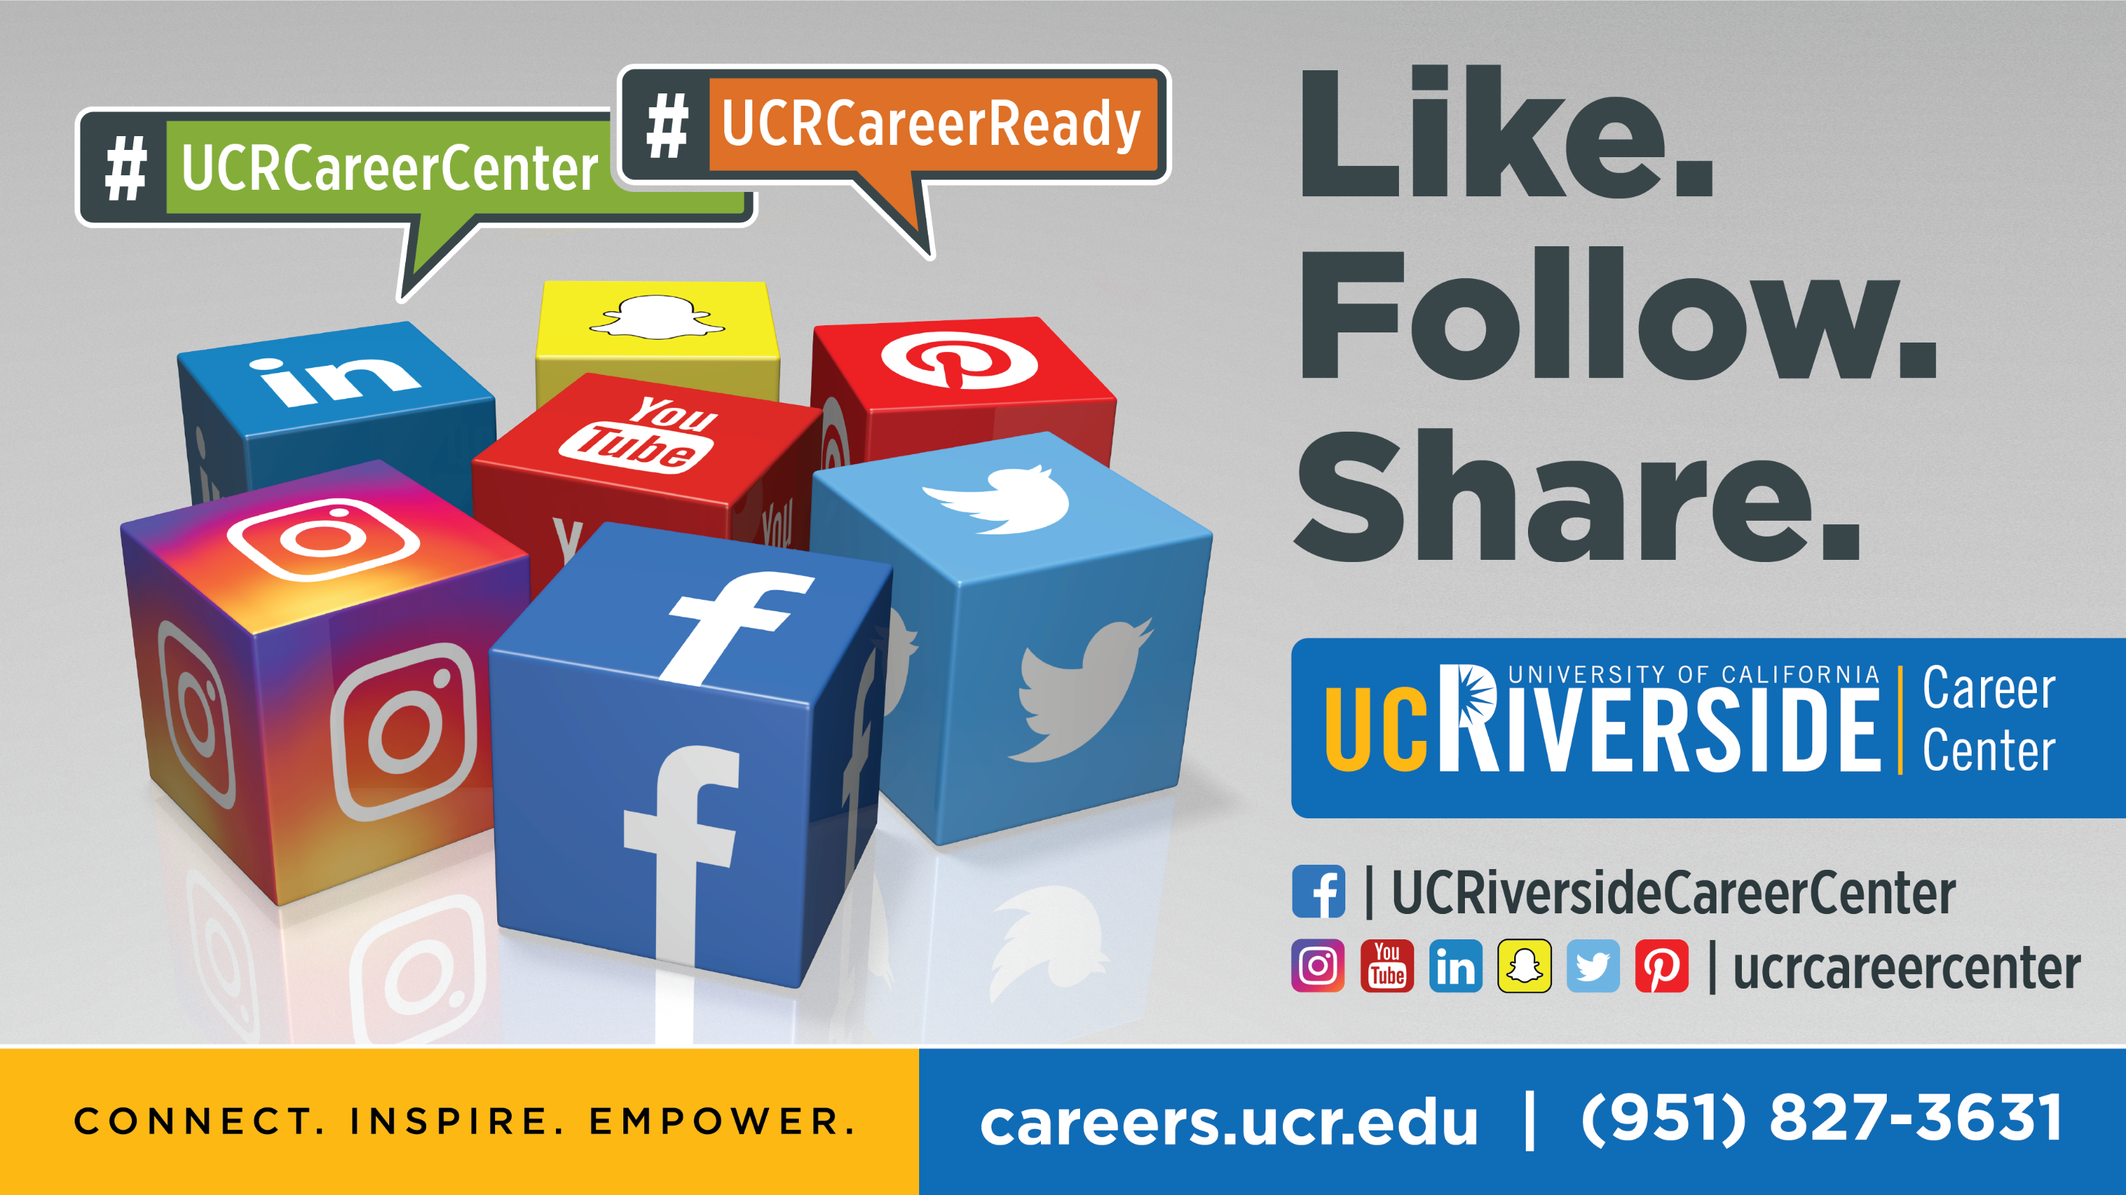

Slide 5

LINKEDIN
Mastering LinkedIn

Slide 6
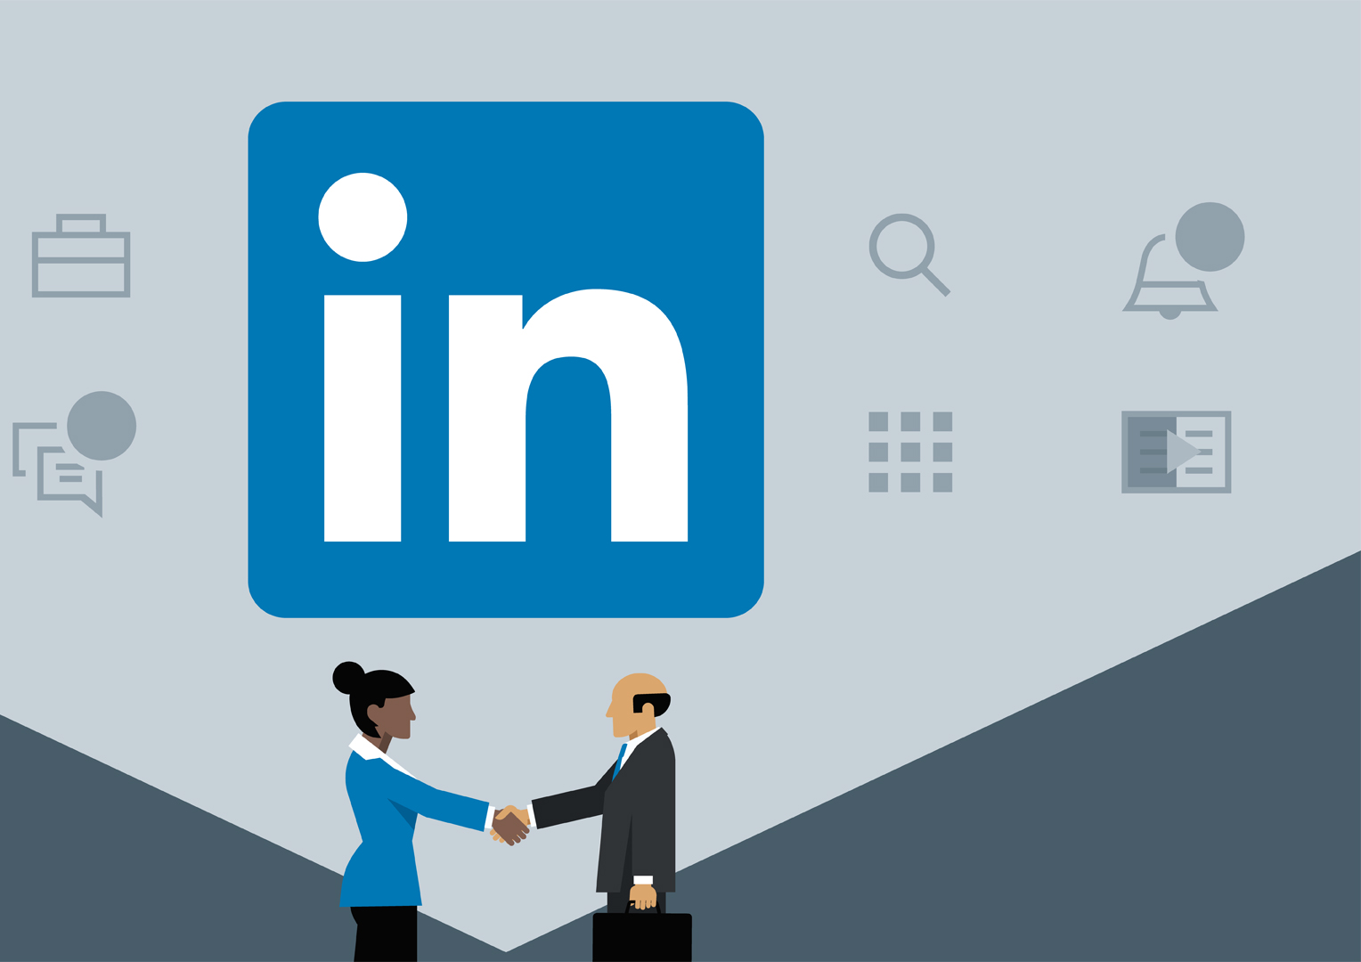
AGENDA
6 MUST have components to make your profile stand out
Additional Profile Enhancing Tips
How to Leverage your network (Activity)
Utilizing the resources to find your next opportunity
Notes:
1. There is a huge, comprehensive network on LinkedIn that includes
20 million+ students & recent grads as of May 2012, fastest growing demographic
37,000 college & university alumni groups
200 million+ professionals
Over 150 industries
Executives from every Fortune 500 firm
2. This extensive network means millions of opportunities to connect by:
Generating leads and joining groups
Researching companies and professionals prior to major events (do your homework)
Establishing and maintaining connections
3. The first thing you need to do: Create your profile! Why? Your LI profile will help you promote yourself, manage your online presence and direct recruiters to the online content you want them to see, and it will allow you to centralize your accomplishments and all social media content in one location. Now we will get into the details of creating your profile so that you are prepared to leverage your network!

Slide 7





Benefits of a LinkedIn Network
40 Million Students & College Graduates
500 Million Professionals
Over 150 Industries
3 Million Jobs Listed
122 Million People Got an Interview from Their Profile
Reference: ADSCODE
Notes:
1. There is a huge, comprehensive network on LinkedIn that includes
20 million+ students & recent grads as of May 2012, fastest growing demographic
37,000 college & university alumni groups
200 million+ professionals
Over 150 industries
Executives from every Fortune 500 firm
2. This extensive network means millions of opportunities to connect by:
Generating leads and joining groups
Researching companies and professionals prior to major events (do your homework)
Establishing and maintaining connections
3. The first thing you need to do: Create your profile! Why? Your LI profile will help you promote yourself, manage your online presence and direct recruiters to the online content you want them to see, and it will allow you to centralize your accomplishments and all social media content in one location. Now we will get into the details of creating your profile so that you are prepared to leverage your network!

Slide 8


Why Create A Profile?
Promote yourself
Centralize your accomplishments
Add another tool to your networking resource kit
Generate leads for opportunities
Join groups
Research company/employee information
Establish and maintain connections

Slide 9

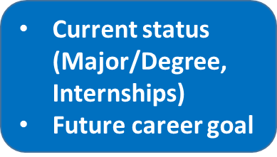
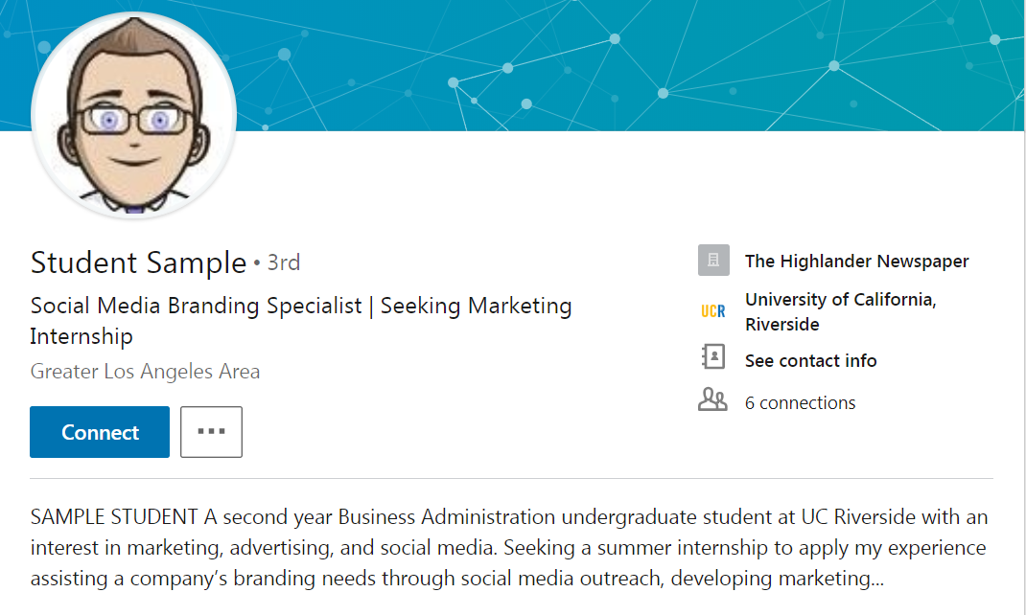
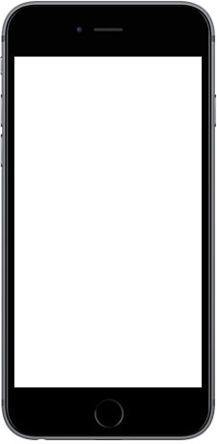
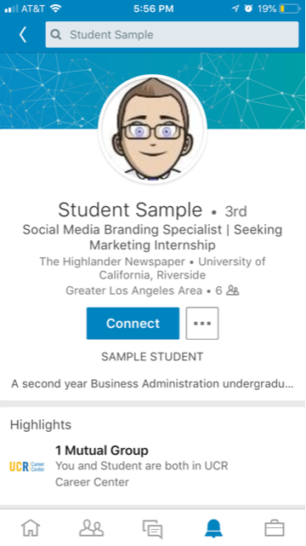

Photo and Headline
Photo Tips
Smile
Business Casual
LinkedIn Booth@ Career Fairs
1
Searchable Content
Notes:
Photo: It doesn’t have to be fancy – just use your cellphone camera in front of a plain background. Wear a nice shirt and don’t forget to smile!
Headline: Tell people what you are excited about now and the cool things you want to do in the future

Slide 10
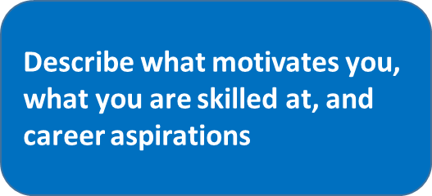
Summary
2
SAMPLE STUDENT
A second year Business Administration undergraduate student at UC Riverside with an interest in marketing, advertising, and social media. Seeking a summer internship to apply my experience assisting a company’s branding needs through social media outreach, developing marketing plans, digital marketing, and conducting customer research.
Specialties
•Event planning
•Social networking and marketing
•Account management
• Microsoft Offices (Word, PowerPoint, Excel)
• Adobe CS5.5 Suite (Photoshop, Flash)

Slide 11

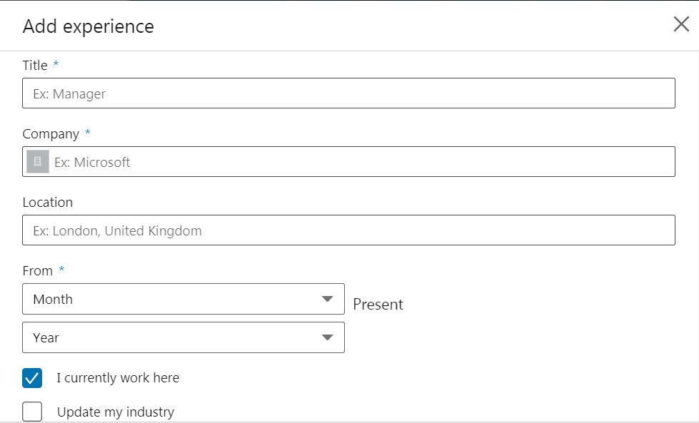
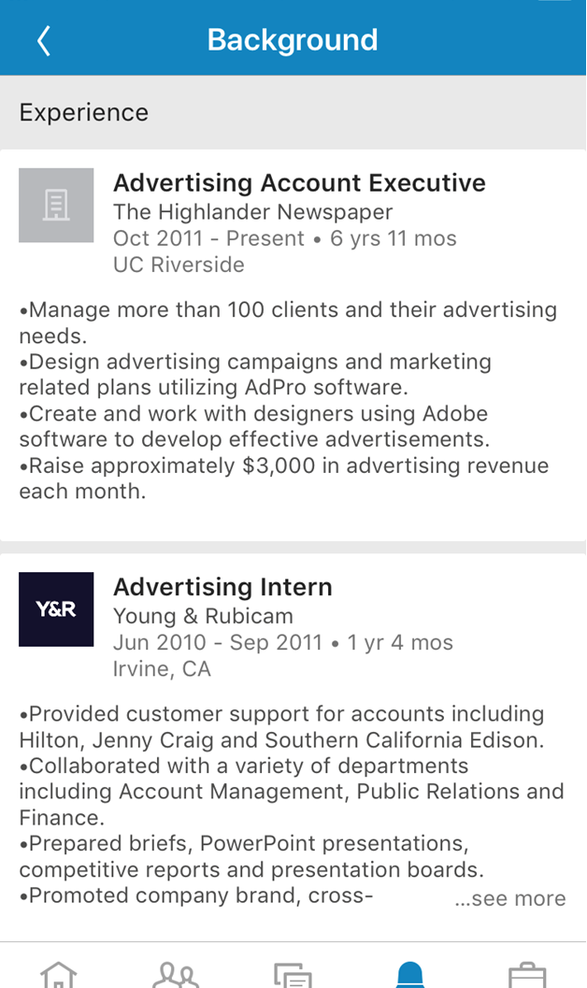
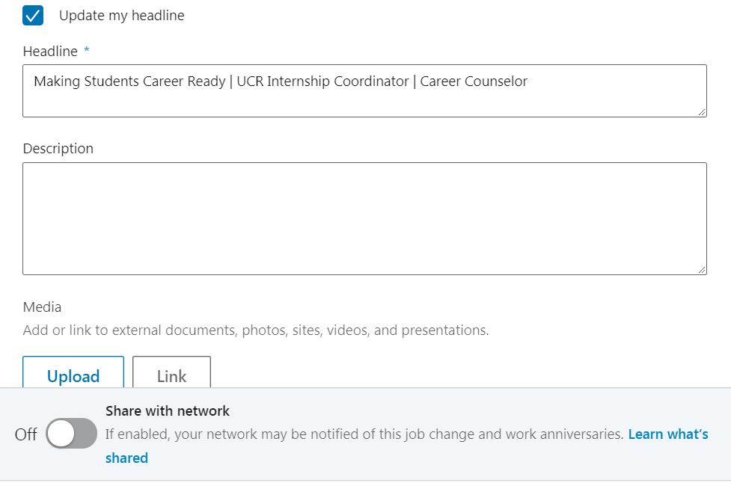

Experience
3
Current and previous experiences
Accomplishments
Attach photos, presentations and videos

Slide 12
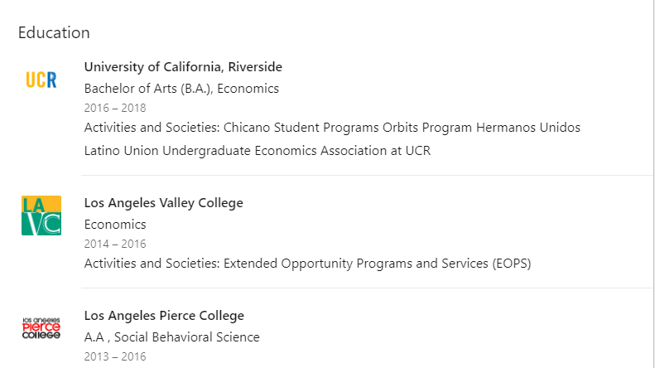
4
Starting with college, list
all the educational experiences you've had - including summer programs.
Education

Slide 13
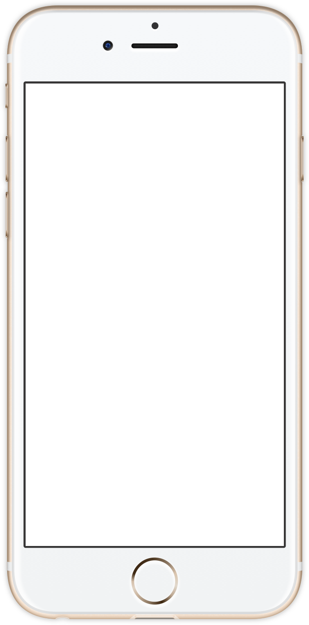

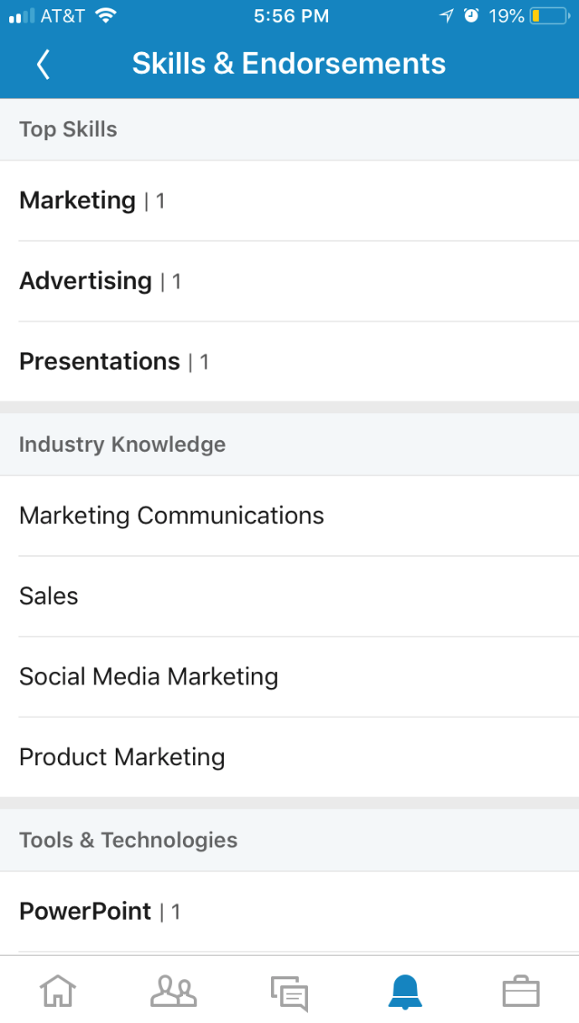
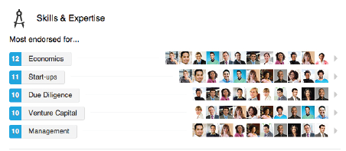

5
Skills & Expertise
Add at least 5 key skills. This will allow your connections to endorse you for those skills.

Slide 14
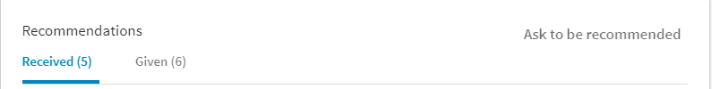
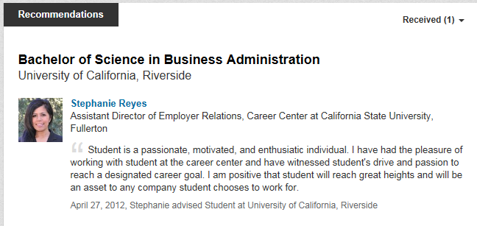
6
Recommendations
Can be found at the bottom of connections page
Ask managers, professors, or classmates who've worked with you
closely to write a recommendation.
This gives extra credibility to your strengths and skills.

Slide 15
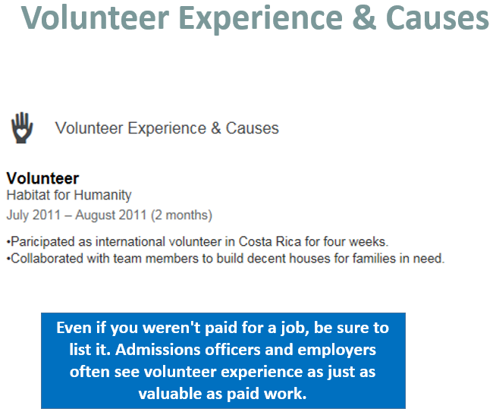
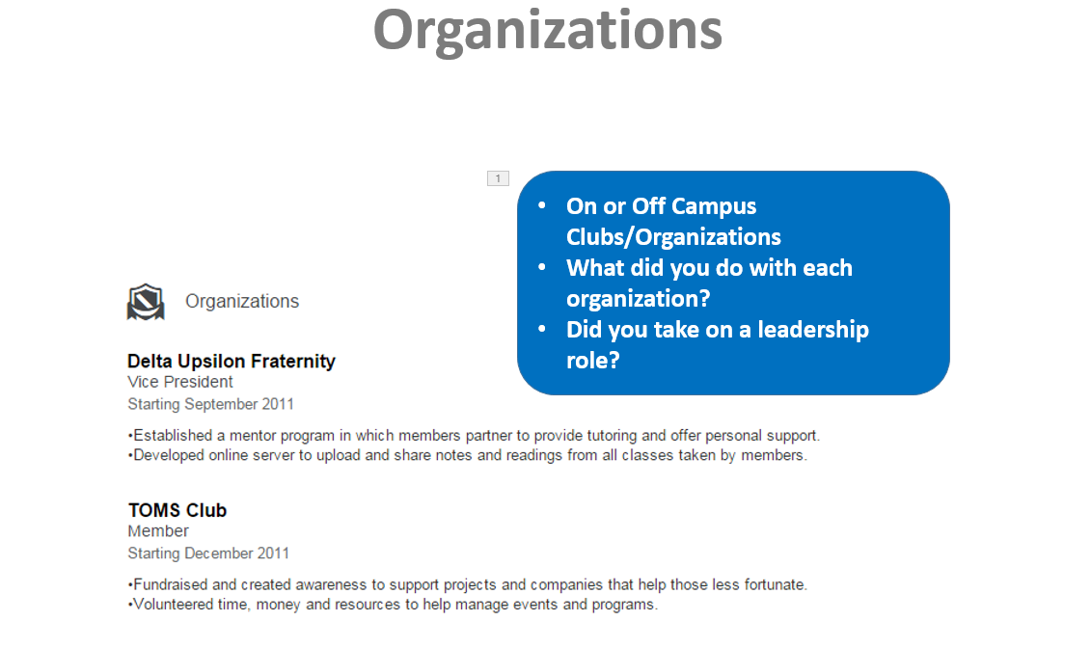
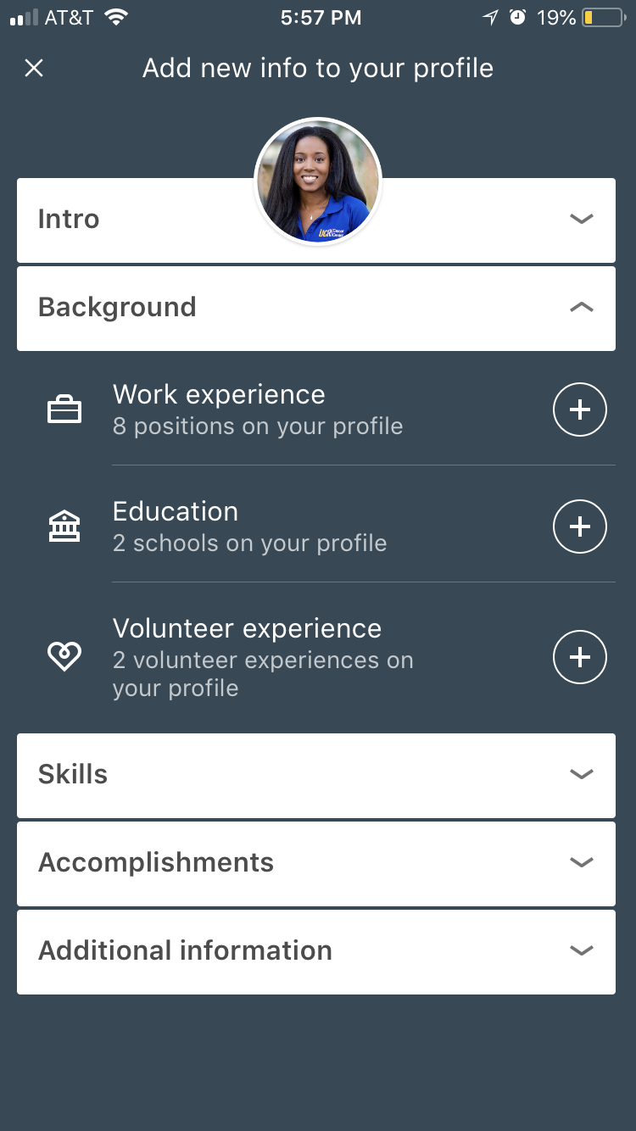
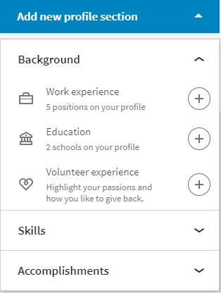
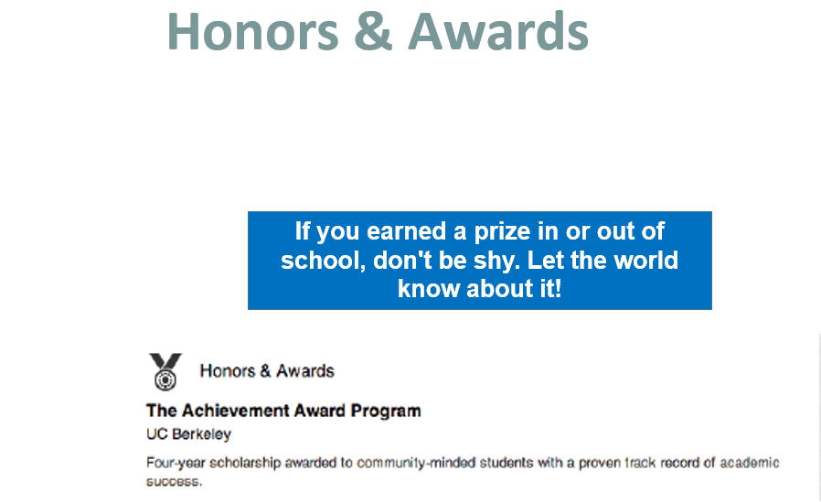
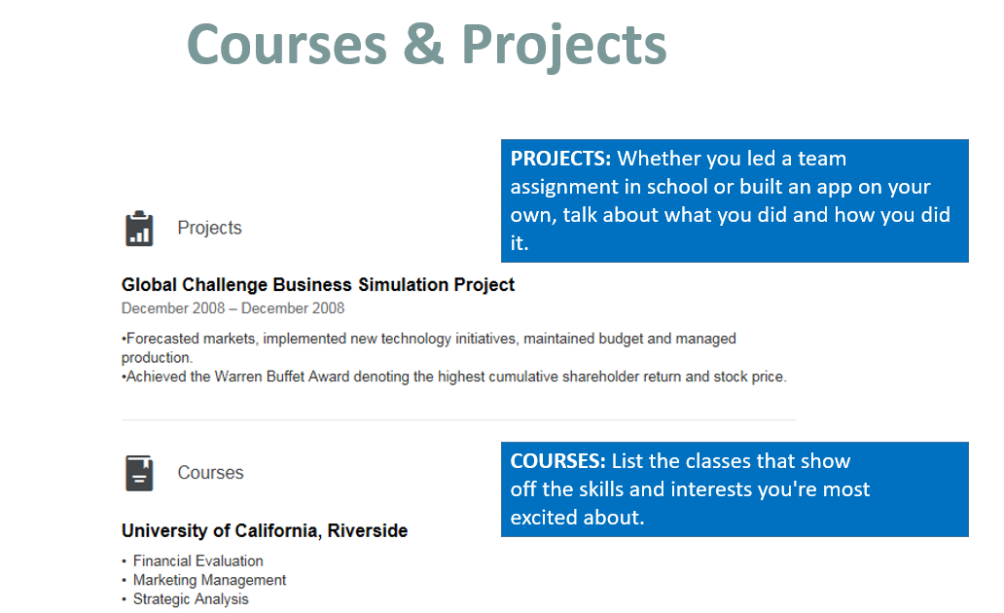
Profile Enhancing Tips
PROJECTS: Whether you led a team assignment in school or built an app on your own, talk about what you did and how you did it
COURSES: List the classes that show off skills and interests you’re most excited about

Slide 16

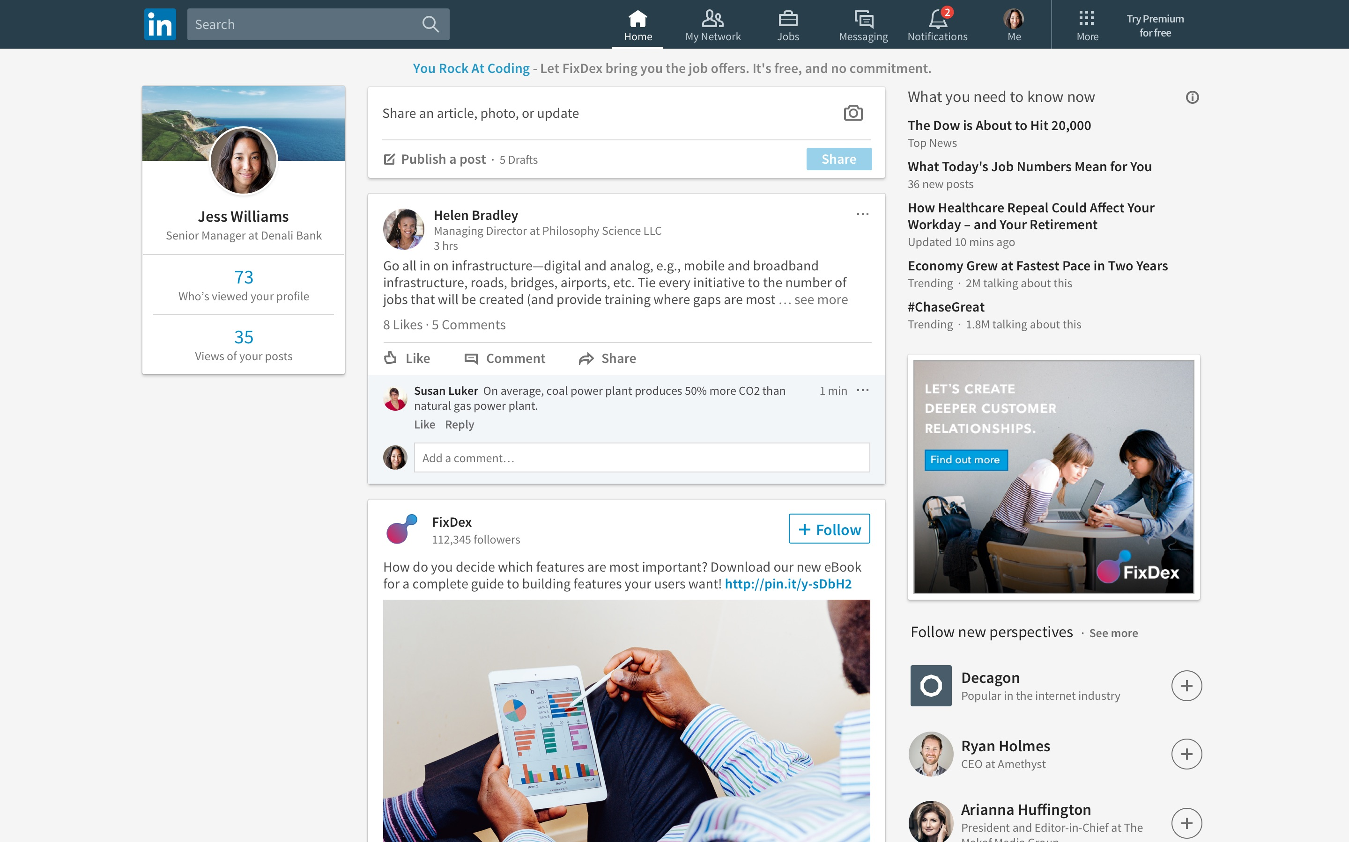
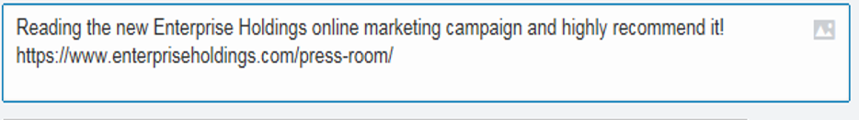
The “Home” Page
Share articles, tag companies and people
People who share updates regularly are 41% more likely to be contacted through LinkedIn
See new jobs posted, like & share connections’ updates
Notes:
Utilize your home page to maximize your LinkedIn profile views, and be in the know when new jobs are posted. By consistently sharing articles and status updates you will continuously show up in your connections’ “news feed” prompting them to potentially view your profile or endorse your skills via your profile page. Which should be one of your goals to begin leveraging your LinkedIn account in your job search.
Share the love- Show your connections you care, and are interested in what they have to say by liking and sharing their updates. They most likely will return the favor.
Stay relevant, but not annoying to your connections. You don’t need to post, share, or like an article every hour of the day. Keep it to maybe every two days if you are actively pursuing your job search. Otherwise 1-2 times a week is fine to stay current with your connections.

Slide 17
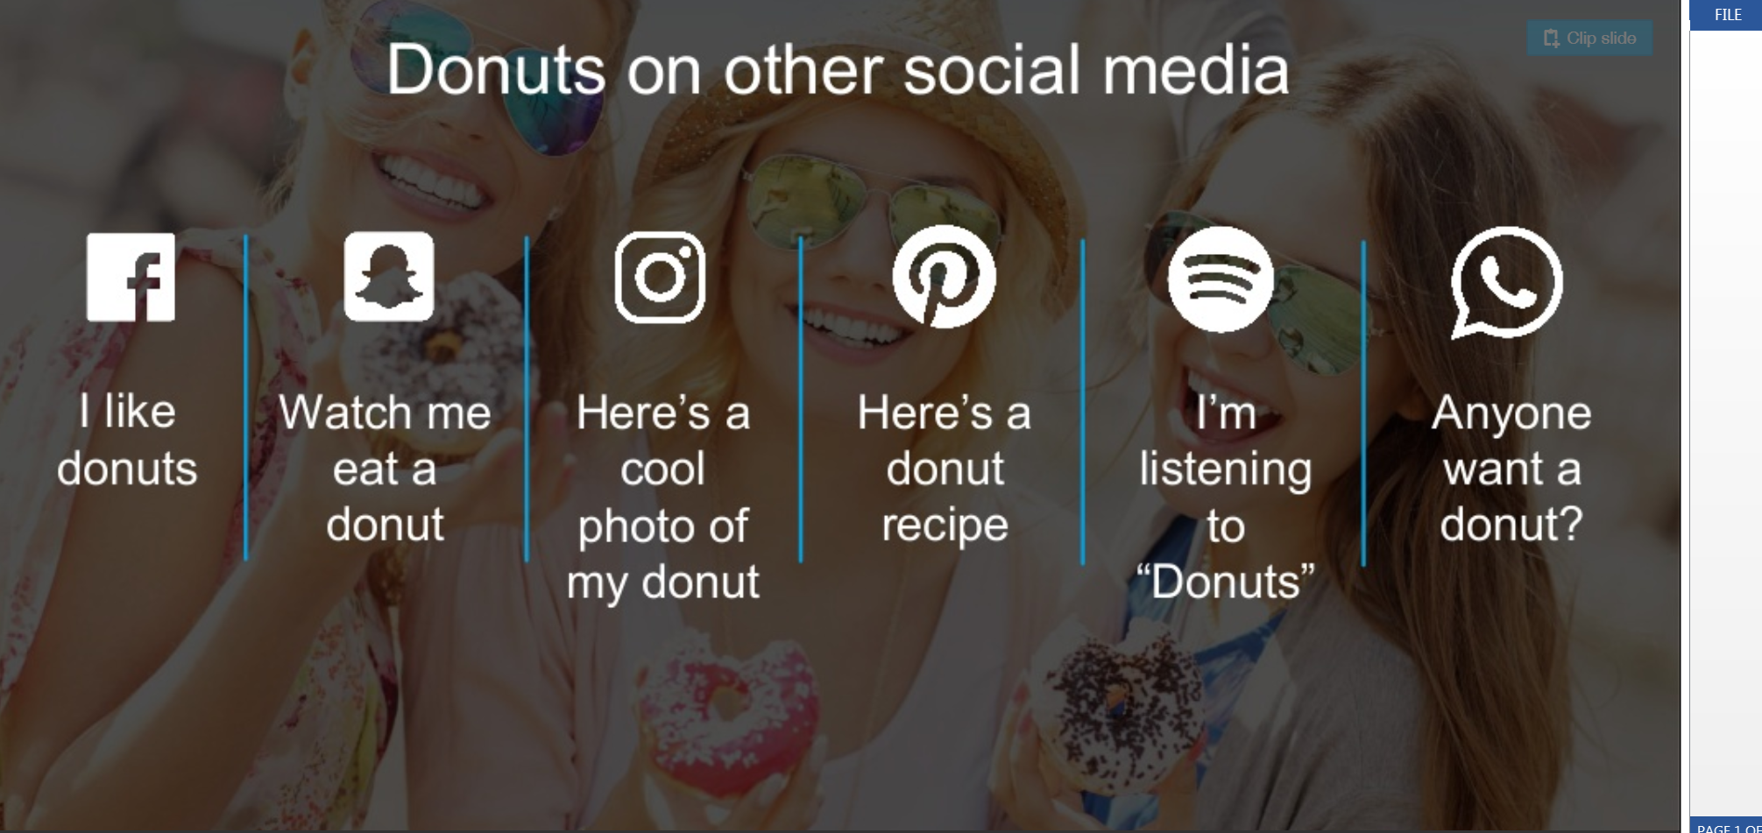
Know The Difference
Status Updates on Your Personal/Social Profiles

Slide 18
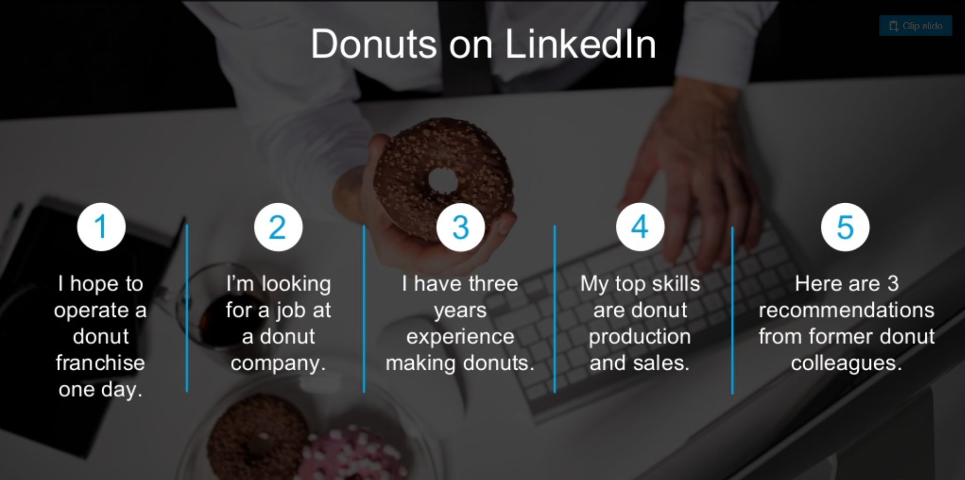
Know The Difference
Status Updates on LinkedIn

Slide 19
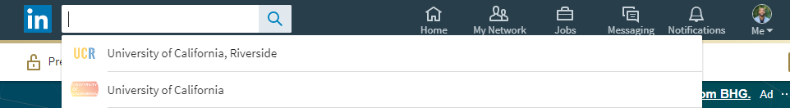
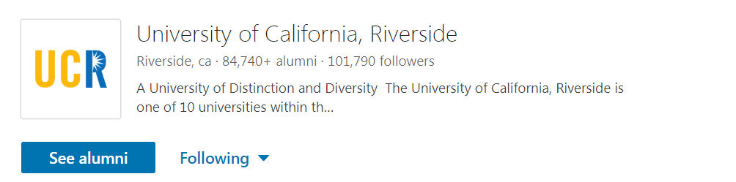

Find Alumni
Notes:
ALUMNI!!! – LinkedIn has a new feature called University Pages. Not only can you find alumni, but you can connect with alumni who are pursuing a career path of interest to you and find alumni who had a similar major as you currently have. Alumni always love to give back so why not begin your network there.
Check out alumni profiles to discover how other students with similar majors, areas of study, and career interests landed in their current position.
Contact alumni for “informational interviews”
Get the inside scoop on company culture and the interview process from alumni working at companies of your interest
Get introduced to 3rd connections by having alumni connections “introduce you”

Slide 20
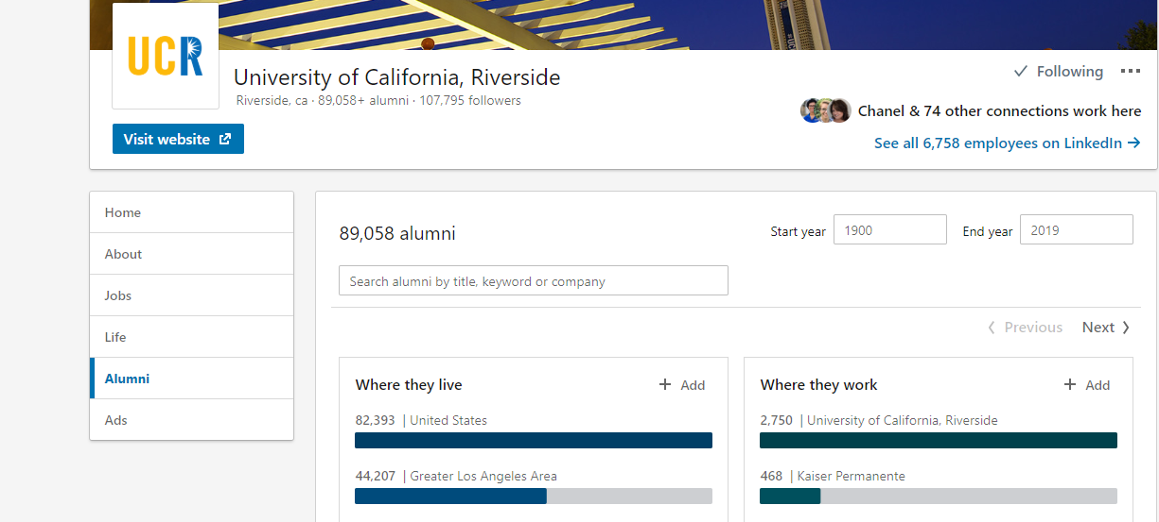
Find Alumni
Notes:
Adding connections is another important goal to have in leveraging your LinkedIn account. Without connections you aren’t networking, you’re not getting your name out there, and you’re not in the know with your industry of interest.
Most common question: So how do I add connections if I don’t know any professionals???
Friends, family, and co-workers are a great way to start adding connections. LinkedIn will check your existing email accounts to see if any of your current email connections are on LinkedIn. If they are you have the ability to choose who you would like to connect with.
ALUMNI!!! – LinkedIn has a new feature called University Pages. Not only can you find alumni, but you can connect with alumni who are pursuing a career path of interest to you and find alumni who had a similar major as you currently have. Alumni always love to give back so why not begin your network there.
Make it a goal to add 5-10 new connections a week if you are actively pursuing a job.

Slide 21
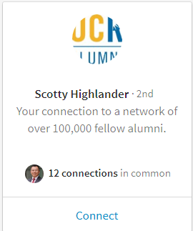
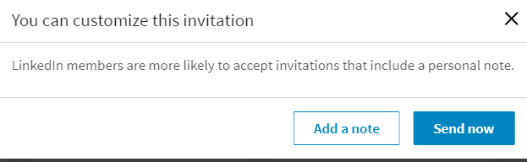
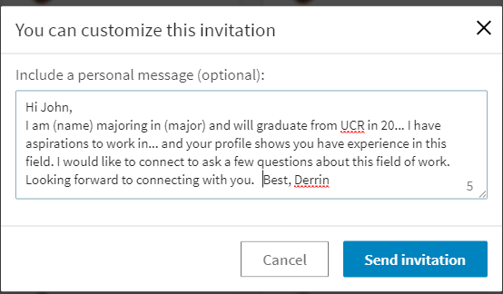


Personalize It!
Notes:
Personalized message vs. Generic message
Use the connection message as a follow up method when meeting professionals at workshops, conferences, career fairs, or other networking events.
Find recruiters at companies you have applied to and follow up to find out if they received your resume.

Slide 22

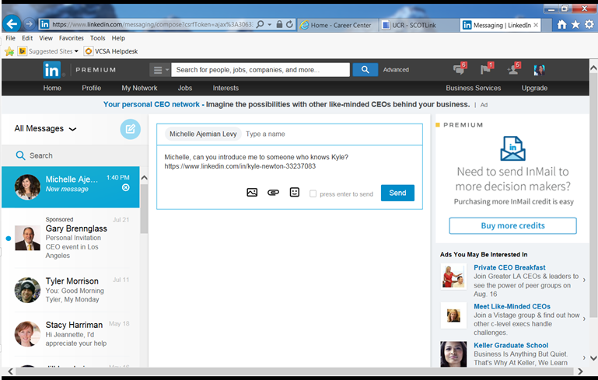
Get Introduced
Increase chances of getting new connections by being introduced
By-pass the 300 characters limit.
Be able to elaborate through an inbox message
Notes:
Personalized message vs. Generic message
Use the connection message as a follow up method when meeting professionals at workshops, conferences, career fairs, or other networking events.
Find recruiters at companies you have applied to and follow up to find out if they received your resume.

Slide 23
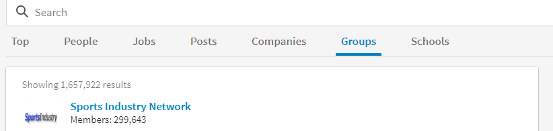

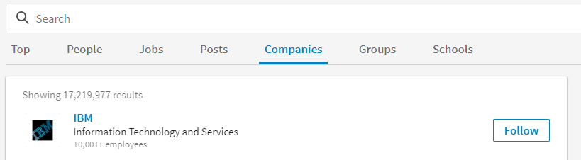
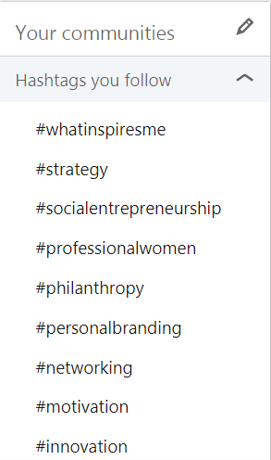
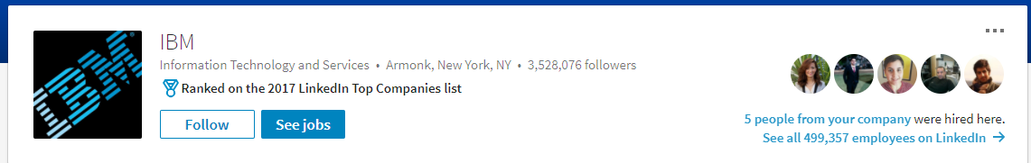

Leveraging Enhancing Tips
Join Groups
Follow Companies
TIP: You Can Send a Direct Message to Any Professional You Are in a Group With
Job Leads
Follow Hashtags
The more companies you follow the more leads you get, and it will being to populate your home page with affiliated companies
Notes:
LinkedIn Groups are a wonderful place to connect with students and professionals in your career field, keep up-to-date on the latest topics and news in your industry.
Search for groups by keywords or let LinkedIn recommend groups you may be interested based on your profile!

Slide 24

Utilizing Resources for Your Next Opportunity
Utilizing Resources for Opportunities
Traditional Job Search vs. LinkedIn Job Search
LinkedIn Job Search
Informal
Multiple opportunities to connect or be connected with recruiters or talent acquisitions
Notes:
Use the Advanced Search feature to:
-Search for Recruiters, Professionals, and Alumni in your industry or company of interest
-Connect for the purpose of conducting an information interview and/or as part of the job search
-Research by looking at a professional’s profile to see what combination of education and experience got them to the position they are in today! When writing a cover letter, use LinkedIn to find the specific hiring manager for the job you are applying to, and then personalize your cover letter. And, in preparation for an interview, research the professionals you will be interviewing with.
**Notice that recruiters and professionals have their industry specific keywords in their headings and profiles… that is how you found them! Be sure to include keywords for your target industry in your heading and profile so that recruiters and professionals can find you too!

Slide 25
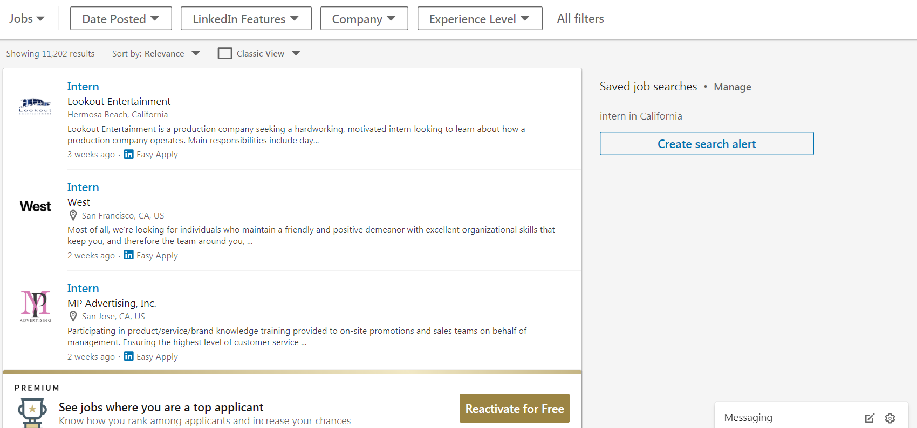
Job Search Tools
Notes:
Use the Advanced Search feature to:
-Search for Recruiters, Professionals, and Alumni in your industry or company of interest
-Connect for the purpose of conducting an information interview and/or as part of the job search
-Research by looking at a professional’s profile to see what combination of education and experience got them to the position they are in today! When writing a cover letter, use LinkedIn to find the specific hiring manager for the job you are applying to, and then personalize your cover letter. And, in preparation for an interview, research the professionals you will be interviewing with.
**Notice that recruiters and professionals have their industry specific keywords in their headings and profiles… that is how you found them! Be sure to include keywords for your target industry in your heading and profile so that recruiters and professionals can find you too!

Slide 26
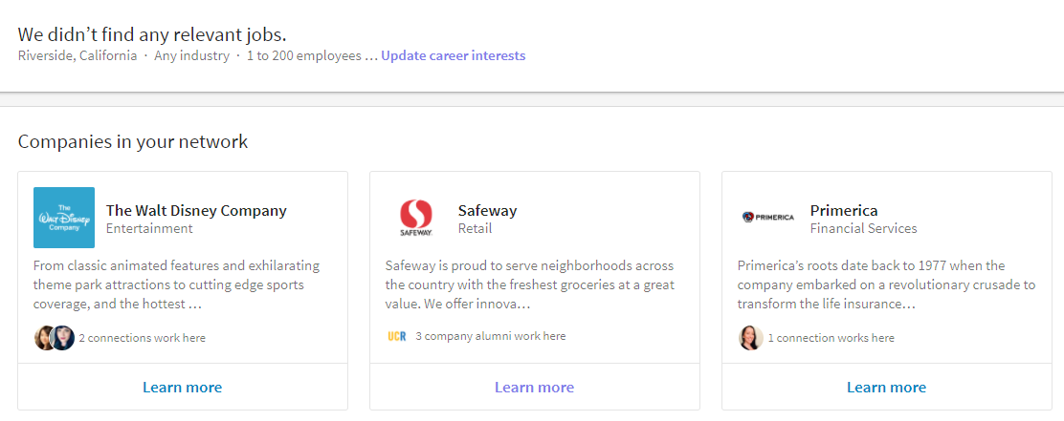

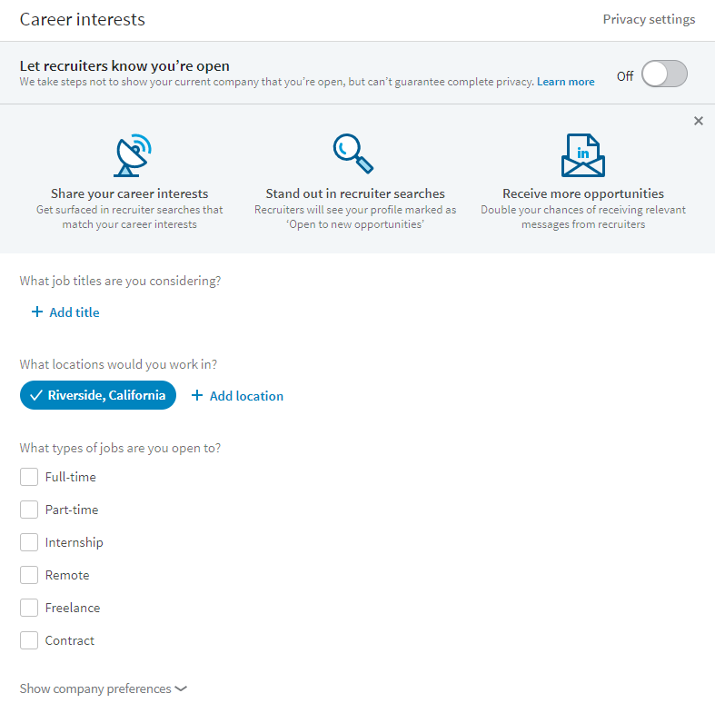



Job Search Tools
Populate your relevant job searches
Increase your chances of landing a job by using your network
Notes:
Use the Advanced Search feature to:
-Search for Recruiters, Professionals, and Alumni in your industry or company of interest
-Connect for the purpose of conducting an information interview and/or as part of the job search
-Research by looking at a professional’s profile to see what combination of education and experience got them to the position they are in today! When writing a cover letter, use LinkedIn to find the specific hiring manager for the job you are applying to, and then personalize your cover letter. And, in preparation for an interview, research the professionals you will be interviewing with.
**Notice that recruiters and professionals have their industry specific keywords in their headings and profiles… that is how you found them! Be sure to include keywords for your target industry in your heading and profile so that recruiters and professionals can find you too!

Slide 27
A modern, on-the-go platform designed especially for college-based recruiting for jobs, internships, events and resources.
Students gain access to job/internship postings from 200,000+ employers around the world, including all Fortune 500 companies!
Employers enjoy a faster, more user-friendly experience to post jobs and view applicants.

Slide 28
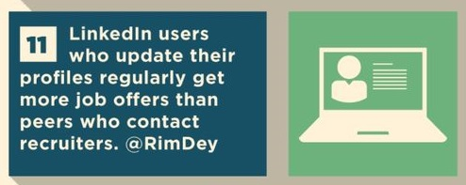
Take It Off Line
Did you know that approximately 70% of jobs are filled through networking?
Consider:
Information Interviews
Coffee/Lunch
Mixers
On-campus panels, career fairs and information sessions

Slide 29
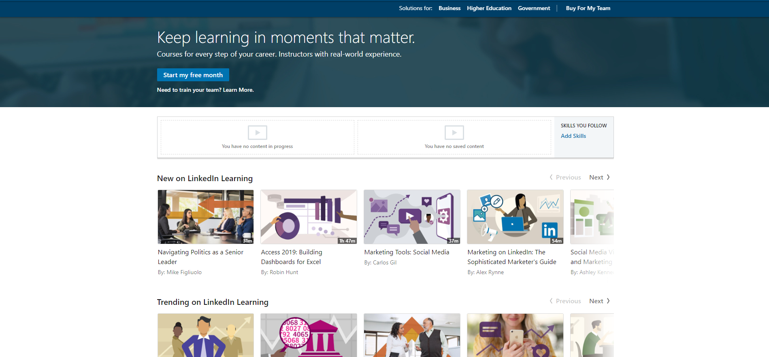


Slide 30
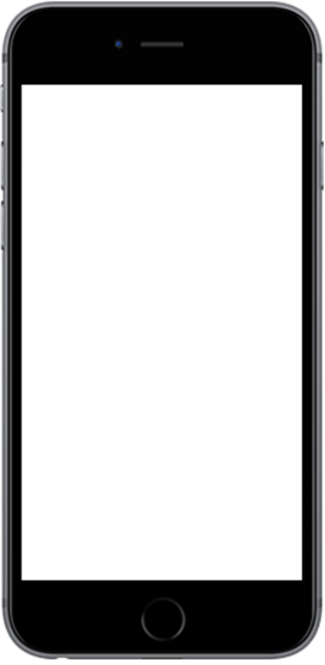




Who's in the room networking activity
Notes:
Photo: It doesn’t have to be fancy – just use your cellphone camera in front of a plain background. Wear a nice shirt and don’t forget to smile!
Headline: Tell people what you are excited about now and the cool things you want to do in the future

Slide 31

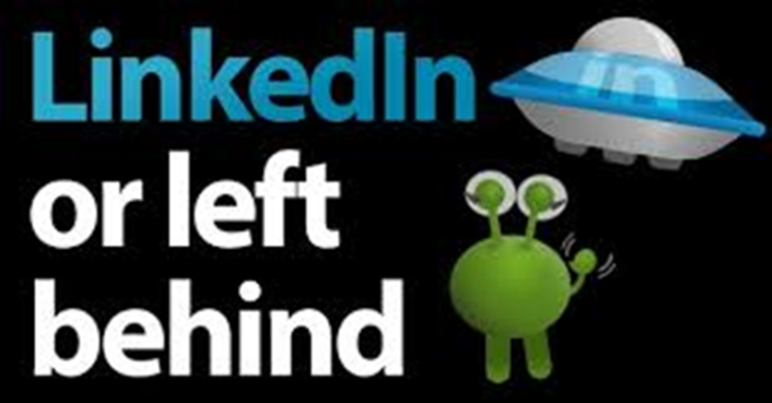
Questions?

Slide 32

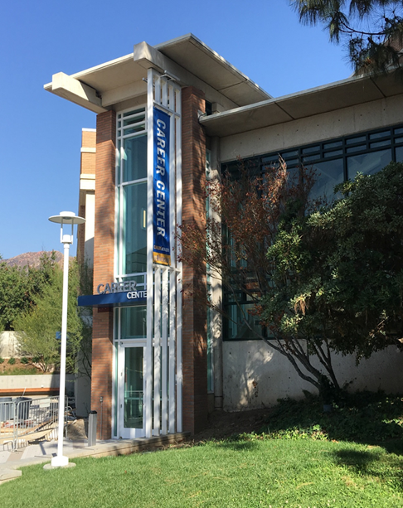
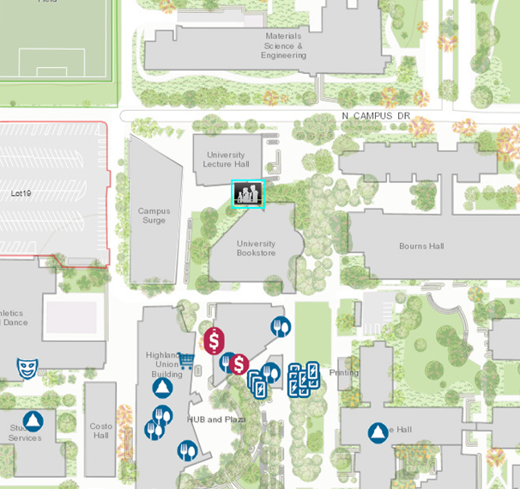
Come Visit Us
Come See Us!
Hours:
Mon. - Fri. 8 am to 5 pm
except Wed. 9 am to 5 pm
Drop-In Hours:
Mon. - Thurs. 10 am-3pm
Fri. 10 am-12 pm

