Slide 1


YOUR CONTENT CAN GO
IN THIS AREA
2017-18 Annual Report

Slide 2
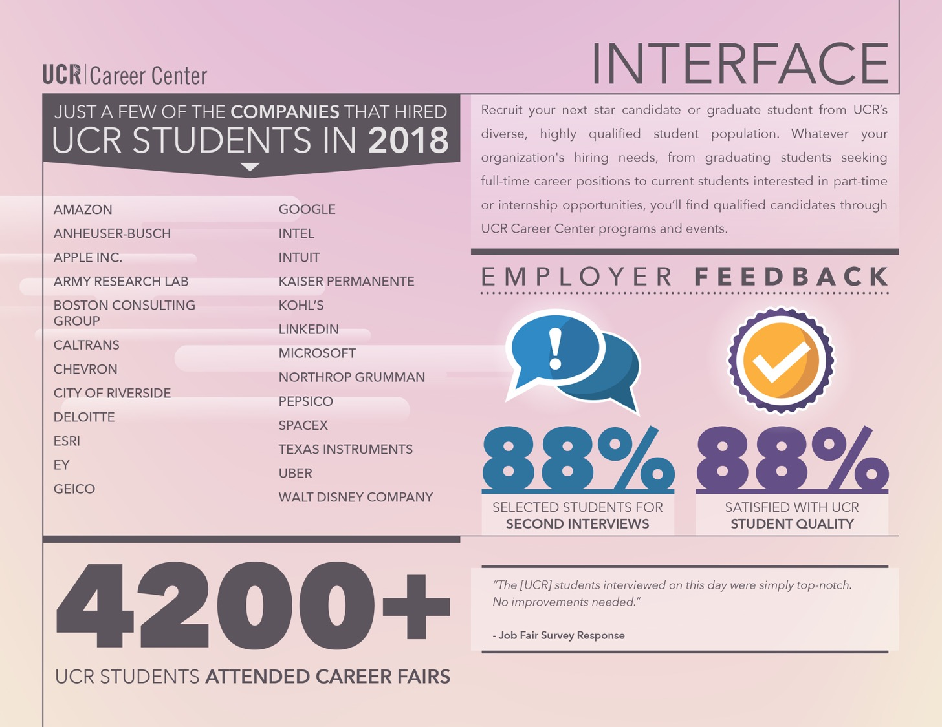
2017-18 Annual Report

Slide 3
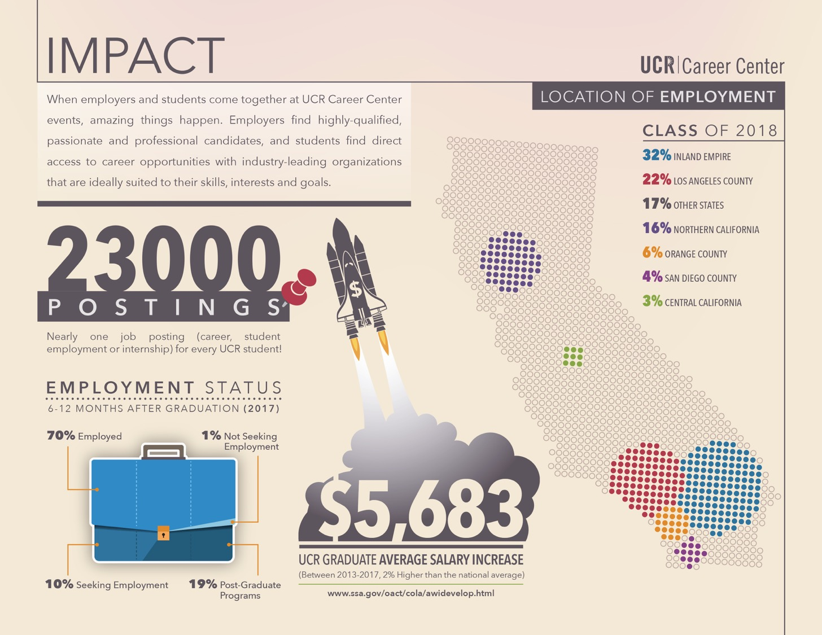
2017-18 Annual Report

Slide 4
A modern, on-the-go platform designed especially for college-based recruiting for jobs, internships, events and resources.
Students gain access to job/internship postings from 200,000+ employers around the world, including all Fortune 500 companies!
Employers enjoy a faster, more user-friendly experience to post jobs and view applicants.

Slide 5
Students enjoy:
A personalized feed of jobs, internships, events and resources — like Netflix but for careers!
A “Favorite” option to know when top employers are posting jobs and coming to campus.
A seamless experience across all devices: phones, tablets and computers.

Slide 6

Create a Handshake Account
1.
Log into go.ucr.edu/ucrhandshake with your UCR username and password.
2.
Complete your UCR Handshake profile by adding your resume, photos, skills and more. Make your profile public to employers.
3.
Click “Jobs” in the menu bar and start applying. Save searches and sign up for notifications about future opportunities that match your interests!

Slide 7


Slide 8


Slide 9

Networking
Your Way to a Job:
Build Meaningful Relationships
Notes:
N: What are we covering?
Examples + Putting into action

Slide 10

EVERYONE YOU WILL EVER MEET KNOWS SOMETHING YOU DON'T
- Bill Nye

Slide 11

What We’re Going to Talk About…
What is Networking?
Tips to Network Successfully
Where Can You Network?
Networking Through Social Media
Practice What You’ve Learned
Maintaining Connections
Who's in your Network?

Slide 12

What is Networking?

Slide 13
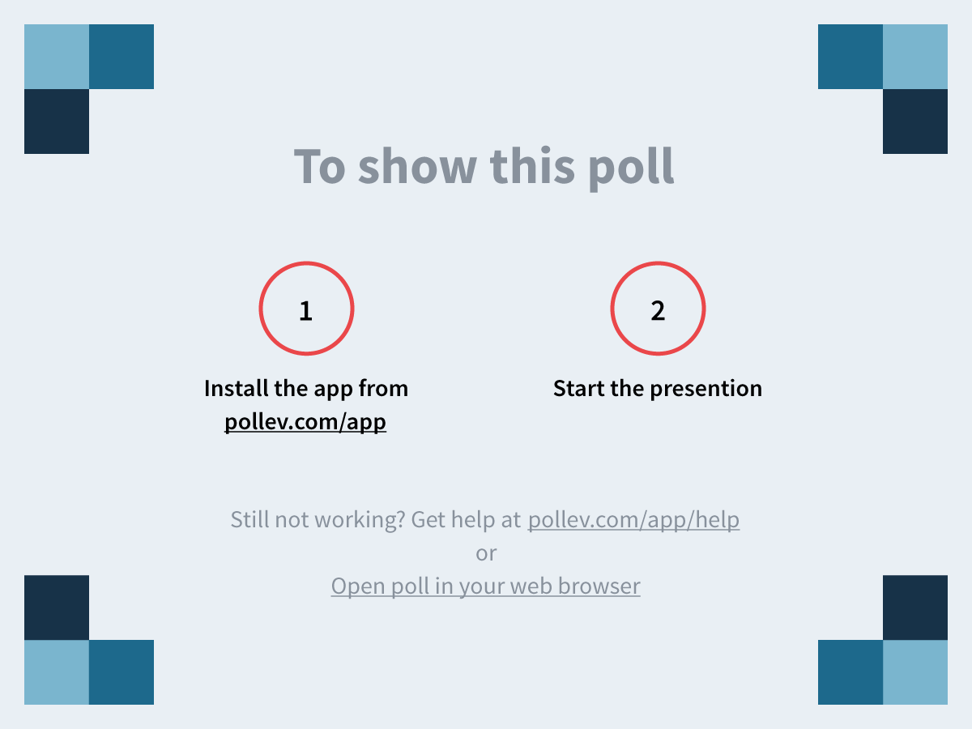
Notes:
What comes to mind when you think of networking https://www.polleverywhere.com/free_text_polls/KMUpP1dbz8aUVVU

Slide 14
What is Networking?
Networking is the development and maintenance of mutually valuable relationships.

Slide 15

The Misconceptions
It’s only takes place at networking events
Shy people are poor at networking
You only need it if you’re going into business
I have a high GPA, I don’t need to network
I only have to gain relationships with people in my
field of interest
REALLY?

Slide 16

Facts About Networking
It’s about developing MEANINGFUL relationships
70% of jobs/opportunities are not found online but through MUTUAL relationships
It starts way BEFORE YOU NEED A JOB
It isn’t always about knowing the rich and powerful
(Your BEST FRIEND could land you your next job!)
It’s true, it isn’t just about what you know, but who you know that gets you the opportunity to show what you know

Slide 17

When & Where to Network
Social Networks
Friends, Family, Neighbors
Alumni contacts
Professors
Other Faculty & Staff
Volunteer contacts
Social media –LinkedIn, Facebook, Twitter, etc.
Professional Networks
UC Riverside events (Career fairs, Job Discovery panels, Workshops)
Professional networking events
Chamber of Commerce
Rotary, Kiwanis, Lions Clubs
Committee involvement
County of Riverside (volunteers)

Slide 18








Slide 19
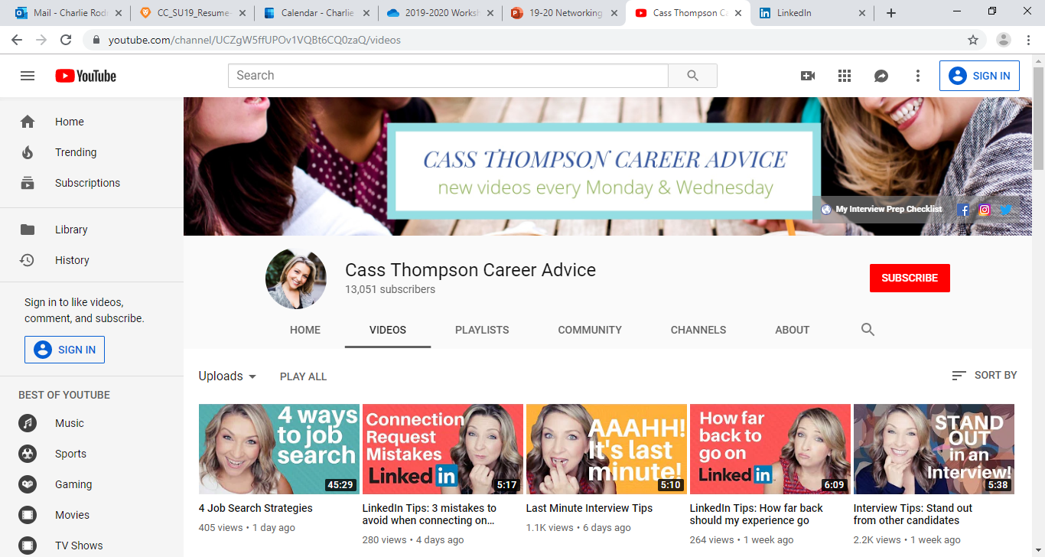
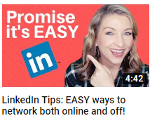
https://www.youtube.com/watch?v=msylAij9oIA

Slide 20
3 Questions Before You Network
What are you known for today?
Eg: strengths, skill sets, experience
What do you want to be known for?
Eg: reputation, personal branding, credibility
How do you get there?
Eg: short and long term SMART goals
Source: Great on the Job, Jodi Glickman

Slide 21

Networking Tips
When attending a networking event...
Set goals
Perfect your 30 second pitch (Your Story)
Stay focused
Meet new people and introduce others
Listen attentively for opportunities
Be prepared to follow up
Notes:
Tips:
Listen attentively for opportunities: I to You ratio- Balance the conversation don’t monopolize it.

Slide 22
Be Prepared!!
Conservative email address
Professional outgoing voicemail
Make sure your voicemail box is not full
Neutral virtual presence
Create a business card (optional)
Sally Career
Bachelor of Science, Business Administration University of California, Riverside
linkedin.com/sallycareer 951.827.1234 sallycareerucr@gmail.com

Slide 23

Sample Questions For Networking
PROFESSIONAL:
How did you get into your profession?
What parts of your job do you find most challenging?
What do you find most enjoyable?
Are there any negatives to your job?
What is a typical day like for you?
How would you describe the corporate culture?
What skills are required in your position on a day-to-day basis?
What is unique about your company?
What advice do you have for someone looking to get into your field of work?
What’s the best business advice your have ever received?
Who else do you recommend that I should talk to *tonight*?
PERSONAL:
What is the best job you’ve ever had? What is the worst?
Where did you grow up?
What do you like to do in your spare time?

Slide 24
Activity
Practice networking for the next 5 minutes
Turn to your neighbor, pitch yourself, and take turn asking some of these questions
What is your major?
How did you choose your major?
What do you like the most/least about your major?
What are your plans after graduation?
What do you do for fun?

Slide 25
Mixer
0
0
5
4
3
2
1
0
0
9
8
7
6
5
4
3
2
1
0
9
8
7
6
5
4
3
2
1
0
9
8
7
6
5
4
3
2
1
0
9
8
7
6
5
4
3
2
1
0
9
8
7
6
5
4
3
2
1
0
9
8
7
6
5
4
3
2
1
0
0
5
0
4
Hours
Minutes
Seconds

Slide 26
Mixer
0
0
5
4
3
2
1
0
0
9
8
7
6
5
4
3
2
1
0
9
8
7
6
5
4
3
2
1
0
9
8
7
6
5
4
3
2
1
0
9
8
7
6
5
4
3
2
1
0
9
8
7
6
5
4
3
2
1
0
9
8
7
6
5
4
3
2
1
0
0
5
0
4
Hours
Minutes
Seconds

Slide 27
Mixer
0
0
5
4
3
2
1
0
0
9
8
7
6
5
4
3
2
1
0
9
8
7
6
5
4
3
2
1
0
9
8
7
6
5
4
3
2
1
0
9
8
7
6
5
4
3
2
1
0
9
8
7
6
5
4
3
2
1
0
9
8
7
6
5
4
3
2
1
0
0
5
0
4
Hours
Minutes
Seconds

Slide 28

Debrief
What worked?
What didn’t?
How did you feel?
What did you learn?

Slide 29
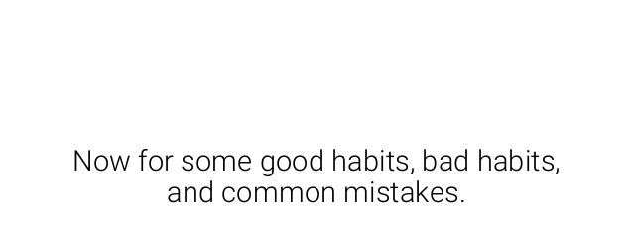

Slide 30

Connecting Through Social Media

Slide 31

Crafting a Personalized Note on
Introduce Yourself
My name is Maya Lim and I am a senior majoring in Ethnic Studies at UC Riverside. I very much enjoyed meeting you at the Spring Job Fair.
Why do you want to be connected?
I’m reaching out because I am very interested in learning more about the advertising industry. Last summer, I interned in the public relations department at Guess? Inc.
Notes:
Introduce yourself. Whether you use this sentence to include your mutual contact, where you’ve met, or your shared background, tailoring your intro for the specific contact shows that you’re serious about connecting with him or her.
Mention: Why do you want to be connected? Quickly dive into why you are writing. Do you love this person’s updates? Do you want to ask this person questions about her company or background?
Let that topic sentence guide a paragraph (only one!) where you get into a few details.
Mention that you are currently in school, your year, and that you are interested in working in or learning more about the relevant industry. Depending on your intent,you can highlight one relevant experience (i.e. club, summer internship, etc.) and ask an insightful question. If you appear poised and respectful, chances are that you will get a response, which could lead to a potential summer internship. Never directly ask for an internship in an introductory email. Remember, true networking is about building relationships by helping others, not simply receiving favors.
Don’t forget to say “thank you”!
* In-mail maximum length: 2,000 characters
Use LinkedIn. Once you've made those connections, keep them. LinkedIn is a great way to stay in touch with professional contacts, so make sure you make an active effort to keep your profile updated.

Slide 32
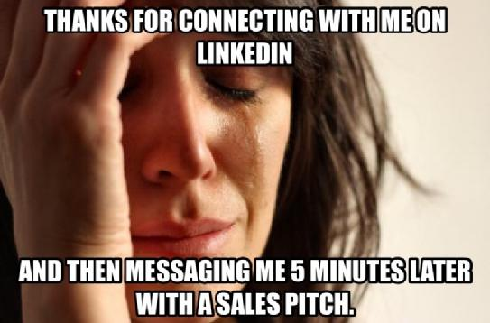
Conversation Starters On:
Examples of what NOT to write:
Can you help me?
I’d like to connect with you on LinkedIn
Be mindful of 300 word limit when first messaging professionals.
Notes:
The amazing thing about LinkedIn is that it allows you to connect one-on-one with nearly anyone in the world.
Try not to send brief or automated messages that don’t give people any meaningful reason to connect—“Can you help me?” or “I’d like to connect with you on LinkedIn.” It’s lazy, it’s unprofessional, and it’s highly unlikely to get a response.

Slide 33

Bad Networking Habits
Hanging out with the same person or stay in cliques
Staying by the food table/bar for too long
Not engaging in full conversations
Fail to make eye contact and smile
Asking closed-ended questions

Slide 34

Common Mistakes
Lack of action & focus
Display disengaged body language
Too informal too soon
Ask for too much
No follow through
Forget to have fun
Notes:
Gum chewing
Alcohol
Profanity/Phones
Smoking
GASP!!
GRASP (R=Ringing)

Slide 35



Connecting Through Social Media

Slide 36
I’ve started the conversation, now what?

Slide 37
The Email Intro…
Your professor has given you the name and email address for an UCR alumna working in the field of your dreams. What is the appropriate way to introduce yourself via email?
Notes:
Put yourself in the role of the professional who is receiving your email…
Split group up into teams. Critique the two emails based on the tips we learned from the video. Which elements are appropriate? What needs improvement?
Handout: What’s the difference? Next slide.

Slide 38
What’s the Difference?
Hi Clara!
It would be really cool to meet you and learn about your career path. It would be really nice if I can get 15 to 20 minutes of your time. Well, looking forward for your reply. -Ali H.
Student
“The unexamined life is not worth living”
Dear Ms. Lee:
I am a junior majoring in History at the University of California, Riverside. Professor Addison suggested I get in touch with you regarding my interest in the preservation of local historical districts.
Although I am not currently looking for a job, I am very interested in learning all I can about typical career paths in this field and what skills I might need to develop. I would greatly appreciate 20 to 30 minutes of your time to ask you a few questions about your current position and the challenges/rewards involved.
Thank you for your consideration. I look forward to contacting you to arrange a time.
Sincerely,
Allison Harris, UCR History 2020
(951) 222-3333 | Alison.Harris@ucr.edu
Notes:
For salutations in which you don’t know whether they are male or female, refer to them by full name (first and last name). No salutations are necessary.

Slide 39
The Final Touches

Slide 40
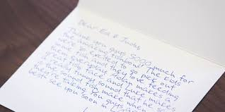


Follow-Up and Maintaining Relationships
Thank you note
Progress emails
Related articles
Holiday greetings
Notes:
How often?
Provide an example from your own experience

Slide 41

Who's in your Network?
Establishing your BOARD OF TRUSTEES:
An appointed board of connections that you entrust for your self-development.
- 3-5 people you can count on to help you find your next opportunity.
- Mentor/Confidant you share ideas with
- Should come from different backgrounds to help you develop perspective
Family
Colleagues
Professors
Best Friend
Mentors

Slide 42

Questions?

Slide 43
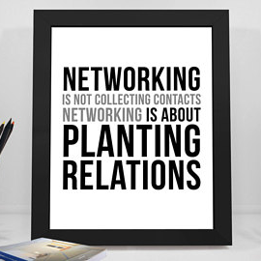

Slide 44

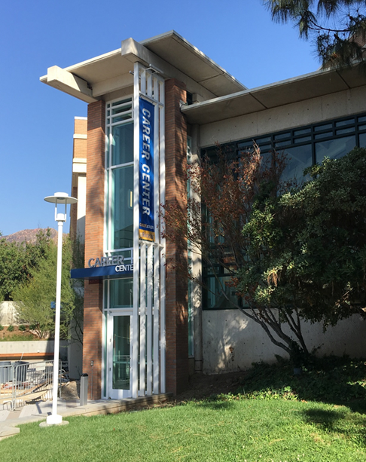
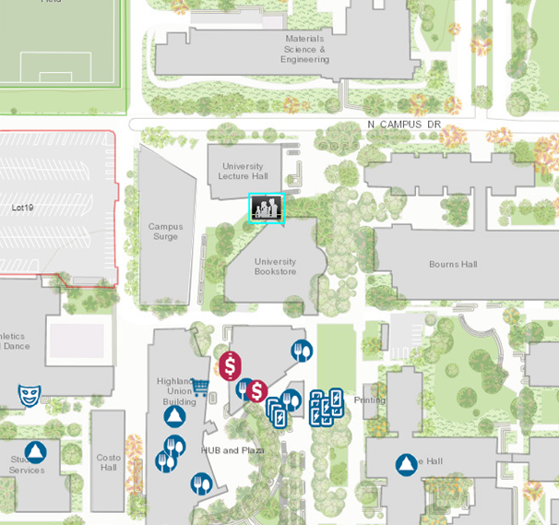
Come Visit Us
Come See Us!
Hours:
Mon. - Fri. 8 am to 5 pm
except Wed. 9 am to 5 pm
Drop-In Hours:
Mon. - Thurs. 10 am-3pm
Fri. 10 am-12 pm

