Slide 1


Seniors: Land a Job For When You Graduate
On-Campus Interview Program

Slide 2

A modern, on-the-go platform designed especially for college-based recruiting for jobs, internships, events and resources.
Students gain access to job/internship postings from 200,000+ employers around the world, including all Fortune 500 companies!
Employers enjoy a faster, more user-friendly experience to post jobs and view applicants.

Slide 3
Students enjoy:
A personalized feed of jobs, internships, events and resources – like Netflix but for careers!
A “Favorite” option to know when top employers are posting jobs and coming to campus.
A seamless experience across all devices: phones, tablets, and computers.

Slide 4
Create a Handshake Account:
Log into ucr.joinhandshake.com with your UCR username and password.
Create a new Handshake profile by adding your resume, photos, skills, and more. Make your profile public to employers.
Click “Jobs” in the menu bar and start applying. Save searches and sign up for notifications about future opportunities that match your interests!
ucr.joinhandshake.com

Slide 5

Agenda
Career Center Overview
What is the On-Campus Interview (OCI) Program
Who Participates
When to Participate
Benefits of the Program
Types of Schedules and Interviews
UCR Handshake & OCI
How to Participate (Live Demo)
Interview Tips
Dressing for Success
Questions

Slide 6
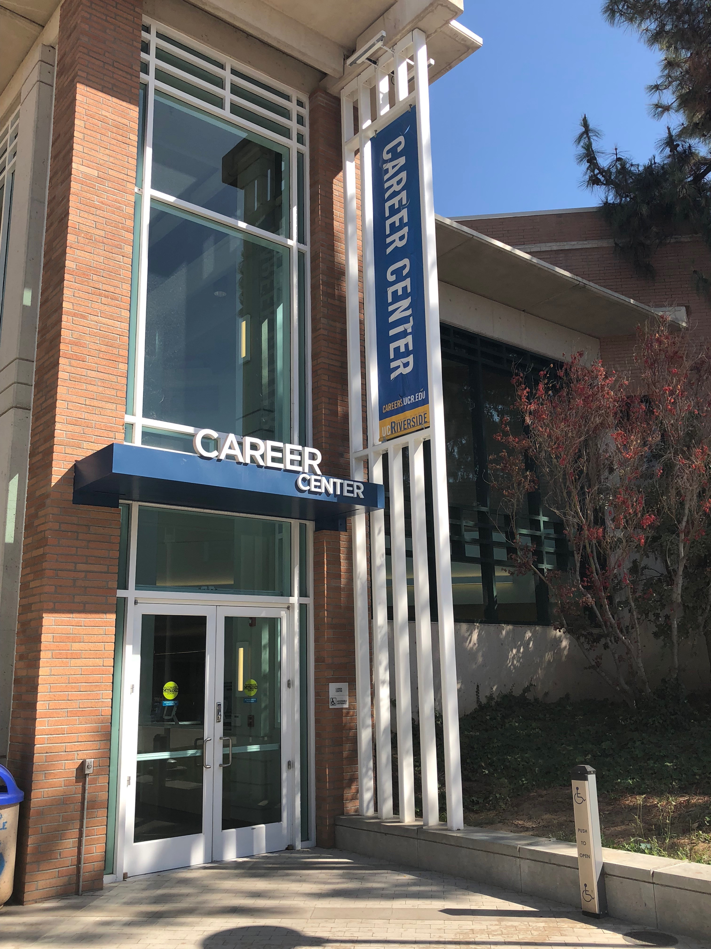
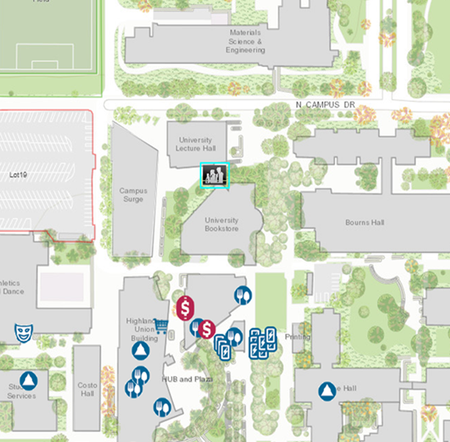
Come See Us!
Hours:
Monday – Friday 8:00am – 5:00pm
Except Wednesday 9:00am – 5:00pm
Drop-In Hours:
Monday – Friday 10:00am – 3:00pm
Friday 10:00am – 12:00pm

Slide 7

Career Center Overview
Career Center operates Mon. – Fri. 8-5pm
Drop-in Hours are Mon. – Thurs. 10-3pm & Fri. 10-12pm
Resources:
Career Planning
Job Search Assistance
Internships
Graduate & Professional School Prep
Online Services
Website: careers.ucr.edu
Phone: 951-827-3631

Slide 8

On-Campus Interview Program (OCI)
Operates Fall, Winter, & Spring quarters
OCI brings employers to campus to interview students for full-time career positions and full-time paid internships.
The OCI program is open to ALL MAJORS, graduate and undergraduate. Most of these positions are targeting 3rd and 4th year students.
Employers that participate have specifically chosen UCR as a target campus.
All interviews are held at the UCR Career Center.
The OCI program provides a “jump start” on first round interviews as part of the hiring process.

Slide 9


































Who Participates???

Slide 10

Benefits of the OCI Program
Convenience – interviews are held at the Career Center
Employers have an existing relationship with UCR
OCI Coordinator – student outreach & support
Develop interview skills
Get in front of employers who only recruit through university recruiting
Increase chances of multiple offers
Begin your career right after ending your college career

Slide 11

Types of Interview/ Schedules
Interviews:
Schedules:
Individual Interview
Small Group Interview
Virtual Interview
Phone Interview
Behavioral-Based Interview
Task Oriented or Testing Interview
Case Interview
Open
Preselect
Preselect Continuous
Room Only
TIP: We are seeing a trend in Employers using the Room Only schedule and filling their interview schedule from the Career Fairs or other employer events.

Slide 12
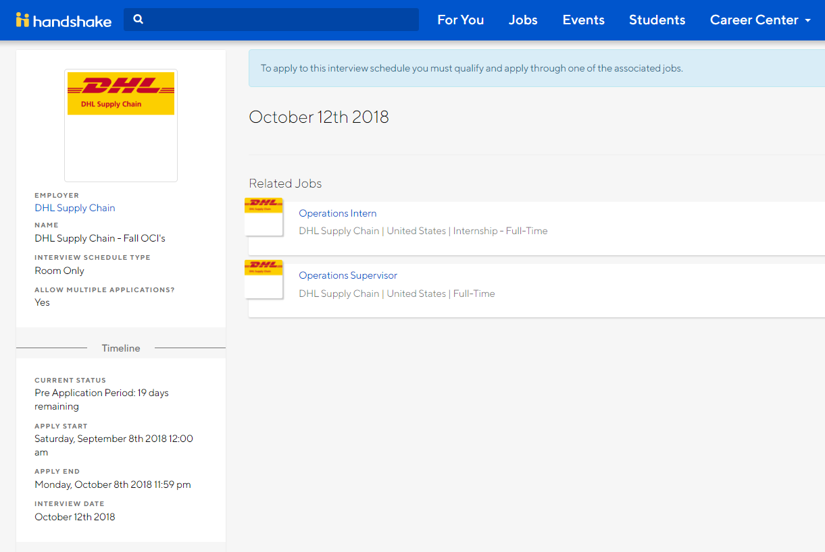
UCR Handshake & OCI
“Room-Only” Schedules
In Handshake you are now able to view all ‘room-only’ schedule job postings that are available through OCI.
What does this mean? – Able to see what positions are being recruited for through the OCI program by employers who are sourcing applicants through an alternate source.
So what should you do? – You’re now able to see a complete list of participating OCI employers as well as the jobs that they will be recruiting for. You will also be able to go into a career fair knowing who will be participating in OCI.
*NOTE: Please make sure to speak to all employers that may interest you, NOT just ones you know are recruiting. You never know who will be sourcing students for later interviews.

Slide 13
How to Participate Live Demo
https://ucr.joinhandshake.com/

Slide 14

Interviewing Tips (before the interview)
Know the Employer:
Research the company thoroughly
Know the company’s market, products, & goals
Memorize useful facts
The Job Description:
If a job description is available for the position you are interviewing for, think about how your experience and skill fit. Consider examples and evidence to support your ability to excel in this job.
Know yourself:
What are my skills?
What is my passion? What type of work environment do I prefer?
Practice Makes Perfect:
Consider most often aske questions. Be prepared to answer them.
Give concise, complete answers
Utilize the virtual Career Center for helpful tips and practice interview questions
Additional Prep Tips:
Prepare 2-3 thought out provoking questions to ask your interviewer after the interview.
Prepare thank you notes or remember to send a thank you email after your interview

Slide 15
STAR Method (to answer behavioral based questions)
Prepare
Listen carefully to the question and think of an event. Take a few seconds to ensure that you have the best example you can. Don’t rush it.
Situation
Task
Explain the task you had to complete, highlighting any specific challenges or constraints.
Deadlines
Action
What?
When?
Where?
etc.
Who?
Describe a specific event or situation that you were in.
Result
Issues
Costs
etc.
Describe the specific actions that you took to complete the task. These should highlight desirable traits the interviewer is looking for.
Close with the result of your efforts. Include figures to quantify the result if possible.

Slide 16

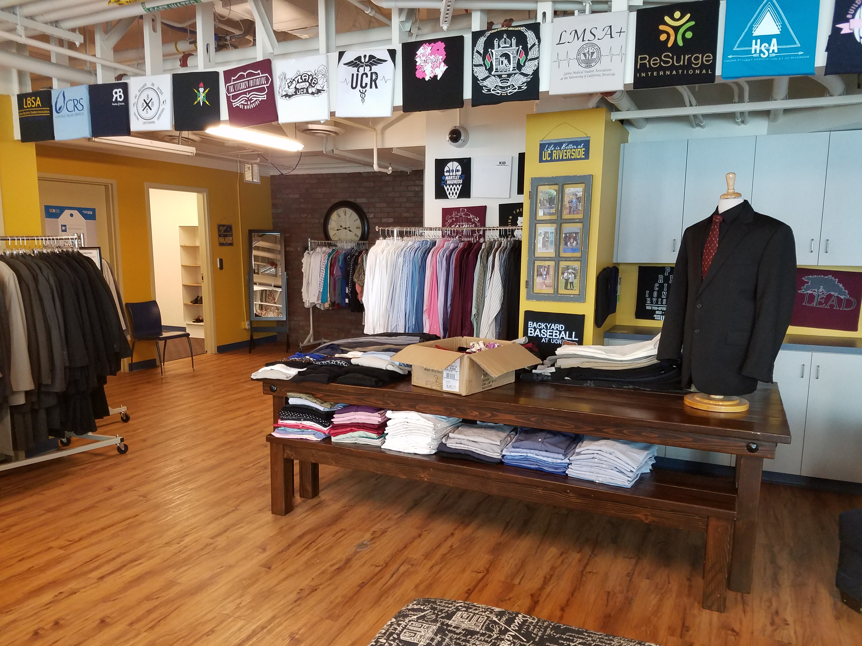




Dress for Success
R’Professional Career Closet
Mon. – Thu. 10am – 1pm
3 items per quarter
HUB 105 (Bear’s Den)
Interview Clothing Options:
Two Piece Suit
Jacket / Blazer / Cardigan
Dress Shirt / Blouse
Dress Pants / skirts
Dress Shoes
Tie / Bowtie / scarf
Business dresses
Dress shoes / heels

Slide 17

Interview – Do’s & Don’ts
Do’s
Don’ts
Be on time
Give a firm handshake and smile
Make eye contact when speaking & connect with interviewer(s)
Be polite
Dress fort the occasion
Bring extra copies of your resume
Bring prepared questions to ask the interviewer following the interview
Bring blank thank you notes (optional)
Ask for a business card
Don’t arrive late
Don’t be too personal
Don’t use profanity
Don’t be derogatory about past experiences
Don’t talk money
Don’t slouch

Slide 18

Interview Tips
Closing the Interview
Your time to ask questions
Ask about the next steps (if not already mentioned)
Ask for business cards if not offered
If appropriate, shake everyone’s hand, call them by name if possible and thank them for their time
RELAX…you’re done!

Slide 19

Interview Tips
After the Interview
Send a thank you note or a thank you email to the interviewer.
Follow-up if the date that they said they would get back to you has passed
Always be professional
***Exception: If an employer has specifically mentioned not to contact, that they will contact you. Do not contact them.

Slide 20


Slide 21

THANK YOU!
Chanel Parrish
On-Campus Interview Coordinator
Phone
951-827-3834
Email
chanel.parrish@ucr.edu

