Slide 1


Slide 2
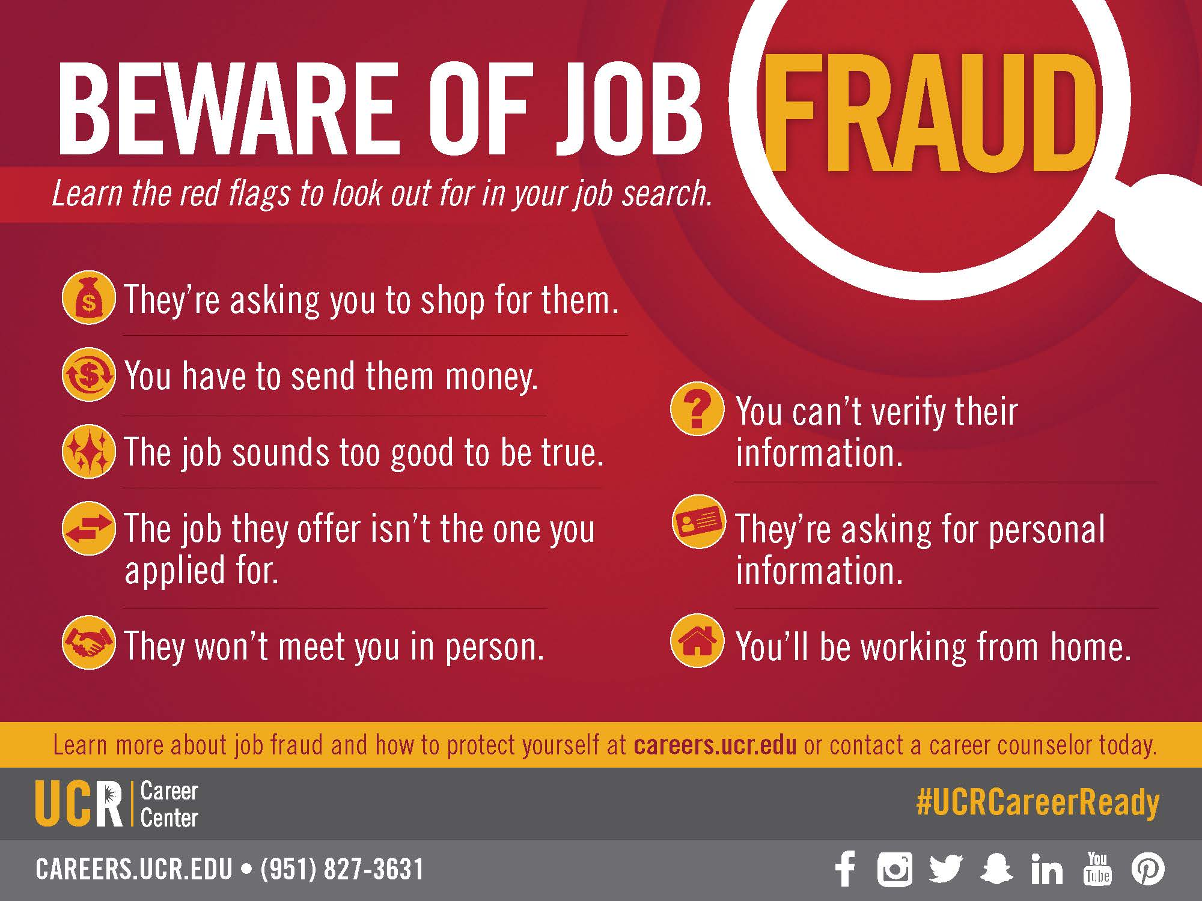

Slide 3

Create a Handshake Account
1.
Log into go.ucr.edu/ucrhandshake with your UCR username and password.
2.
Complete your UCR Handshake profile by adding your resume, photos, skills and more. Make your profile public to employers.
3.
Click “Jobs” in the menu bar and start applying. Save searches and sign up for notifications about future opportunities that match your interests!

Slide 4

Overview of Career Center Services

Slide 5

What We Do
Drop-in
Career Planning
Resume/Cover Letter Review
Interview Preparation
Job/Internship Search Assistance
Career Fairs/Employer Events
Virtual Career Center
Graduate & Professional School Planning
Notes:
Briefly talk about each item.

Slide 6

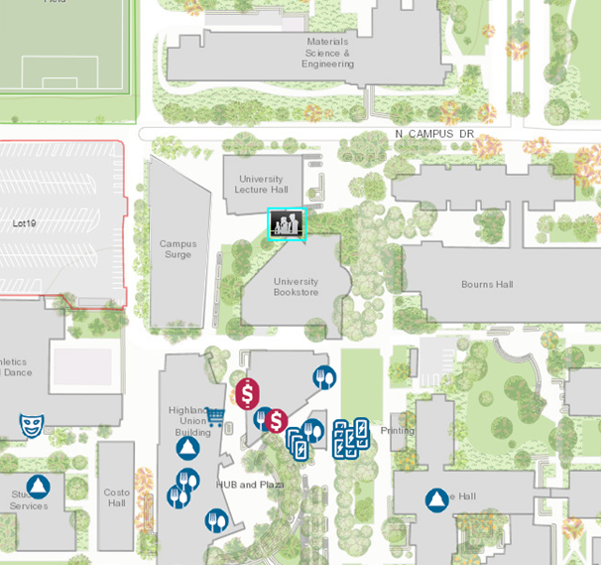
Come Visit Us
We are located in the Career Center Plaza. Our entrance is the University Lecture Hall and the Skye Hall, behind the UCR Campus Store.
Hours:
Mon. - Fri. 8 am to 5 pm
except Wed. 9 am to 5 pm
Drop-In Hours:
Mon. - Thurs. 10 am-3pm
Fri. 10 am-12 pm

Slide 7
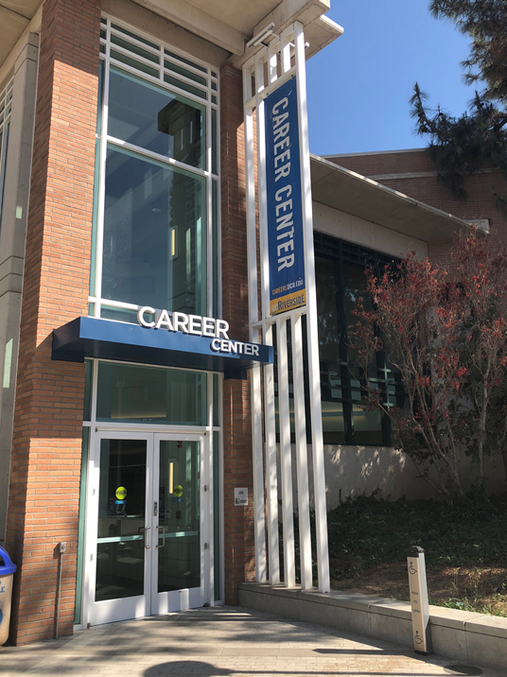
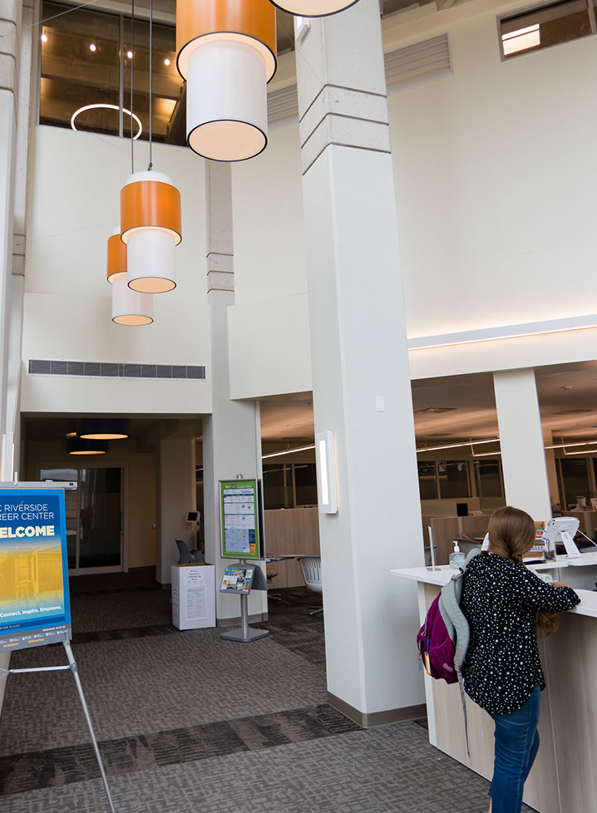


Slide 8

Career Planning
Career Exploration Workshops & Panels
One-on-One Career Counseling
How to Choose a Major
Career and Interest Tests
Graduate/Professional School Preparation/Tips
Notes:
Career Planning: 10 minute drop-in hours and individual counseling by appointments
Major Choice Assistance
Career Exploration Workshops & Panels: Employer or panel of employers, example Job Discovery Series
Career Panels: all through out the year – especially during Job Discovery Series (quarterly)
Career and Interest Assessments: See a counselor first during drop-in for consultation. Assessments to explore interests, personality type.
Grad/Professional School Prep

Slide 9
Job Search Assistance
Handshake database for jobs/internships
Job and Internship Related Workshops
On-Campus Interview Program
Information Sessions from Employers/Graduate Programs
Practice Interview Questions
Notes:
Handshake: Online Job database for UCR students only. It houses part time, full time, internship, volunteer/community service positions.
Job and Internship Workshops: Basic skill building workshops are offered every quarter. Besides the Job search and internship workshops, we offer interview skills, making professional connections and conversational skills workshops.
On-Campus Interview Program: From October through May, employers interview graduating students at the Career Center for career positions. It is offered for juniors and seniors only.
Information sessions: Employers have a session or info table on campus to talk about their companies and career opportunities.
Resume Builder & Mock Interview Tool: Online resume, cover letter software as well as online interview skills training program.

Slide 10
Major Events: Career and Information Fairs
Career Expo: The Diversity Job Fair (Fall)
Career Night: The Spring Job Fair (Spring)
Last Chance Job Fair (Spring)
General Career Fairs
Finance, Accounting & Business Job Fair (Fall)
Science, Technology, Engineering, Math (STEM) Job Fair (Fall)
Engineering & Technology Job Fair (Winter)
Internship & Non Profit Job Fair (Winter)
Education & Teacher Job Fair (Spring Break)
Specialty Job Fairs
Graduate/Professional School Information Day Fairs
Graduate & Professional School Information Day Fair (Fall)
Law School Information Day Fair (Fall)
Health Professionals School Information Day Fair (Spring)
Notes:
(3) General Career Fairs: Career Expo – Fall Job Fair (Fall qtr), Career Night – biggest career fair (Spring qtr), and Last Chance Job Fair – as it says, it is your last chance to attend a job fair for that year (Spring qtr).
(4) Specialty Career Fairs: Meet the Firms for Accounting & Finance students (Fall qtr), STEM (Science/Technology/Engineering/Math) Fair (Fall qtr), Engineering & Technical Career Fair (Win qtr) Federal Government Job Fair (Win qtr) and Teacher Job Fair (Win qtr)
(3) Graduate & Professional School Information Day (Fall) and Law School Information Day (Fall) Health Professions School Fair (spring qtr)
Field trips : Visit to companies, example Target, AON

Slide 11
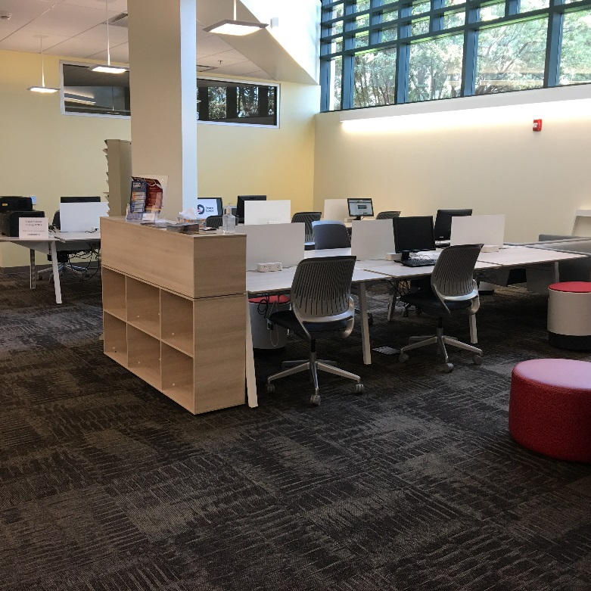
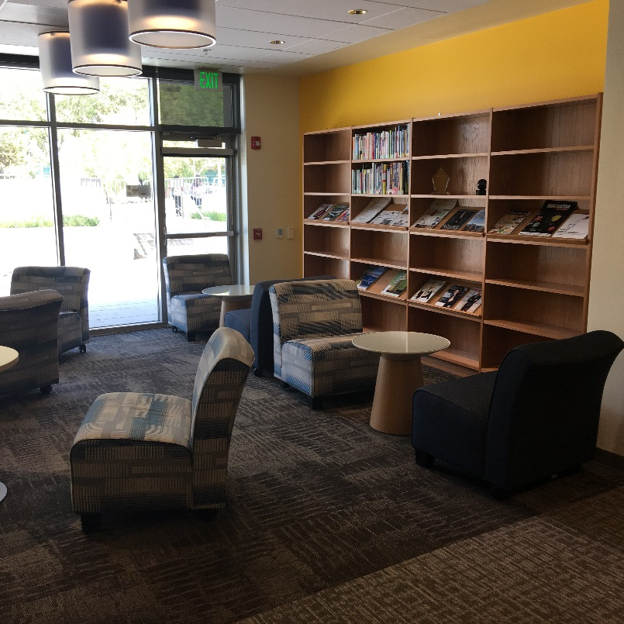
Career Center Resources
Career Literature
Industry Information
Employer Directories
Job Search Strategies Literature
Graduate and Professional School Guides
Computers for Career Related Topics
Notes:
Once you finished talking about Career Resource Room, go alive and demonstrate the website and SCOTLink. If you don’t have wireless connection, proceed to next slides with screen shots.

Slide 12
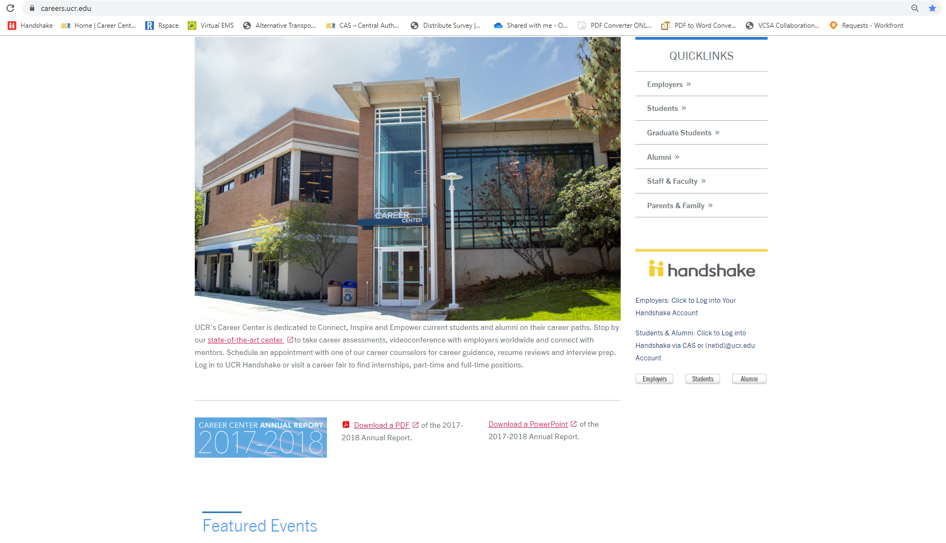
careers.ucr.edu

Slide 13
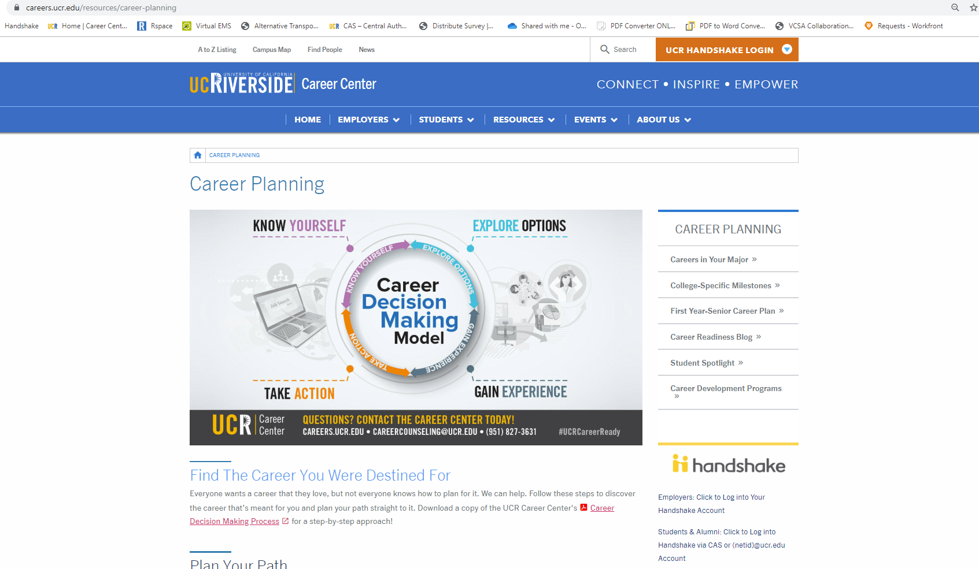
Notes:
For example, if you would like to know about career planning process (for a 1st, 2nd, 3rd or 4th year), go to Career planning/Counseling
Assessment
Careers in Your Major
Milestones
4 year plan
Business Program

Slide 14
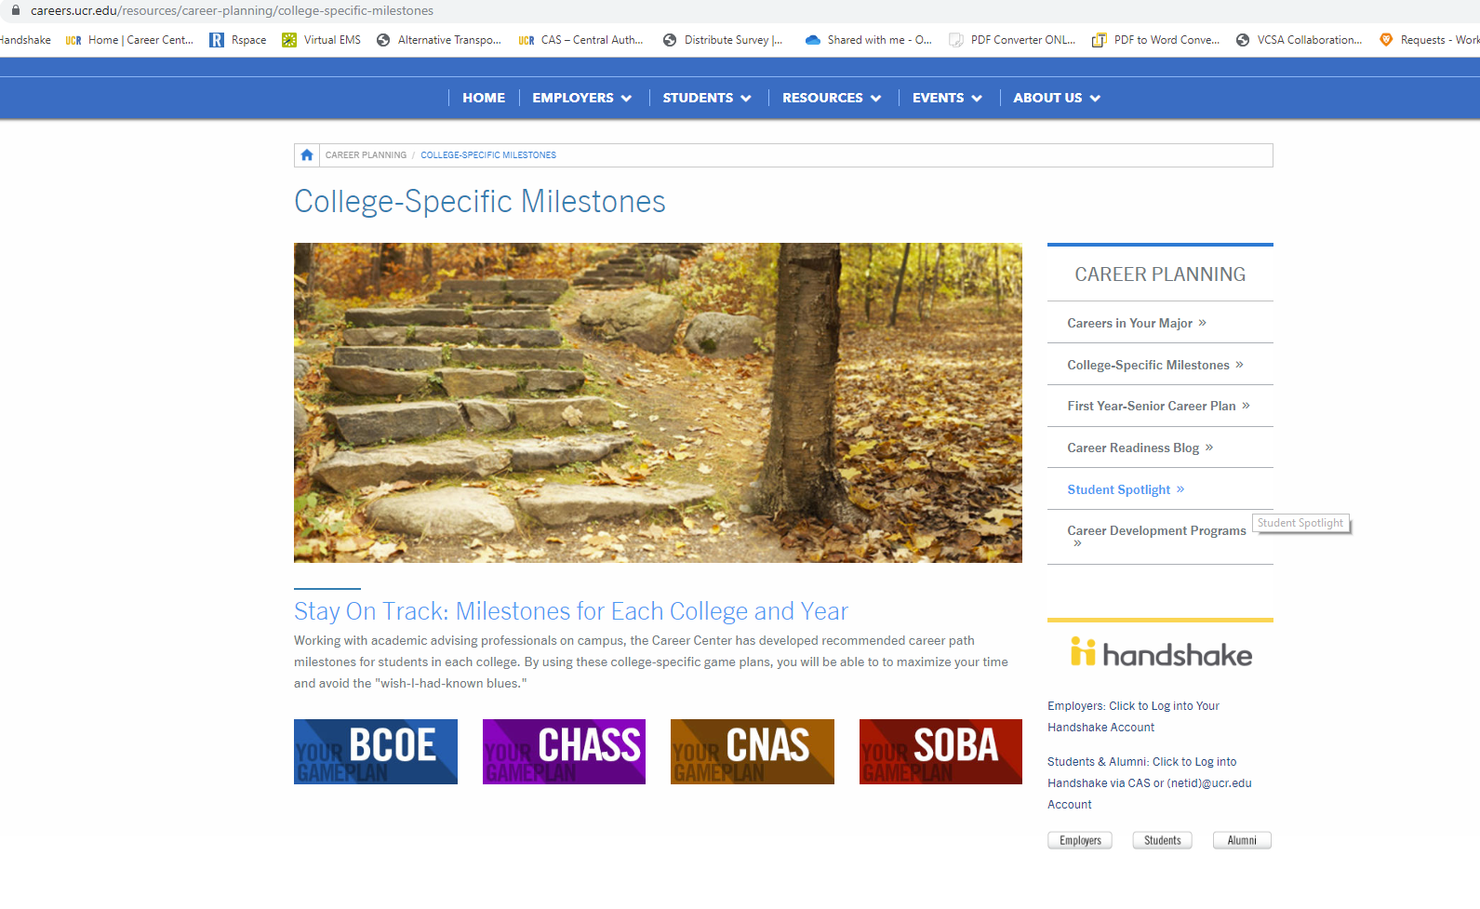

Slide 15
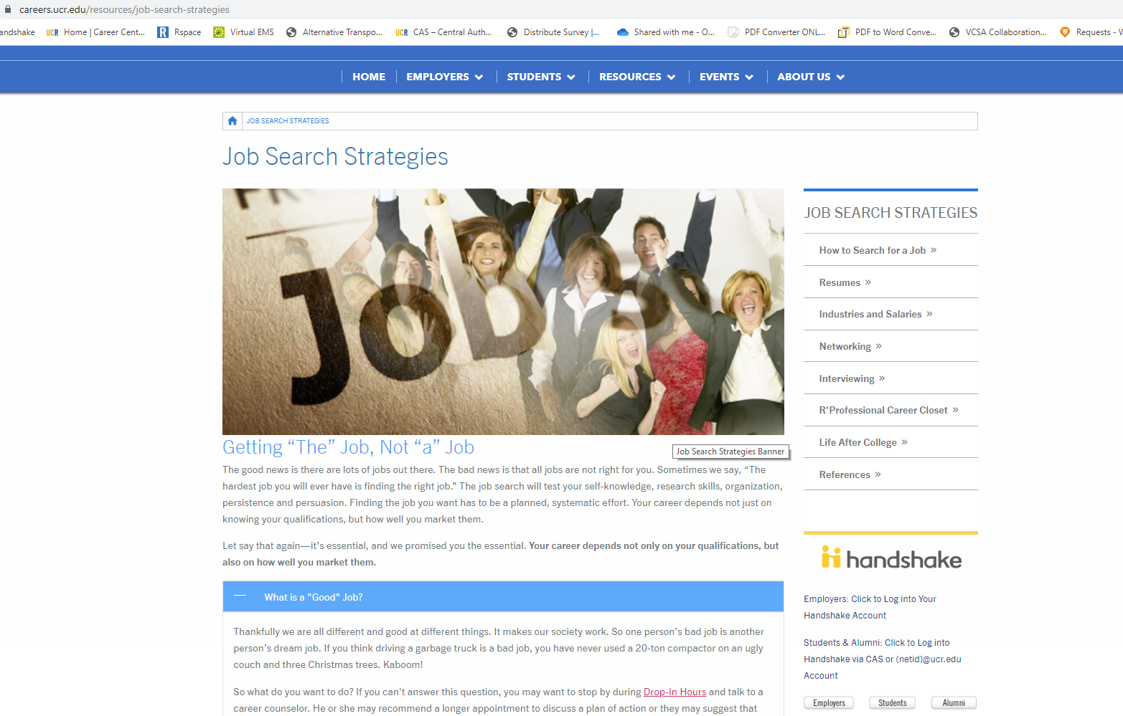

Slide 16

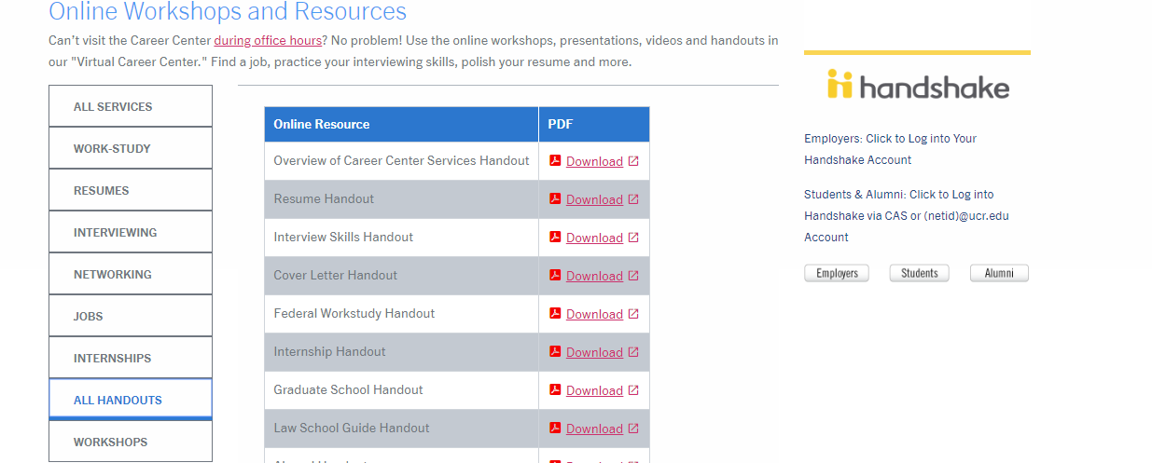
Online Resources/Virtual Career Center
UCR Handshake
Calendar of Events
Social Media
  Facebook, LinkedIn, Twitter, Pinterest, Instagram, Snapchat, YouTube
Company Information
  Career Insider, CareerShift, Glassdoor
Online Workshops and Resources (careers.ucr.edu)
Notes:
“Virtual Career Center is available 24/7”.
Info on the Go!
Online workshops and resources: If you missed a workshop/workshops, you can download an actual power point presentation as well as activity sheets or handouts.
SCOTLink: Access to SCOTjobs, Resume Builder, Interview Stream, NaceLink, Company Information, Events, TypeFocus
Podcasts & YouTube videos: Fun and interactive way to learn about many career topics.
Social Media: Facebook Group: UCR Career Center has its own group. Please join for fun news and updates, LinkedIn
Company Information: Resources for researching companies and exploring industries

Slide 17
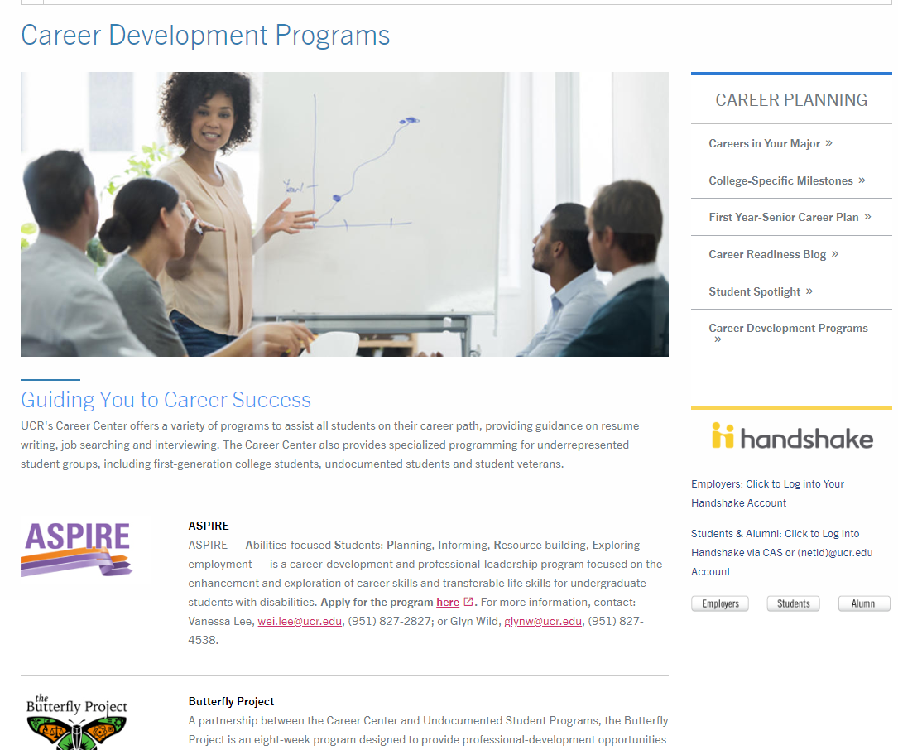
Career Development Programs

Slide 18






ASPIRE (Abilities-focused Students: Planning, Informing, Resource building, Exploring employment)
The Butterfly Project (A partnership between the Career Center and Undocumented Student Programs)
Get HIRED (Help International students Reach Employment Destinations)
Internship Success Program
Operation VETS (Veteran, Employment, Transition, Success)
ORBITS (Obtain Resources, Become Informed, Target Success)

Slide 19

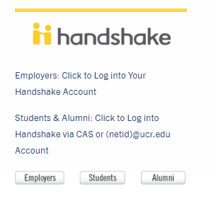
How to Access UCR Handshake
go.ucr.edu/ucrhandshake
OR
Career Center Website
(careers.ucr.edu)
R’Web Portal
(See the logo below)
Notes:
Only ways to log in, do not create an account with your email

Slide 20
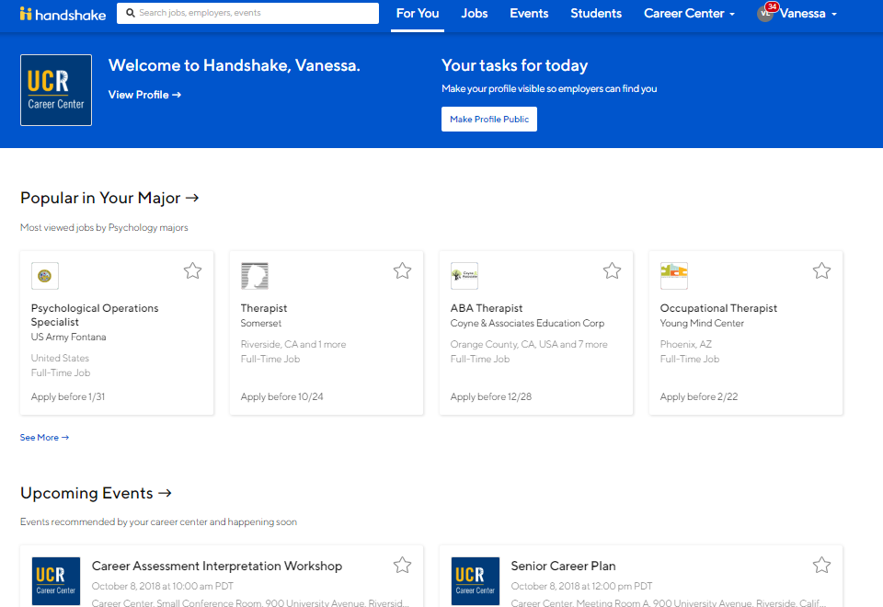

Slide 21
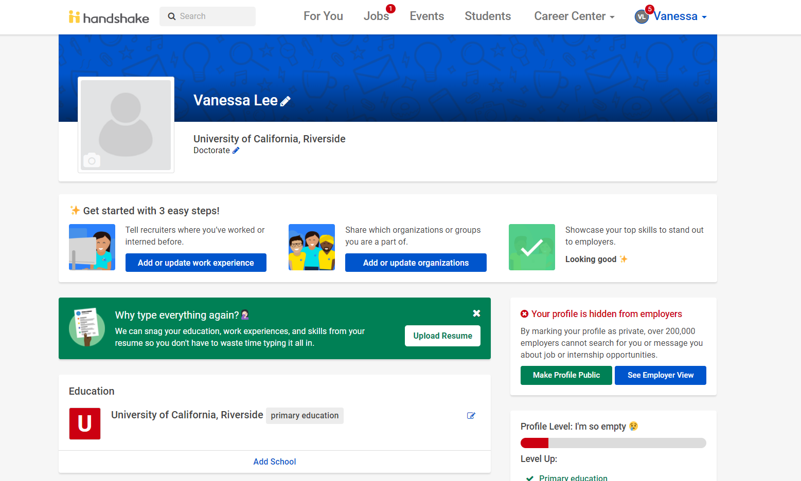
Your handshake Profile Page

Slide 22
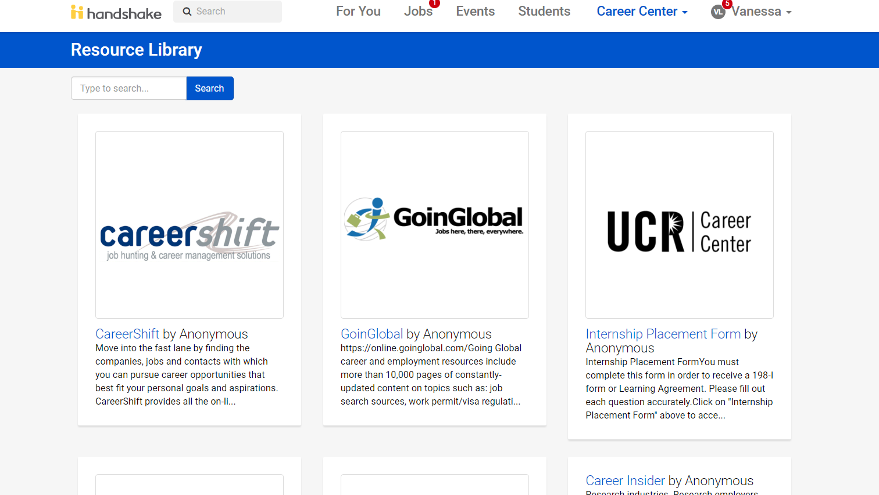

Slide 23
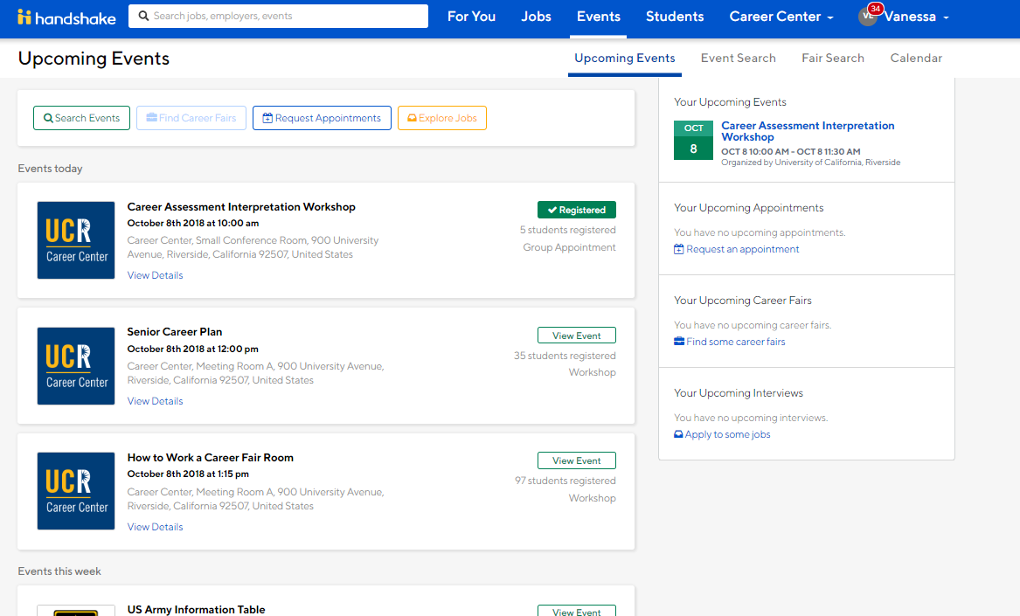

Slide 24
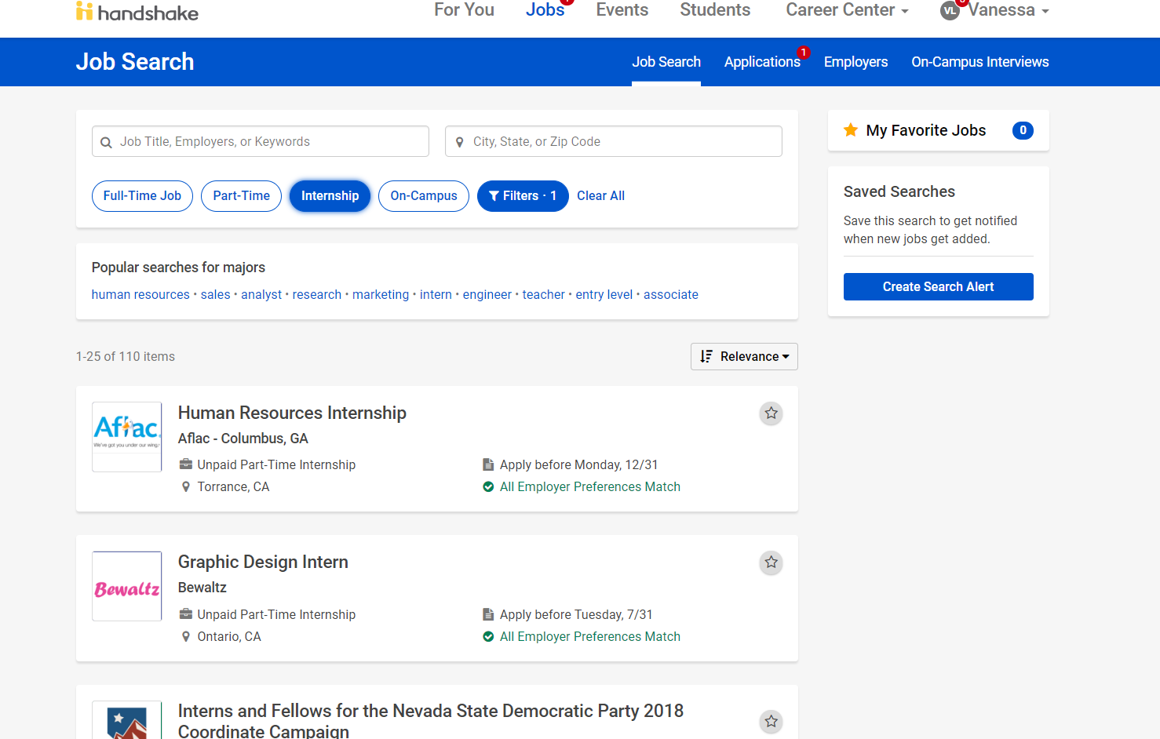

Slide 25
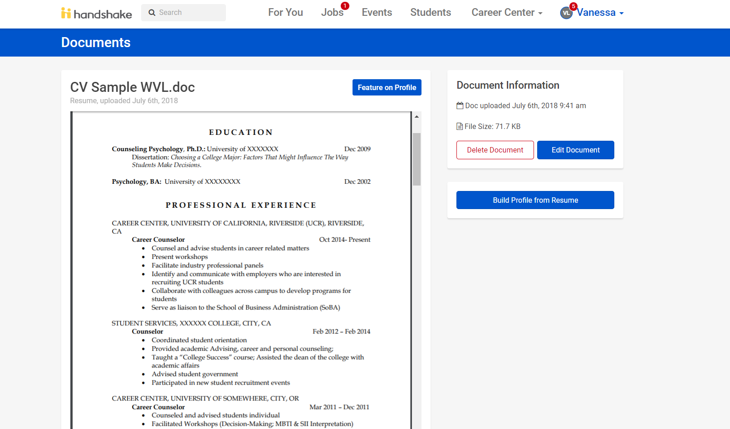

Slide 26
FAQ’s
When Should I visit
the Career Center?
Notes:
We advise that students use our services from their first year on campus. That way, they can establish a connection with the staff that can help shape their goals. We offer a full range of services to students from first year through graduate school. Career planning and development work is a process.

Slide 27
FAQ’s
Will the Career Center find me a job?
Notes:
No. Like most university careers centers, the Career Center has two foci; Employer Engagement & Student Development.
This way, employers choose the employees they want and students are confident that their basic skills are strong and flexible.

Slide 28
FAQ’s
Do Career Assessments tell me what career I should choose?
Notes:
Career assessments are an excellent resource for helping individuals make decisions about careers, but they do not measure skill or aptitude. They measure interests and temperament and show traits and interests we share with those in various career fields. Research is clear that sharing interests with those with whom we work helps us enjoy our jobs. When we enjoy our jobs we are more likely to be successful regardless of our skills.

Slide 29
FAQ’s
Where are we located?

Slide 30

More Questions??

Slide 31

To schedule an appointment
Call us at 951-827-3631
Or visit
the Career Center in person
Or Join UCR

