Slide 1

You can drop-in at the Career Center for a 10 minute resume critique?

Slide 2
Employers offer resume critiques at the Career Center throughout the quarter!

Slide 3
Recruiters spend 5-7 seconds looking at a resume?

Slide 4


Slide 5


Slide 6

Create a Handshake Account
1.
Log into go.ucr.edu/ucrhandshake with your UCR username and password.
2.
Create a new Handshake profile by adding your resume, photos, skills and more. Make your profile public to employers.
3.
Click “Jobs” in the menu bar and start applying. Save searches and sign up for notifications about future opportunities that match your interests!

Slide 7

Resume Writing
Notes:
N: What are we covering?
Examples + Putting into action

Slide 8

What is a resume?
Overview of experience
Qualifications & Credentials
Specific,
Relevant
Background
Update on a regular basis
Changeable Document
Your first impression
Notes:
Ask the audience, What is a resume?

Slide 9
Agenda
What is a Resume?
Resume Format
  Chronological Format
  Functional Format
Main Sections on a Resume
  Header/Contact Info
  Objective
  Education
  Experience
  Skills
  Activities
Tailor your Resume
Resume Checklist
Stuff not to Include on your Resume
Resume Activity
References
LinkedIn
Next Steps
Notes:
Customer service position using [specific] experience to improve...
A [position] using [specific skills] to [benefit for company]
Optional

Slide 10
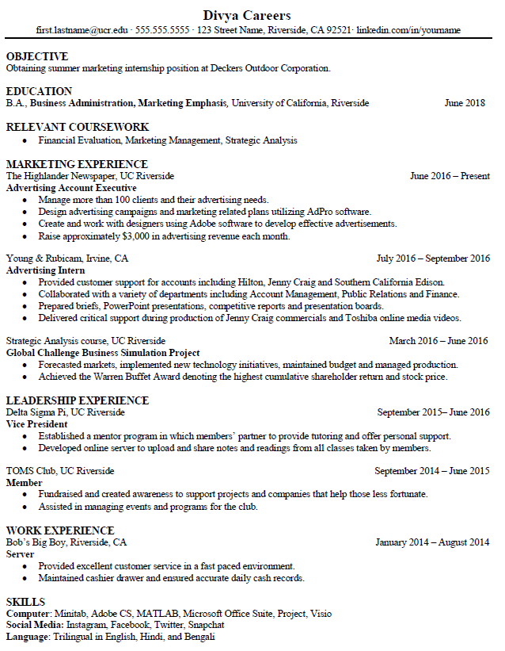
Chronological Format
  Presents education and work experience in reverse chronological order
                Recent
                Oldest
  Easy to read
  Most commonly used and preferred by employers
  Very effective if majority of education and work experience is related to role

Slide 11
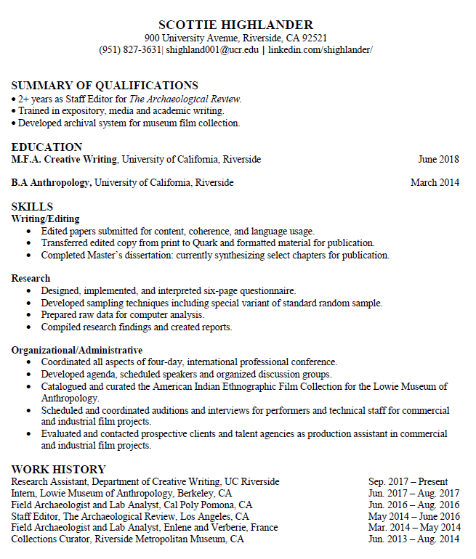
Functional Format
  Focuses on skills and abilities, not dates of employment
  Lists skills you’ve demonstrated which are required for a particular job
  Allows you to emphasize skills gained through volunteer work and co-curricular activities
  Often used by career changers, graduate students and postdoctoral scholars

Slide 12
1
Main Sections on a Resume
2
3
6
4
  Contact Information
  Objective (optional)
  Education
  Experience
  Skills
  Relevant Coursework
  Activities*
4
4
5
Notes:
We are going to take you through each section on your resume. Please open a blank Word document or use the resume handout to begin drafting your own resume. We will stop after each section and give you time to complete that section on your own. Ideally you have a draft of a resume before you leave!
Share main sections: note Relevant Coursework location/inclusion depends on relevance to position & Activities are not included on this resume but can be added usually at the bottom
Good resume example because there are easy to read experience sections, its well organized, and since they included an objective (optional) it is clear and concise

Slide 13


Contact Info, less white space
Contact Info, more white space
Notes:
Tips:
Professional email address
Name should be bigger than contact info
When listing contact information, be aware that too many addresses, phone numbers, and email addresses may actually make harder to reach you not easier. BTW, List the phone number you are MOST LIKELY TO ANSWER. These days that is usually your cell phone. Likewise, use the email address that you most often access. Companies have become familiar with YAHOO.MAIL and HOTMAIL and often expect candidates to use such “portable” addresses that do not close when you graduate. One caution, however, has to do with your email handle. While your friends may like to contact you at “SEXY_GIRL@HOTMAIL.COM” a recruiter may not see the humor. A simple address such as Jane.Doe@Yahoo.com will be fine.
You don’t need to list both your permanent and local address, use the address closest to the position you are applying to.
Be sure to personalize your voicemail recording so that employers know they’ve reached the right person & your first impression is both professional & friendly!

Slide 14
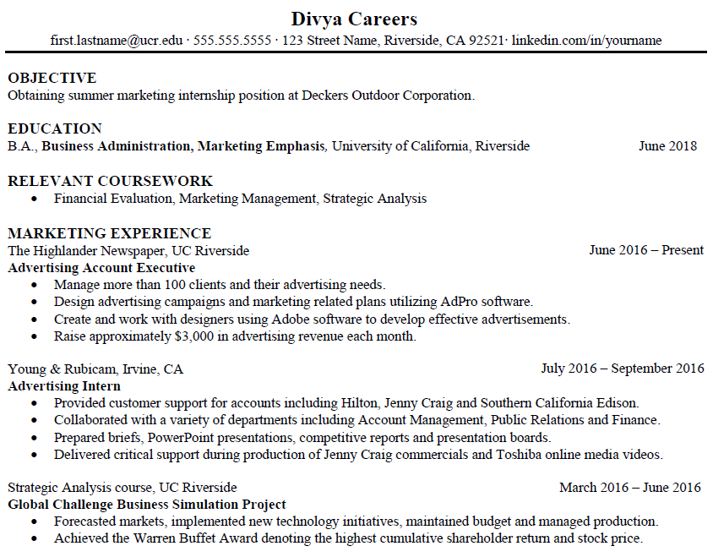
Objective

Slide 15
Objective (optional)
To obtain the [position] at [specific company].
To obtain a summer marketing internship position at Decker’s Outdoor Corporation.
Or…
Recent history graduate with experience in administrative operations, seeking position with ABC Widgets as a Manager Trainee.
Notes:
Customer service position using [specific] experience to improve...
A [position] using [specific skills] to [benefit for company]
Optional

Slide 16
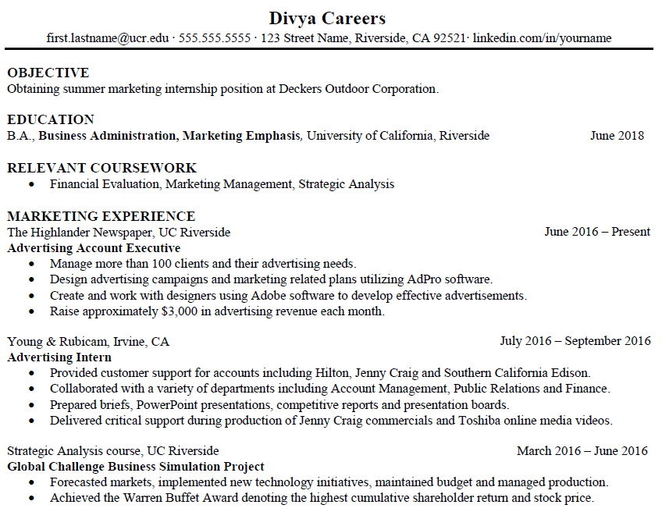
Education

Slide 17
Education
EDUCATION
B.A., Business Administration, Marketing, University of California, Riverside June 2019
A.A., University Studies, Chaffey College, Rancho Cucamonga, CA June 2017
Relevant Coursework
Financial Evaluation
Marketing Management
Strategic Analysis
Tips:
Most recent degree first
Dates on the right hand side to avoid “white” space
Include minors if relevant
Only list schools from which you receive a degree
GPA is optional
Relevant courses or study abroad
Notes:
Keep the education section very simple as well. Do not include GPA unless requested specifically requested by the employer. Do not include information about your minor unless it is specifically germane to your job. (For instance, if you have a major in Economics and a minor in Information Systems and you are applying for an accounting job, it is not relevant, but if you are applying for an IT job, then it becomes relevant. Abbreviate your degree. Everybody knows that BA means Bachelor of Arts and it saves a whole bunch of space
Note: The concentration is listed here because the objective of the resume is a marketing internship

Slide 18
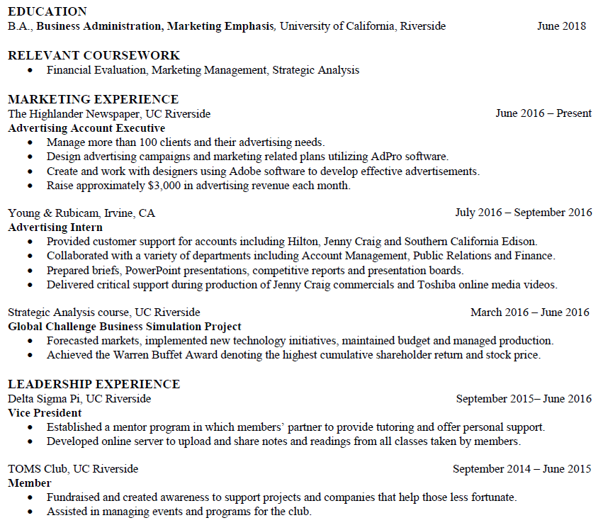
Experience
Experience

Slide 19

What counts as experience?
Paid or unpaid
Presentations or public speaking
SERVICE in student organizations
Formal or informal faculty research
Volunteering and internships
Class projects, labs, MAJOR assignments
Notes:
Perhaps the most common questions we hear at the Career Center have to do with experience. Most college students are stumped when they are asked about their experience because many have not had full-time positions erroneously believe that prospective employers only care about full time positions. So what the heck is experience anyway?
Briefly put, experience can be paid or unpaid. Must involve a specific task or objective and must have some sort of external accountability. For instance, the following may not be seen favorably by an employer:
“Learned C++ programming.”
But this would be a plus:
“Received an “A” on class project using C++ programming skills to encode garage door opener.”
Presentations, holding an office in a student group, working formally or informally on a faculty research project, community volunteering, internships, and MAJOR class projects ALL can count… as long as there was an external monitor following your progress.
Should you omit non-relevant jobs? If you are sure the jobs is completely irrelevant, do not include it. However, sometimes a job is in a completely different field, but it equipped you with transferable skills which are important to a new job. For instance, working in fast food might be seen as irrelevant to someone seeking a position in logistics. If the fast food job included substantial inventory, ordering, and materials management responsibilities, then it should be kept and these duties included. This is an area in which many student can supplement a lack of work experience. Include internships, volunteers experience, club and social group activities that give foundation to transferable skills. If you are a member of the Young Collegians and have served on a planning committee for a community event highlight the committee work as an example of communication and planning skills.
By the way, if you are considering graduate school, undergraduate research is very important. It establishes your research credentials and it indicates why professors or teaching assistants are writing letters of recommendation for you.

Slide 20
How Do I Talk About Experience?
Not job title, but tasks
  Cashier…Try this:
    Operated cash register and balanced $1500 in receipts
Accomplishments, not duties
  Responsible for sales…Try this:
    Awarded associate of the month for record-setting sales
Use “action” words
  Responsible for tutoring students… try this:
    Established positive rapport with 15, 6th graders, assisting them in Language Arts
Notes:
Let’s answer the last question first. Should you omit non-relevant jobs? If you are sure the jobs is completely irrelevant, do not include it. However, sometimes a job is in a completely different field, but it equipped you with transferable skills which are important to a new job. For instance, working in fast food might be seen as irrelevant to someone seeking a position in logistics. If the fast food job included substantial inventory, ordering, and materials management responsibilities, then it should be kept and these duties included.
In most situations, jobs will be listed with most recent job first and should include your title, company name and location, dates employed,
and responsibilities.
Be sure to list all duties performed on the job, using action verbs to describe your work. One of the best list of action verbs is available at the Quintessential Careers website at http://www.quintcareers.com/action_skills.html. Use phrases like “Drafted annual report” or “Promoted showroom merchandise” instead of “Responsible for annual report” or “Folded shirts and pants.”
In your first resume, list ALL experience. It is easy to cut out unnecessary fluff, but it is difficult to add later. Cutting and pasting is your friend.

Slide 21

Experience Examples/ TAR Method
Work Experience
Lifeguard
Sand Point Country Club, Temecula, CA June 2017 – September 2019 (Summers)
Taught summer swimming classes for up to 15 children ages five to ten, focusing on core techniques and safety
Monitored swimming areas for rule violations and drowning victims
Assisted in maintaining pool facilities and recreation areas surrounding pool areas
Spearheaded entertainment activities sponsored by country club
Supervised coworkers during assigned shifts at check-in and concession stand
Notes:
Redo to highlight TAR method >> 1 bar/2 bar/3 bar to distinguish
-----------------------------------------------------------------------
Tailor your section headings to the position you are applying to!
You can break up your experience by grouping like experiences together and using the tailored section heading to highlight a set of experiences relevant to the job applying to
Most recent first with title, organization, location, and dates
Describe responsibilities with action verbs in the proper tense
Use industry language, numbers, and describe accomplishments
Avoid personal pronouns (I, my, or me)
-------------------------------------------------------------------------------------------------------
***N: TAR Method example

Slide 22
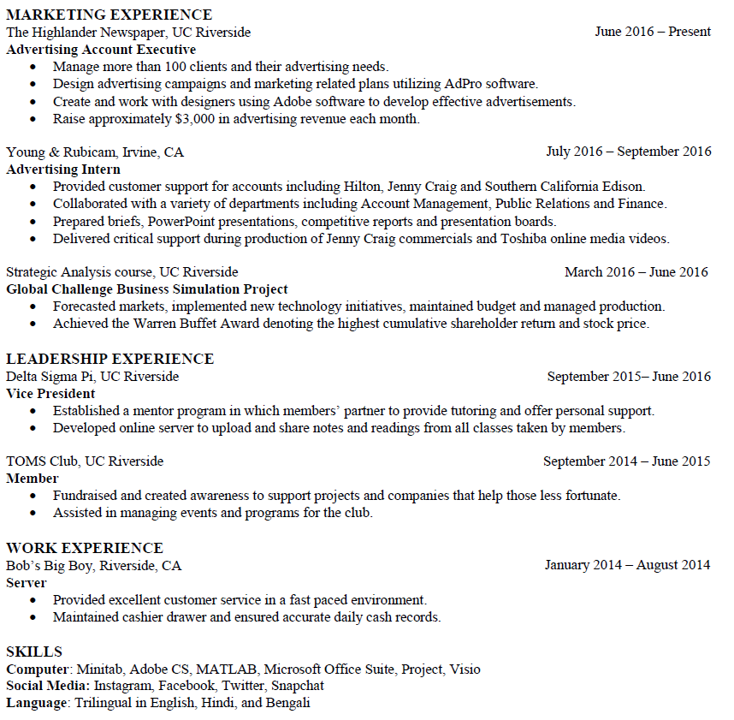
Skills

Slide 23
You’ve Got Skills!
Skills
Computer: Minitab, Adobe CS, MATLAB, Microsoft Office: Word, Excel, PowerPoint, Access, Project
Social Media: Instagram, Snapchat, Twitter, Facebook [*Business Use Only*]
Language: Bilingual in English and Spanish (reading, writing, speaking)
Technical Skills
Programming: C/C++, html, Windows, UNIX
Software: Microsoft Word, PowerPoint, Excel [*Add only if do not have “Computer Skills” section]
Laboratory Skills
SDS-PAGE, PCR/Cloning, ELISA, Electrophoresis, Spectrophotometry Computer Data Analysis, Amino acid analysis, Microscopy, DNA/Extraction/Quantification
Notes:
There are two kinds of skills you pick up on jobs, transferable experience and specific experience.
Transferable skills are those skills that work anywhere. Assisting customers at Mervyns requires the same sort of tact and patience as assisting clients in an accounting firm, so do not underrate the skills you have learned in part time jobs.
Tips:
Consider separating technical skills specific to your field
Quantify skills whenever possible
------------------------------------------------------------------------------------
***Higher in some situations based on job role (I.e. Technical and Laboratory Skills)
***Social Media
Languages (specification of capabilities)

Slide 24
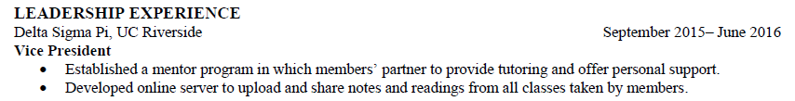
Difference Between Experience & Activity
Experience is described with bullet points that describe the relevant skills & experience acquired in a role.
Activity lists a membership or volunteer activity that is less relevant and/or less of a time commitment.
Notes:
Include campus and off-campus involvement in student organizations & volunteer organizations
Highlight scholarships and university honors

Slide 25

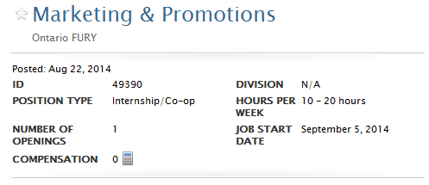
Tailor Your Resume
Qualifications
• Candidates must possess excellent oral and written communication skills
• Proficiency in Microsoft Office (Excel, Power Point, etc.)
• Highly motivated, with a positive attitude
• Enthusiasm for and/or experience in professional sports industry
• Thoroughness and attention to detail
• Ability to work in a fast-paced environment and multi-task
• Must have high level of interpersonal skills to handle sensitive and confidential situations and information
• Strong customer service skills required
• Working towards a BA/BS in Marketing, Advertising or related field
September 12, 2017
December 1, 2017
Description
The Marketing and Promotions interns are responsible for assisting the marketing team in developing and implementing strategic marketing, advertising, promotions and public relations strategies. The intern will be out in the community helping promote the Fury brand.
Notes:
There are two kinds of skills, transferable and specific.
Transferable skills are those skills that work anywhere. Assisting customers at Mervyns requires the same sort of tact and patience as assisting clients in an accounting firm, so do not underrate the skills you have learned in part time jobs.
Specific skills are less likely to be valued in all job environments. The fact that you can program in C++ may impress an engineering firm, but will not get you an interview in marketing firm…. Unless the firm is marketing software products.
LAB SKILLS
SDS-PAGE PCR/Cloning ELISA
Electrophoresis Spectrophotometry Computer Data Analysis
Amino acid analysis DNA/Extraction/Quantification Microscopy

Slide 26
Tailor Your Resume: Try it!
OBJECTIVE
To obtain the Marketing and Promotions Internship with the Ontario FURY.
EDUCATION
Bachelor of Arts, Business Administration, Marketing Concentration June 2017
University of California, Riverside
Relevant Coursework: Sports in the 21st Century, Creative Marketing, Interpersonal Communication
EXPERIENCE
Collaborated with 5 community sponsors to raise approximately $1,000 for the annual UCR Basketball Homecoming
SKILLS
Computer: Microsoft Office: Excel, PowerPoint, Word, Adobe Photoshop
Social Media: Facebook, Twitter, LinkedIn, Instagram, YouTube
Language: Bilingual in Spanish and English (reading, writing, speaking)
Notes:
REWORKED + have the transitions function OR do we need a redesign?

Slide 27

Resume Check List
One page maximum
10-second glance: most relevant first
Tailor your resume to the position
Use industry language to describe experience
All relevant experience, paid or unpaid
High school experience (Juniors + remove this)
Avoid personal pronouns (I, me, my)
Use appropriate verb tenses
Error free (both spelling and grammar)
Notes:
Typically one page—except extensive, relevant skills
20 second glance- explain!
Job description language
High school experience—omit after first year, unless

Slide 28

Stuff NOT to Include in an Application
Include your picture
List age, marital status and other demographic information
Send as a word doc – save as PDF before sending
Reference – create a separate page

Slide 29


Let’s Try It!
Take 5 minutes to independently work on your resume
- Include your Contact Information section, Education section, 1 Experience with 1-2 bullet points, Skills Section
Take another 5 minutes to pair off with a partner and review your Resumes and provide feedback.

Slide 30

What else do you need?
References Page
Develop your LinkedIn
Resume review

Slide 31

References
A reference is someone who:
  knows your work habits
  has known you for a long time
  is credible
  is not just a personal friend or your mother
Contact your references before
  Ask if they are willing to give you a positive
  reference
Make sure their information is correct
  Names, job titles and phone numbers
Notes:
Finally, references are important and should likely be included as a separate sheet from your resume.
Who might that include? Supervisors, co-workers, professors
ALWAYS let people know that you wish to use them as a reference.
Who?
Someone you have worked with
Someone you have known for a long time
Someone who is credible
Supervisors, co-workers, professors, customers
Contact your references before
Make sure you have all the correct information- names, job titles, and phone numbers

Slide 32
References Format Samples
SCOTT BEARS
900 University Avenue, Riverside, CA 92521
555.555.5555
scott.bears@gmail.com
www.linkedin.com/scottbears
REFERENCES
Name
Position
Company/Organization
Phone number
Email Address
Professional Relationship
Note: Your format for the reference should be the same as your resume’s header format.

Slide 33
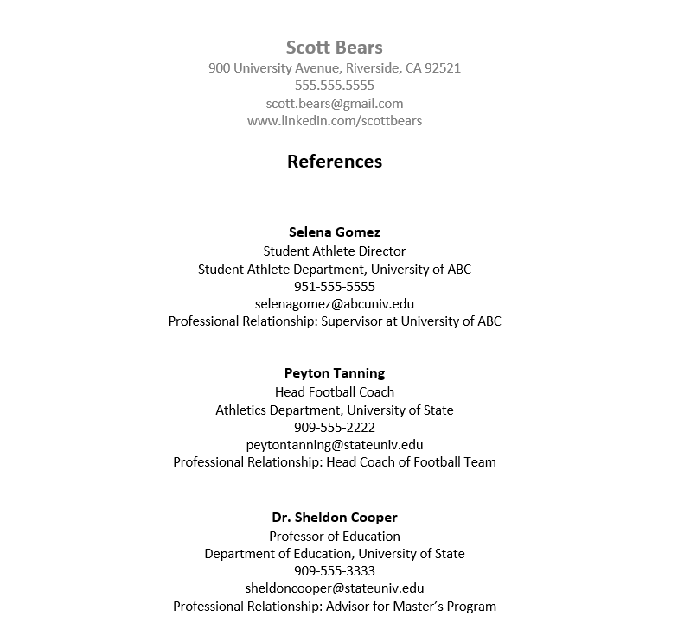

Slide 34

Why?
75-80% of jobs are found through the hidden marketplace
HR recruiters are using LinkedIn to reduce recruitment costs
Create a profile
Use new student-focused sections
Maintain current & complete content
Upload your resume
Attend a “Mastering LinkedIn” workshop
Notes:
According to a recent study, 56% of employers use social networking sites to recruit
Career Explorer—For students: explore career paths, navigate LinkedIn, connect with professionals and currently free to post entry level positions for employers
LinkedIn just launched a "Apply With LinkedIn" button, which employers can embed on their websites, just like a Facebook "Like" button. When a candidate hits that button, their LinkedIn profile will be automatically be submitted for the position (rather than a resume). It will also show them if they have any contacts at the company they are applying to, and allow them to send those contacts a message.

Slide 35
Next Steps
Have your resume critiqued during a 10 minute Drop-In at the Career Center
(Mon-Thurs 10-3, Fri 10-12)
Upload your Resume to UCR Handshake & complete your UCR Handshake profile

Slide 36

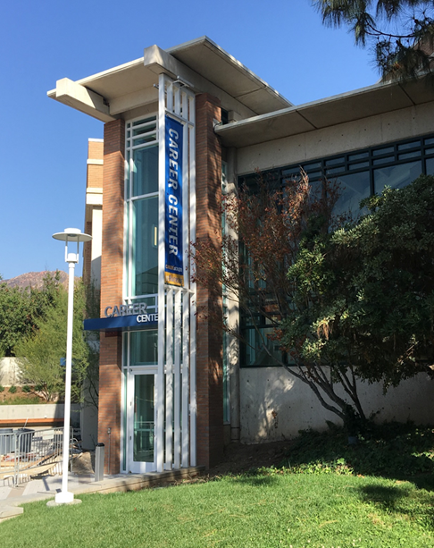
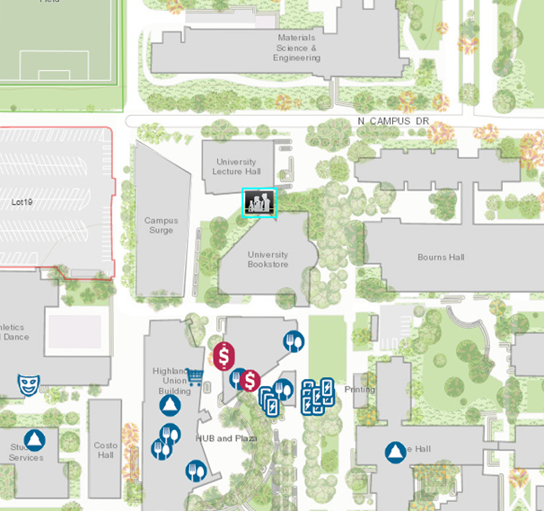
Come See Us!
Hours:
Mon. - Fri. 8 am to 5 pm
except Wed. 9 am to 5 pm
Drop-In Hours:
Mon. - Thurs. 10 am-3pm
Fri. 10 am-12 pm

