Slide 1

Many employers are interested in engaging 1st & 2nd year students via Early Identification Programs?

Slide 2


Slide 3


Slide 4





Second Year Career Plan

Slide 5




SECOND Year Career Plan
Your step-by-step guide to career planning success
Notes:
You can use this slide as your opening or closing slide. Should you choose to use it as a closing, make sure you review the main points of your presentation. One creative way to do that is by adding animations to the various graphics on a slide. This slide has 4 different graphics, and, when you view the slideshow, you will see that you can click to reveal the next graphic. Similarly, as you review the main topics in your presentation, you may want each point to show up when you are addressing that topic.
Add animation to images and graphics:
Select your image or graphic.
Click on the Animations tab.
Choose from the options. The animation for this slide is “Split”. The drop-down menu in the Animation section gives even more animations you can use.
If you have multiple graphics or images, you will see a number appear next to it that notes the order of the animations.
Note: You will want to choose the animations carefully. You do not want to make your audience dizzy from your presentation.

Slide 6
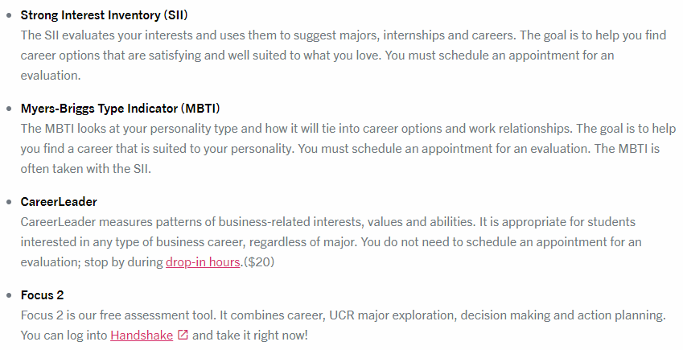
We Recommend
Meet with a career counselor
Take a career assessment.
Notes:
When conducting research, it is easy to go to one source: Wikipedia. However, you need to include a variety of sources in your research. Consider the following sources:
Who can I interview to get more information on the topic?
Is the topic current and will it be relevant to my audience?
What articles, blogs, and magazines may have something related to my topic?
Is there a YouTube video on the topic? If so, what is it about?
What images can I find related to the topic?

Slide 7
We Recommend
Attend a Choosing a Major workshop
Explore the UCR General Catalog: catalog.ucr.edu
Meet with your academic advisor
Explore UCR Alumni on LinkedIn
Notes:
When conducting research, it is easy to go to one source: Wikipedia. However, you need to include a variety of sources in your research. Consider the following sources:
Who can I interview to get more information on the topic?
Is the topic current and will it be relevant to my audience?
What articles, blogs, and magazines may have something related to my topic?
Is there a YouTube video on the topic? If so, what is it about?
What images can I find related to the topic?

Slide 8








Slide 9

We Recommend
Get involved in a student organization and/or volunteer for a cause that interests you
Conduct an informational interview with a professional in a career that interests you
Check out the Career Center Calendar
Explore UCR alumni on LinkedIn

Slide 10
We Recommend
Attend a Resume Writing Workshop
(Bring your laptop or tablet)
Find resume samples at careers.ucr.edu
Upload your resume into UCR Handshake
Continue to add to your resume as you
gain more experience
Attend an Ace the Interview workshop

Slide 11
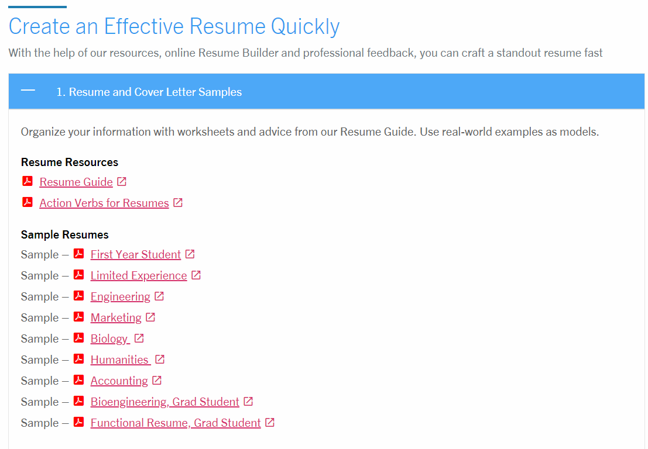

Slide 12
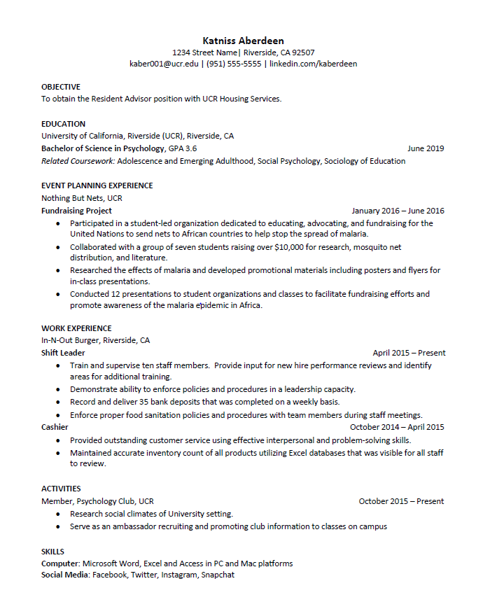

Slide 13




We Recommend
Use your UCR Handshake account
EIPs, OCI, UCDC, UC Sacramento
Use LinkedIn
Attend Career Center job fairs, internship and part time job events
Find additional job and intern listings, as well as opportunities abroad at careers.ucr.edu
Explore study abroad opportunities at international.ucr.edu/abroad

Slide 14

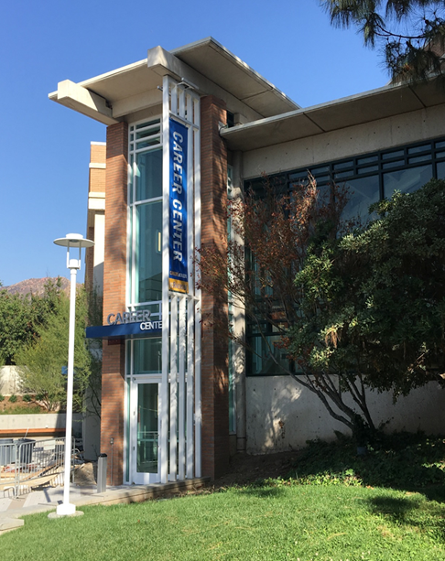
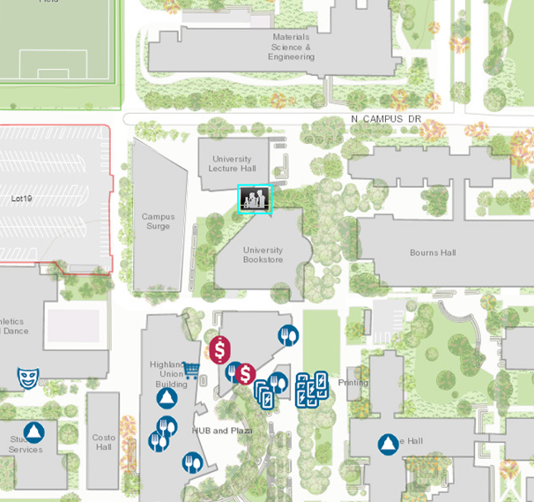
Come See Us!
Hours:
Mon. - Fri. 8 am to 5 pm
except Wed. 9 am to 5 pm
Drop-In Hours:
Mon. - Thurs. 10 am-3pm
Fri. 10 am-12 pm

