Slide 1

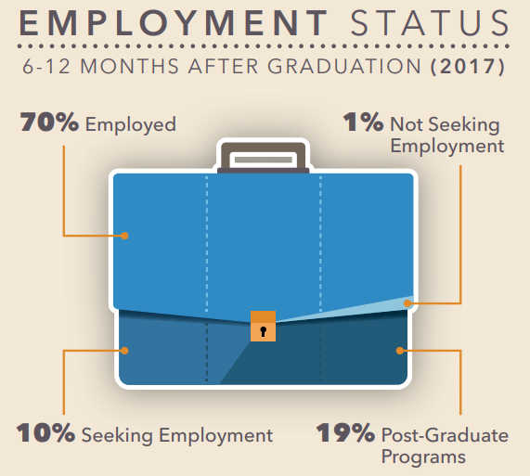

Slide 2
14,190
Full-Time Jobs
were posted on Handshake in 2018-2019

Slide 3







Graduate Schools where the Class of 2019 enrolled

Slide 4


Slide 5


Senior Career Plan
Senior Career Plan
First Year-Senior Series
#UCRCareerReady
Notes:
Show Senior Career Plan You Tube video https://www.youtube.com/watch?v=um7-nhEHT44

Slide 6
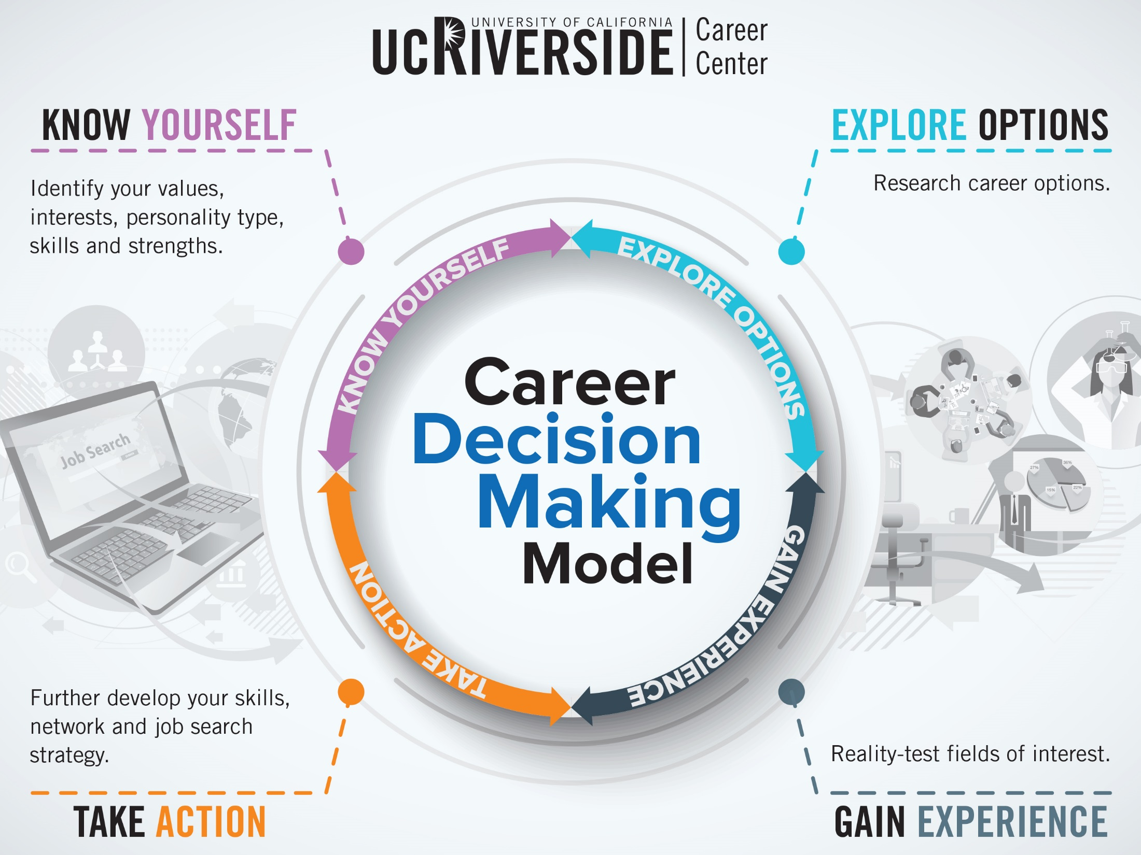

Slide 7




Notes:
It’s your senior year - prepare to stand out! To get ready for a successful transition to the next chapter of your professional journey, have a polished resume, excellent interviewing skills, and internship or job experience. Take steps now to complete tasks for employment or graduate/professional school admissions.
Start the workshop by asking attendees to turn to their neighbor and ask each other if they are ready for graduation and why? Ask individuals to share with the group.
Have a group discussion regarding the questions on the slide.
If students are uncertain about the answers to any of the questions on the slide:
Mention self-reflection- Getting to know yourself will give you a better understanding of what you want in life. What classes have you liked or disliked? What jobs, volunteer or on campus experiences have you enjoyed or not enjoyed? Do you like working in groups or individually? What is important to me within a workplace?
These are just a few questions to get you thinking about what career path might interest you.
If you don’t know at this point, take an assessment to help you narrow down your options and understand the work environment you would thrive in.
-Do you know your personality type, interests, skills and values
http://careers.ucr.edu/careerplanningcounseling/careerplanningcounseling.html
*The Career Center can help you explore, identify resources, set goals and build job and search skills.

Slide 8
Notes:
Employment
Can you work in the field of your choosing without a grad or professional degree?
What are your career options?
Research Career Job Outlook, Salary, Education, Training, etc.
ONET www.onetonline.org
BLS www.bls.gov/ooh
Scotjobs careers.ucr.edu
Explorehealthcareers.org
Careers.ucr.edu- Careers in your major
http://careers.ucr.edu/careerplanningcounseling/careersmajor/careersmajor.html
You need to be prepared in order to successfully land a career upon graduation.
Expand Your Opportunities!!!
-Decide on where you are willing to move to. Identify a target radius of places you are willing to work.
Build Your toolkit-
Resume, cover letter, portfolio, online brand
Resume Builder
Online resources “handouts” section – www.careers.ucr.edu
Preparation
-Meet with a counselor and personalize your strategy
-Interviewing Skills (Mock Interview Tool in SCOTLink )
Scotlink: Careershift, Vault, Scotjobs, Nacelink
Indeed.com, SimplyHired.com, Glassdoor, CareerTV
LinkedIn
Professional Associations
On Campus Interviews
Career Fairs
Take Action
-Start applying for Jobs/Internships on regular basis!!!
Put your resume in RESUME BOOKS available through SCOTlink
Continue to build your network or START NOW!!
Internships/Volunteering
Enhance your skills in public speaking (toastmasters, student orgs), writing, computer programs
Visit the career center for assistance with all of the above
Remember, once you graduate you can still have access to the Career Center resources for 90 days and then for a small fee.
Create a personalized strategy and identify your next steps with a career counselor.
Attend these workshops and events: Career Fairs, the Senior Success Series, Job Discovery Series, Employer Information Sessions, Seniors: Land A Job for When You Graduate Now (OCI), How Not to Get Fired: Professional Etiquette, Where Are the Jobs? The Hidden Job Market, What’s My Worth? Salary Negotiation, Dining Etiquette and LinkedIn: Your Job & Internship Search.
Utilize social media to network with employers
Set up search agents based on career interests in SCOTjobs to alert you of new postings and opportunities.
Participate in the On Campus Interview program. Log into SCOTLink. In SCOTjobs select “Advanced Search” and “Show Me - Only Employers Interviewing at the Career Center.”
Maximize your exposure by adding your resume to an Opt In Resume Book in the Documents tab of your SCOTLink account.

Slide 9
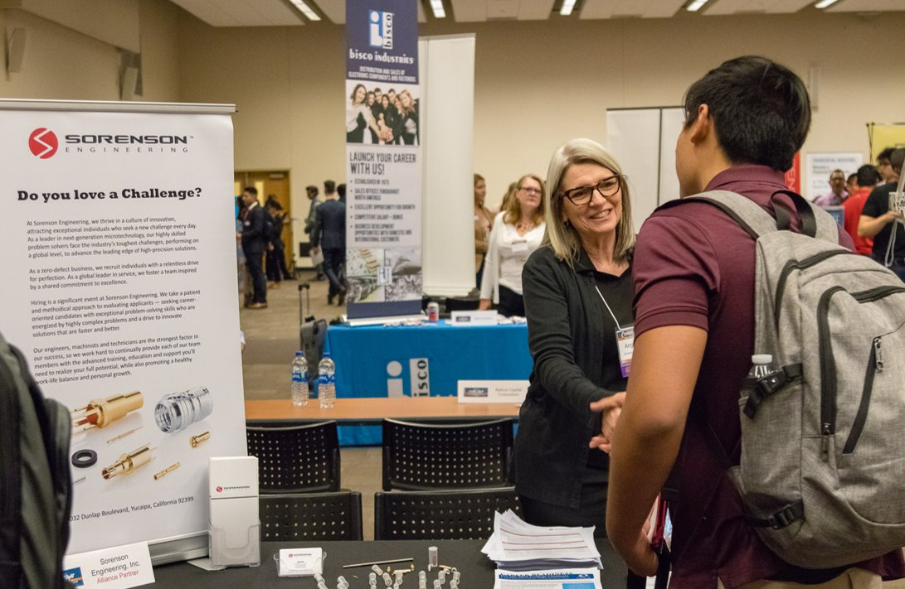


Have you...
Met with a career counselor?
Logged into UCR Handshake?
Attended Career Events?
Set up a job search agent?
Networked with employers via social media?
Practiced your interview skills?
Participated in the On-Campus Interview Program?

Slide 10

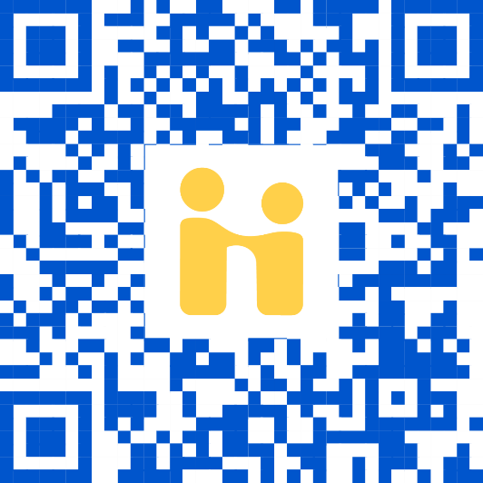
A personalized feed of jobs, internships, events and resources — like Netflix but for careers!
A “Favorite” option to know when top employers are posting jobs and coming to campus.
A seamless experience across all devices: phones, tablets and computers.

Slide 11
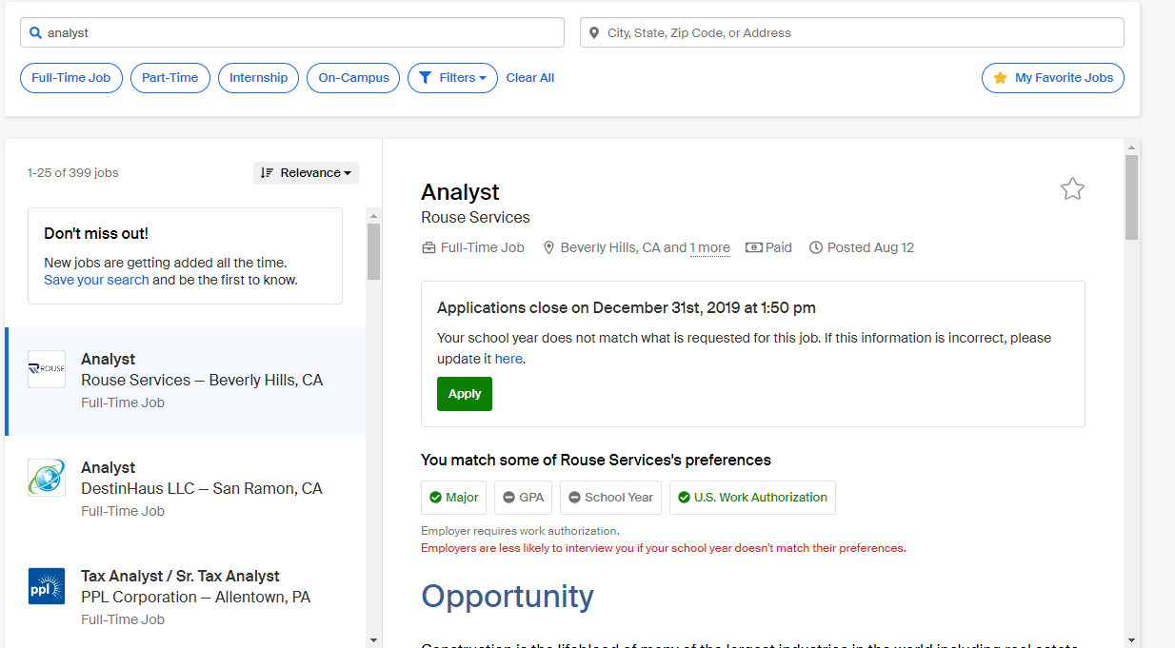
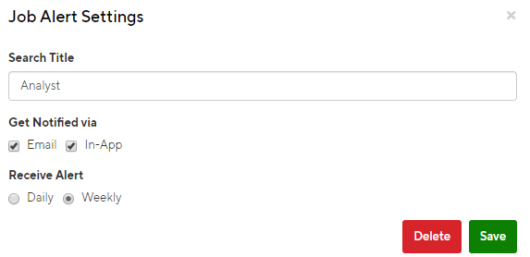

Slide 12
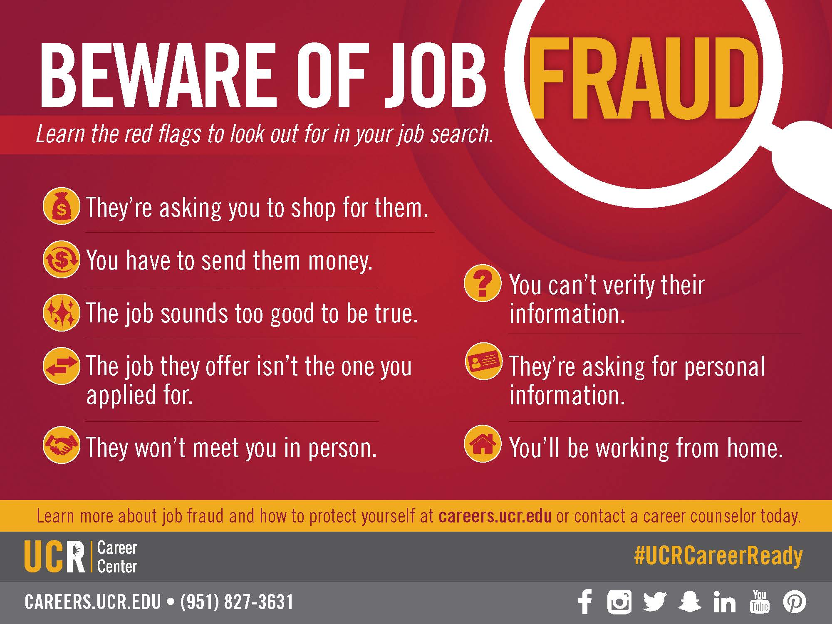

Slide 13
Notes:
Okay so you are going to Grad/Professional School….
See a career counselor to ensure you are on target to achieve your graduate/professional school goals. Refer to the College-Specific Game Plans for timelines, and attend Graduate/Professional School Fairs to network with representatives.
Attend Graduate and Professional School Information Day, Law School Information Day, and Health Professions School Information Day.
Complete graduate/professional school applications and apply.
Continue to get related research, on-campus, community and volunteer experience.
Research programs- Deadlines, test prep, personal statement, letters of rec
GRE, GMAT, MCAT, CBEST, LSAT, Petersons.com, phds.org, academic resource center, Kaplan, HPAC

Slide 14
Have you...
Attended the Discovering... Series?
Attended the Graduate & Professional School Information Day, Law School Information Day, and Health Professions School Information Day Fairs?
Completed applications and applied?
Thought about continuing to get related, on-campus, community, and/or volunteer experience?

Slide 15













Notes:
Continue to network and get internship or work experience before you graduate to verify your interests and build experience. Keep track of where you have applied for jobs, and follow up with employers and/or graduate school admissions representatives.
Use a “To Do List” to stay organized.
Develop a system, such as an Excel spreadsheet, to keep track of where you have applied.
Continue to develop and maintain your professional contacts.
-Make sure to develop a system that works for you in following up with place you have applied. Look into Management Training programs, Diversity programs, leadership development programs, maintain professional contacts- faculty, staff, etc..
Log on to website to direct students towards “Career Plan” handouts.

Slide 16
Are you...
Developing a system to keep track of your applications?
Continuing to develop and maintain your professional contacts?

