Slide 1


To Be or Not to Be?
Graduate & Professional School Edition
Notes:
To use this title animation slide with a new image simply 1) move the top semi-transparent shape to the side, 2) delete placeholder image,
3) click on the picture icon to add a new picture, 4) Move semi-transparent shape back to original position, 5) Update text on slide.

Slide 2

Important Items
Mentor Follow-up through : e-mail, phone call, in person one-on-one etc.
Workshop passport. Make sure to attend at least 3 of our workshops or you can meet with us to go over certain topics of interest
Informational Interview with a desired Professional. Make sure to meet up with a professional to discuss the daily tasks, educational background and experience
LinkedIn Profile

Slide 3

Agenda
1
2
3
4
5
Undergraduate vs Graduate Education
Common Myths
Types of Degrees
Program Considerations
Application Pieces

Slide 4

Undergrad vs.
Grad

Slide 5

Undergrad...
Learner (Novice)
Broad Foundation
Externally Directed
Passive Learner
Graduate/Professional...
Colleague to Expert
Development of Specialty
Self-Directed
Active Learner & Creator

Slide 6
Common Myths

Slide 7
Myths
Jobs in the sciences or psychology require advanced degrees
Consider long term career goals
While many fields require advanced degrees, most do not
Many opportunities exist for those with undergraduate training only

Slide 8
Myths
The more education I have, the more money I can make once I have a job.
Consider the cost of attending graduate school vs. the lost income potential
Education + Experience = Earning Potential
Not all graduate degrees directly correlate to a higher salary

Slide 9
Myths
I’m not ready to find a job, but I’ve done well in school. I’ll go to grad school until I’m confident about the job market.
Graduate school is not meant to replace your job search
An advanced degree without practical experience may undermine your career success
An advanced degree may result in being overqualified for jobs of interest

Slide 10
Types of Degrees

Slide 11


Types of Degrees
Master-Level
Master of Arts (MA)
Master of Science (MS)
Master of Business Administration (MBA)
Doctoral (Academic and Professional)
Doctor of Philosophy (PhD)
Doctor of Education (EdD)
Juris Doctor (JD)
Others
Certificates
Post-doctoral
Combination (MD/PhD or MBA/JD)

Slide 12
Post-Baccalaureate Programs
.... change your career?
Have a bachelor’s degree but want to...
A Post-Baccalaureate program may be for you
.... improve academic standing for graduate/professional school?
.... earn a second bachelor’s degree?

Slide 13
Post-Bac Programs are...
Not considered traditional graduate education, but are more advanced than a bachelor’s degree
An option to take pre-requisite courses for graduate or professional programs
Typically eight to 12 months in length

Slide 14
Program Considerations

Slide 15
Choosing a Program
Quality
Prestige
Other...
Location
Faculty
Research
Cost

Slide 16



Program Considerations
Finding programs

Slide 17

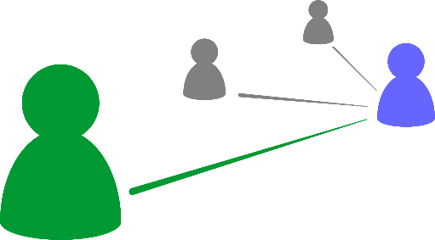
Program Considerations
Cohort Model
Course Structure
Highly structured
Fewer electives
Peer Networking
Strong network with peers
Limits external interaction
Time Structured
Standardized time frame
Not flexible

Slide 18
Program Considerations
Research or Applied Programs
Emphasis
Theory
Practice
Area of Study
Specific
Broad
Faculty Relationship
Advisor
Mentor
Final Project
Thesis/Dissertation
Exam/Portfolio/Practicum
Structure
Independent
Cohort

Slide 19


Program Considerations
Campus or Online
Campus
In class discussions
Access to faculty/peers
Access to campus services
Financial aid options
Online
Online forums
Flexibility
Self-motivated
Study space

Slide 20

Program Considerations
What are my career goals after graduation?
Questions to ask yourself:
What kind of relationship do I want with my peers?
What is my work-style like?

Slide 21
Program Considerations
Financial Aid
Institutional Funding
Teaching Assistant
Graduate Assistant
Research Assistant
Fellowship
Scholarships
Merit-based
Need-based
Loans
Subsidized
Unsubsidized

Slide 22
Application Pieces

Slide 23

General Application Pieces
Resume
Transcripts
Exam Scores
Personal Statement
Letters of Recommendation

Slide 24
Transcripts
Application
Exams
Official
Unofficial
Leave enough time to mail
Institutional
Program-Specific
Find your best study method
Schedule early enough to allow for scoring
Personal Statements
Letters of Recommendation
Share motivation and preparation
Ask admissions representatives questions
Highlight unique qualities and career goals
Use the ARC
Ask several weeks in advance
Provide resume and highlights
Writers should speak to academic preparedness and/or professional competence

Slide 25
Staying Organized

Slide 26



Stay organized
Find a way to keep track of your program research or application status that works for you

Slide 27

Choosing a Program
Yellow Ribbon Program Information
Accrediting Bodies
Petersons.com
Gradschools.com
Quality/Prestige
Cost
Location
Faculty/Research
Other…

Slide 28

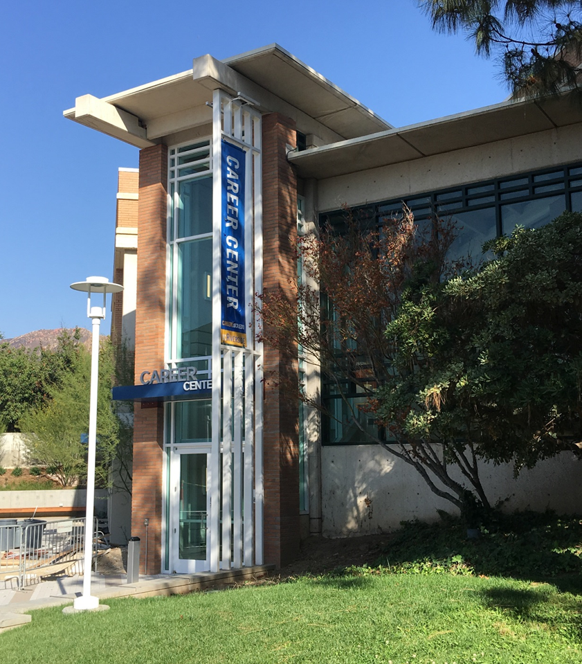
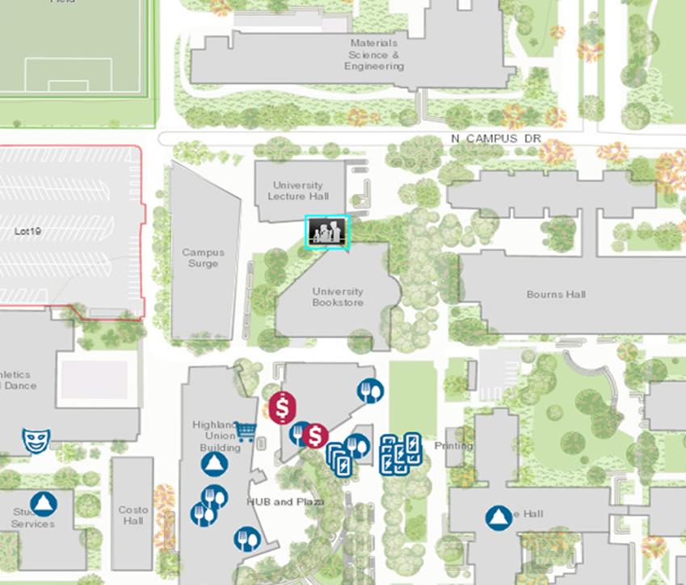
Come See Us
Hours:
Mon. - Fri. 8 am to 5 pm
except Wed. 9 am to 5 pm
Drop-In Hours:
Mon. - Thurs. 10 am-3pm
Fri. 10 am-12 pm

