Slide 1
To Be or Not to Be: Law School Edition
Make the right decision for your career

Slide 2
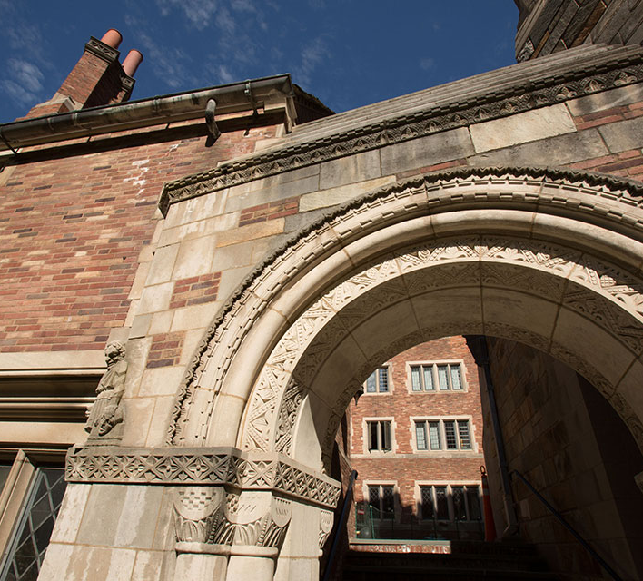
Divider slide
Ice Breaker Activity
Turn to your neighbor
Introduce yourself (name and major)
Share why you are interested in going to law school
What does it mean to you to get your Juris Doctorate(J.D)?

Slide 3


Agenda
Careers with a Juris Doctorate
2. Prepare to apply to Law School
3. All about the LSAT, transcripts, personal statements and letter of recommendations
5. Things to Remember

Slide 4

Careers with a Juris Doctorate

Slide 5

Always leverage off of your degree
5
A Juris Doctor (J.D.) is the degree awarded to law school graduates.
Most J.D. programs are three-year programs and there are other four-year programs that are part-time and a couple that are accelerated programs that are two-year programs.
After you pass the state bar exam then graduates can practice in any area of law.
Notes:
Patent law requires a technical undergraduate major (or substantial coursework in science courses) and a passing score on the patent bar exam. For more information on patent law requirements, go to the United State Patent and Trademark Office (USPTO). (Penn State University)
A J.D. can also lead to a range of law-related careers in government, politics, business, higher education, alternative dispute resolution, consulting, public interest advocacy, and numerous other fields.
Don’t confuse the J.D. with the LL.M., a masters of laws degree for students who have already earned their J.D. or for international students with a legal background who want to learn U.S. law.

Slide 6
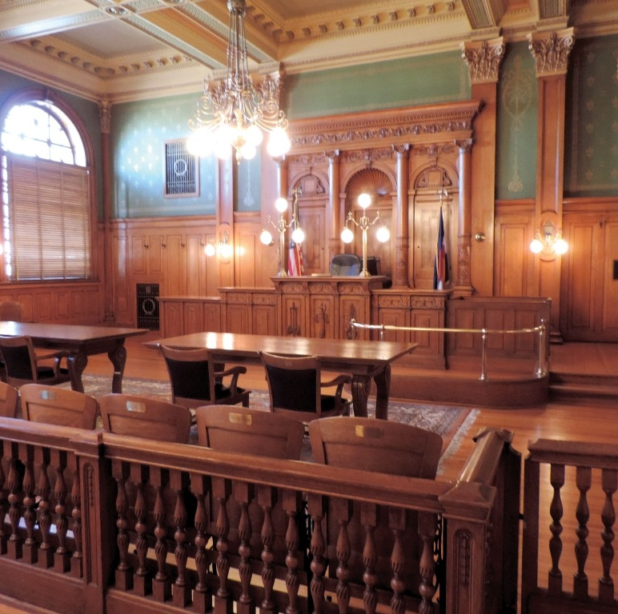

COMPARISON 1
Lawyer
Research lawyers
Public defenders
Junior associates of private law firms
Once they pass a state bar exam, individuals can also pursue legal specializations including professional litigator, corporate counselor, and civil defense attorney
After years of long hours and simple assignments, lawyers may earn partner or senior associate status, though competition for these positions is fierce. (High working standards and ethics play a part in a lawyer's likelihood of being promoted, along with having good contacts and references.)
Business: Corporations, Real Estate as a Broker
You can earn a dual degree for example an MBA and JD combines
Public Service Careers
Politics
Social work
Human Resources
Community Associations
Specialized degree in public health, political science, urban planning, international studies, political science or public policy
Creative Arts:
Copyright law
Media law
Intellectual property laws
Notes:
Business:
You can earn a dual degree for example an MBA and JD combined. Students with both a legal and business management education can excel in a corporate environment. Many large companies retain a legal department to handle business issues as they arise.
Banking institutions employ lawyers to ensure compliance with financial regulations, both domestically and internationally. Entrepreneurs may save start-up capital using their legal education to begin their own business venture.
Education:
Legal educators Non-Profit: Public Service Careers
Public service careers
are another career choice for J.D. holders. Social work organizations, human services, and community associations often benefit from employees with legal expertise. Specialized degrees in public service, public health, political science, or urban planning can Real Real Estate:
Public Service :Another option for J.D. degree holders or those with dual degrees in international studies, political science, or public policy is political career options. Professionals may find careers in government agencies, embassies, and international organizations. Careers in politics may require many years at an entry-level or probationary position before escalating to a higher office. Legal knowledge provides an advantage to professionals looking to advance in the political arena.
Creative Arts:There are many non-standard creative career options that exist for students with a law degree. Graduates of a J.D. program may go on to work as screen or television writers, journalists, authors, and publishers. Creative students supplement a writing career with an understanding of legal issues related to copyright law, media law, and intellectual property laws. Additionally, graduates who pass a state bar exam may also choose to legally represent professionals in the creative field.

Slide 7

Prepare to Apply to Law School
Get organized

Slide 8
How to get Organized and Ready to Apply
Research different Law schools and their rankings and look at their recruitment deadlines
Create a secure account on LSAC.org
Register and prepare for the LSAT
Attend a Law School Forum or Information Day Fair
Sign up for LSAC’s Credential Assembly Service (CAS)
Submit transcripts and letters of Recommendation
Register with LSAC’s Candidate Referral Service.
Keep track on your application status.
Notes:
Research different Law schools and their rankings and look at their recruitment deadlines:
gradschools.com
petersons.com
gradschools.usnews.rankingsandreviews.com/best-graduate-schools
washingtonmonthly.com/college guide
Create a secure account on LSAC.org : You are able to track everything related to your application
Register and prepare for the LSAT. Many law schools will require you to take the test by December for admission the following fall. It’s recommended to take the test earlier- June/September/October.
Attend a Law School Forum or Information Day Fair meet with 100 law school recruiters face-to-face and/or attend UCR’s Law School Information Day Fair.
Sign up for LSAC’s Credential Assembly Service (CAS)
Submit transcripts and letters of Recommendation
Register with LSAC’s Candidate Referral Service. This will allow law schools to recruit you.
Use LSAC account to apply to as many law schools that are aligned with your goals
Keep track on your application status. You can do this through LSAC

Slide 9

All About the LSAT, transcripts, personal statement and letters of recommendation
Prepare in Advance

Slide 10

How Law Schools Determine whom to Admit
10
Application Package
Application
LSAT score
Letters of recommendation(if required)
Personal statement
Application Fee (if required)
Any additional requirements unique to that particular school (Resume, unofficial transcript etc.)
Important Tips
There is no such thing as an “honest mistake” make sure all application material is accurate and you have not adjusted any documents. This can affect you before, during and after law school.
Apply early! Most schools recruit through out the whole year, but you don’t want your application to be reviewed last minute
If you apply early then you can make a decision to either accept one of the early offers you received or continue to apply to more law schools
Two factors applied objectively: Undergraduate GPA and LSAT Score
“If your credentials fall below the school’s standards, you will probably be denied admissions.”- If you can justify credentials that don’t meet standards then make sure to add it to the addendum.
Other factors they may consider: Experience, Personal Statement, Obstacles you may have overcome, past accomplishments, grade improvement…etc.

Slide 11


Letters of Recommendation
Transcripts
Start building a genuine relationship with your professors
Go to their office hours. Get interested in their research or projects they are working on
Request a letter of recommendation three months in advance and follow-up
Provide your professor a deadline
In your email request to your professor include your resume, purpose of why you want to go to law school, remind the professor the class you participated in and the grade you received
Send your professor a thank you note and update them on your application progress
Some law schools will not accept T.A. letters of recommendation. Please double check each law school website or call their admissions office
UCR Request Transcript Information
Please visit the registrars website for details. Make sure your request is made two weeks in advance.
Important Tips:
You have to directly send transcripts to LSAC.
Notes:
LSAC.org has more specific details on transcripts

Slide 12


Personal Statement
Tell your story
A personal statement informs admissions representatives about yourself.
Everyone has a unique story and schools want to recruit qualified students beyond their grades and test score.
If you have overcome a serious obstacle in your life to get where you are today, share that with the committee.
This is an opportunity to share your passion of why you want to attend law school.

Slide 13
LSAT
General Information
Visit lsac.org for more information
LSAT measures Reasoning and Reading skills. Skills needed to complete law school successfully
Test is 3 ½ hours long : 5 sections ( 4 scored) multiple-choice sections Logical Reasoning (two sections), Analytical Reasoning, Reading Comprehension, and an unscored Variable Section. (35 mins each- 24-26 questions per section total of 100-102 questions)
Two unscored sections: One multiple choice section and written sample (35 mins each)
You will not know which multiple choice section is unscored.
There is no pass or fail score
Scores range from 120-180
Average score 150
Notes:
The reason they have an unscored section is because LSAC is trying out new questions and they want to see how difficult the question are for students taking the LSAT.
The written sample is not scored but it’s sent to law schools admissions.

Slide 14
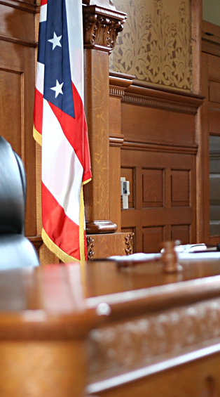

Preparing for the LSAT
Highly recommend to prepare for the LSAT. Many students don’t achieve their full potential without some preparation.
There are many LSAT Prep test companies : UCR ARC, Kaplan Test Prep, Princeton Review, TestMasters, ScoreItUp and many more!
Diagnose your strengths and weaknesses- Khan Academy (LSAC official online prep program)
Take a timed practice test and writing sample
Get familiar with the question types and test instructions
Watch test prep videos from lsac.org
Free materials at lsac.org. Click on “The LSAT” then select “Preparing for the LSAT”

Slide 15
Funding Law school
Law school can be pricey. Ranging anywhere from $50,000+ a year. This does not include other expenses not allocated. So your law school education might cost you$150,000+.
The availability of scholarships and grants is limited, but worth researching. The earlier you apply the more funding your institution might offer you.
Some scholarships and grants are merit or need-based.
Some schools award merit money shortly after admission, while others require separate forms.
Confirm with each school what their individual school requirements are. Apply early for all institutional aid from law schools.
Look into a variety of different student loan options and scholarships.
“Today, approximately
80% of law school
students rely on
education loans
as their primary,
but not exclusive,
source of financial aid
for law school”- LSAC.org

Slide 16

Things to Remember
Make a Checklist

Slide 17
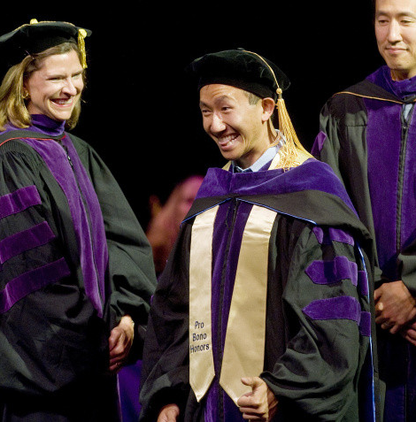
Things to Remember
17
Research, prepare and don’t wait last minute to apply!
Utilize your on-campus resources
Join a pre-law school student organization
Make sure to attend a law school forum or our law school information day fair
Talk to admissions representatives
STUDY for the LSAT
Network with pre-law students, current law students and industry people
Get experience! Volunteer or intern at a place that is law service related

Slide 18
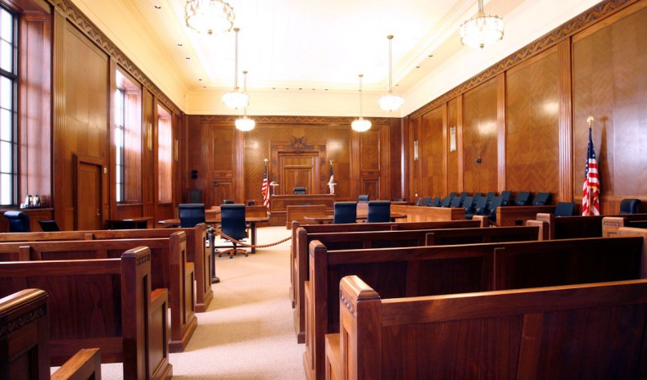
Large Photo Slide
Follow your DREAMS! But make the best decision for you!
18

Slide 19
THANK YOU

Slide 20
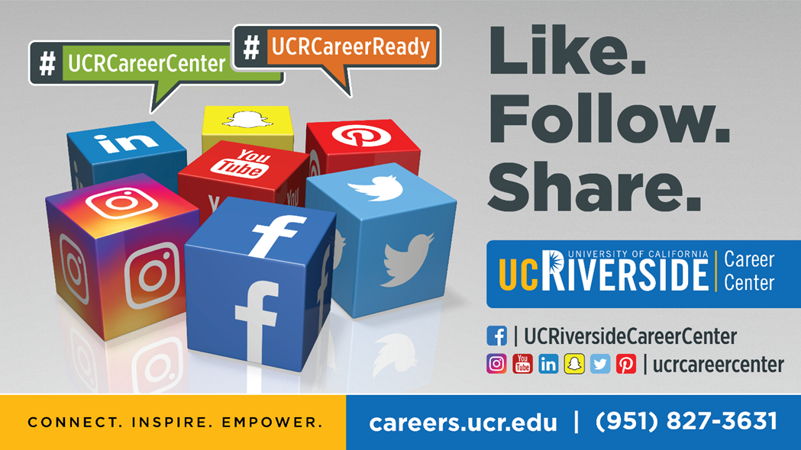

Slide 21
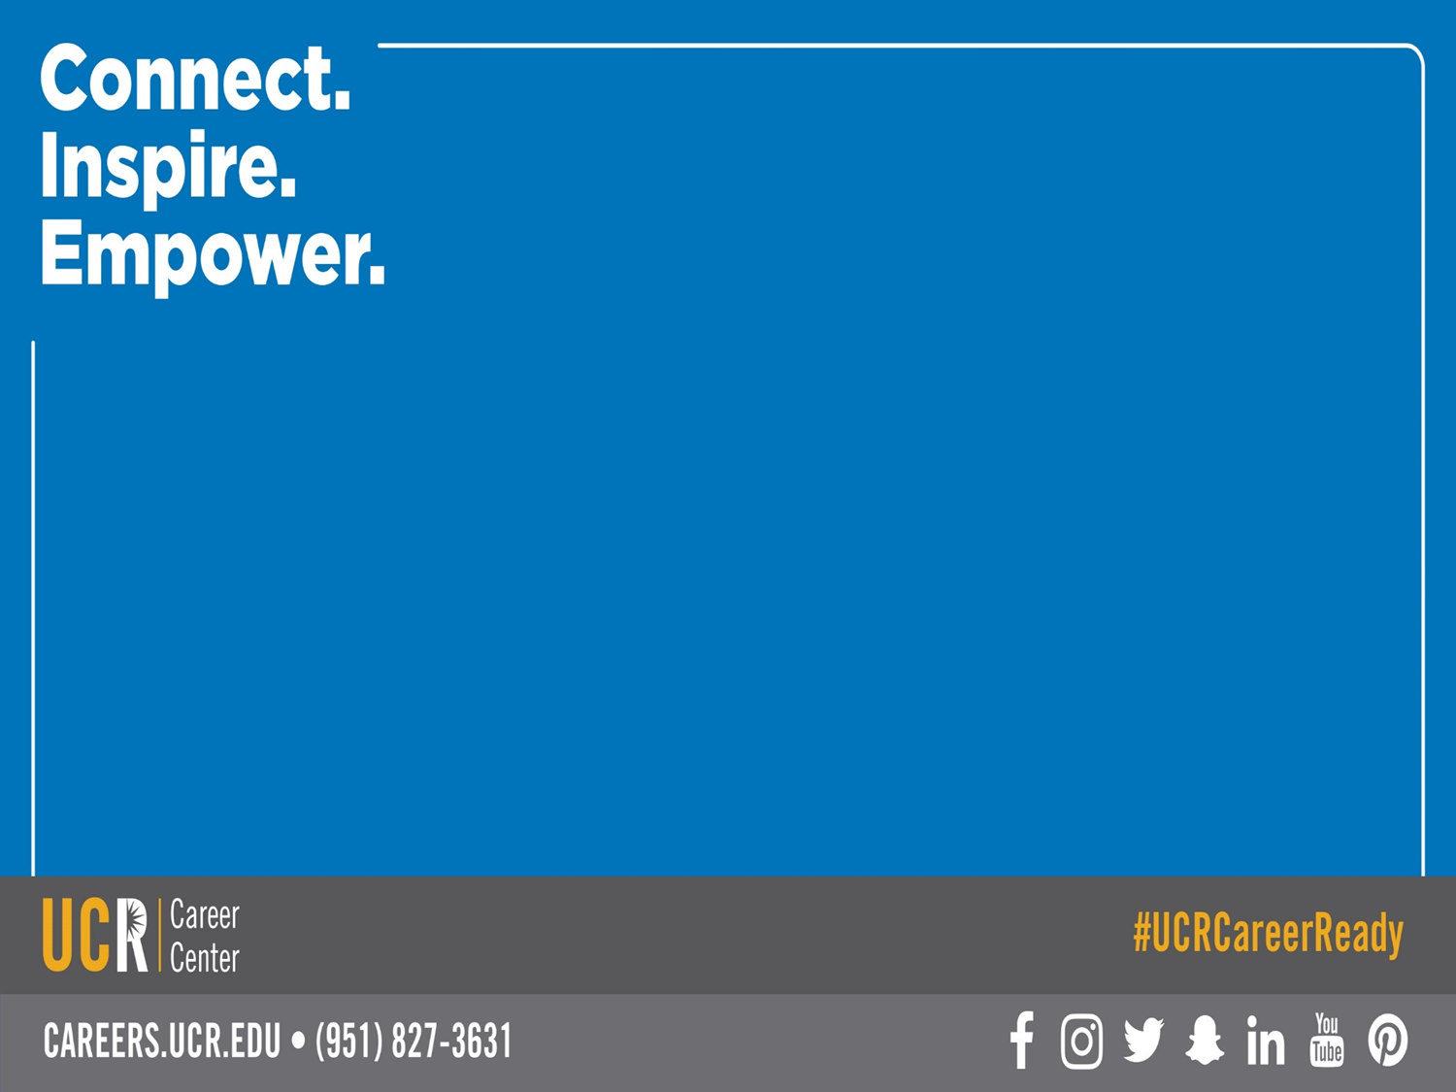
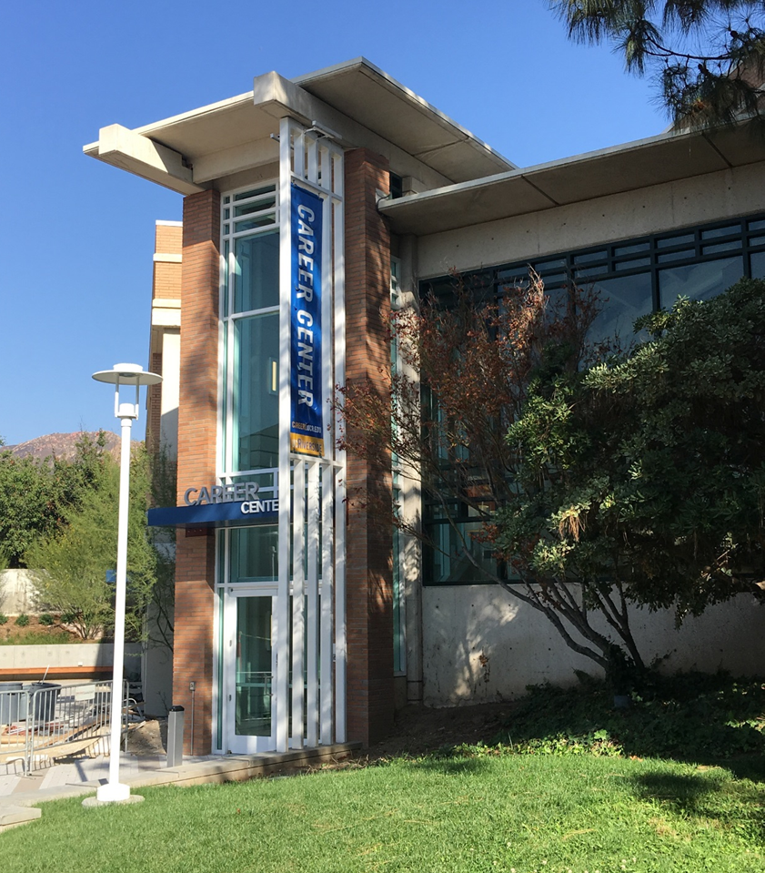
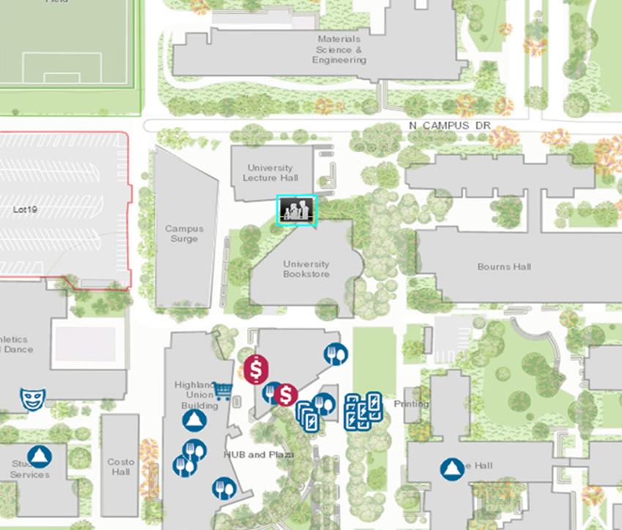
Come See Us
Hours:
Mon. - Fri. 8 am to 5 pm
except Wed. 9 am to 5 pm
Drop-In Hours:
Mon. - Thurs. 10 am-3pm
Fri. 10 am-12 pm

