Slide 1

If you plan on going to graduate and professional schools right after college, you need to apply during Fall of your senior year.

Slide 2
Top 2 Factors influencing employers’ decision to hire:
Completed an internship with your organization
As an internship experience in your industry

Slide 3


Slide 4


Slide 5





Transfer Career Plan

Slide 6




TRANSFER Career Plan
Your step-by-step guide to career planning success
Notes:
You can use this slide as your opening or closing slide. Should you choose to use it as a closing, make sure you review the main points of your presentation. One creative way to do that is by adding animations to the various graphics on a slide. This slide has 4 different graphics, and, when you view the slideshow, you will see that you can click to reveal the next graphic. Similarly, as you review the main topics in your presentation, you may want each point to show up when you are addressing that topic.
Add animation to images and graphics:
Select your image or graphic.
Click on the Animations tab.
Choose from the options. The animation for this slide is “Split”. The drop-down menu in the Animation section gives even more animations you can use.
If you have multiple graphics or images, you will see a number appear next to it that notes the order of the animations.
Note: You will want to choose the animations carefully. You do not want to make your audience dizzy from your presentation.

Slide 7
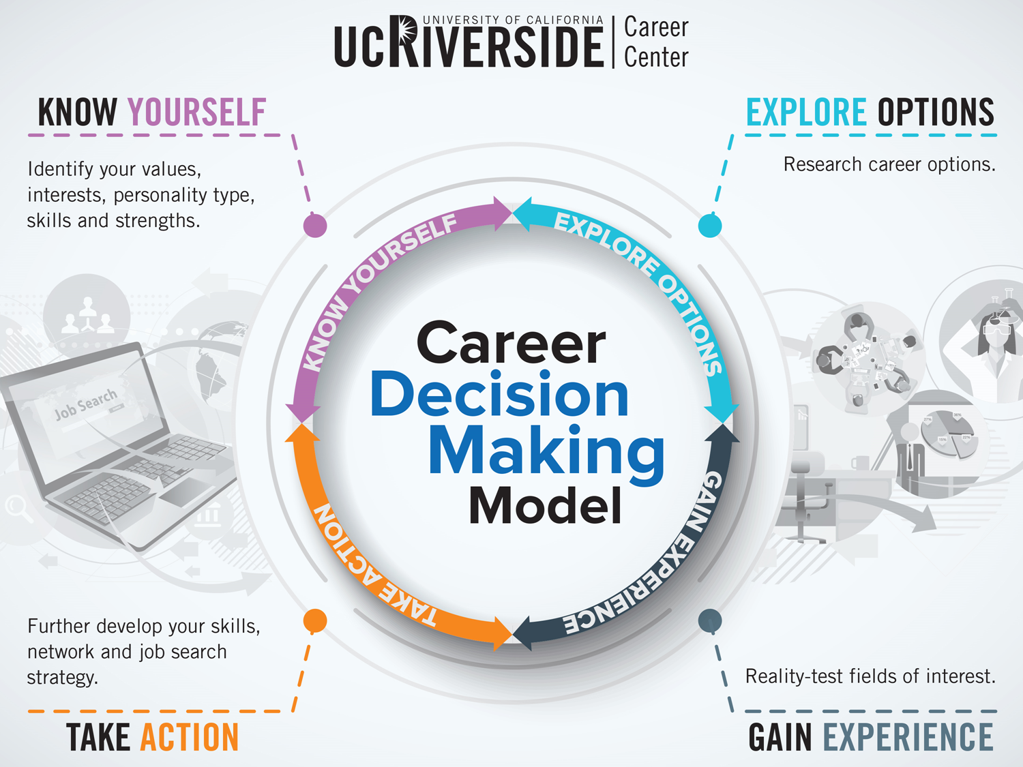

Slide 8

On-Campus Resource:
Talk to your academic advisor
Visit Transfer and Commuter Lounge
Career Center Involvement:
Quarterly calendar of events
Job Discovery Employer Panels
Networking Events
Graduate and Professional School Panels
Campus Involvement:
Highlander link
Student Life
On-Campus Career Center Resource:
Meet with a Career Counselor
Drop-In Vs. Appointment
Notes:
It’s time to further develop and utilize your networking skills. Talk to people all around you– other students, family, friends, professors, supervisors, and professionals you meet at career fairs or other events. Have a “career conversation” to explore careers and eventually find a job.
Talk to everyone you know: faculty, staff, advisors, career counselors, family, and friends.
Attend these workshops and events: Career Fairs, Job Discovery Series, Employer Information Sessions, Networking Your Way to a Job, Now Hiring Interns and Former Interns Tell All.
Create or enhance your LinkedIn profile by attending LinkedIn: How to Build Your Profile & LinkedIn: Your Job & Internship Search.
Conduct information interviews with people who work in your desired career.

Slide 9

We Recommend
Attend the Ace the Interview and/or Interviewing for Introverts workshop.
Practice your interview skills with our Mock Interview appointments
  Schedule an appointment with a career counselor to get feedback!
  Practice actual interview questions with a counselor
  Talk interview logistics with a counselor
  Bring in interview questions you anticipate for future interviews

Slide 10
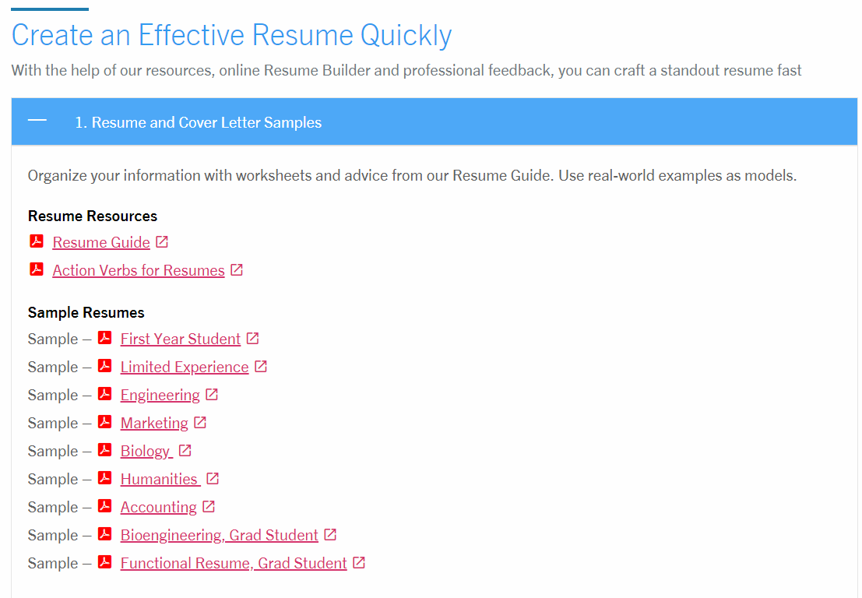

Slide 11
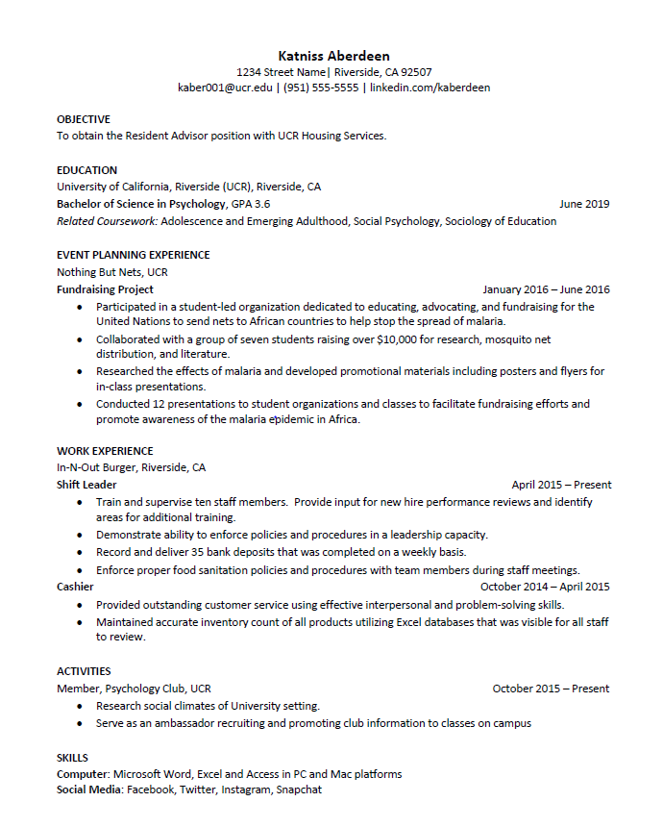

Slide 12






We Recommend
Talk to everyone you know (Be intentional)
  Strategically build relationships for a future opportunities (ex. attending events, volunteering, part-time work etc.)
Attend internship related workshops, events & Career Fairs
Create or enhance your LinkedIn profile
Conduct information interviews
  Leverage your position as a college student to meet those in industries you are curious about
Notes:
When conducting research, it is easy to go to one source: Wikipedia. However, you need to include a variety of sources in your research. Consider the following sources:
Who can I interview to get more information on the topic?
Is the topic current and will it be relevant to my audience?
What articles, blogs, and magazines may have something related to my topic?
Is there a YouTube video on the topic? If so, what is it about?
What images can I find related to the topic?

Slide 13




Consider these factors
      Determine if grad school is a necessary step for career choice​
Research the occupation: Occupational Outlook Handbook, O*NET
Research graduate school requirements:

Slide 14






Write your personal statement – Visit the Academic Resource Center (ARC) for help
Get letters of recommendation – 2-3 months in advance!
Utilize the ARC’s test prep seminars

Slide 15

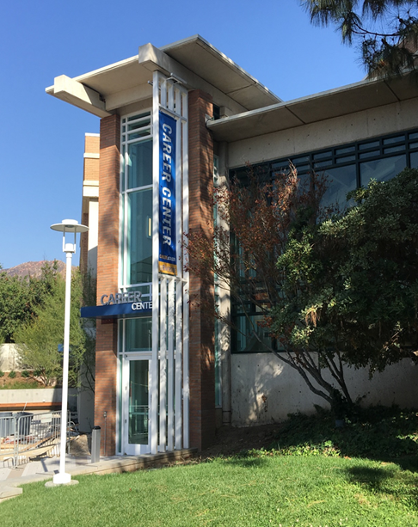
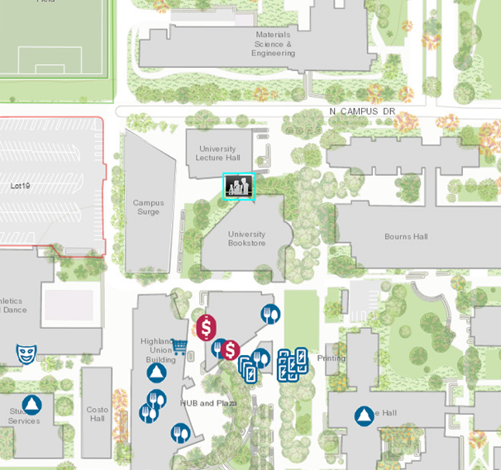
Come See Us!
Hours:
Mon. - Fri. 8 am to 5 pm
except Wed. 9 am to 5 pm
Drop-In Hours:
Mon. - Thurs. 10 am-3pm
Fri. 10 am-12 pm

