Slide 1


YOUR CONTENT CAN GO
IN THIS AREA
2017-18 Annual Report

Slide 2
70% of students who graduated from UCR were employed within 6-12 months of graduation.
2017-18 Annual Report

Slide 3
Recruiters are using Google and LinkedIn searches to find talent (70% report that they have rejected candidates because of the information they found)
press.careerbuilder.com, 2017

Slide 4
Based on extensive analysis of historical and current labor market trends, CareerBuilder is projecting a 5 percent growth in U.S. jobs between 2017 and 2022. While that number is encouraging, it is a net total, meaning that while 8,194,220 jobs will likely be added, 302,930 jobs will be lost.

Slide 5


Slide 6
A modern, on-the-go platform designed especially for college-based recruiting for jobs, internships, events and resources.
Students gain access to job/internship postings from 200,000+ employers around the world, including all Fortune 500 companies!
Employers enjoy a faster, more user-friendly experience to post jobs and view applicants.

Slide 7
Students enjoy:
A personalized feed of jobs, internships, events and resources — like Netflix but for careers!
A “Favorite” option to know when top employers are posting jobs and coming to campus.
A seamless experience across all devices: phones, tablets and computers.

Slide 8
Create a Handshake Account
1.
Log into go.ucr.edu/ucrhandshake with your UCR username and password.
2.
Complete your UCR Handshake profile by adding your resume, photos, skills and more. Make your profile public to employers.
3.
Click “Jobs” in the menu bar and start applying. Save searches and sign up for notifications about future opportunities that match your interests!

Slide 9

Where are the Jobs: Job Search Strategies
Notes:
Include a job and internship timeline
Recruiting Timeline:
Applying for full time jobs for the following year: Fall October to Mid-November
Applying for summer internships & full time positions: Spring Late January to Mid-April

Slide 10

AGENDA
Activity: What’s Your Job Search Strategy?
The Job Market and Hiring Process
Assess Your Job Search
Search and Apply

Slide 11
What’s Your Job Search Strategy?
Give yourself point(s) if you…
Actively search for jobs online and apply =
Attend career fairs and info sessions to network =
Use social media such as LinkedIn for job search, joining groups, following employers =
Activate your network circles sharing you are a job seeker =
Do informational interviews to learn about professions =
1 point
3 points
2 points
2 points
3 points
Total= 11 points
Notes:
Let’s take a moment to assess our job search by giving ourselves a point for each of the following strategies.
Have students partner with their neighbor and ask each other if they have use the strategies listed. Have them share their experiences with the strategies. This activity is meant to bring awareness of the actual strategies they are or are not using for job search.
At the end of the game, ask the audience if anyone would like to share their results for a prize? Let them know that by talking to their neighbor, they have fulfilled one job search strategy which is networking.
The goal of this game is to show participants how important it is to heighten their job search skills and to get them thinking about different ways to job search

Slide 12


Current Job Market
Good!
Since 2017 unemployment is as low as it's been since 2000 (According to the Bureau of Labor Statistics, California is currently at a 4.2% unemployment rate )
Competitive
Process starts long before graduation
More time, more work required
know yourself and gain experience
Job Search: almost like a full-time job
Goal: Stand out from the rest

Slide 13
Hiring Process – Visual Perspective
100’s/1,000’s received
Resumes electronically scanned
1-3 Invited to interview
Notes:
This is an example and it is dependent on the number of positions and employers

Slide 14
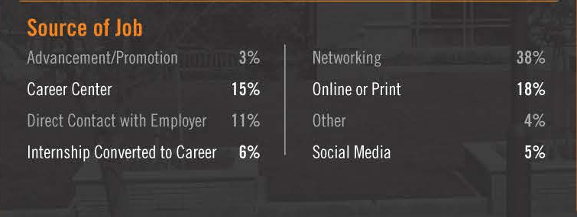
How UCR Students are Securing Jobs
2016-2017 Annual Report

Slide 15
Assess Your Job Search
Self-Assess
Research Marketplace
Activate Your Network
What is important to you in your career?
What do you know about your career of interest?
Who do you already know? Who do you want to get to know?
Notes:
1) You should be able to:
Describe what you want to do
Match your skills, values, and interests to career fields and job titles
Research your career fields
2) Researching Employers can help you learn about the organization and determine your place in it:
Make a list of preferred employers to target
Learn more about the employers by researching
Employer Websites
Networking Opportunities
Job Related Search Engines
Annual Reports
Trade Associations
Newspapers
Fellow Professionals
Competitors
Internet
TechConnect
Consider conducting informational interviews
3) Prepare Job search Materials and Job Search campaign:
Prepare an effective resume and cover letter – getting a job is SALES!
1 page accomplishments based resume
Proof-read!
Practice interviewing
Review practice questions before going to an interview
Purchase appropriate interview apparel
Focus on the employer’s need

Slide 16

1. Self-assessment
What is important to you in your career?
Take a Career Assessment
Focus 2, Myers Briggs Type Indicator, Strong Interest Inventory, Career Leader ($)
What kinds of opportunities align with your priorities?
Job function, location, industry/company, etc.
Keep an open mind:
Function
Industry
Company/organization
Glassdoor
Prioritize your personal needs
Notes:
Look at values, personality, interests, skills. List a few of each. What is most important to you in a career?
Now look at job function, industry, company type, and environment. What do you need to satisfy your key items from above?
Now prioritize your needs. What comes first? Second? If you had to give something up, what would it be? Where are you flexible?

Slide 17



2. Research Marketplace
Take time to understand the realities. They may differ from your expectations.
Book of lists, chambers of commerce
Industry Journals, Mass Media
www.bls.gov/ooh/
www.careers.ucr.edu/
www.glassdoor.com
www.onetonline.org/
Notes:
All links still work!
Investigate job functions, industries and geographic locations of jobs where you have an initial interest:Current events & future trends
Chronicle, wallstreet economist, glassdoor

Slide 18

3. Activate Your Network
Take an inventory of your network
How can they help?
Reach out
Be specific about desired outcomes
Expand your network
Ask for referrals
Informational Interviews
LinkedIn.com
Alumni Center
Professional associations
Local networking groups (Young Professionals)
Social media platforms

Slide 19
Where to Search
UCR Career Center
Online Sources
Handshake
NACELink, Career Shift
On Campus Interviews (OCI)
Employer Information Sessions
Employer Coffee Chats
Job Discovery Series
Annual Career Fairs
Direct Contact with Employers
National Job Sites
Industry Specific Sites
Company Specific Sites
Association Sites
International Sites
Government Sites
Social Media: LinkedIn, Twitter, Facebook
Notes:
Send a letter of application and your resume to the HR department or to specific managers.
Follow Up
The success of this method is greatly increased when letters are followed up by phone calls.
Nacelink Network – nationwide, high profile companies are members of NACE, Natl Association of Colleges and Employers
National job – major national job search sites on the Web representing ten of thousands of jobs nationwide
Industry-specific – These sites are for specific industries, including Accounting, Financial, Academic, Computer, Engineering, Medical and Health, etc
Company-specific – job listings on company websites
Association – professional associations
International - sites that have job openings in Europe, Asia, and Australia. Some positions require bilingual skills, and some listings are in the country’s native language
Government sites – federal employment
**Handout of sample listings

Slide 20


Slide 21

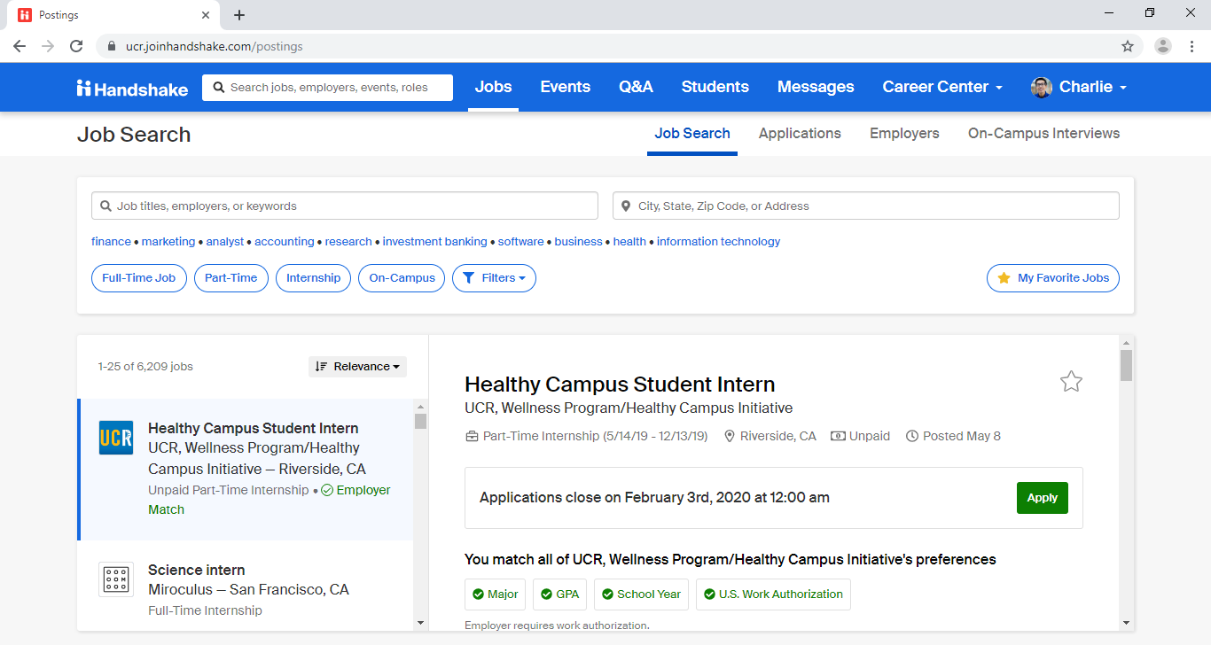
Narrow down your search by including key information
Keywords
Location
Industry/Function
Position Type
Be proactive!
Notes:
No single place to apply
No guaranteed follow up on results
You take the lead, the whole way through
Identify reliable sources of job postings
Be proactive!

Slide 22
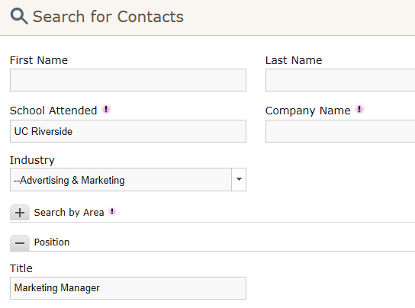

Search for:
Occupations
Contacts
Companies
My Campaigns

Slide 23


What is it?
Employers come to UCR to interview students
Opportunity to interview for multiple internships and full-time jobs
How?
1. Log in to
2. Upload Resume
3. Sign Up online
Notes:
Stay on top of your interview status:
Students will receive email notification of their interview status as well as new employers coming to campus

Slide 24
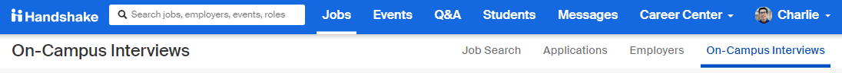
On-Campus Interview
Juniors and Graduating Seniors are encouraged to participate!
Employers choose to interview UCR talent on campus
Chance to interview for multiple internship and full-time positions
Notes:
Stay on top of your interview status:
Students will receive email notification of their interview status as well as new employers coming to campus

Slide 25

Employment Agency
Temporary and Permanent
Various fields and Specific fields (e.g. Health Care)
Work while looking for a permanent job
Gain experience
Earn $
Explore something new
Tip:
Avoid agencies that require you to pay fee for
them to place you!
Local Agencies
Riverside Personnel Service
AppleOne Employment Services
T & T Staffing
Exact Staff
Kinetic Personnel Group
Adecco Staffing
Notes:
Gain experience
Earn a salary
Try out a company - get a “foot in the door”
Work while looking for a permanent job
Work between graduation and grad school
Don’t pay a fee
Examples of Agencies: Yoh Scientific, Kelly Engineering, On Assignment Lab Support, Accounting Advantage, AppleOne, Kelly Services, Staffmark

Slide 26
Career Fairs
Fall:
Finance, Accounting & Business Job Fair
Career Expo: The Diversity Job Fair
Science, Technology, Engineering and Math (STEM) Job Fair
Graduate & Professional School Information Day Fair
Law School Information Day Fair
Winter:
Engineering & Technology Job Fair
Internship & Non-Profit Job Fair
Teacher Job Fair
Spring:
Career Night: The Spring Job Fair
Health Professions School Information Day Fair
Last Chance Job Fair
Stand out and shine by engaging and networking face to face with professionals!
Notes:
26

Slide 27


Analyzing Job Descriptions
Job Description
Intern will learn and be exposed to:
Hands on experience of marketing through both traditional and new media
Real world knowledge of marketing for clients from the insurance industry
Experiences of working with a very friendly and collaborative team
Responsibilities:
Assist in creating content for marketing materials, company blog and multiple social media accounts
Assist in brainstorming and idea planning
Research industry-relevant news and topics to support content creation
Qualifications: Current college or graduate student in Marketing, Advertising, Public Relations, Communications, or related majors;
Must have excellent writing skills in Chinese and English (bilingual in English and Mandarin Chinese);
Editorial mindset that seeks to understand what audiences consume and how to create it
Knowledge and experience with Facebook, WeChat and other social media platforms is required;
Experience creating content for the website and social media is strongly preferred;
Strong proficiency in Microsoft Word, Excel and PowerPoint
Notes:
Point out the following items:
Overview of the position/company
Responsibilities (pay attention to verbs)
Educational requirements
Experience requirements
Transferable skills and specific skills
Their priorities and key words

Slide 28
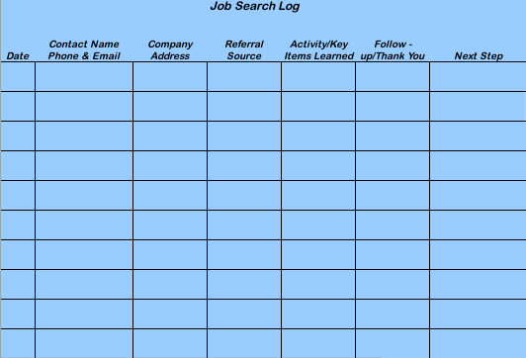
Get Organized!
Notes:
Handout
Follow Up and Record Keeping:
Maintain a careful record of all job announcements, interviews, thank-you notes sent, and follow up actions.
Job seekers who fail to do this often lose valuable contacts as well as credibility with prospective employers.

Slide 29

Follow Up
1 to 2 weeks after the deadline
Contact employer via email or by phonecall
Key information to include:
Date you applied
Job title
Attach resume for their review
Contact information
Exception:
If the employer stated to not contact them, do not contact them.

Slide 30

Job Search Goal Setting
Pick one job search strategy you plan to implement…
Actively search for jobs online and apply
Attend career fairs and info sessions to network
Use social media such as LinkedIn for job search, joining groups, following employers
Activate your network circles sharing you are a job seeker
Do informational interviews to learn about professions
Notes:
Let’s take a moment to assess our job search by giving ourselves a point for each of the following strategies.
Have students partner with their neighbor and ask each other if they have use the strategies listed. Have them share their experiences with the strategies. This activity is meant to bring awareness of the actual strategies they are or are not using for job search.
At the end of the game, ask the audience if anyone would like to share their results for a prize? Let them know that by talking to their neighbor, they have fulfilled one job search strategy which is networking.
The goal of this game is to show participants how important it is to heighten their job search skills and to get them thinking about different ways to job search

Slide 31
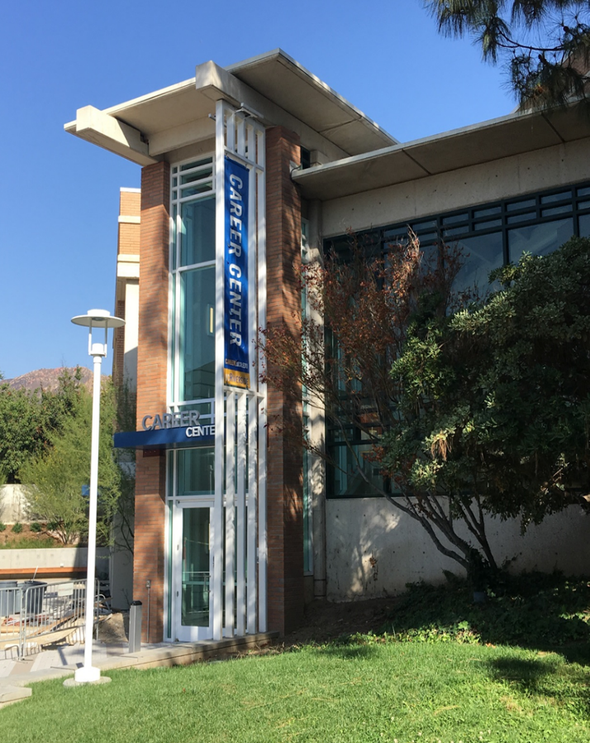
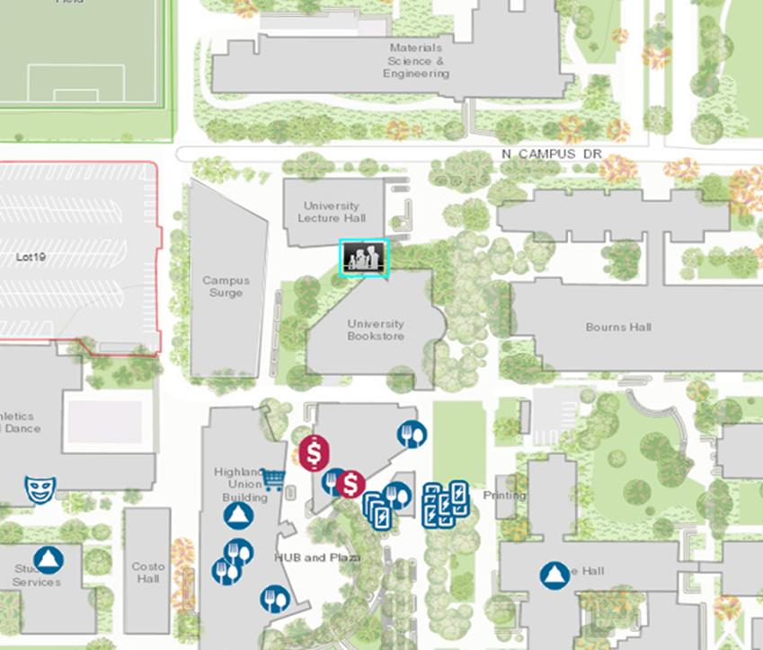
Come See Us
Hours:
Mon. - Fri. 8 am to 5 pm
except Wed. 9 am to 5 pm
Drop-In Hours:
Mon. - Thurs. 10 am-3pm
Fri. 10 am-12 pm

