Slide 1


Slide 2
Create a Handshake Account
1.
Log into ucr.joinhandshake.com with your UCR username and password.
2.
Create a new Handshake profile by adding your resume, photos, skills and more. Make your profile public to employers.
3.
Click “Jobs” in the menu bar and start applying. Save searches and sign up for notifications about future opportunities that match your interests!

Slide 3

Work-Study Orientation

Slide 4

Welcome!
Utilizing your work-study award is a process! Be sure to follow each step.
Topics we will cover today:
Benefits of using work-study
How to apply for a work-study job
How to get hired and paid
Notes:
Marlenee

Slide 5
Do you have work-study?

Slide 6

If you have work-study, accept it!
1.
2.
3.
4.
5.
Log in to R’Web
Go to Financial Aid
Click on Award then Award for Aid Year
Click Accept Award Offer tab
Accept work-study award
If you do not use your work-study award, you will lose it!

Slide 7



What is work-study?
It is a program funded by the federal government
You can obtain a work-study award on and off-campus
Work-study award does not have to be repaid
Notes:
Kelly

Slide 8



What are the benefits of using work-study award?
Help with educational expenses
Flexible hours
Gain experience, skills, & network
Notes:
Kelly

Slide 9

Timeline
  Breaks:
  December 16-20, 2019
  March 23-27, 2020
  May work up to 39 hours
  Start date: September 23, 2019
  May work up to 20 hours
  End date: June 12, 2020
  May work up to 20 hours
Adjust to college life before applying for work-study positions
Notes:
Kelly
Note that during breaks students can work up to 39 hours.
Juggling campus life, studying, classes, personal life AND working may be challenging
However, remember to use it!

Slide 10

Work-study Job Reminders
**Must maintain at least a 2.0 GPA to qualify**
1.
Work-Study does not entitle you to a job.
2.
Jobs are highly competitive. They are REAL jobs.
3.
Show up on time, be courteous, and act responsibly.
4.
Do not surf the internet, make personal phone calls, text, or study.
Notes:
Kelly
Gain new experience, learn new skills, network
Employers will contact most qualified applicants to interview
-follow up with employers

Slide 11
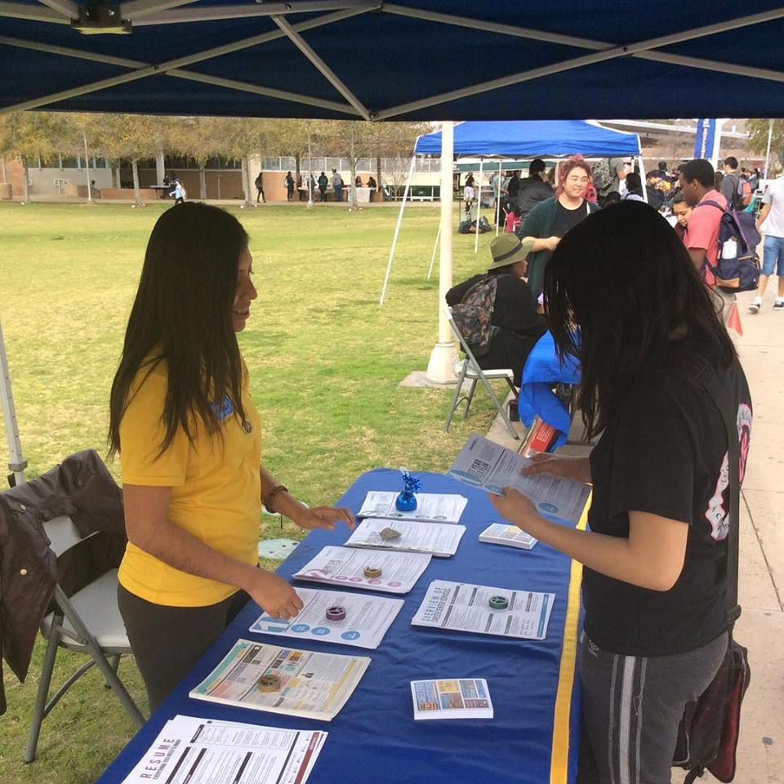
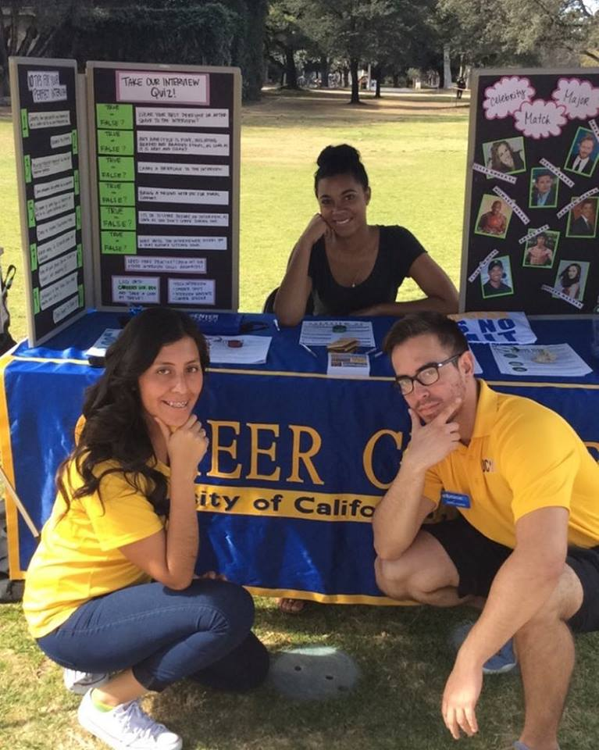
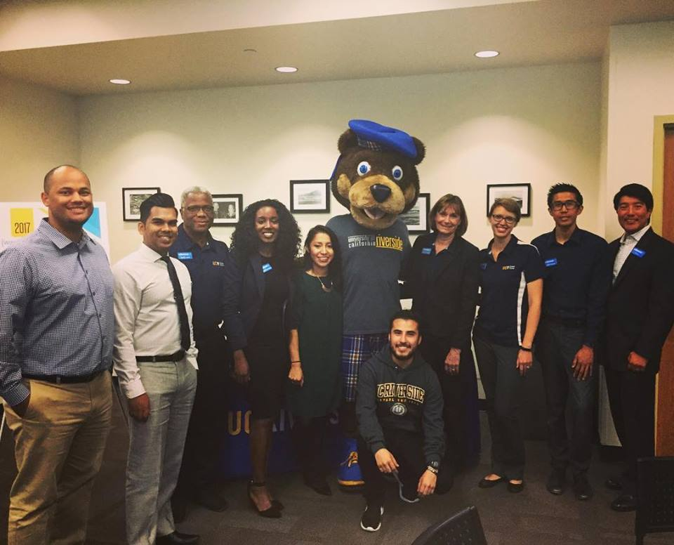
How to obtain a
work-study job?
1.
Log in to Handshake
2.
Search for Jobs
3.
Apply
4.
Get Interviewed
5.
Get Hired
Note: Not all on campus jobs get posted, so you may ask department directly if they are hiring
Notes:
Marlenee_
Job must have code, can be used on and off campus
Gain new experience, learn new skills, network
Employers will contact most qualified applicants to interview
-follow up with employers

Slide 12
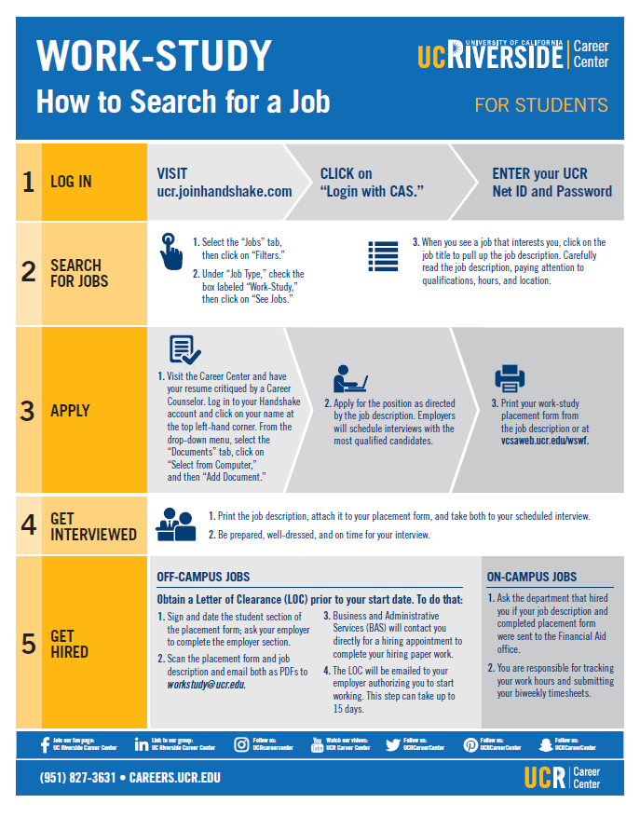

Work-study
Infographic
https://careers.ucr.edu/students/work-study/work-study-process
Notes:
Marlenee
Gain new experience, learn new skills, network
Employers will contact most qualified applicants to interview
-follow up with employers
Log in Demo.

Slide 13
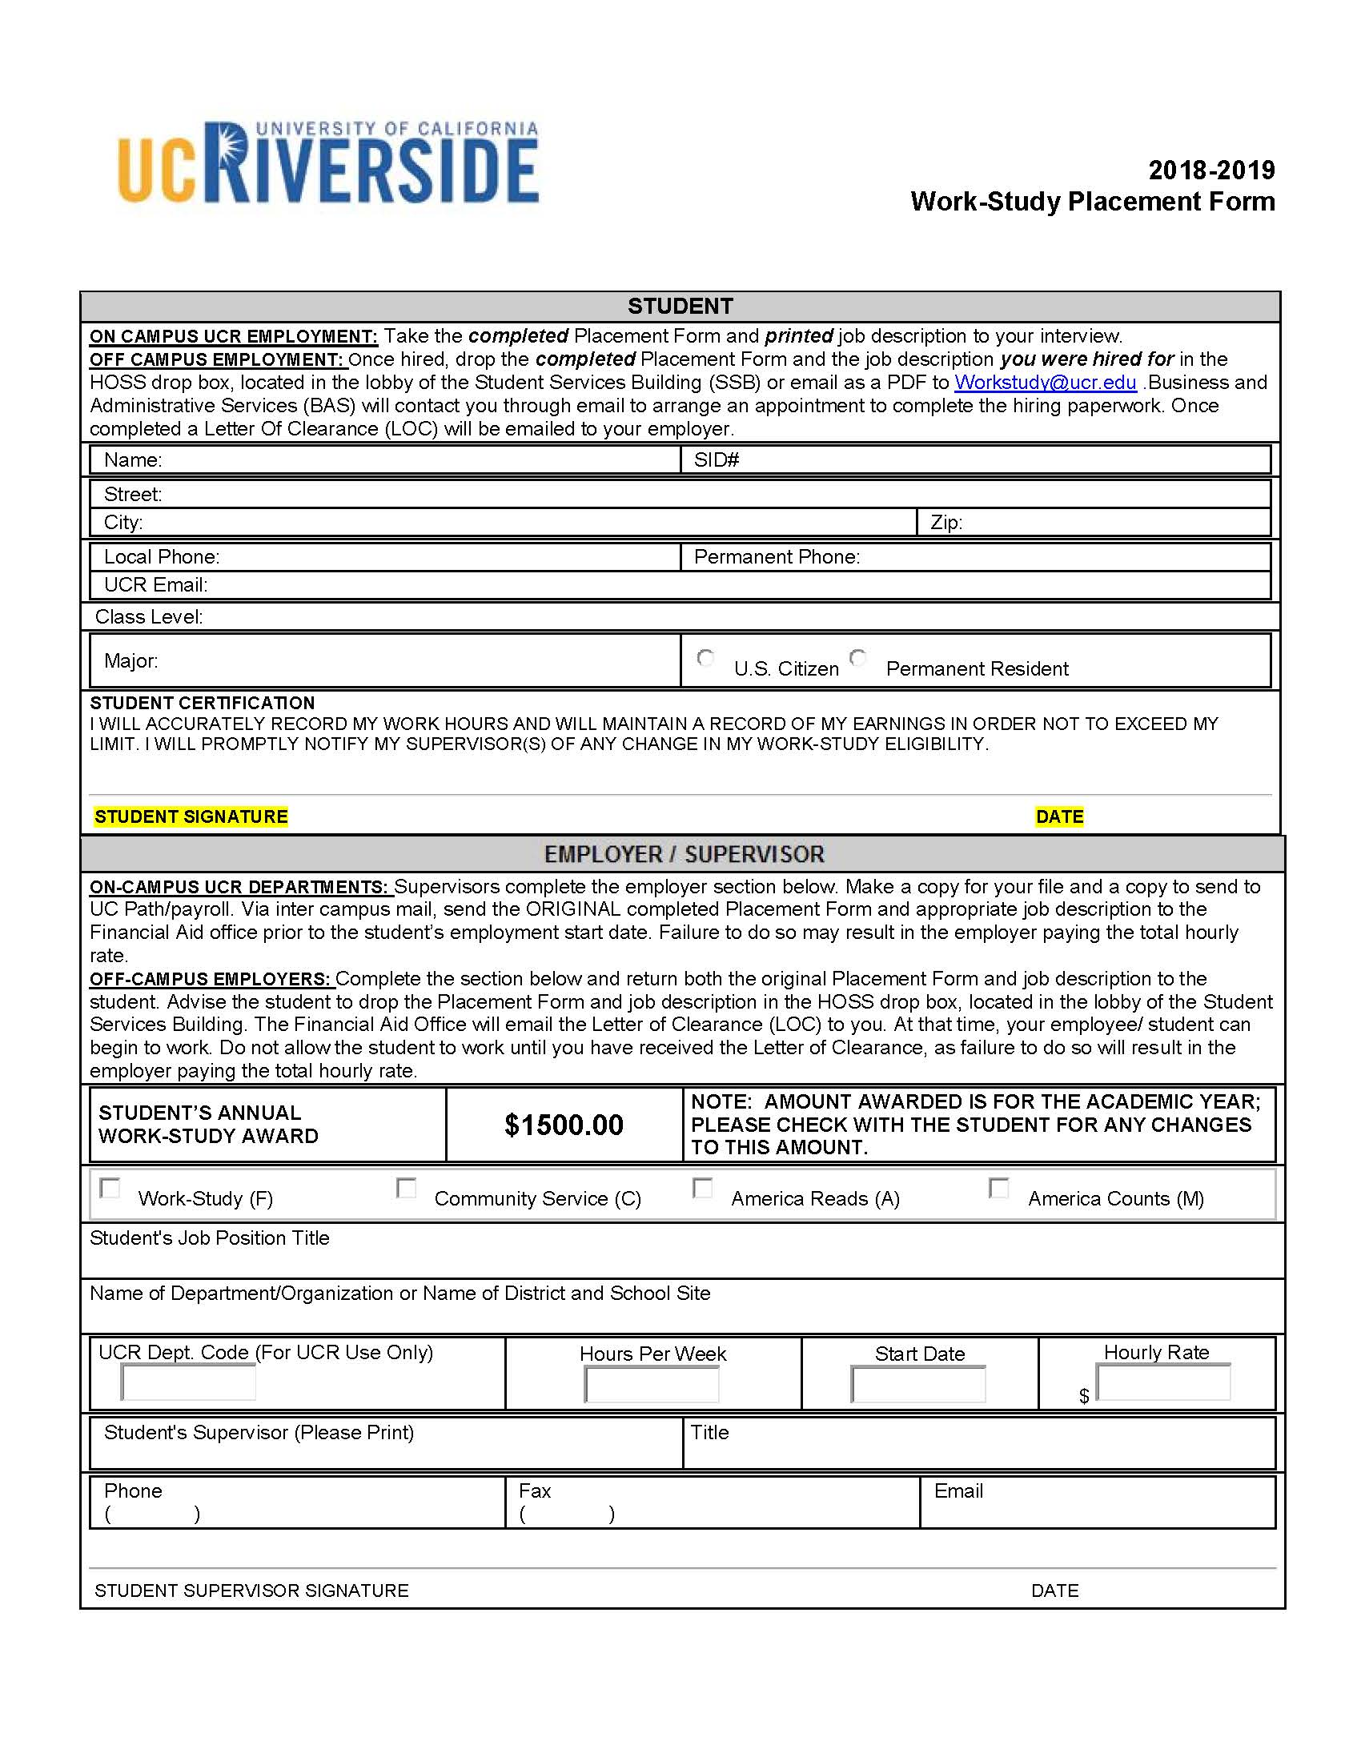
Sample Placement
Form
Notes:
Update
Bring Placement form to job interview along with job description

Slide 14


Resume Tips
In one page include:
  Contact Information
  Education
  Work Experience
  Skills
  Activities, Honors, and Awards
Attend a Career Center Resume Building Workshop
Have resume critiqued by the Career Counselor BEFORE uploading it into Handshake
Notes:
Marlenee

Slide 15


Interview Tips
1.
2.
3.
4.
5.
Dress Appropriately
Read description and prepare questions
Maintain eye contact
Be on time
Follow up with a thank you note
Public Bus Transportation is free to UCR students with student ID!

Slide 16
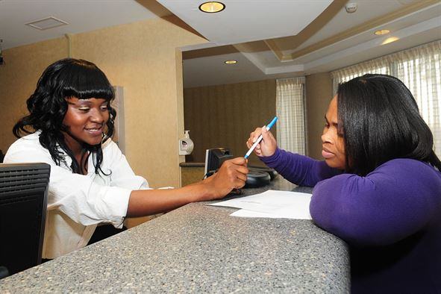

Getting Hired On-Campus
Take your placement form & a printed copy of the job description to your interview.
  If hired, the department will fill out the bottom portion of the Work Study Placement Form then will scan and forward it and the job description to the Financial Aid Office.
Confirm with the department, ensure use of work-study award.
Notes:
Kelly
If hired, the department will fill out the bottom portion of the Placement Form and intercampus mail with the job description to the Financial Aid Office.

Slide 17
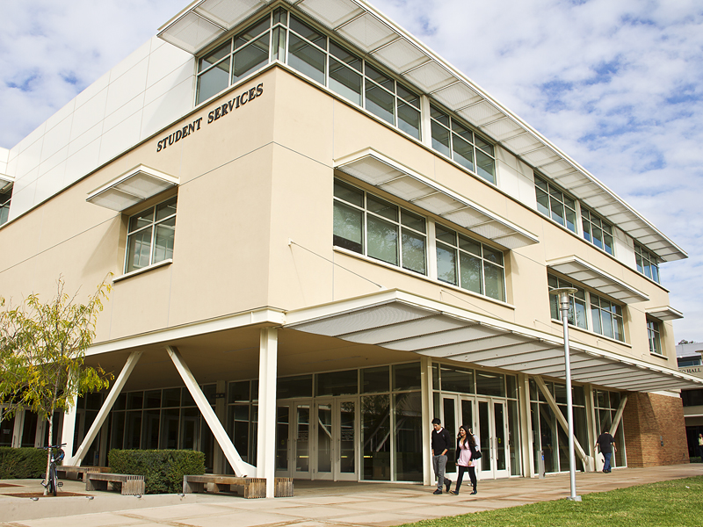
Getting Hired Off-Campus
Sign and date the student section of the placement form; ask your employer to complete the employer section.
Scan to PDF both the Work Study Placement Form and the Job Description and mail to workstudy@ucr.edu
You and your Employer must receive the LOC before you can start work.
Notes:
Kelly
Student drops the original Placement Form and Job Description into the “HOSS” drop box, located in the lobby of the Student Services Building.
Business and Administrative Services will then contact the student to fill out payroll paperwork.
Once hiring paperwork is completed (up to 10 business days) a Letter Of Clearance (LOC) will be emailed to the employer to begin employment. Student must receive the LOC before they can work.

Slide 18

Getting Hired Off-Campus Cont.
3. Business and Administrative Services (BAS) will contact you directly for a appointment to complete your hiring paper work.
4. The LOC will be emailed to your employer authorizing you to start working. This step can take up to 10 days.
You and your employer must receive the LOC before you can start work.
Notes:
Kelly
Student drops the original Placement Form and Job Description into the “HOSS” drop box, located in the lobby of the Student Services Building.
Business & Administrative Services (BAS) will then contact the student to fill out payroll paperwork.
Once hiring paperwork is completed (up to 10 business days) a Letter Of Clearance (LOC) will be emailed to the employer/student to begin employment. Student must receive the LOC before they can work.

Slide 19



Timesheets
Keep track of the hours you work!
  DO NOT exceed your award allocation
  Example = $1000 FWS Award & job that pays $10/hr = 100 hours of work
  You will be paid bi-weekly
    On Campus
      Speak with your employer regarding procedures & deadlines
    Off Campus
      You will receive instructions
Notes:
Kelly

Slide 20
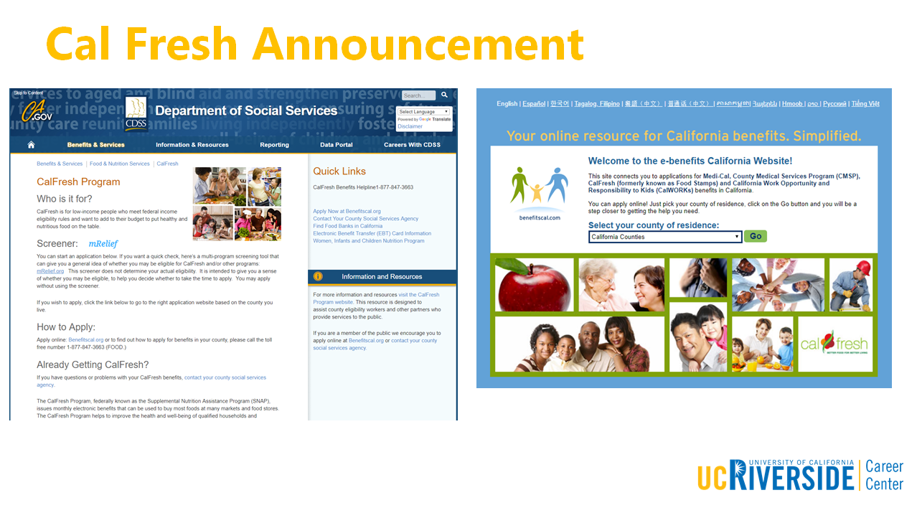
Notes:
Marlenee
http://www.calfresh.ca.gov/

Slide 21
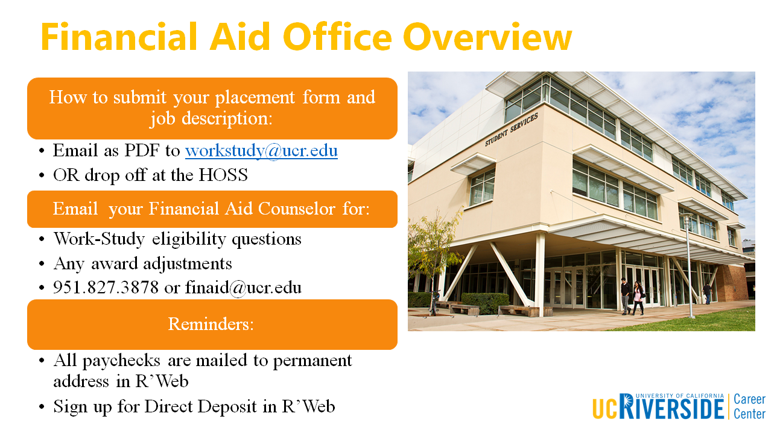
Notes:
Kelly: Marlenee I changed wording

Slide 22
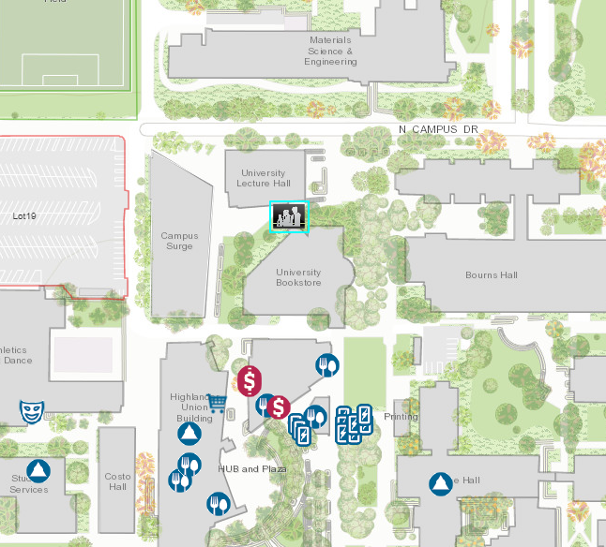
Career Center Overview
Schedule an appointment with a Career Counselor or attend Drop in for:
Job Search Assistance
Interview Prep
Resume and Cover Letter Reviews
Skill-Building Workshops throughout Fall, Winter, and Spring Quarter
Attend
Notes:
Marlenee

Slide 23


Slide 24


Slide 25


Slide 26

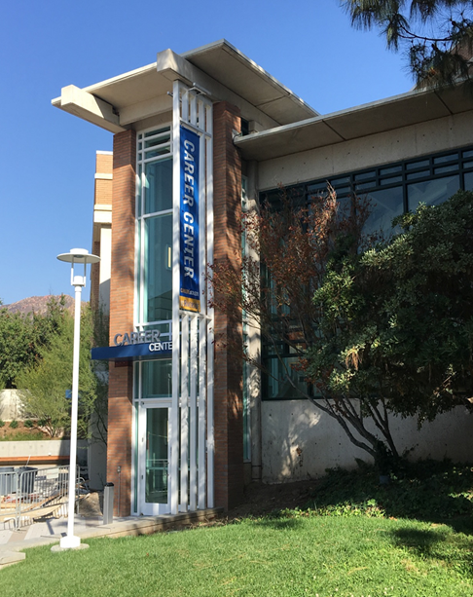
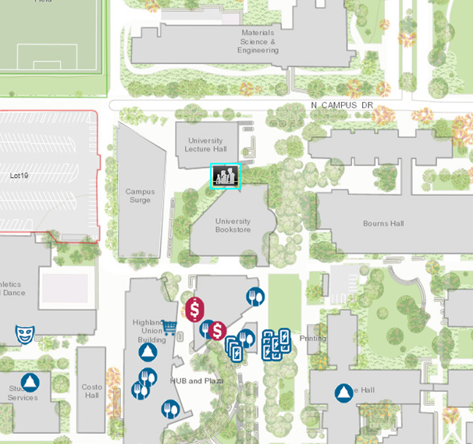
Come See Us!
Hours:
Mon. - Fri. 8 am to 5 pm
except Wed. 9 am to 5 pm
Drop-In Hours:
Mon. - Thurs. 10 am-3pm
Fri. 10 am-12 pm
Notes:
Marlenee

