Slide 1
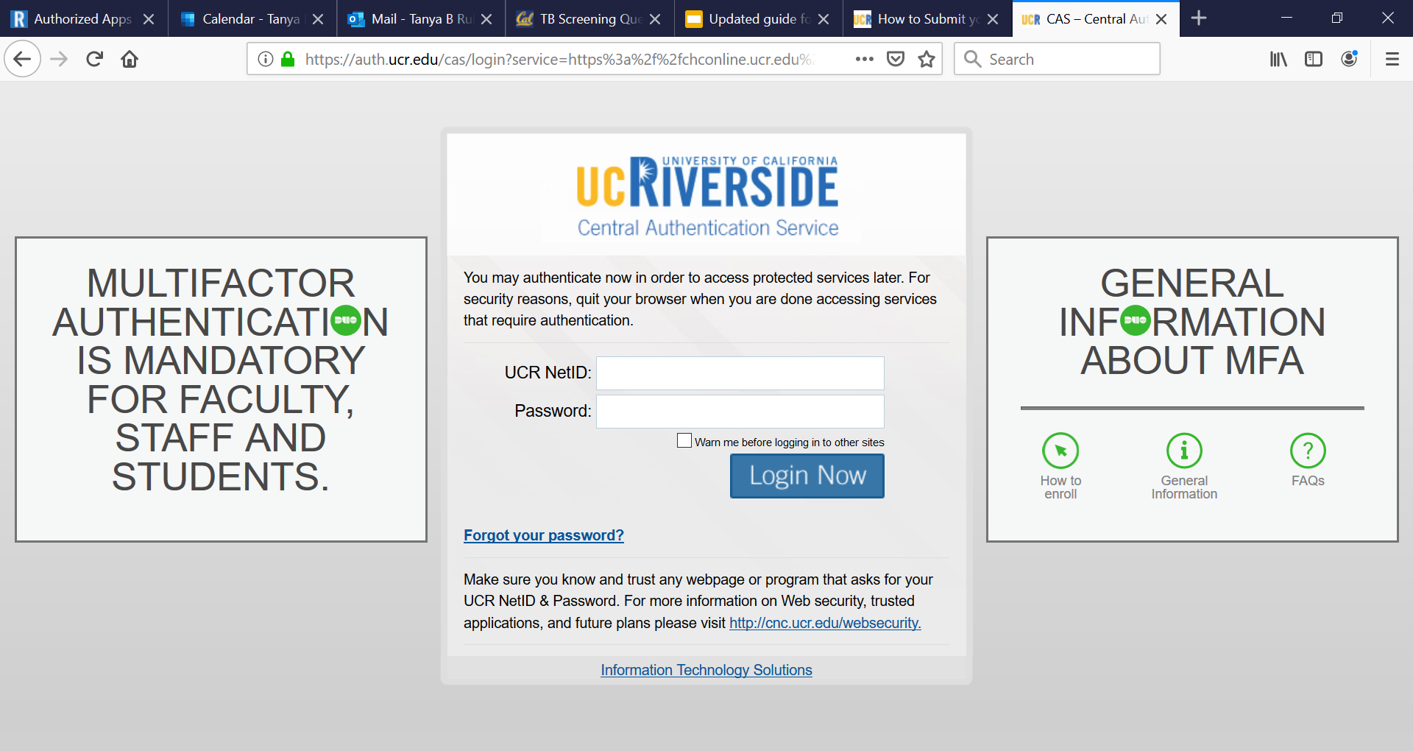
Log in to the patient portal at (link)
You will need your NetID to log in

Slide 2
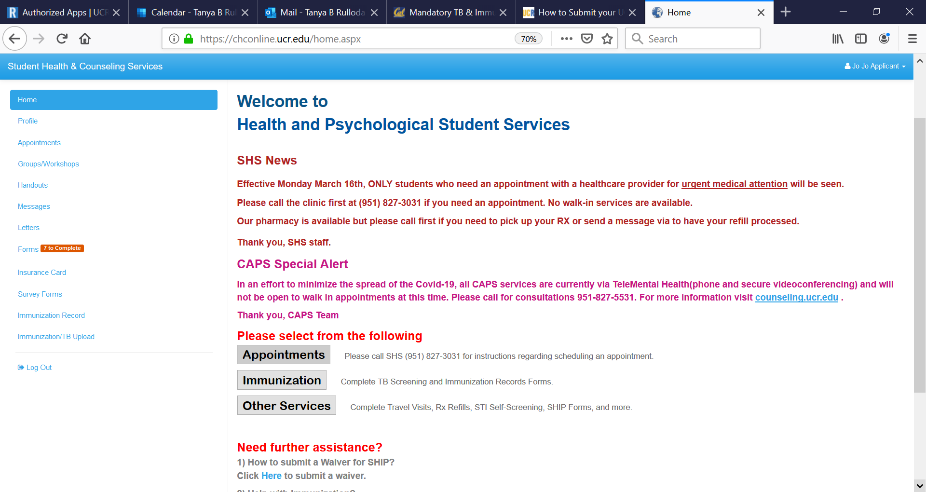
1. Click on Forms

Slide 3
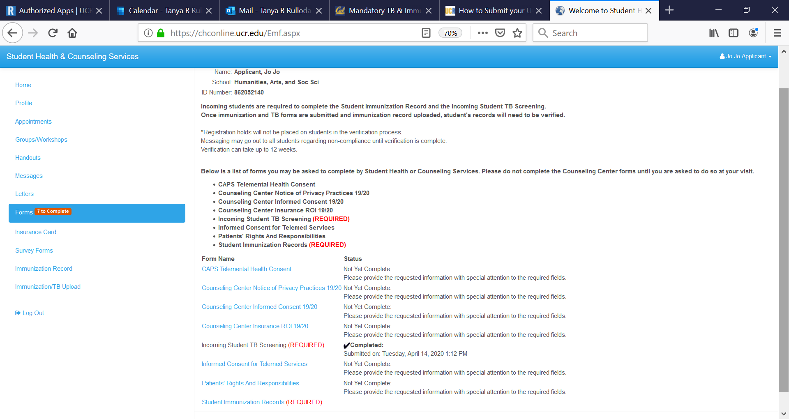
2. Click on Student Immunization Records

Slide 4
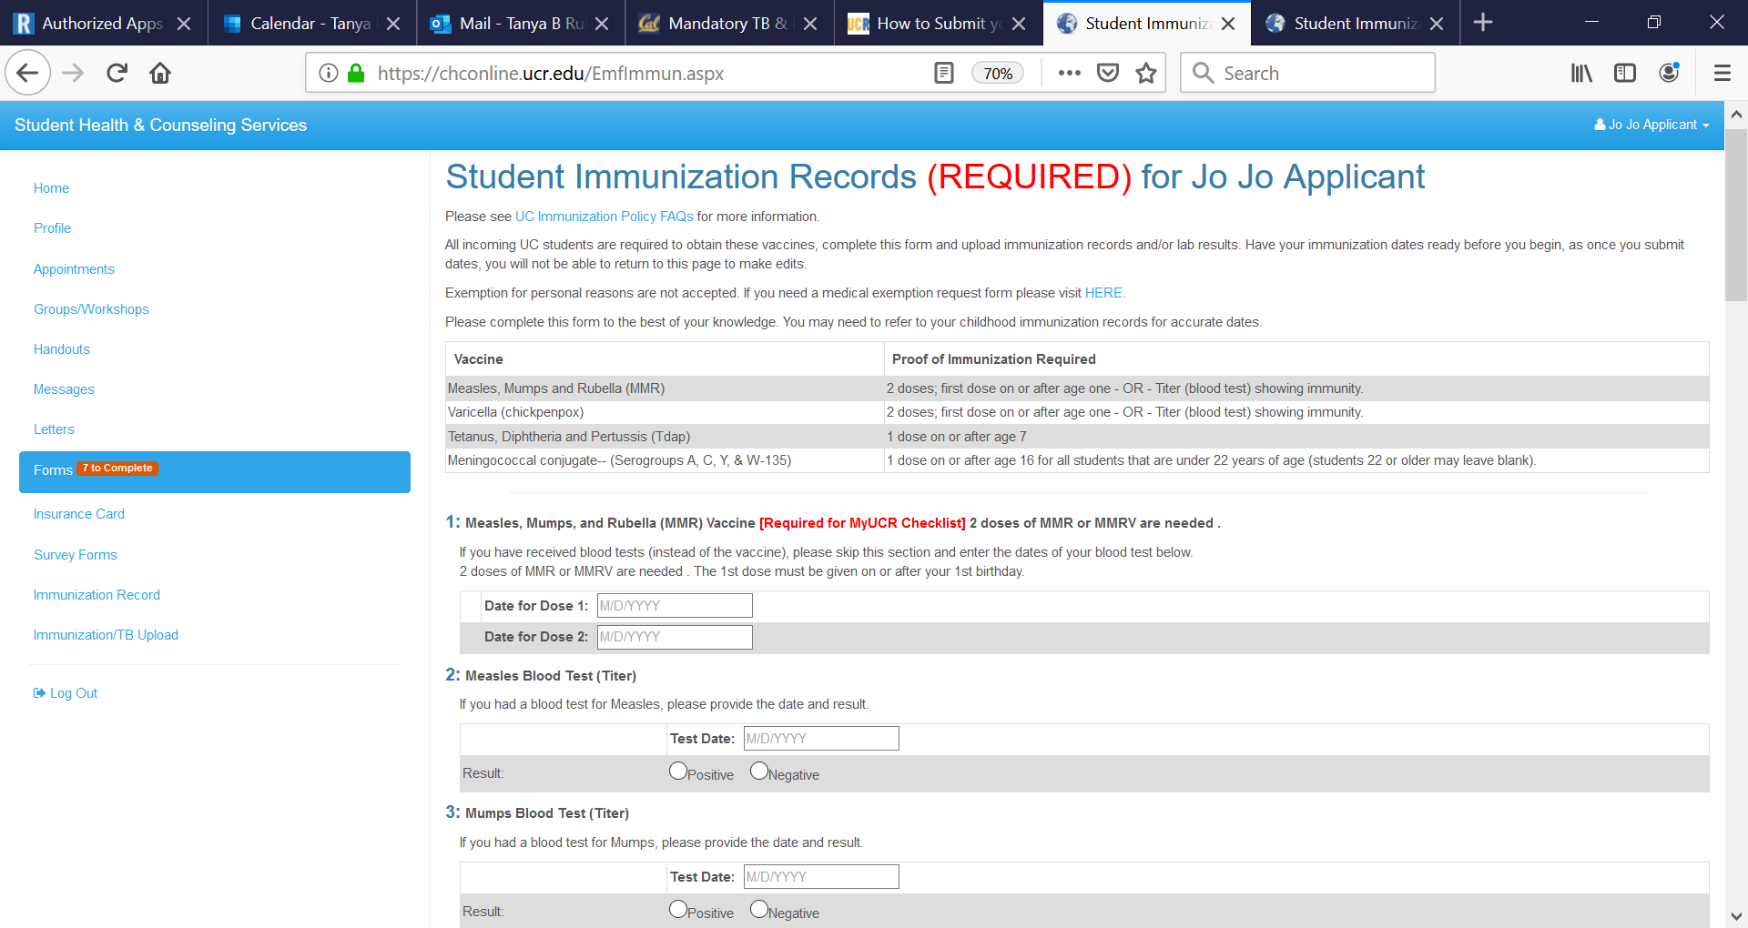
3. Please compare your original immunization record to this form and ensure the dates meet all requirements.

Slide 5
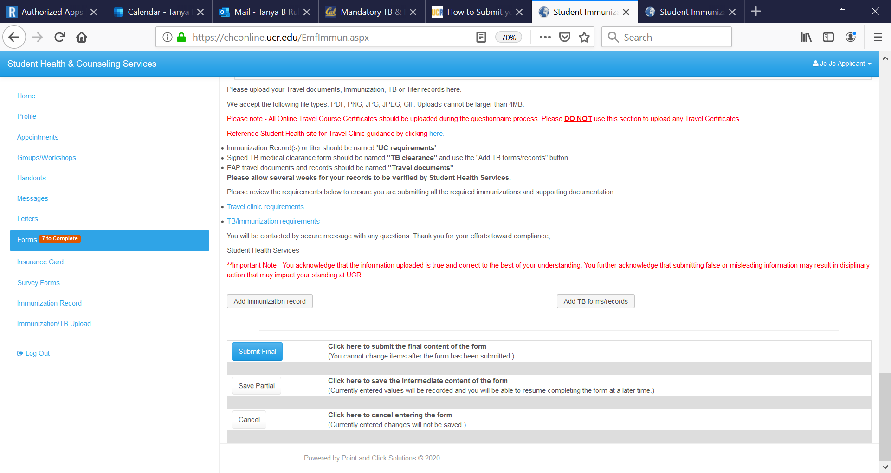
4. After inputting your dates you will need to upload your immunization record here.

Slide 6
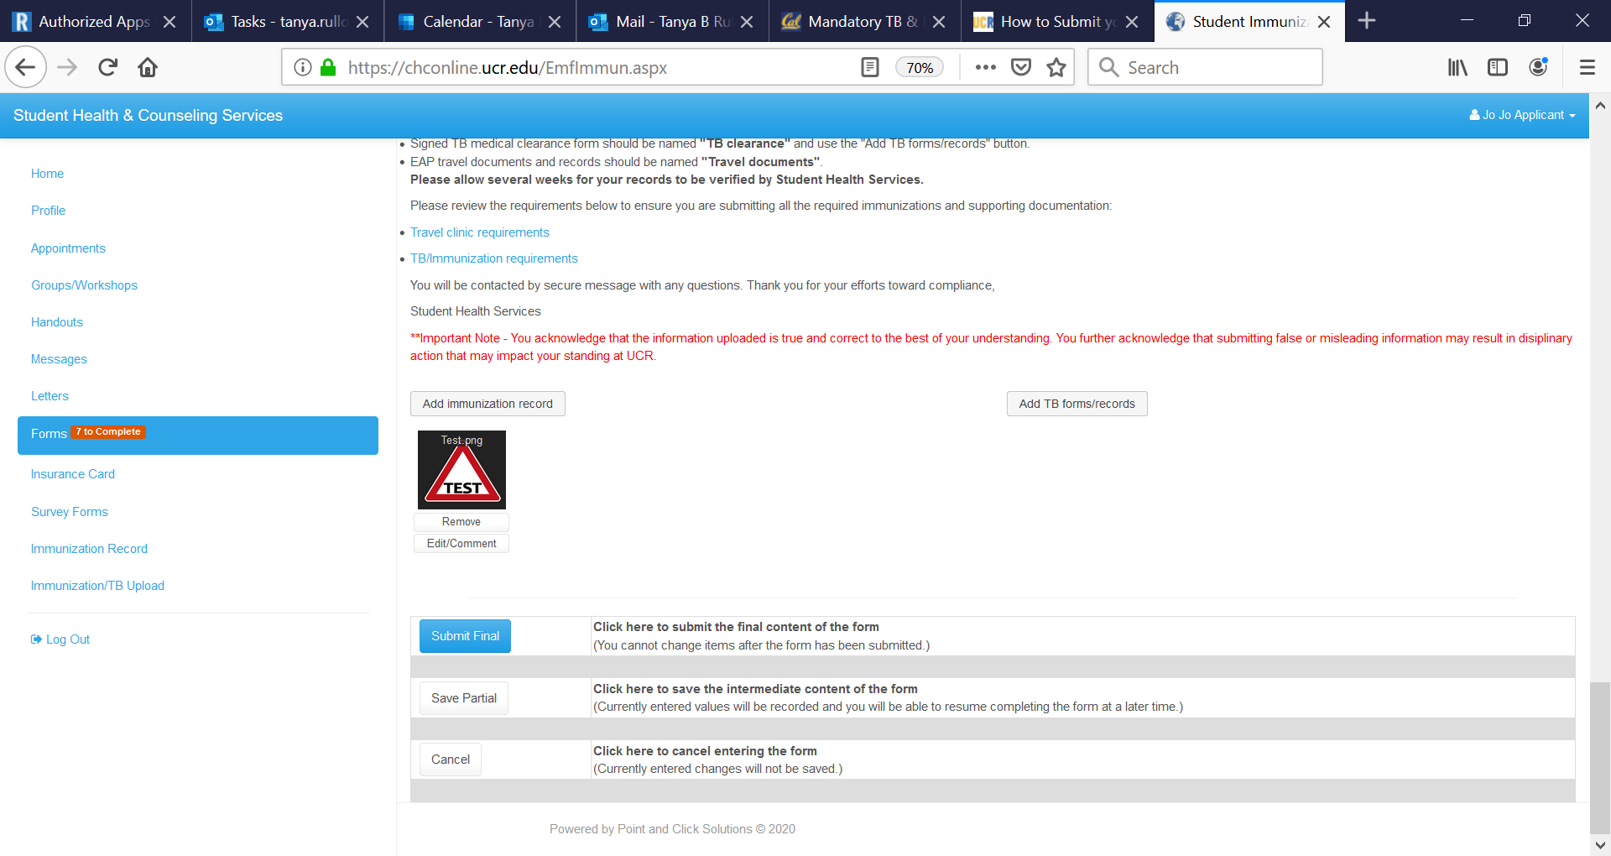
5. Records will show here once added. When you have added all necessary documents click Submit Final.

Slide 7
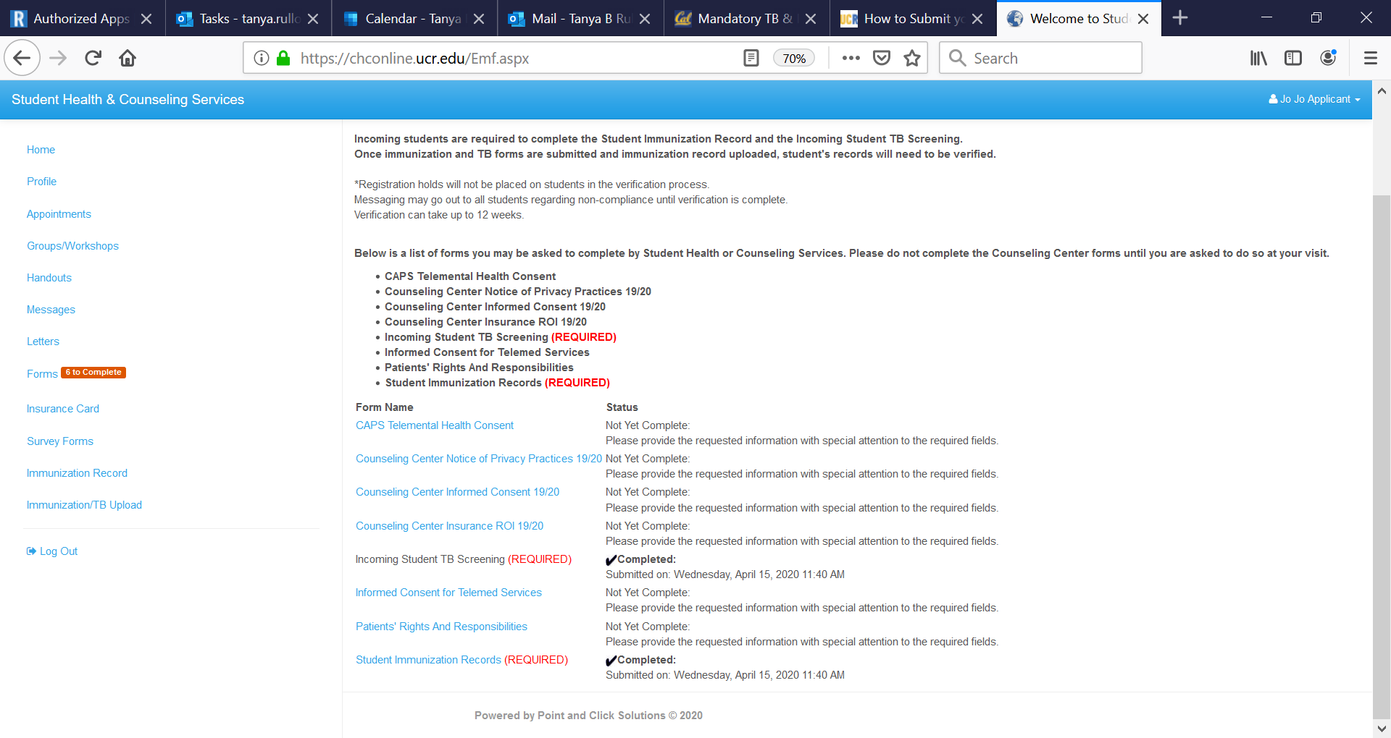
6. Click on Immunization record
Confirmed completion (no action required)

Slide 8
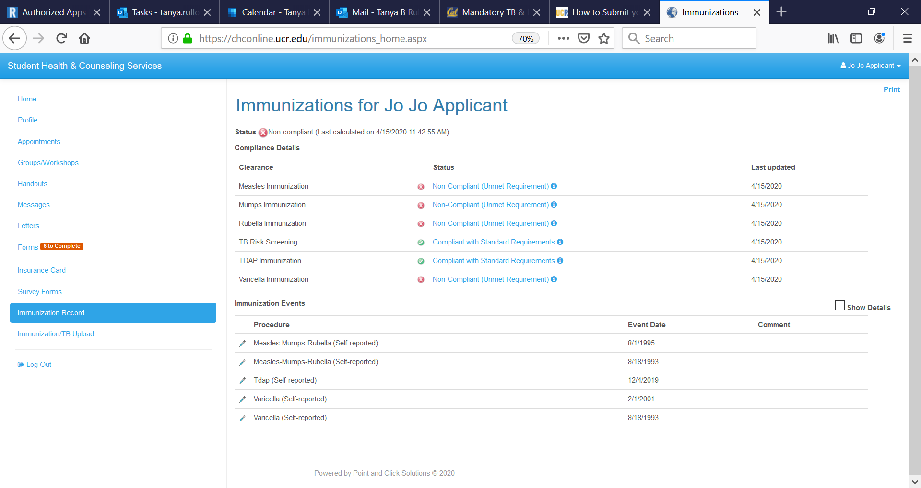
You can keep track of your compliance here.
7. Click here if you need to submit additional records for immunization compliance.

Slide 9
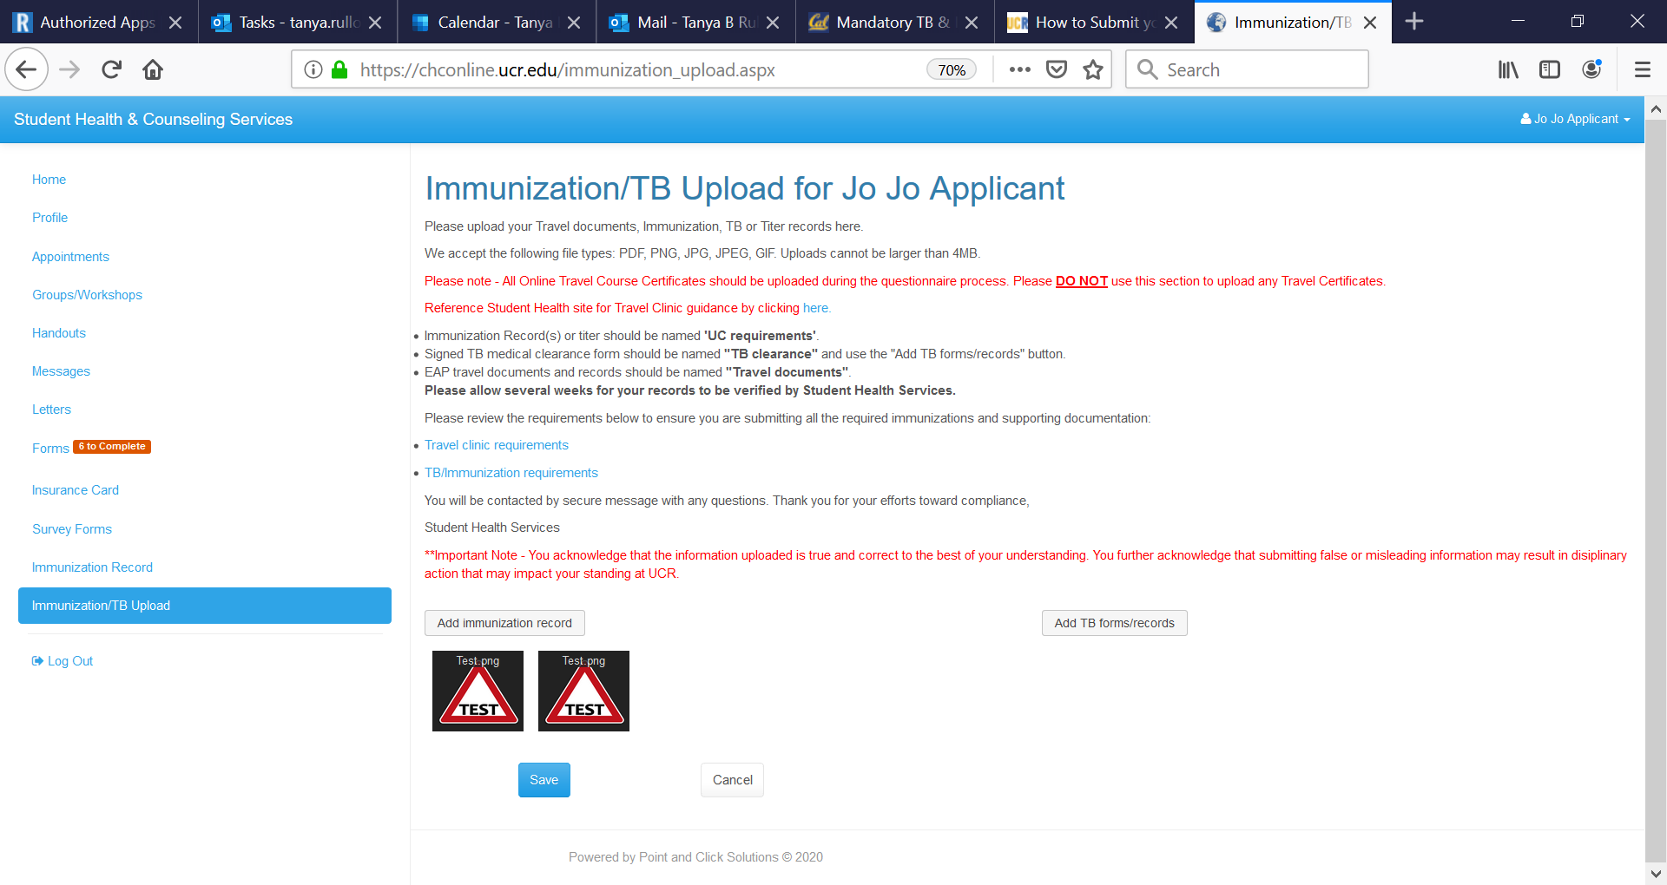
8. Add your records and click Save

Slide 10
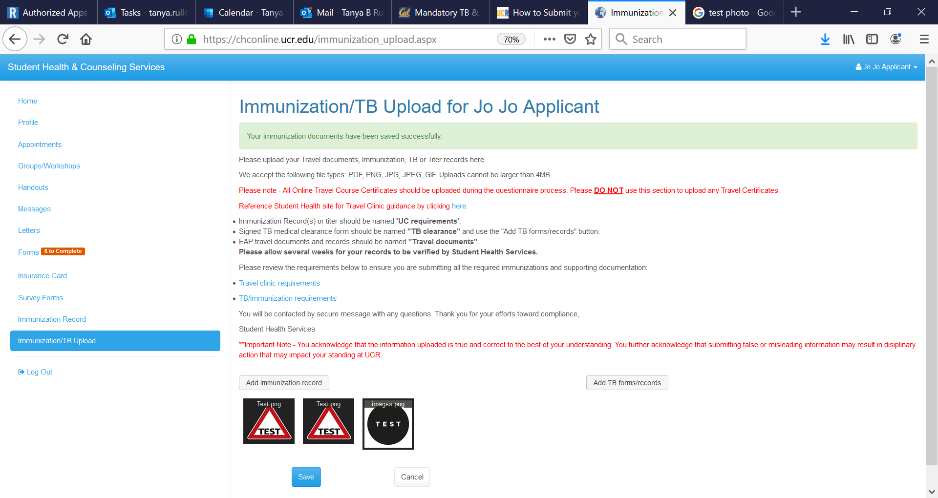
9. All communication regarding immunization compliance is through the health portal in your secure messages. If additional information is needed or there are questions regarding compliance, you will receive a message.

Slide 11
Required Immunizations
MMR- Measles, Mumps and Rubella: 2 doses ON OR AFTER first birthday
Varicella: 2 doses ON OR AFTER first birthday
Tdap:Tetanus, diphtheria, pertussis: Given ON OR AFTER seventh birthday. **Pertussis component is necessary. Td, childhood Dtap does NOT meet compliance. Brand names are Adacel or Boostrix
Meningococcal ACYW-135: required for students between the ages of 16-21 years of age. Brand names are Menveo or Menactra
New Requirement: Influenza (flu): required for students who are living, learning or working on campus

