Slide 1
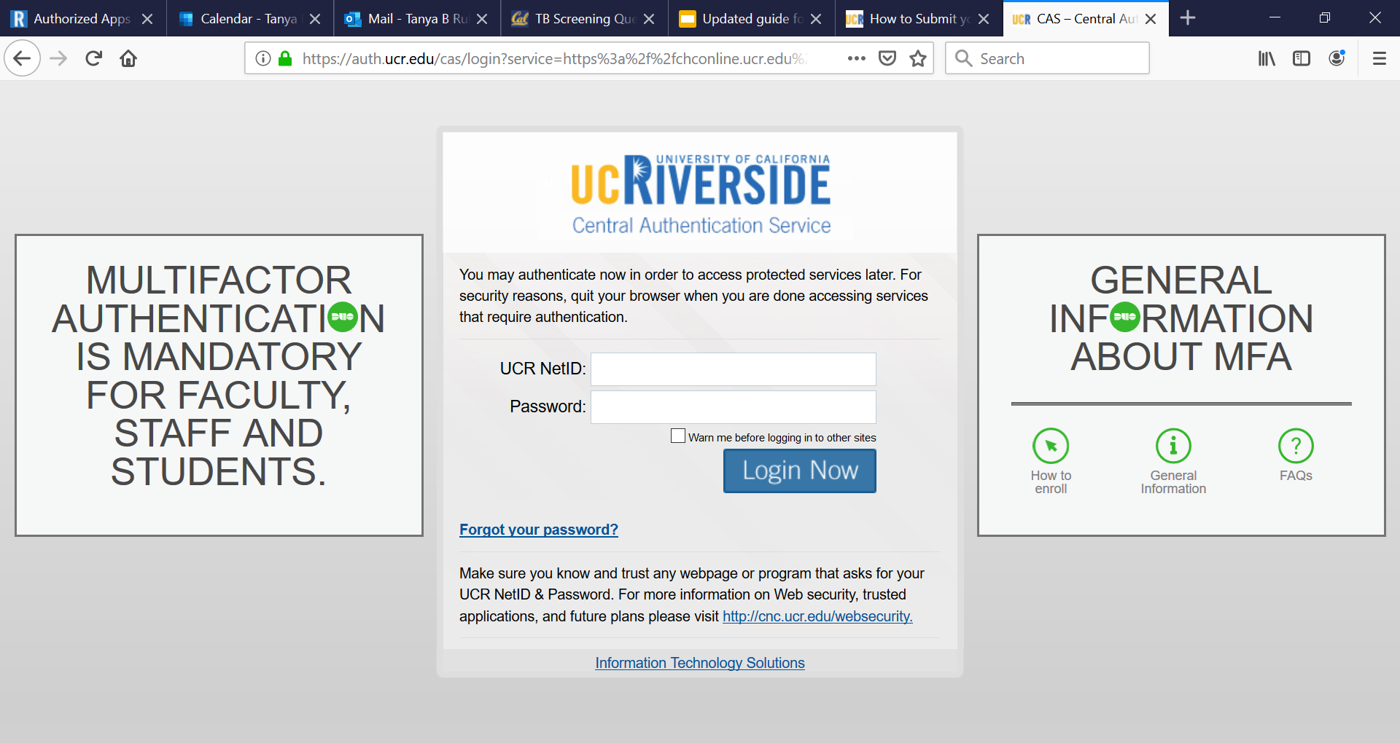
Log in to the health portal
You will need your NetID to log in

Slide 2
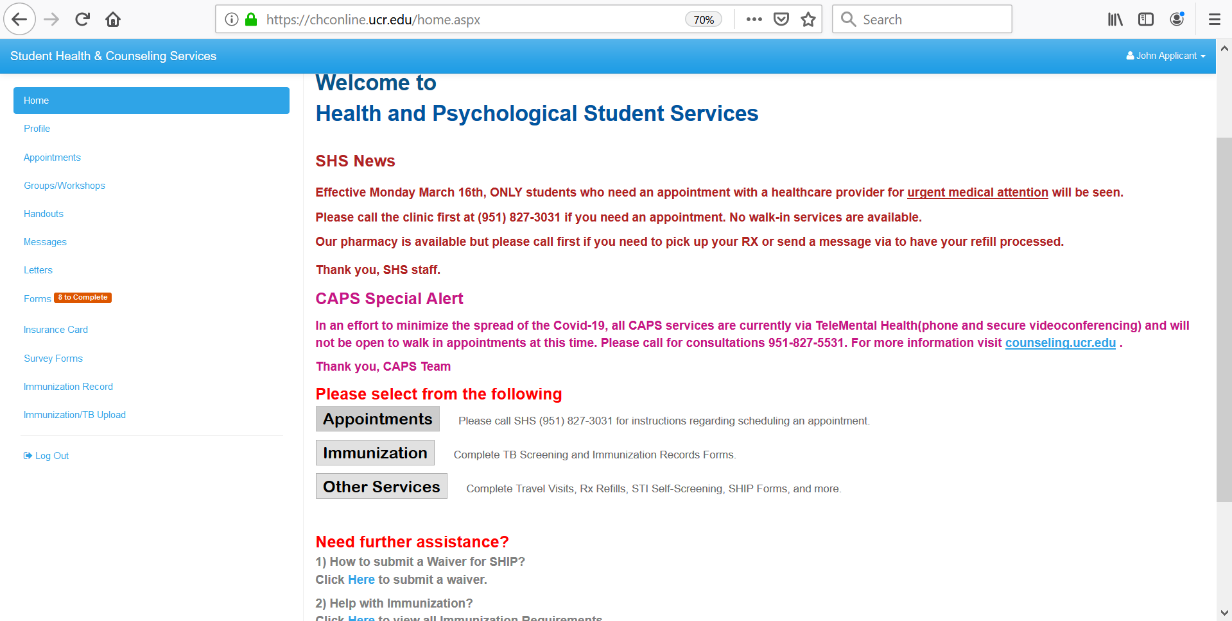
1. Click on Forms

Slide 3
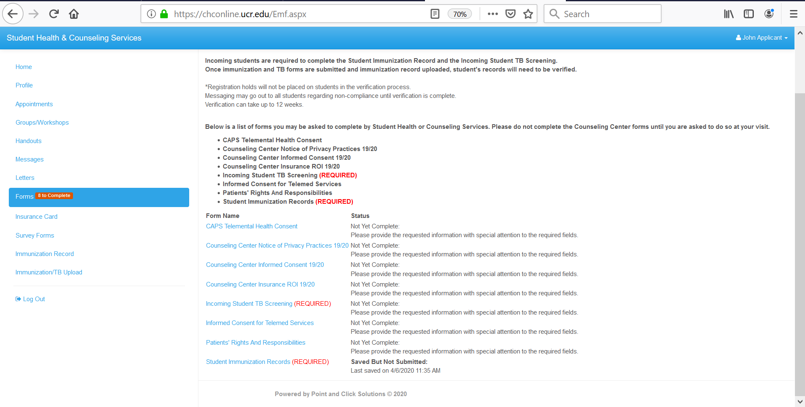
2. Click on Incoming Student TB Screening

Slide 4
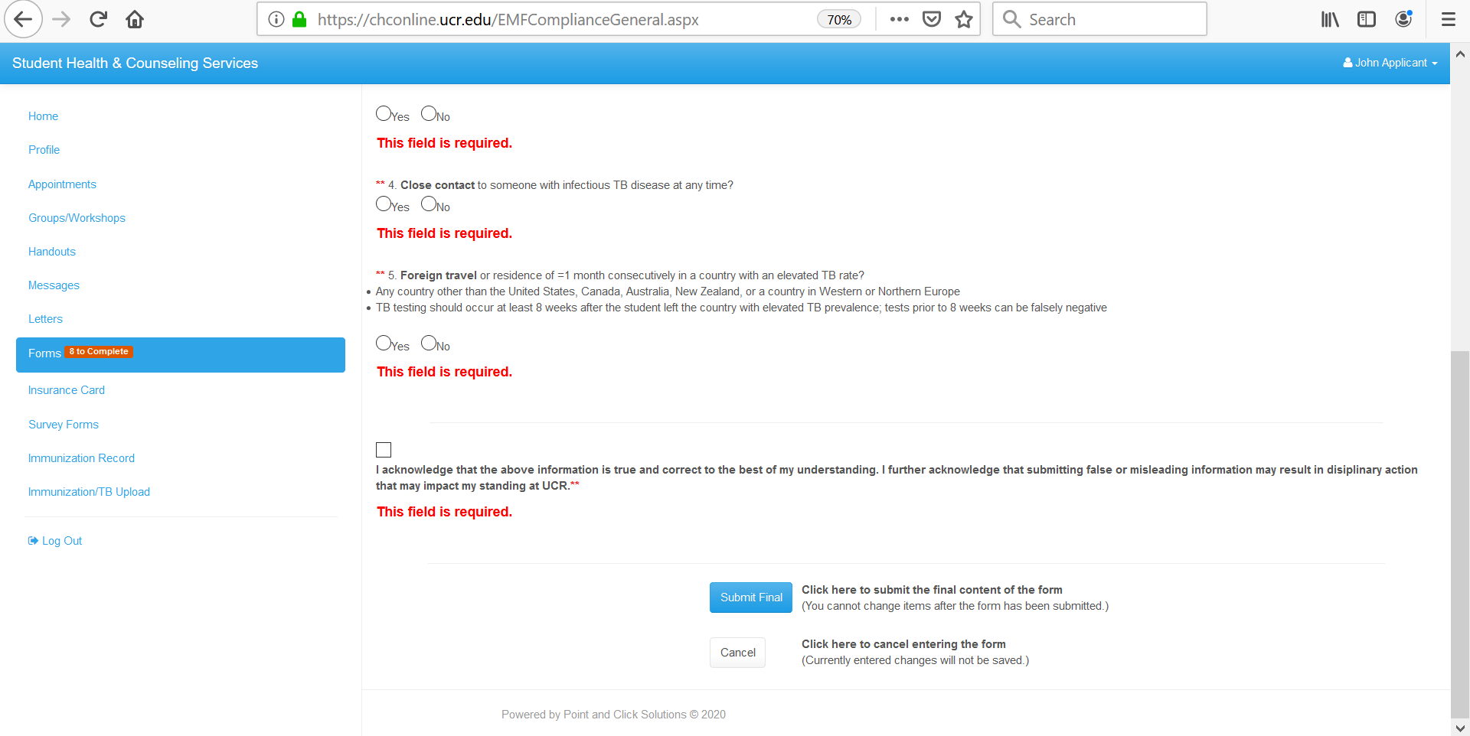
3. Answer the questions to the best of your knowledge
4. Click on Submit Final

Slide 5
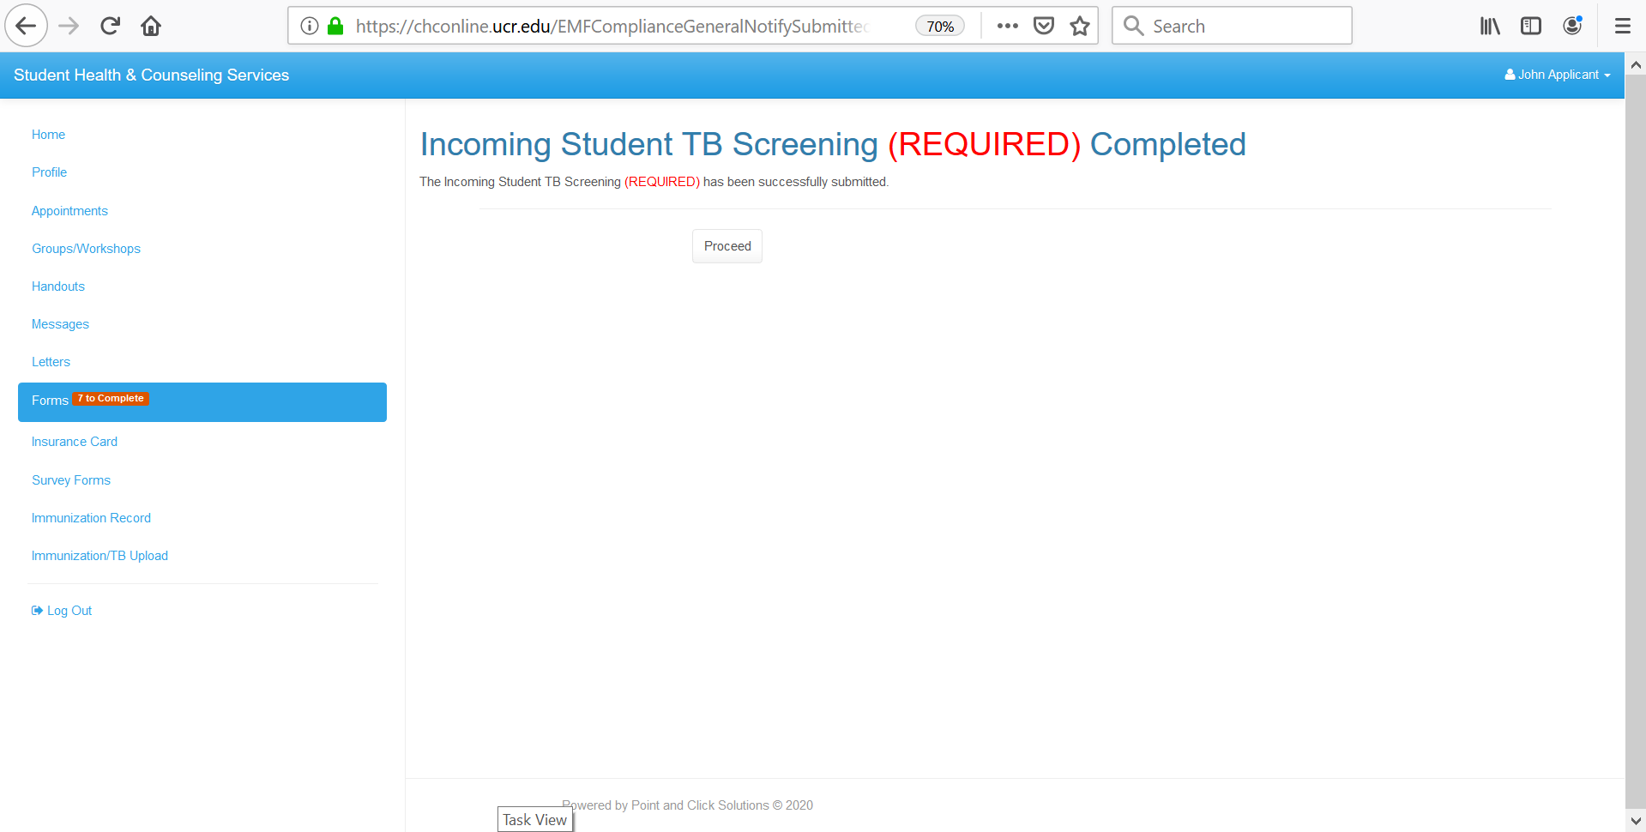

Slide 6
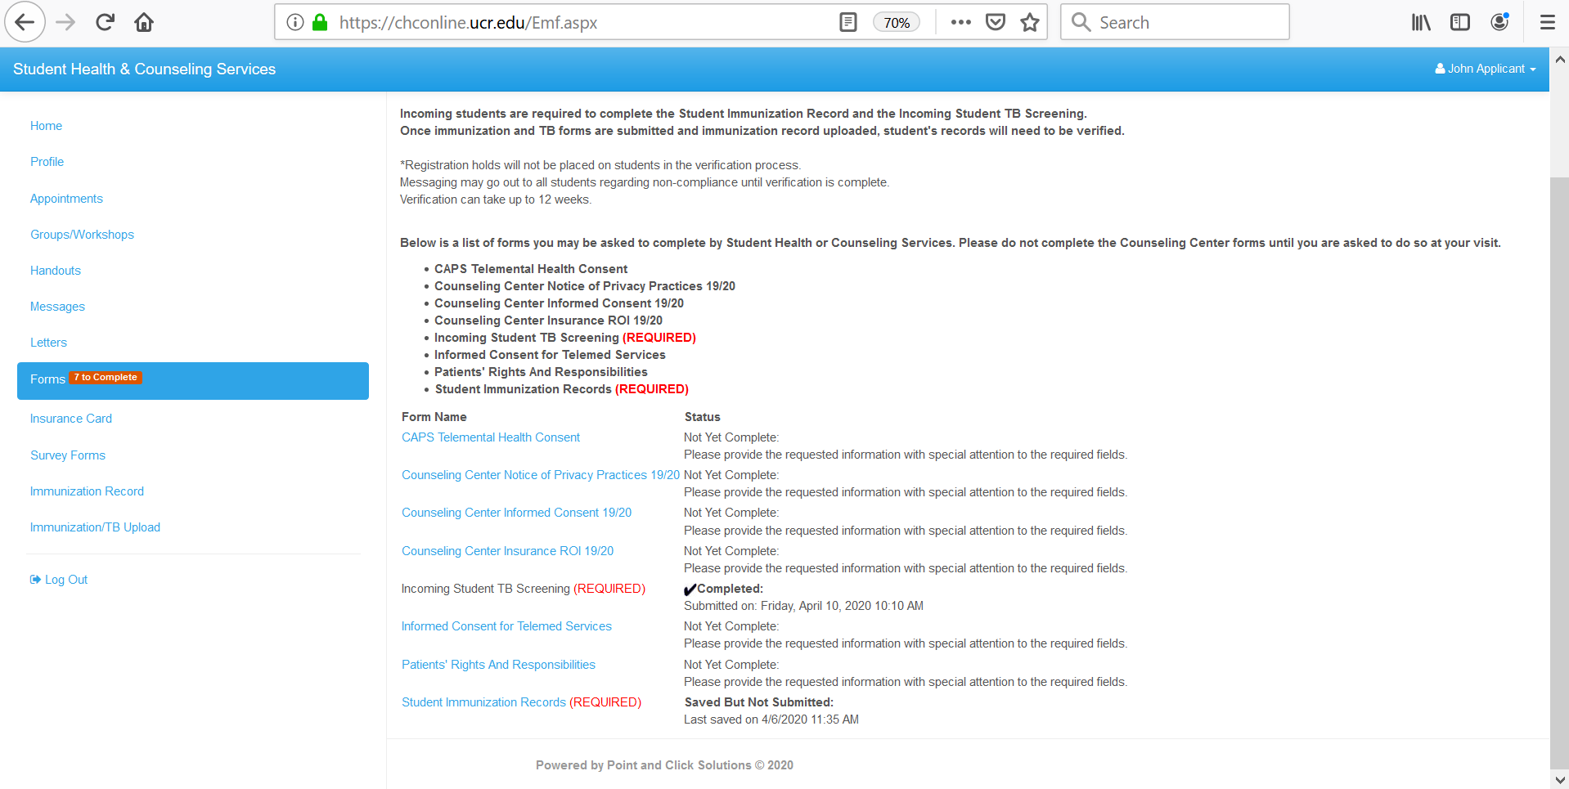
5. Click on Immunization Record
Confirmed completion (no action required)

Slide 7
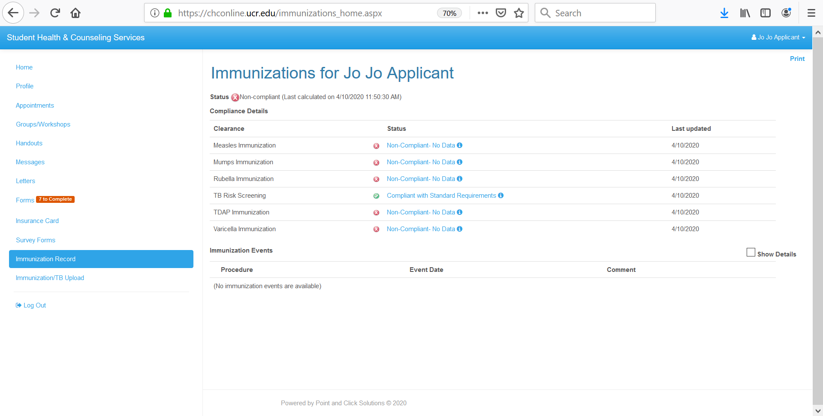
6. If your online immunization record looks like this, great! Stop here, you are finished with the Tuberculosis screening. (If you haven’t already, check out the Immunization Tutorial. If you have additional items on your record, please continue to the next screen shot.
Continue to the next screen shot if you have additional items on your immunization record (chest x-ray, TB testing)

Slide 8
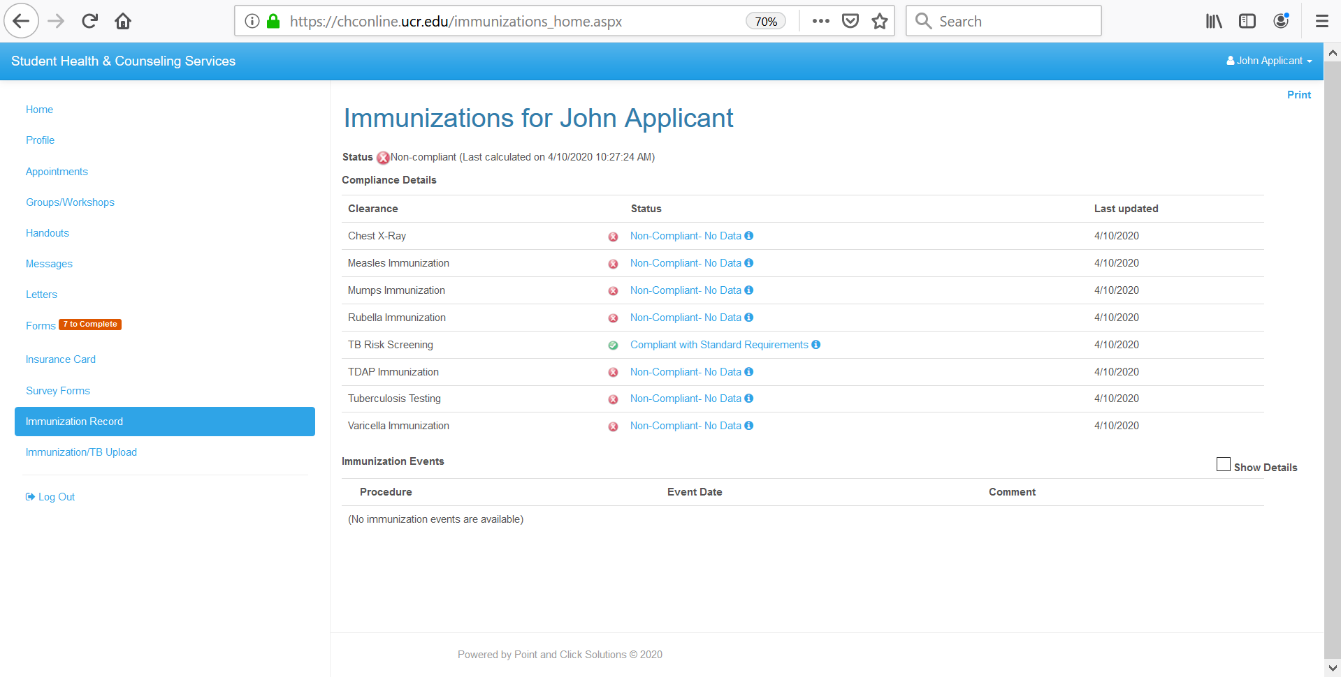
You can reference this page for updates on your TB compliance!
7. If your record is showing either “Tuberculosis Testing,” “Chest X-ray,” OR BOTH please click on Immunization/TB upload to submit your TB tests results and/or chest x-ray.
*NOTE: All tests must be completed within 12 months by submission. Tests completed more than 12 months ago will not be accepted.

Slide 9
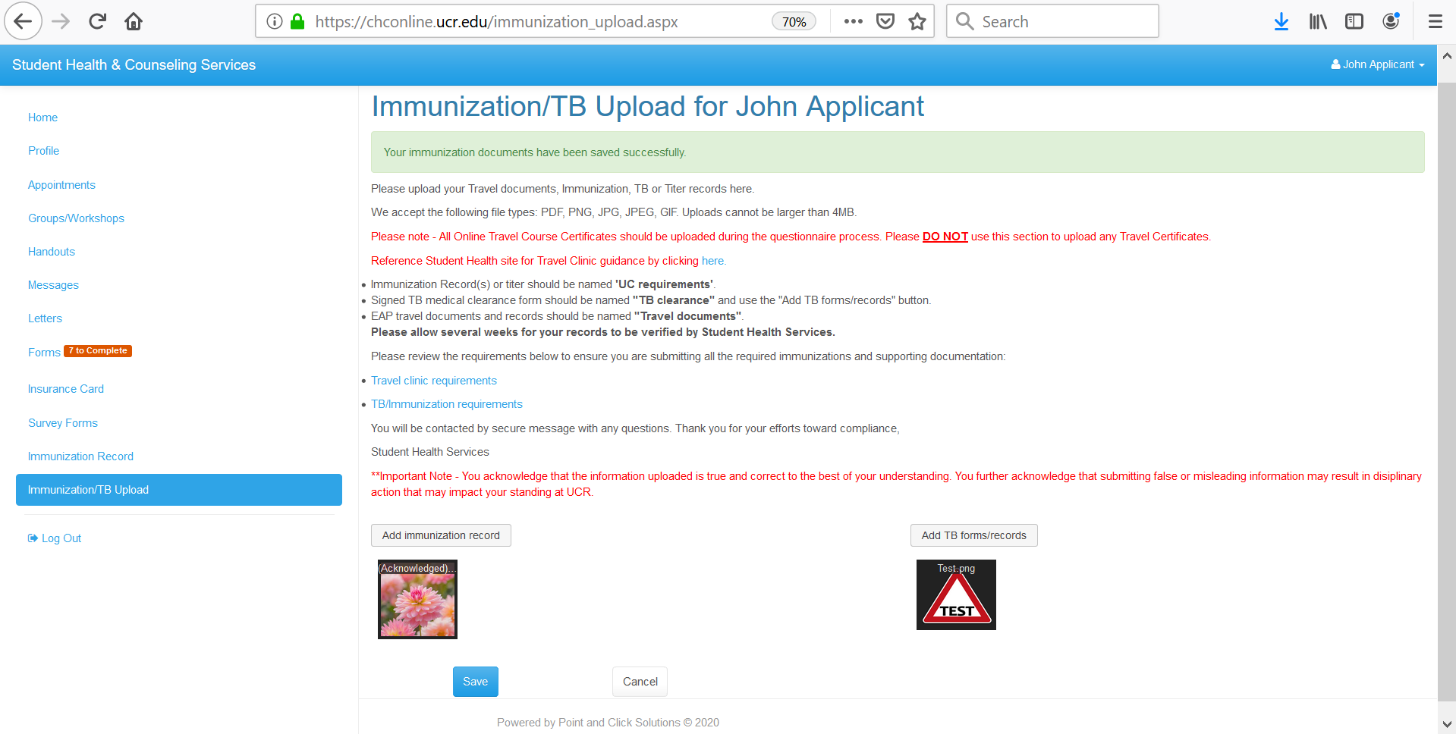
That’s it! You will receive a secure message in your health portal if additional information is needed. Thank you!
8. Upload your TB documents for review and click save

